Slide 1
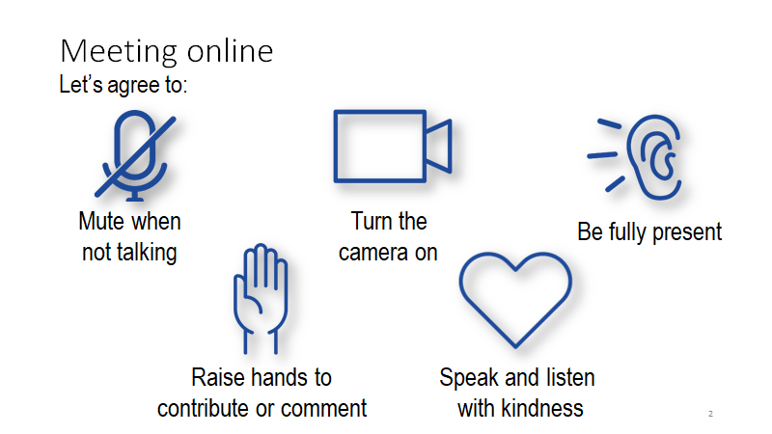
Virtual Rotary - 2020
Before We Start
Rename yourself with first, last name, and title / Club or District
Use the chat function to communicate questions and comments
Notes:
1:30pm –

Slide 2
ell,Getting the Most From Your Participation on Zoom to Know about Online Facilitation
Notes:
Self-introduction and Welcome everyone . . .
We will be giving you more information about use of the Zoom platform, but for right now please be sure that your sound is on “mute.” Also, you can use the chat box as we go along, so we capture all questions and can respond to them during the open mic time at end of the meeting . . .

Slide 3
Attending Virtual Training in the Time of COVID-19
Zoom Platform may be new to you… …but with the limitations of in-person meetings
This is how we can keep Rotarians and Rotaractors
INFORMED AND ENGAGED
Notes:
[Give purpose of meeting] ~ to make you comfortable using the Zoom platform and encourage you to engage and learn from the sessions using the tools provided….

Slide 4
What tools can you expect a facilitator to use during your sessions?
Notes:
continues . . .
An online facilitator does exactly what we do during an in-person training session – we ask thought-provoking questions, encourage small group collaboration, and involve all of our participants in the here and now – and encourage engagement . .
BUT . . .HOW?

Slide 5
Virtual Platforms Provide Opportunities to Vary the Pace
Videos
PowerPoint Slides
Guests who join as subject experts
Polls and other interactive activities
Notes:
Online learning expands content options and accommodates different learning styles . . This platform allows the facilitator to take advantage of that!
Videos, articles, podcasts, infographics, games, and other creative formats.
We will discuss some of these tools during this training.

Slide 6
Preparing for an Effective Zoom Meeting
Notes:
Preparing for An Effective Zoom Meeting

Slide 7
Use a high-quality web camera and microphone or headset
Laptop or desktop preferred over Smart Phone or Tablet
Notes:
Use a high-quality web camera and microphone or headset
Laptop or desktop required

Slide 8
Practice speaking to camera and not screen
Ensure light source is in front of you
Pay attention to your background and to ambient noise
Try to have camera at eye level- not looking up or down at your face. A stack of books can help.
Virtual Backgrounds Available
Notes:
Practice speaking to the camera and not the screen
Ensure light source is in front of you
Pay attention to your background and ambient noise
Virtual backgrounds available at Brand Center

Slide 9
Zoom User Features
Notes:
Be sure your have installed the latest Zoom update to your device!
So we’ll start out with some of the basics of zoom so we are all on the same page and familiar with the Zoom Tools that facilitators may use during the sessions you will attend.

Slide 10
Mute/Unmute (Alt+A on PC keyboard, Cmd+Shift+A on Mac)
Video On/Off ~ Gallery/Speaker View
Chat Box ~ To Everyone or Private Chat (but not totally private)
Reaction Icon (Applaud/Thumbs Up/Recent Additions)
Participant Pane Reactions Yes/No . . . Raise Hand
Notes:
Continues . . .
Mute/unmute . . Video – Gallery/Speaker View . . . . Use chat box . . . . . .Reaction Icon . . .

Slide 11
Participant Pane
User Rename
Raise Hand
Yes/No/Thumbs Up/Thumbs Down, etc.
Notes:
continues . . .
Participant Pane Options . . . Create Virtual Table Tent . . .Raise Hand . . . Yes/No . . . Thumbs Up/Down . . .More . . .
Practice . . .

Slide 12
A Virtual Table Tent
To change your own name that is displayed, hover over your name in the participants list and click Rename
OR
Hover over three dots … in the upper right corner of your video tile to click on dropdown choice to Rename
Or right click on your video thumbnail
Please rename yourself to show your full name and your club name now.
Notes:
In person has tent card with club name – so we want that during this online version
Everyone renames to include full name and club name

Slide 13
Participating in Polls

Slide 14
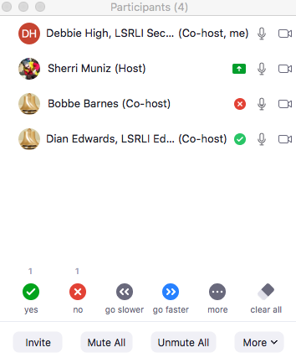
Notes:
Example – Practice a quick response to a “straw poll” in the participant pane.
Notice tally of responses above symbols.

Slide 15
Practice with a Poll Launched by Meeting Host
Notes:
Polls can be created in advance of meeting by anyone authorized to access the meeting set up on the Zoom account. Polls can only be launched by the host. Practice with a Poll that should appear on your screen

Slide 16
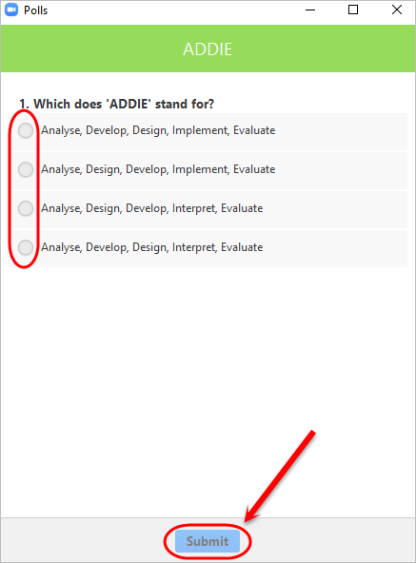
Notes:
Here is a sample of a poll .. . Mark your choice and then click submit
Try out a sample – “My comfort level with Zoom is: High / Medium / Low” – (ask Host to launch the poll and summarize)

Slide 17
Breakout Rooms
Notes:
Breakout Rooms – Wonderful way to connect participants in a smaller grouping.

Slide 18
You will be prompted to join a breakout room.
Often there will be a facilitator assigned to the room to lead discussion.
All participants will be brought back to the main room automatically.
Notes:
Host will send you to a breakout room

Slide 19
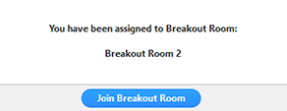
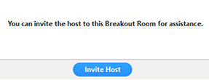
Joining a breakout room
The host will invite you to join the breakout room.
Click Join.
Click Join Breakout Room
Asking for help.
Click Ask for Help in the meeting controls.
If you click Ask for Help, it will notify the meeting host that you need assistance and they will be asked to join your breakout room.
Confirm that you would like assistance by clicking Invite Host.
Notes:
Everyone will have the chance to practice this in the next activity we will do

Slide 20
Leaving the breakout room
You can leave the breakout room and return to the main meeting session at any time, or you can leave the meeting entirely from the breakout room.
Click Leave Breakout Room.
Choose if you want to leave the breakout room or the entire meeting.
When the host ends the breakout rooms, you will be notified and given the option to return to the main room immediately, or in 60 seconds.
Notes:
Breakout activity follows. . For getting to know one another

Slide 21
Chat Box

Slide 22
Zoom Chat
Send chat messages to all users
Send private chat messages to an individual
In-meeting Chat may be saved manually or automatically
Notes:
Tip: Zoom Chat allows users to post comments, questions, technical issues, etc. to everyone or an individual.
Let’s practice the “chat” feature. Open Chat and tell us the name of the town you grew up in.

Slide 23
QUESTIONS?
Notes:
Q & A

