Slide 1
RYLA 2024
Rotary District 7360
Shepherd’s Springs, MD
June 13–15, 2024

Slide 2
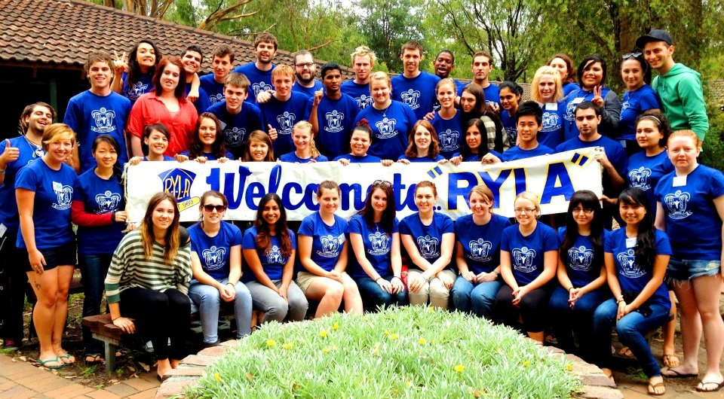

Slide 3
What is RYLA?

Slide 4
RYLA SCHEDULE
District 7360

Slide 5
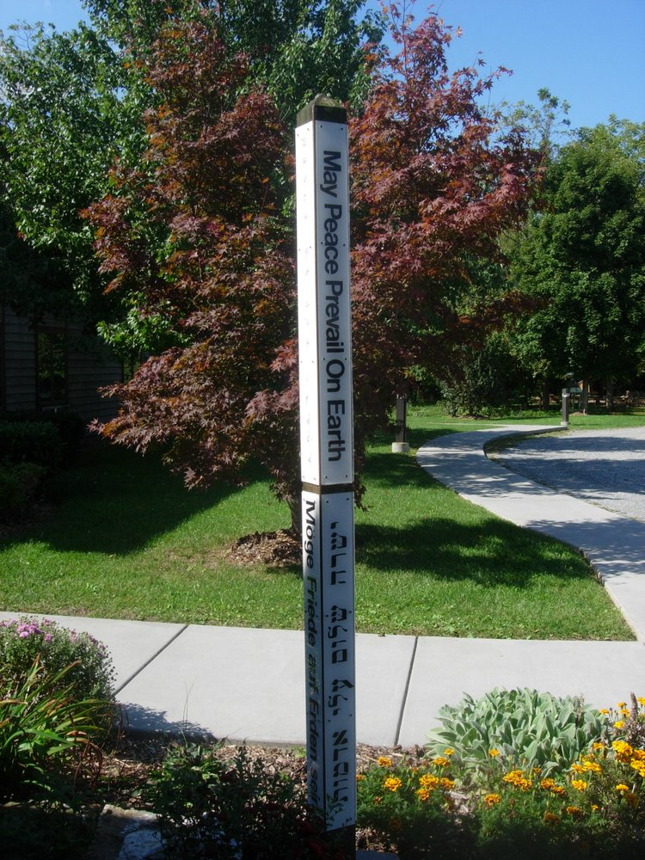
Welcome to Shepherd’s Spring 2023

Slide 6
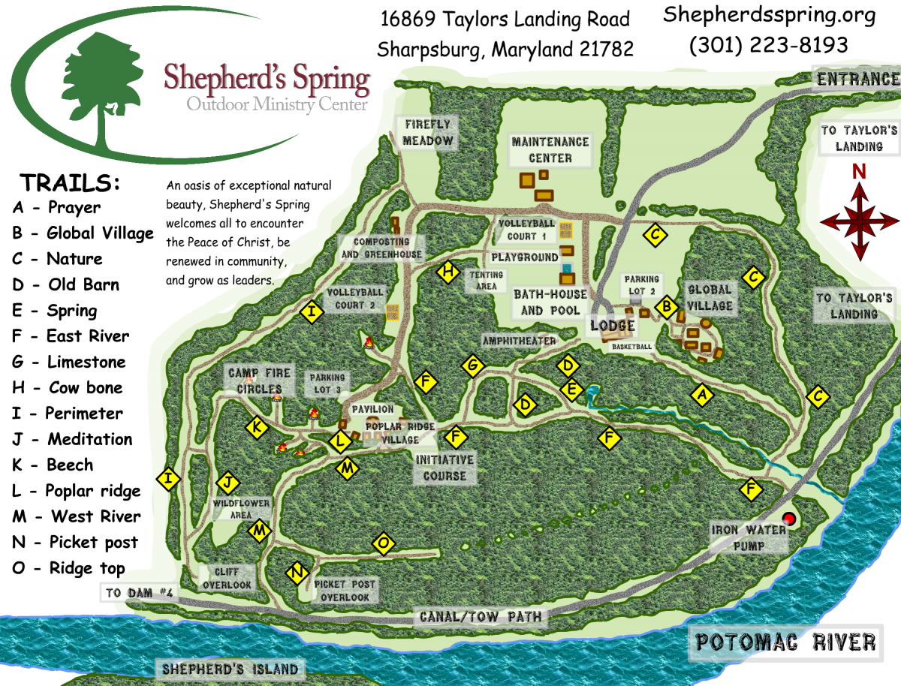
Camp Map
2023

Slide 7
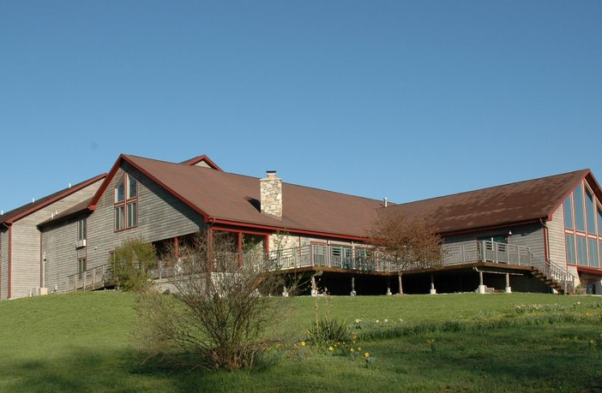
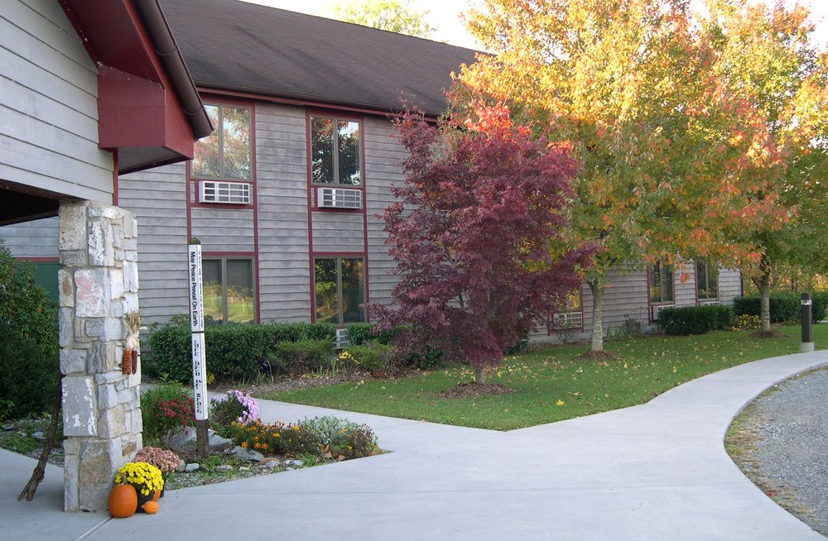
Main Retreat House
Full House
Main Entrance

Slide 8
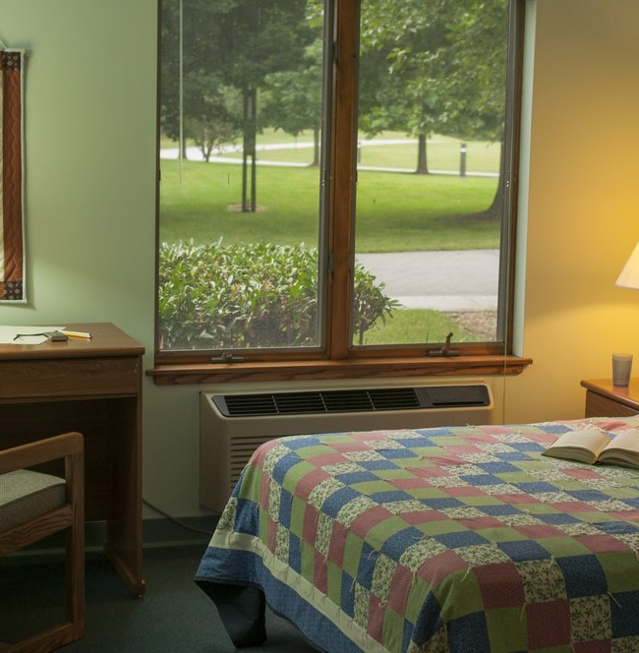
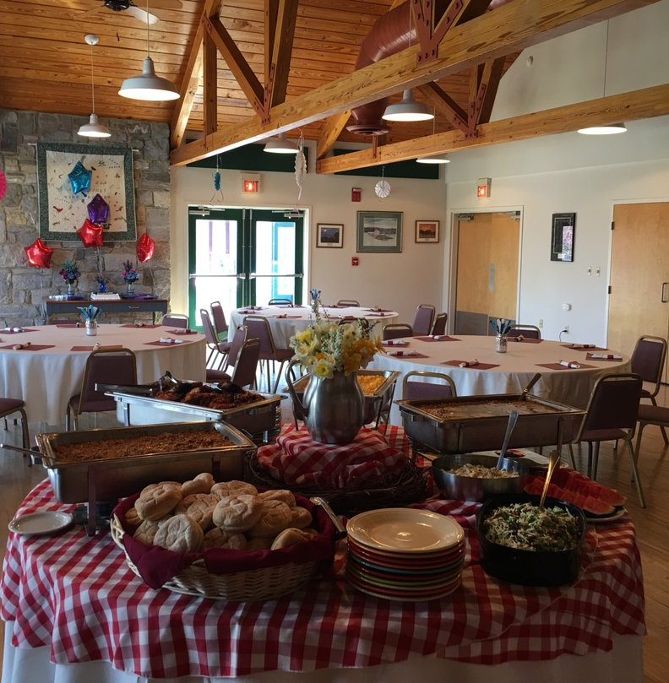
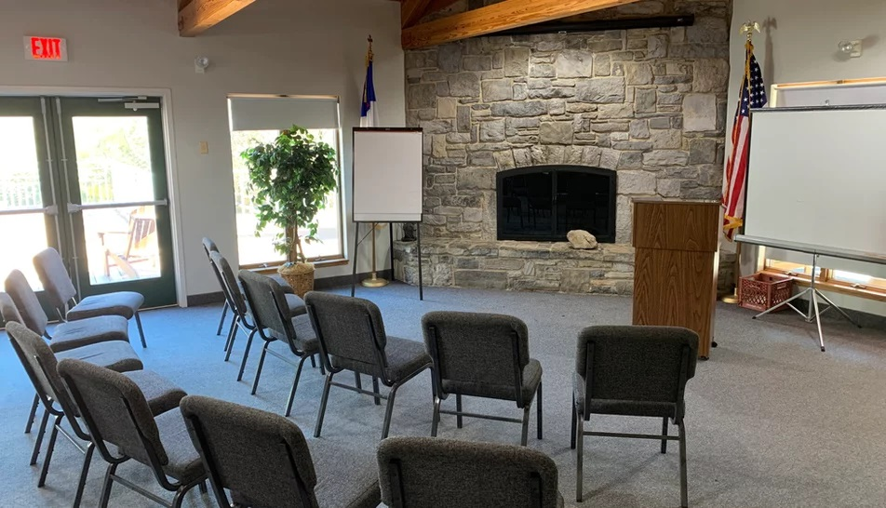
Meeting and Lodging
Guest Rooms Main Retreat House
Dining Room
Conference Room

Slide 9
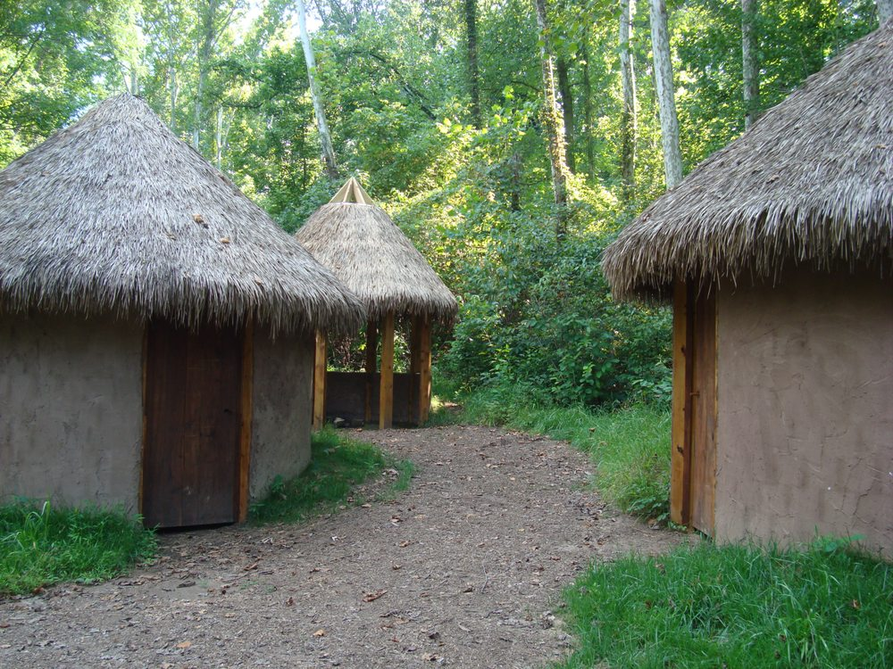
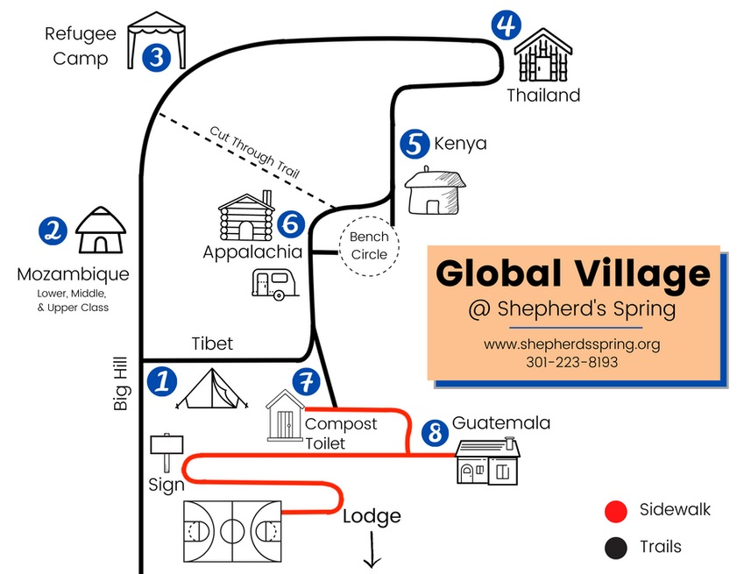
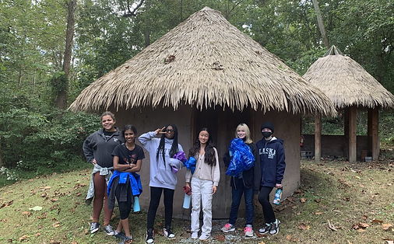
The Global Village Project

Slide 10
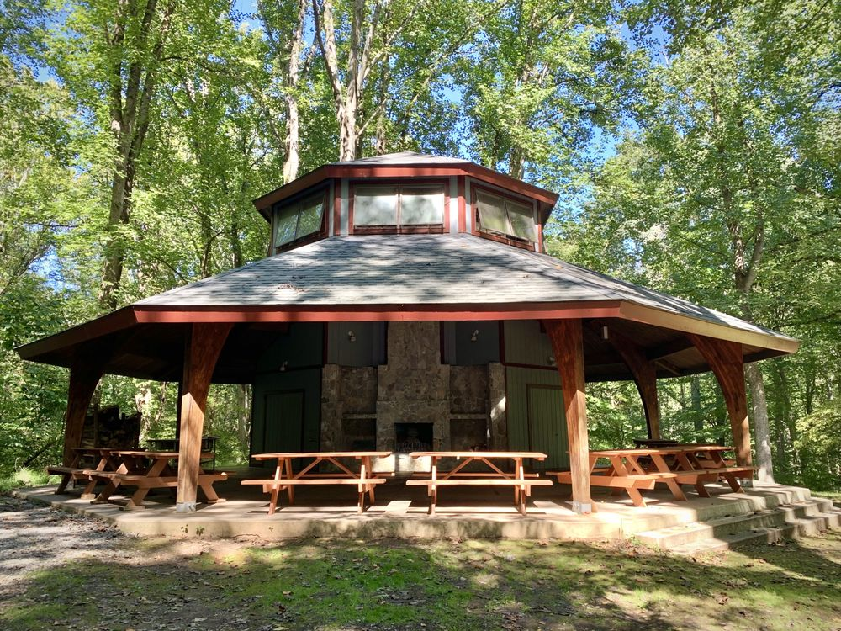
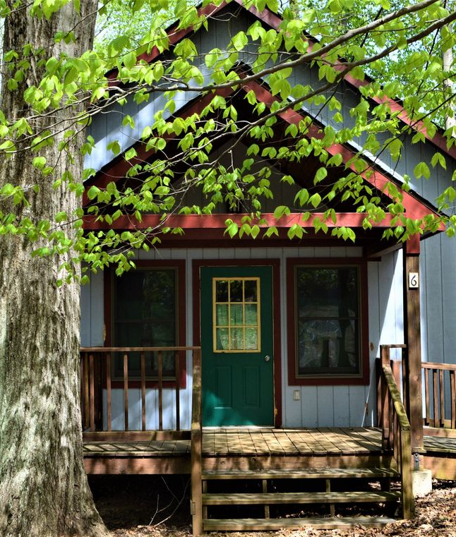
Outdoor Cabins

Slide 11
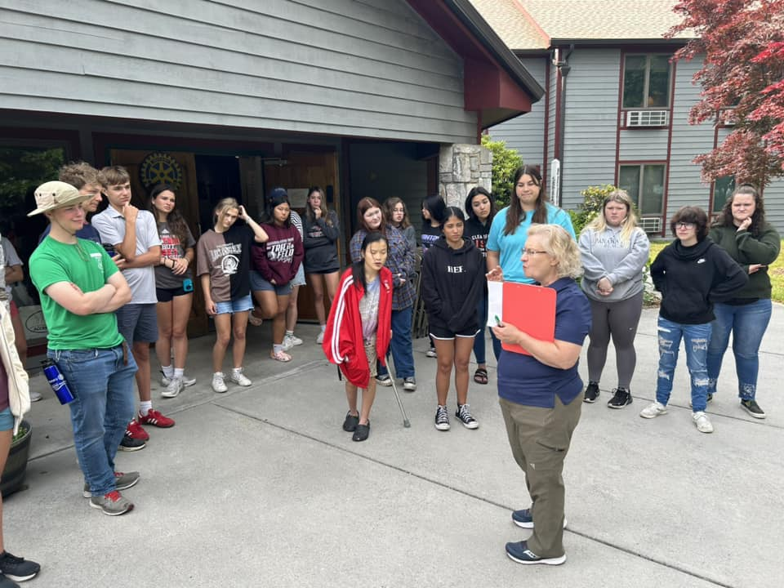
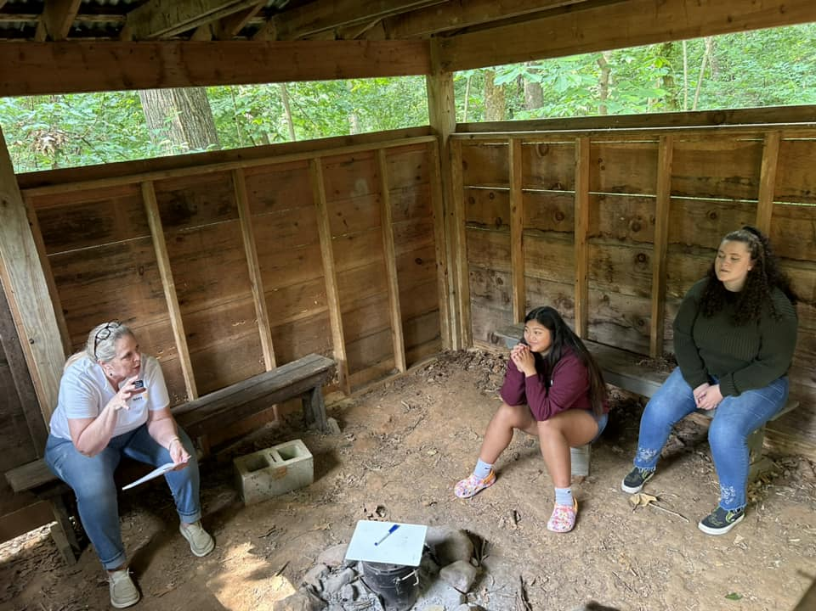
RYLA District 7360 Speakers 2023

Slide 12
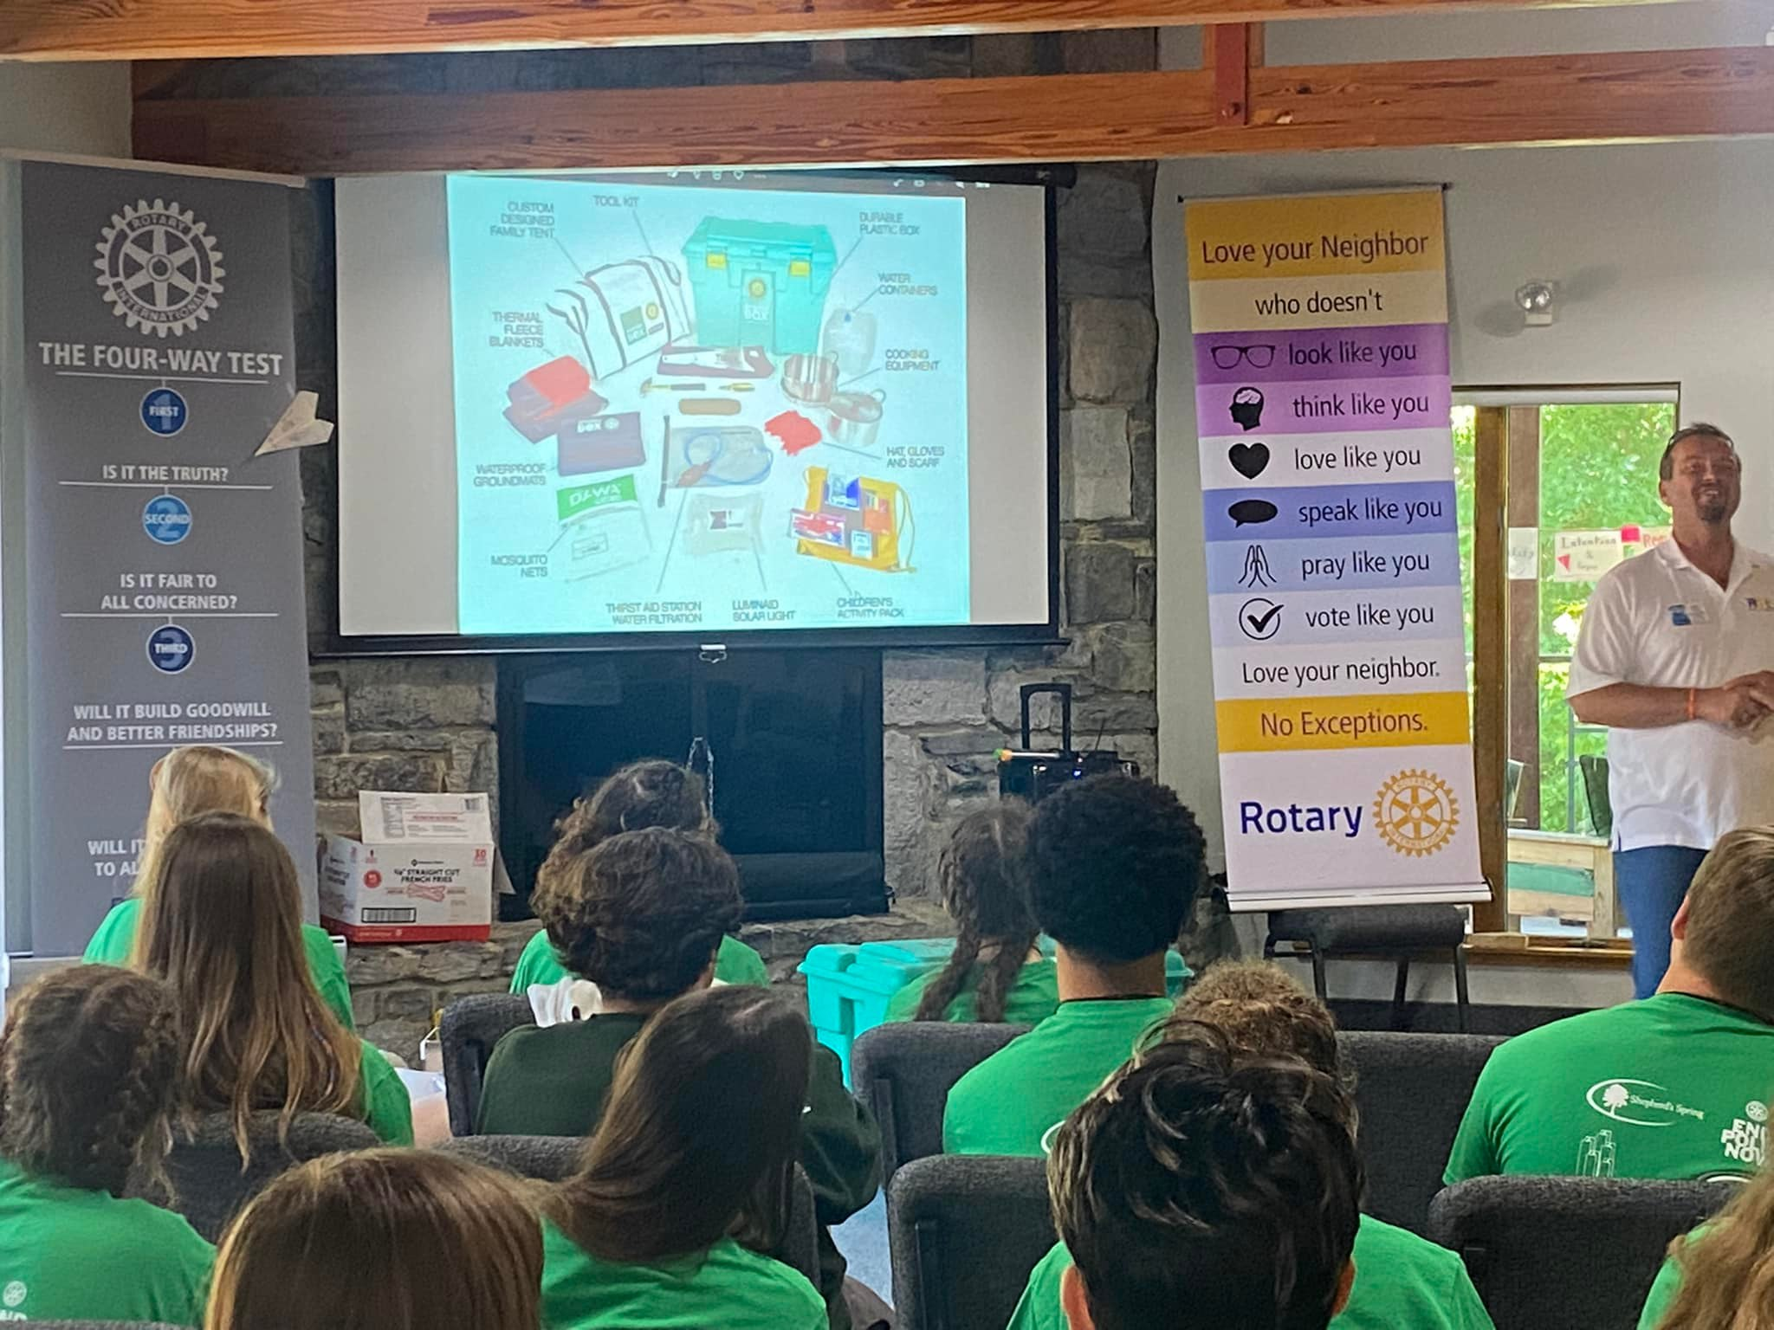
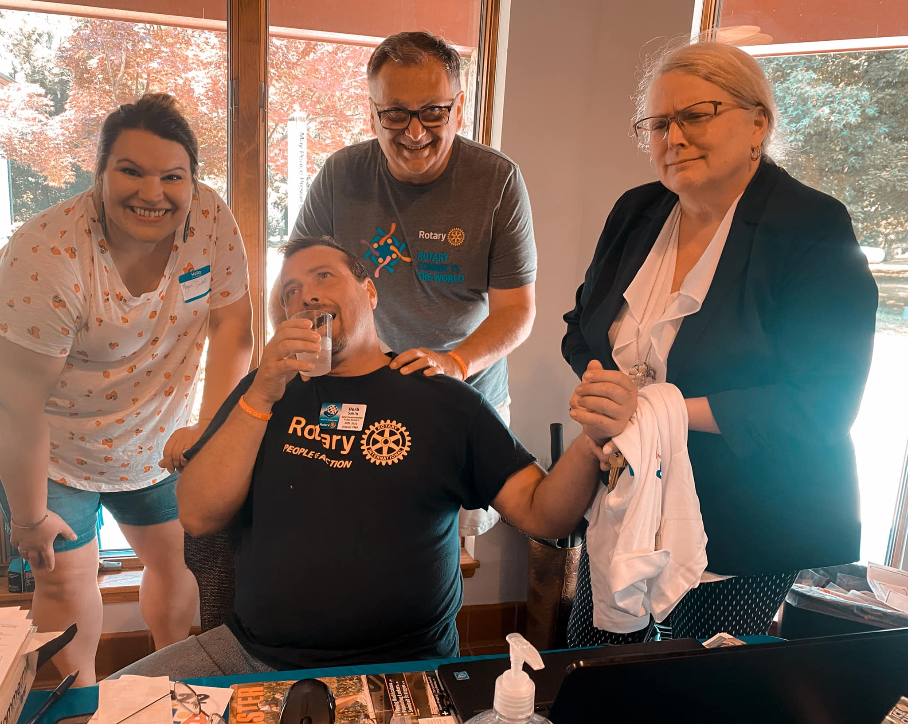
RYLA District 7360 Speakers 2022

Slide 13
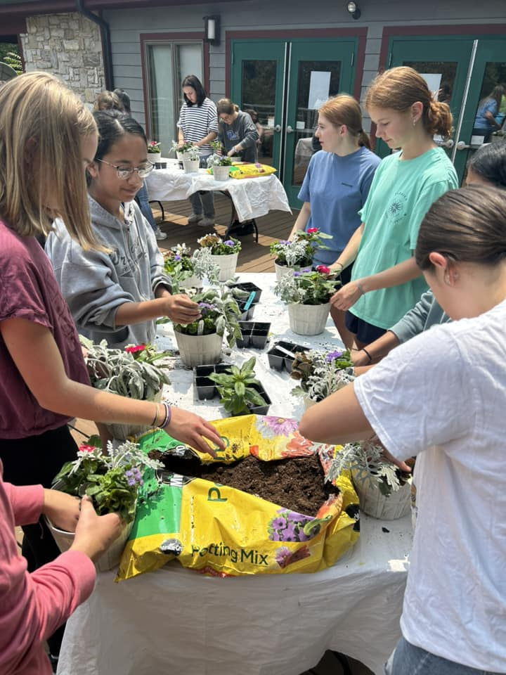
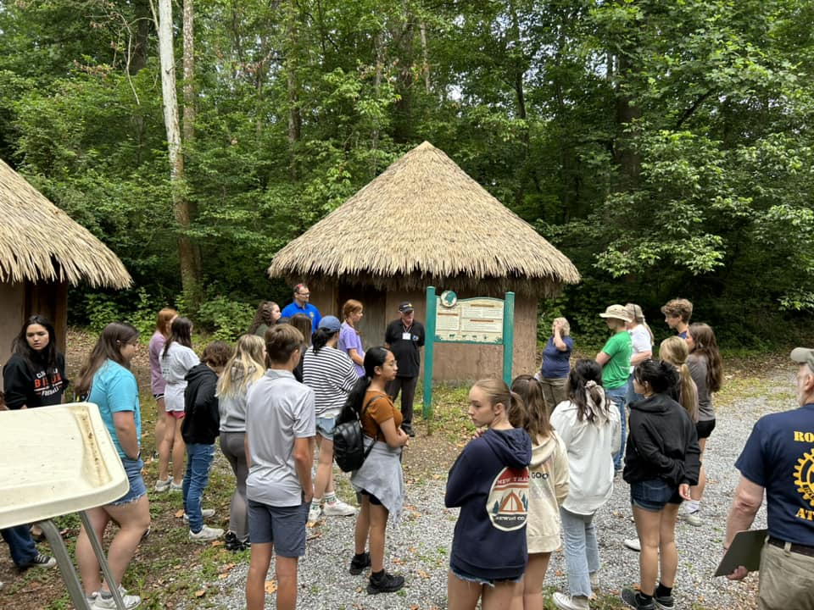
RYLA District 7360 Students 2023

Slide 14
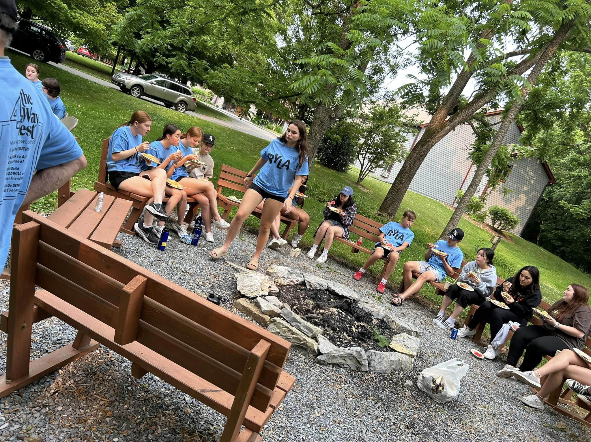
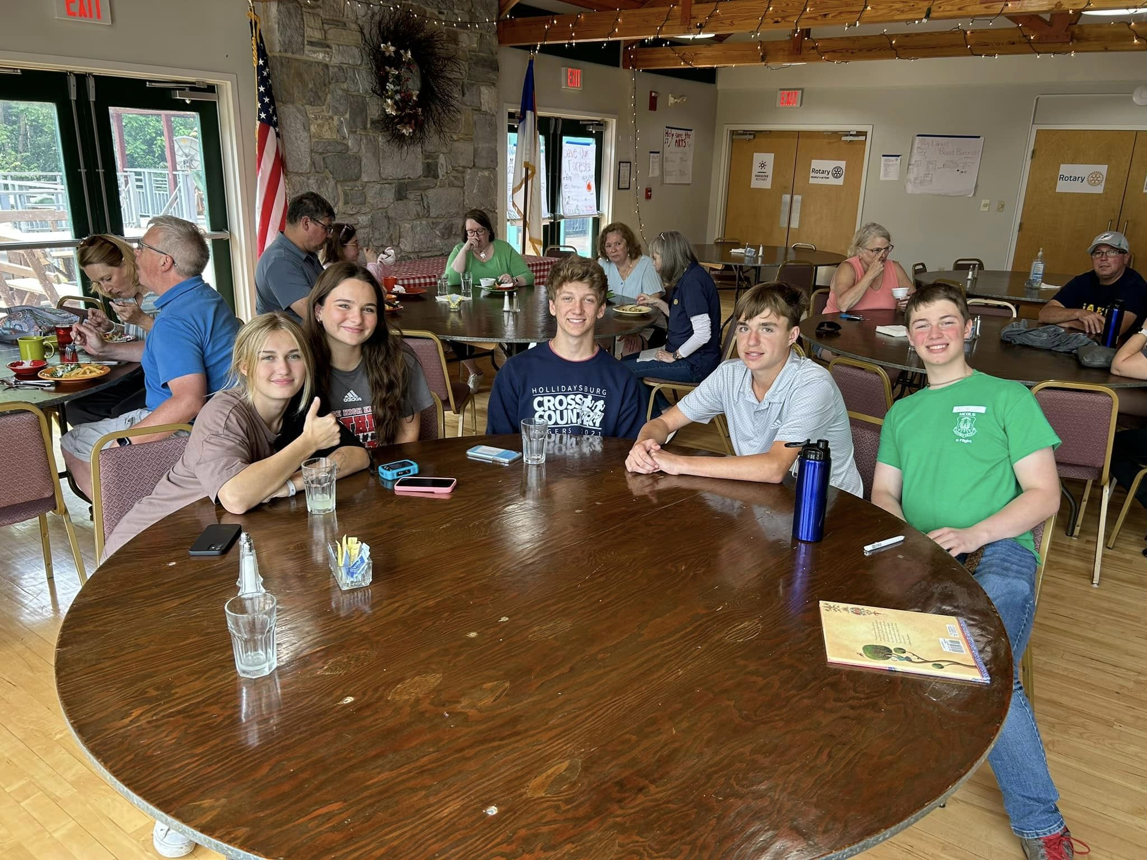
RYLA District 7360 Students 2023

Slide 15
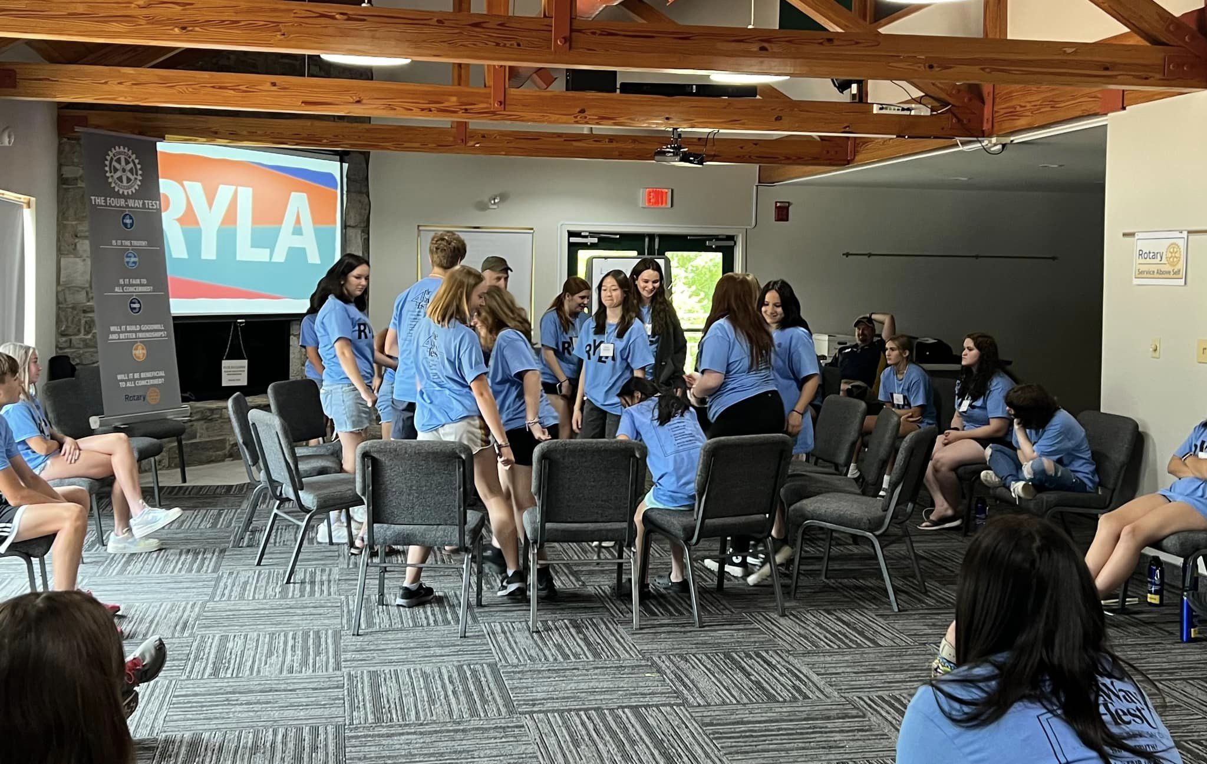
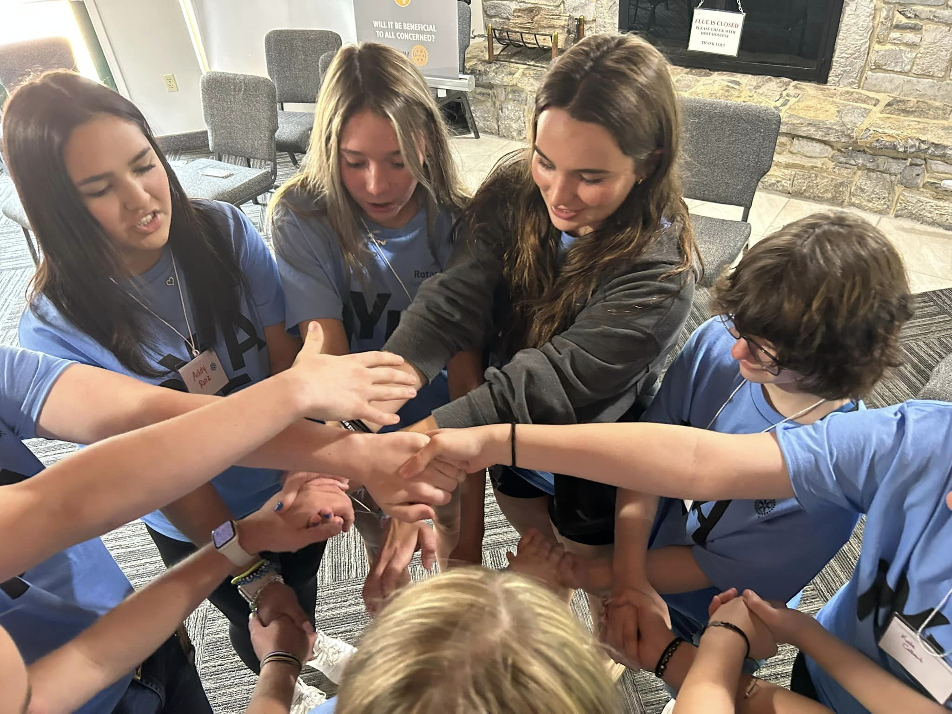
RYLA District 7360 Students 2023

Slide 16
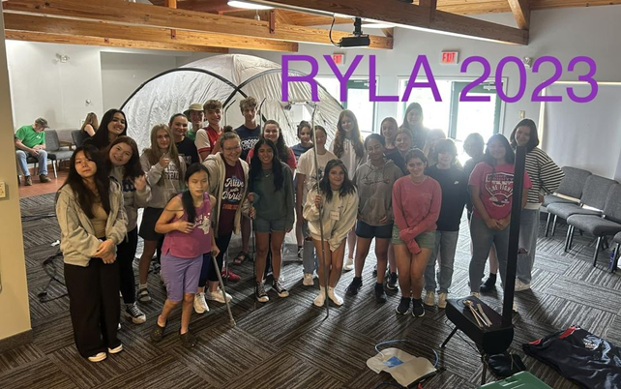
https://www.facebook.com/people/RYLA-District-7360/100076377901308/
RYLA – A Life Changing Experience!
Thank you for the Video from Rotary District 6440, The “Home” District serving Northern Illinois

