Slide 1
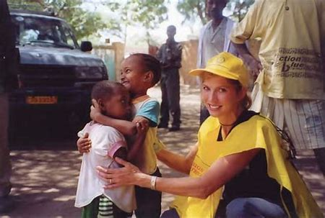
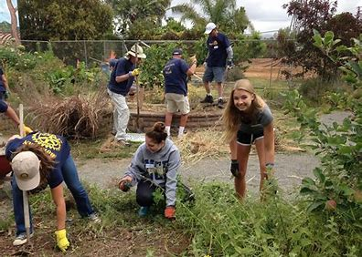
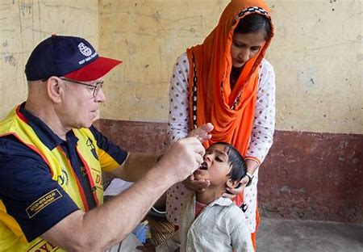
Welcome to This Is Rotary
We are people of action

Slide 2
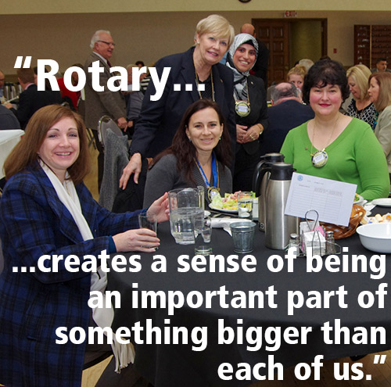
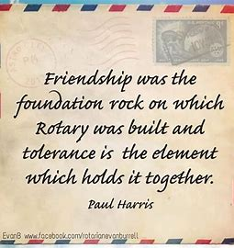
The best way to find yourself is to lose yourself in the service of others.

Slide 3
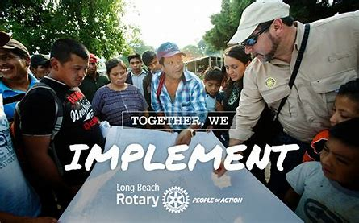
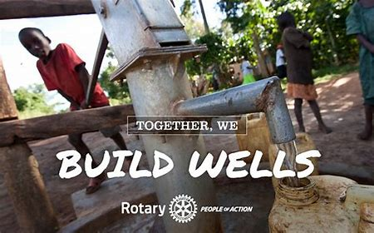
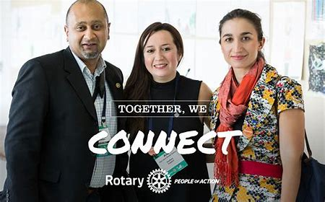
This Is Rotary
People Of Action
Every minute of every day, we feed, we house, we vaccinate, educate, advocate, comfort and provide a variety of services.

Slide 5
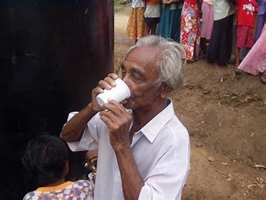
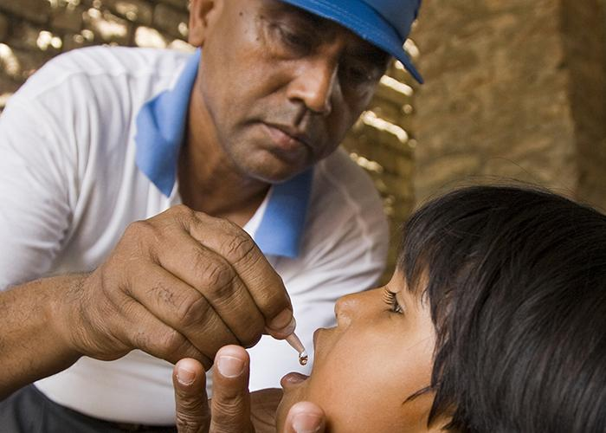
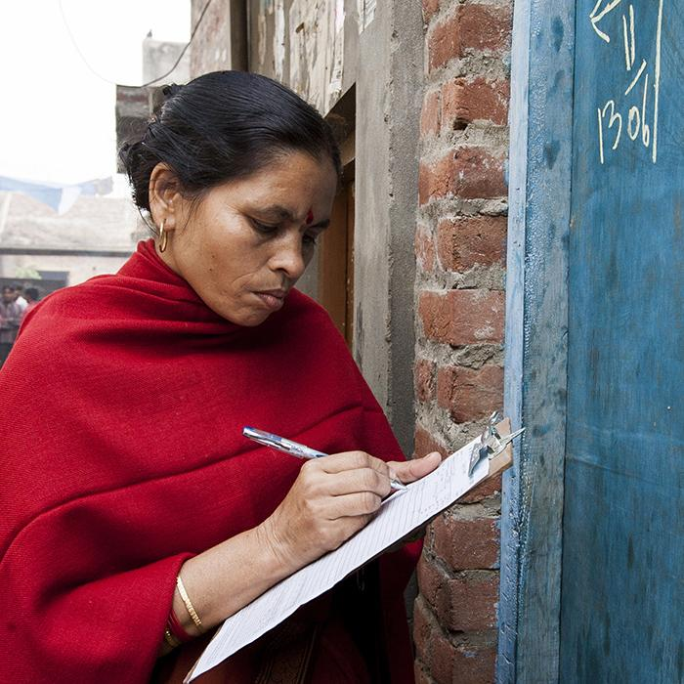
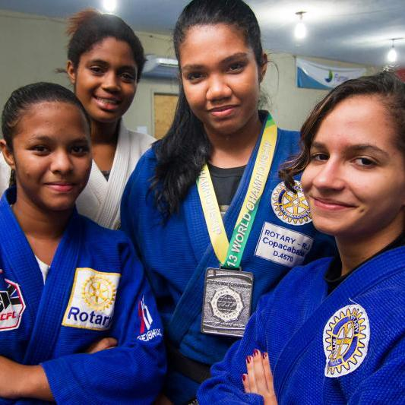
Together We:
Promote Peace
Transform
Save Lives
Fight Hunger
Mentor
Learn
Inspire
End Polio
Empower
Connect

Slide 6
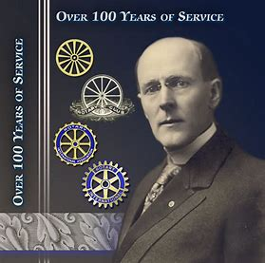
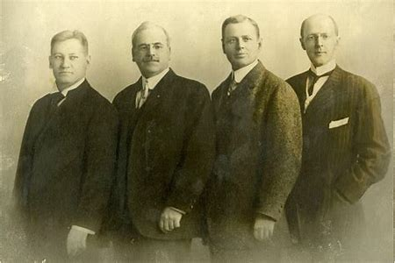
How Rotary Got Started
The first Rotary Club was organized in 1905, by Chicago Attorney Paul P. Harris
The original four member club met for fellowship in rotation at member’s offices…thus the name ROTARY
Their first community service project – a public toilet outside the Chicago City Hall
Paul Harris
People Of Action
From left: Gustavus Loehr, Silvester Schiele, Hiram Shorey and Paul Harris.

Slide 7
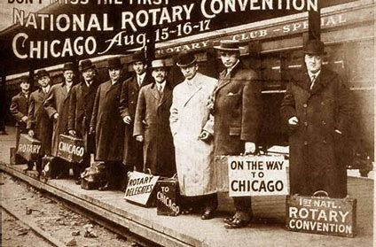
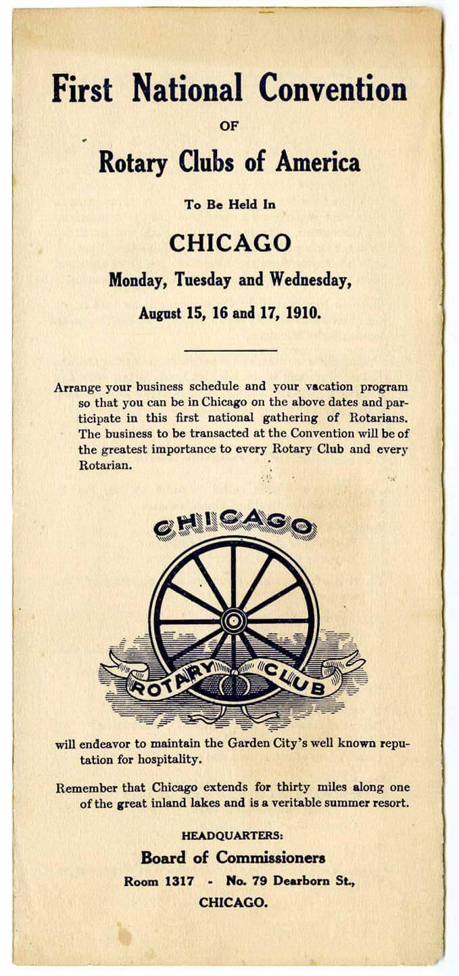

Slide 8
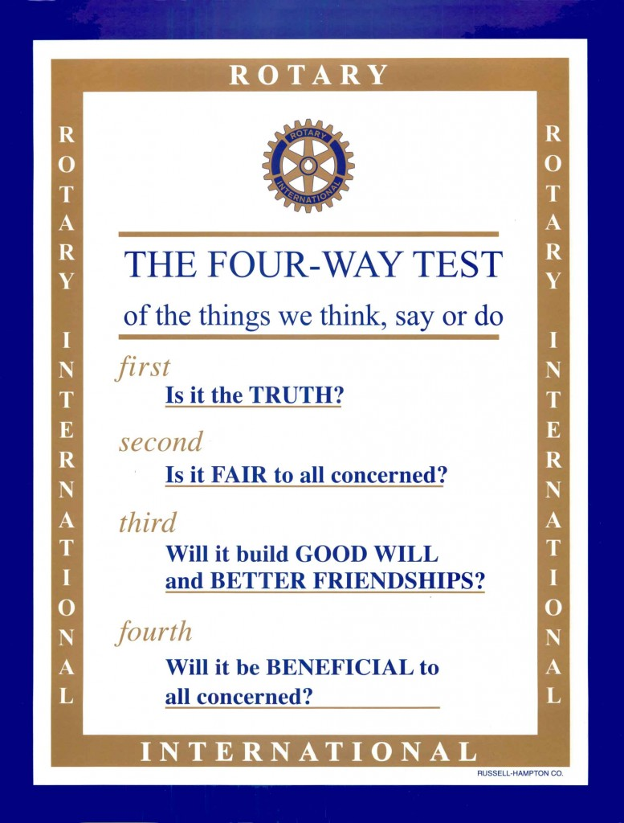
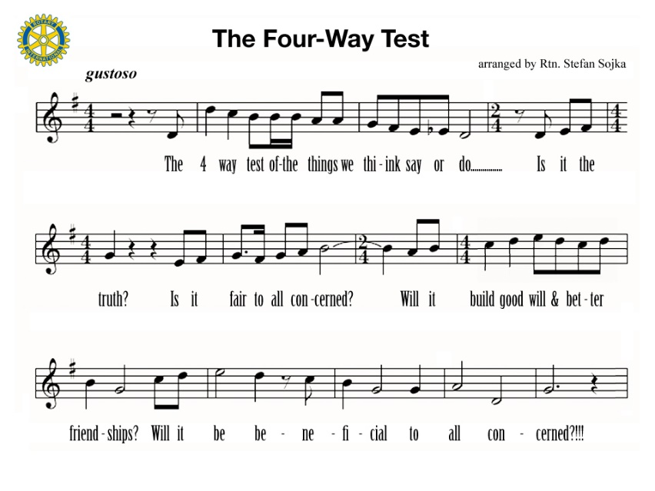
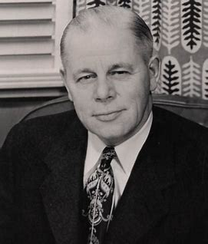
Herbert Taylor
Fifth: Is It Fun?

Slide 9
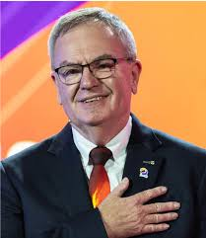
Gordon R McInally, RI President 2023-2024
"Peace is the soil where hope takes root"

Slide 10
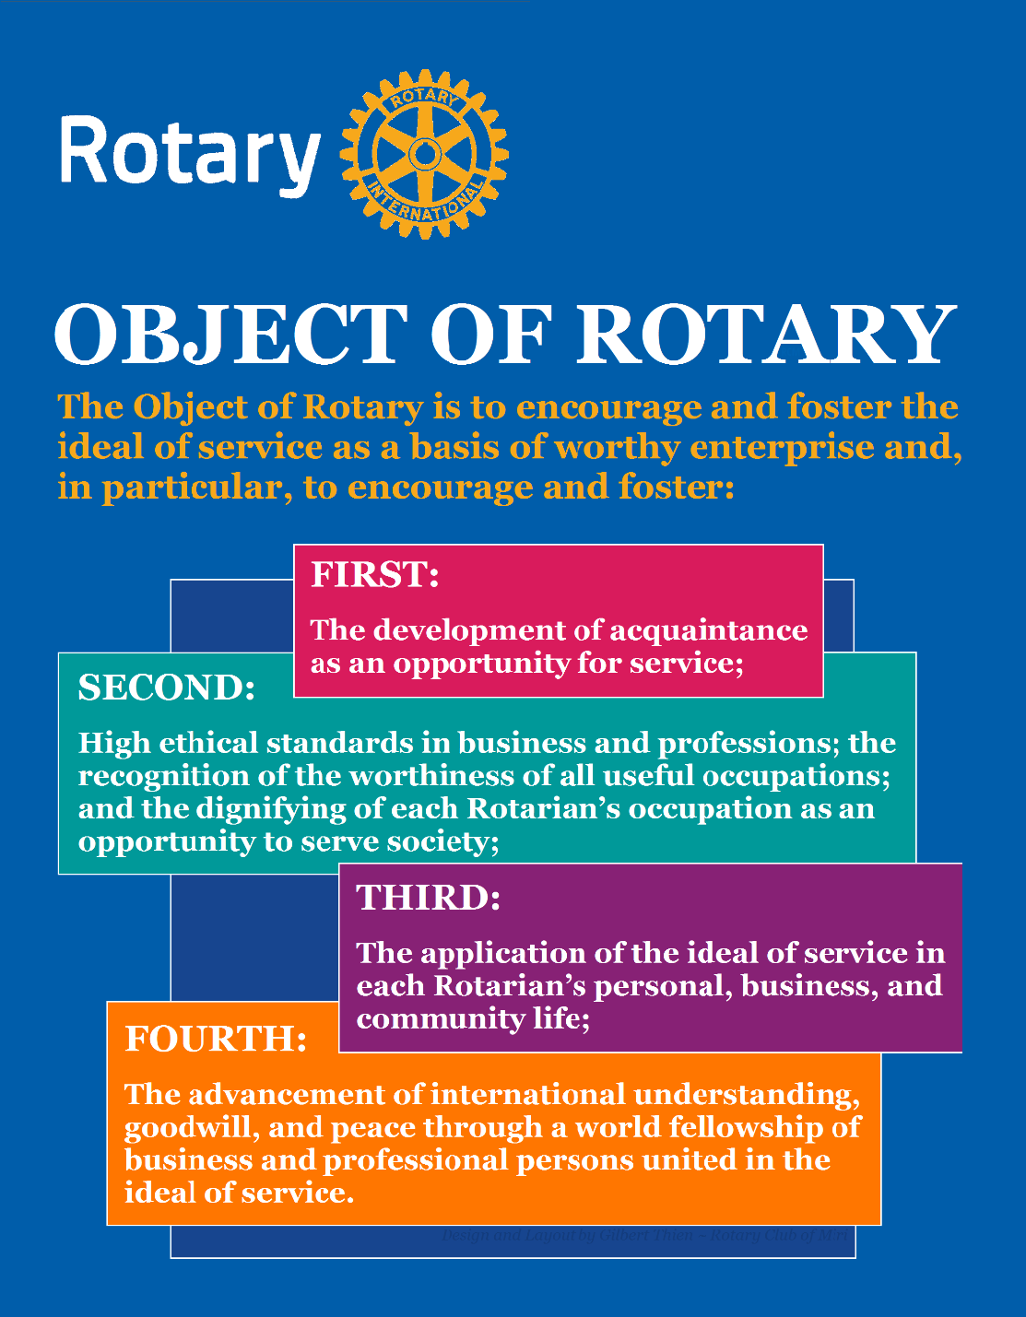
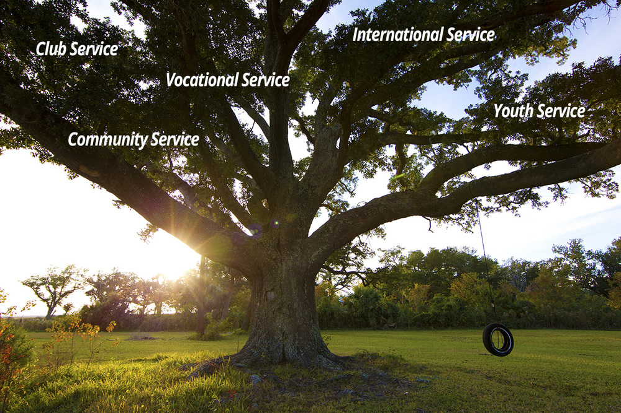
Five Avenues of Service
The Object of Rotary comes to life through Five Avenues of Service

Slide 11
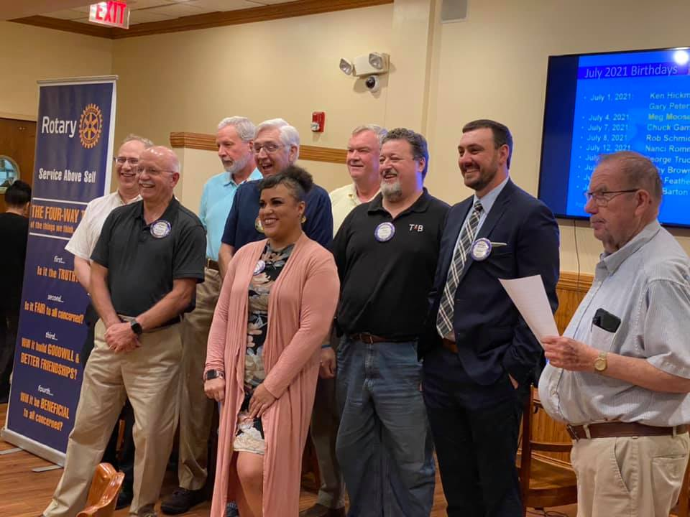
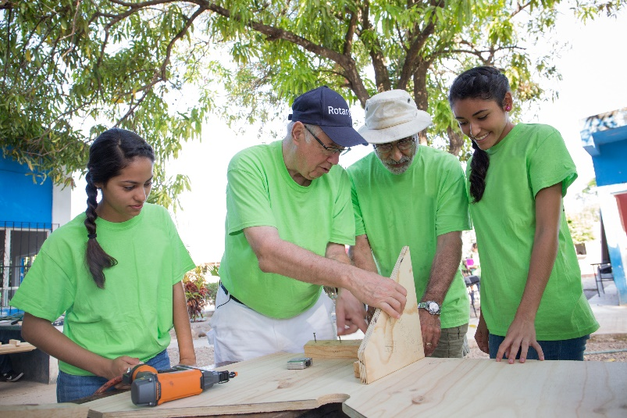
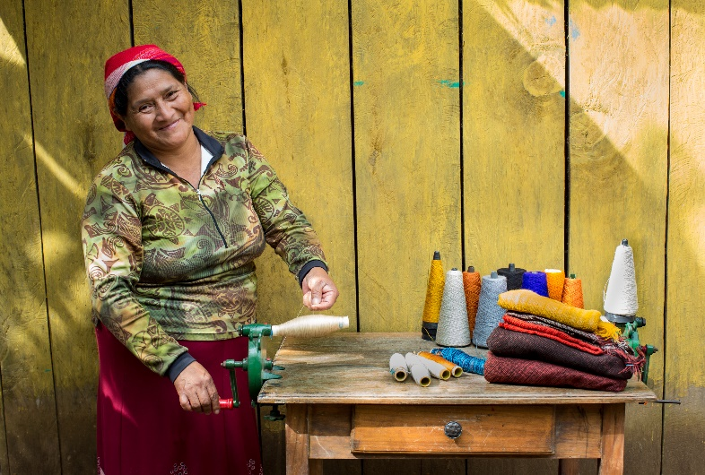
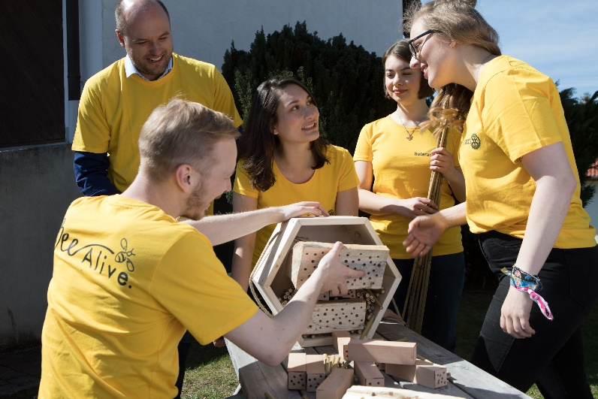
Five Avenues of Service In Action
Club Service
Vocational Service
Community Service
International Service
Youth Service

Slide 12
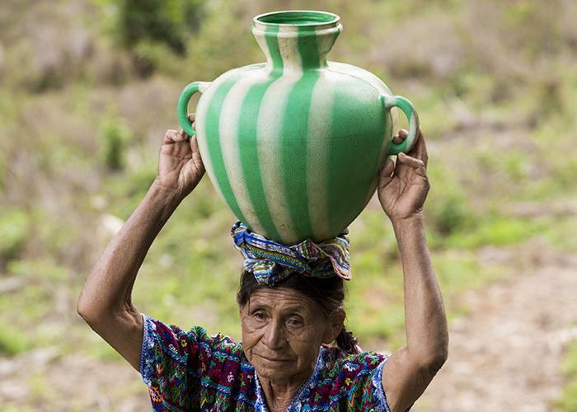
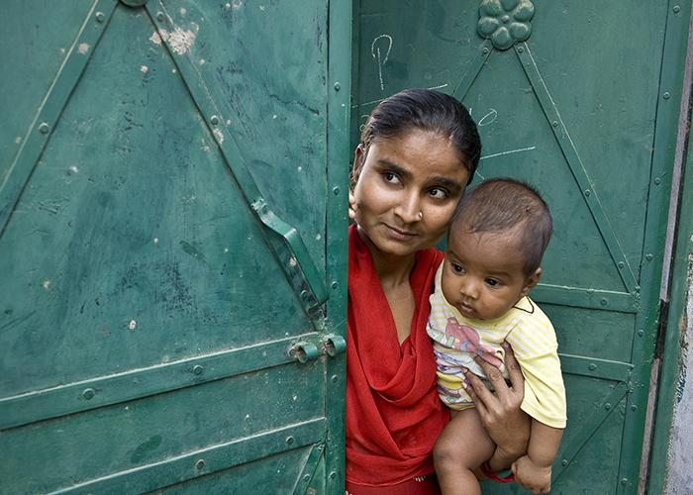
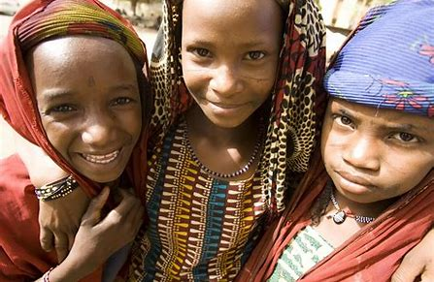
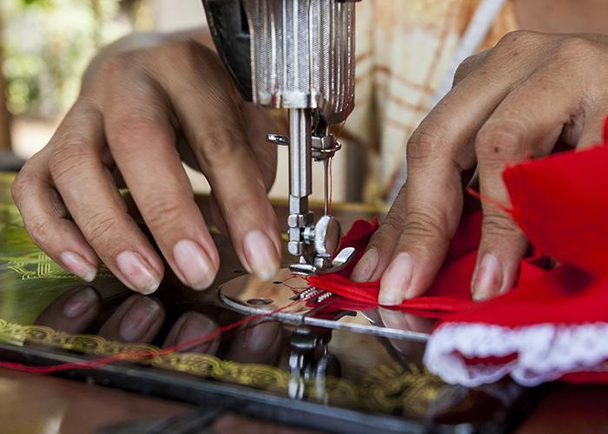
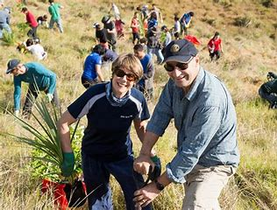
Seven Areas of Focus
Water, Sanitation &
Hygiene
Maternal & Child Health
Peacebuilding & Conflict
Prevention
Disease Prevention &
Treatment
Basic Education & Literacy
Community & Economic Development
Supporting The Environment

Slide 13
Peace & Conflict Prevention
70 Million People Displaced…
Half are children
Rotarians refuse to accept conflict
as a way of life

Slide 14
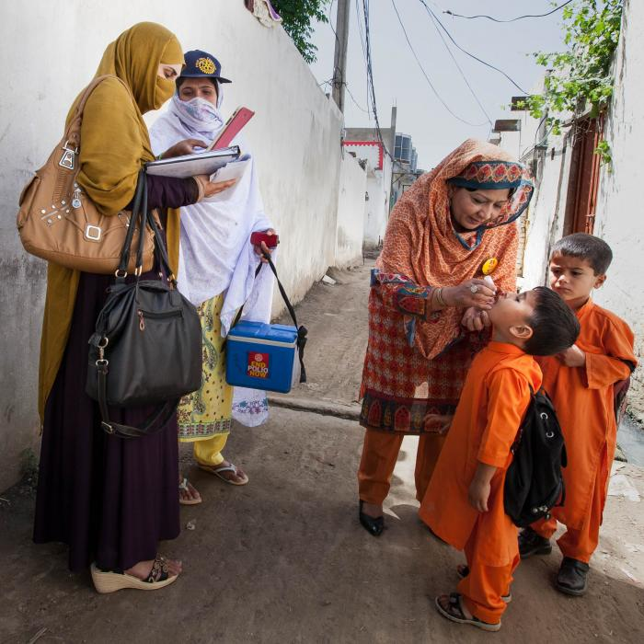
Fighting Disease
99.9% reduction in polio cases since our program started in 1985.
$60 million in grants was given last year to fight disease.

Slide 15
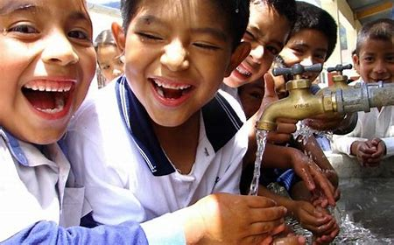
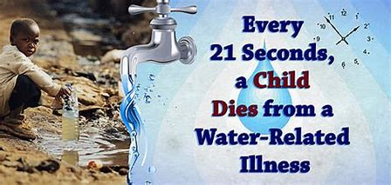
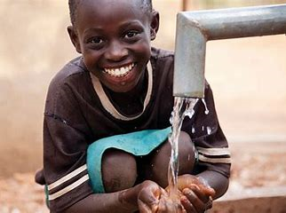
Water & Sanitation
$24 is all it takes to provide one person with safe water.
110 schools in Ghana have better sanitation and hygiene thanks to the Rotary-US Agency for International Development (USAID) partnership.

Slide 16
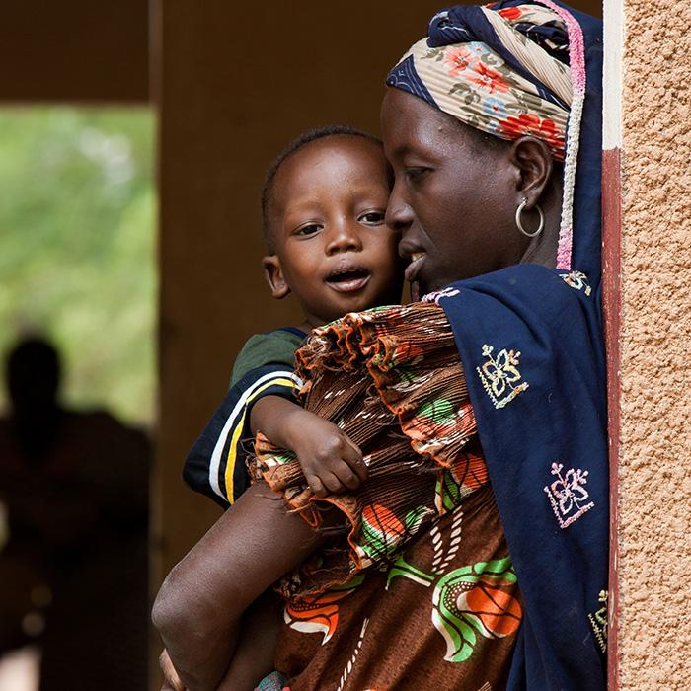
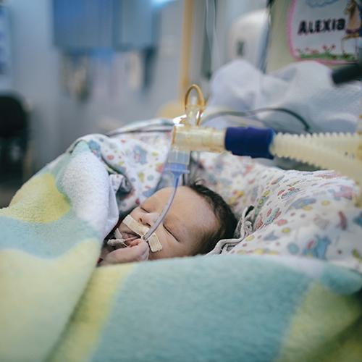
Saving Mothers and Children
6 Million Children Under The Age Of Five Die Each Year Because Of Malnutrition

Slide 17
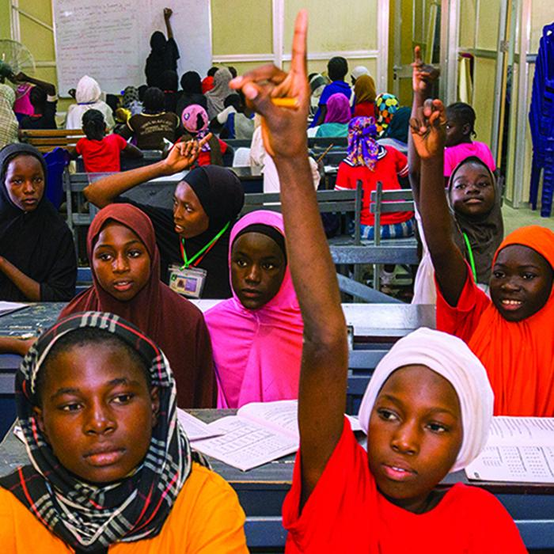
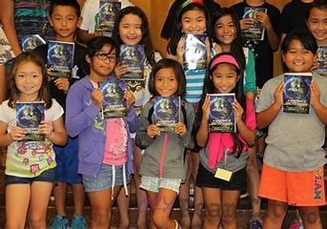
Supporting Education
More than 775 million over the age of 15 are illiterate.

Slide 18
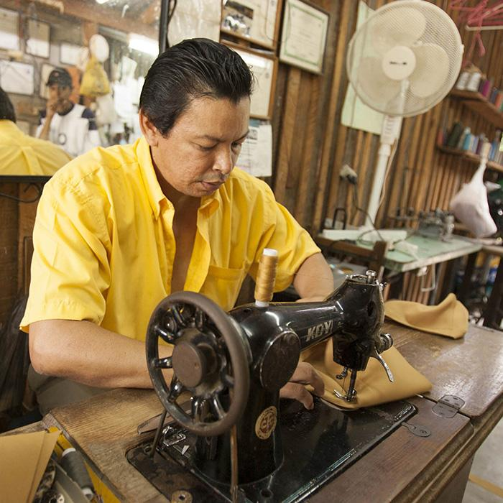
Growing Local Economies
Nearly 800 million live on less than $1.90 a day.
Last year Rotary spent $9.2 million to grow local economies.

Slide 19
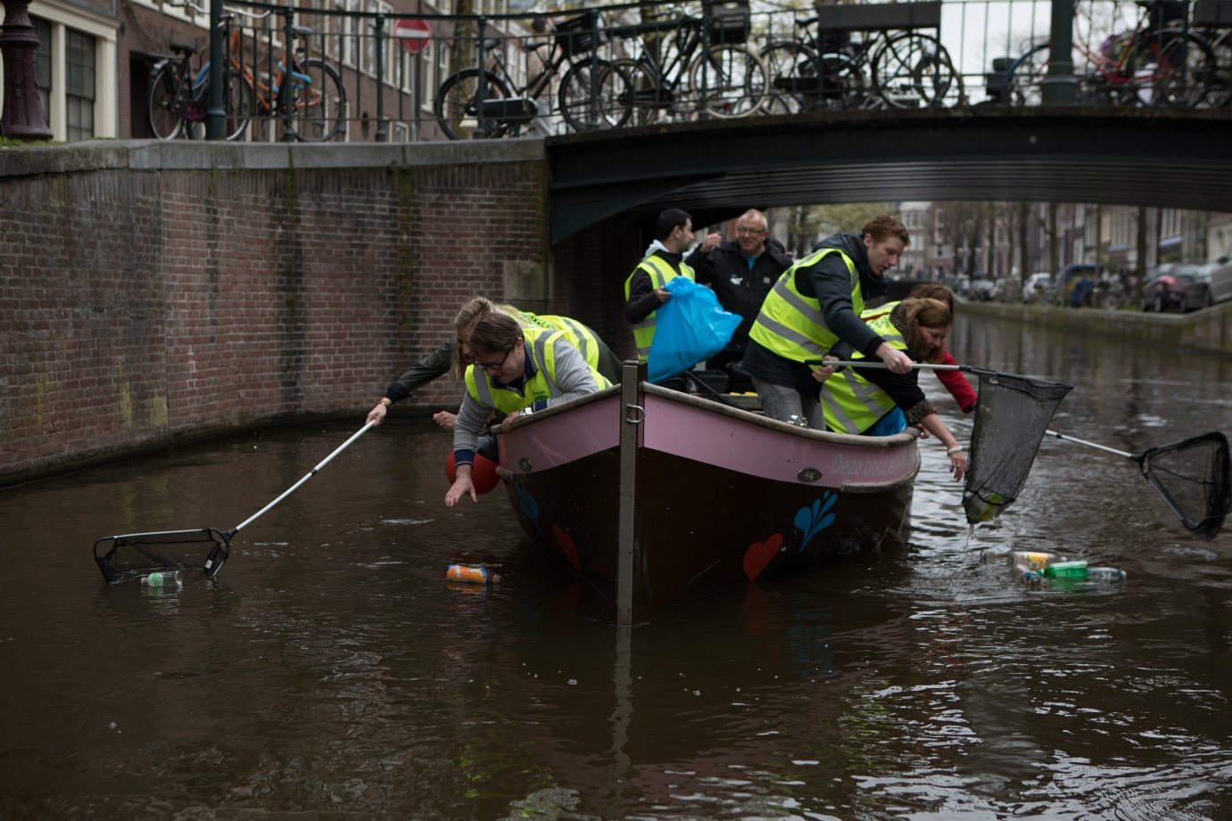
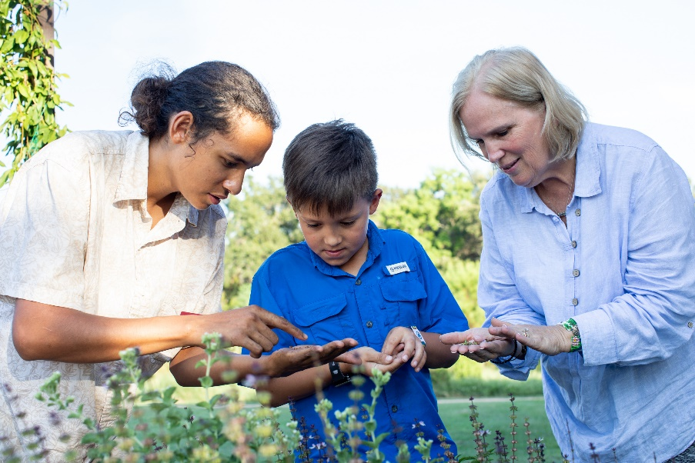
Supporting The Environment

Slide 20
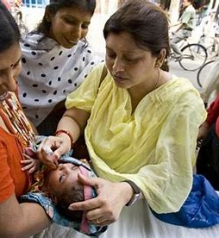
Rotary is easy to understand…
The Four Way Test (What we live by)
The Five Avenues of Service (How we serve)
The Seven Areas of Focus (Issues we address)

Slide 21
Since it was founded more than 100 years ago the Rotary Foundation has spent more than $4 billion on life-changing, sustainable projects.

Slide 22
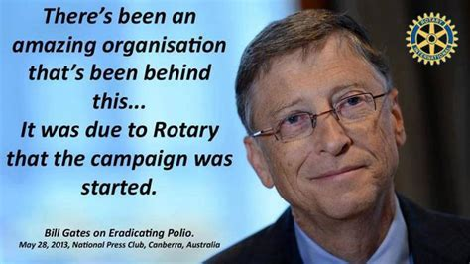
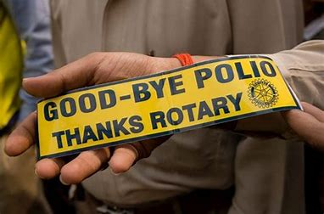
Over 2.5 billion children have been immunized against polio.
Rotarians have contributed $1.9 billion and countless volunteer hours.
There has been a 99.9% reduction of polio cases worldwide.

Slide 23
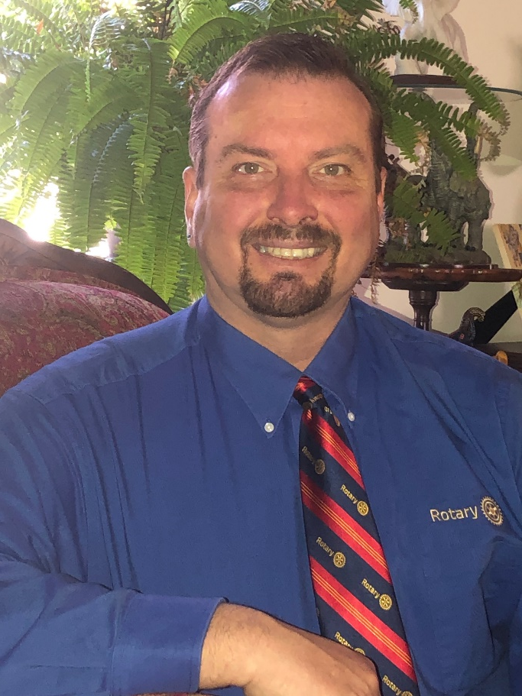
RI District 7360
63 Clubs
2,100 Members
Central Pennsylvania
Western Maryland
Eastern West Virginia
2023-24 District Governor Herb Smith
Hagerstown Sunrise Rotary Club

Slide 24
Your Club Name Here
President – ? ?
~% Female
% Male
30’s to 80’s
Meeting Location gets placed here

Slide 25
F
U
N
D
R
A
I
S
I
N
G
P
R
O
J
E
C
T
S

Slide 26
SUPPORTING LOCAL ORGANIZATIONS

Slide 27
Great Speakers

Slide 28
Socials

Slide 29
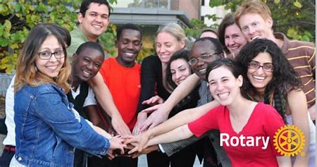
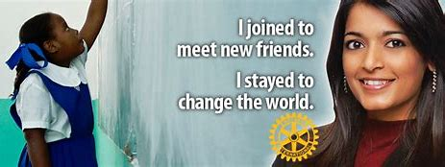
Why Join Rotary?
Friendship, camaraderie and fun
Give back to community
Be part of something larger than yourself
Professional networking
Leadership training
Personal growth and recognition
…..to name just a few of the reasons millions of people around the globe have joined Rotary for 117 years.
(February 23, 1905)

Slide 30
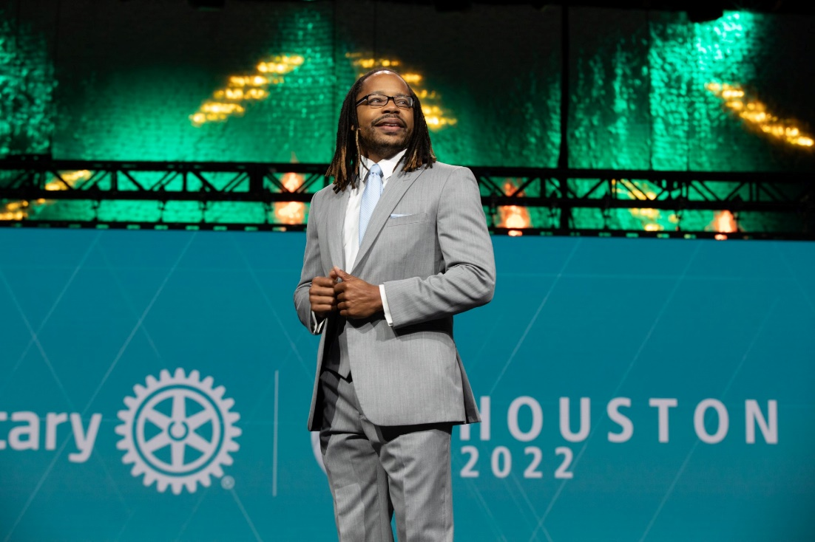
What are the benefits of joining Rotary
Fellowship & life-long friendships
Network & business development
Leadership opportunities
Mentors to assist with professional development
Give back to the community
Be part of something bigger than self
The Rotary Magazine
Travel opportunities

Slide 31
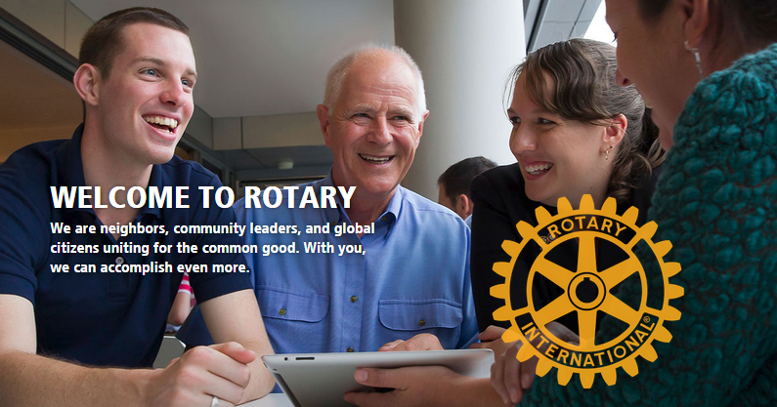

Slide 32
“If you have the love of your fellow men in your heart, my friend, you are a potential Rotarian.”
Paul Harris who organized the first Rotary Club in 1905

Slide 33
Thanks for your interest in Rotary
You Too Can Be A Rotary Hero!

