Slide 1
2024-25 District 7360 Training Assembly
Foundation Lead
April 21, 2024
Ken Martin
Co-Chair, District Foundation Committee
District 7360

Slide 2
Club Foundation Lead is an Important Position
Rotary Intl tracks and extends special rights to seven positions for every club
President
President-elect
Secretary
Treasurer
Membership Lead
Public Image Lead
Foundation Lead
Three Categories of Reports on Rotary Club Central
Membership
Service Activities
Foundation
District 7360

Slide 3
Every District is required to have a Membership, Public Image and Foundation Committees and these three interconnected foci are often viewed as determinants of success of Rotary Clubs.
Support of the Foundation increases the reach of Rotary, which improves its Public Image, resulting in greater interest in Membership, which leads to more support of the Foundation.
The Foundation Lead is most commonly appointed by the President. In a small club they may also serve in another elected capacity, but in larger clubs they most often are chair or co-chair of a club Foundation Committee
The Foundation lead must be shared with RI so they have access to Club Foundation reports in Rotary Club Central

Slide 4
RI lists nine responsibilities
• Motivating club members to give
• Conducting at least four motivational Foundation-focused club programs a year
• Promoting Foundation grants & activities & helping members take part
• Participating in the District Grant Management Seminar
• Overseeing the Grant Qualification process
• Working with the Club Treasurer to manage any Foundation Grant funds the club receives
• Helping the club Treasurer submit donations to the Foundation promptly and accurately
• Collaborating with your District’s International Services Chair and Service Projects committee to develop and fund projects
• Enhancing members’ experience by offering them an opportunity to participate in meaningful service

Slide 5
Simplified Responsibilities – Be a GAMER
Goals
Awareness
Motivation
Engagement (in Club and District Programs/Events)
Recognition

Slide 6
Goals
MINIMUM - With President and Board set goals for Annual Fund and PolioPlus (and enter in Rotary Club Central)
SUGGESTED – Set goals for EREY (Every Rotarian Every Year), Sustaining Members, PHF Fellows)
Monthly Foundation Minutes presented at club meetings
Programs on the Foundation
PolioPlus
Selection of District Community Grant Project
Participation in District Programs
District Foundation Dinner, Foundation Walk, Pedals Out Polio, World’s Greatest
Meal

Slide 7
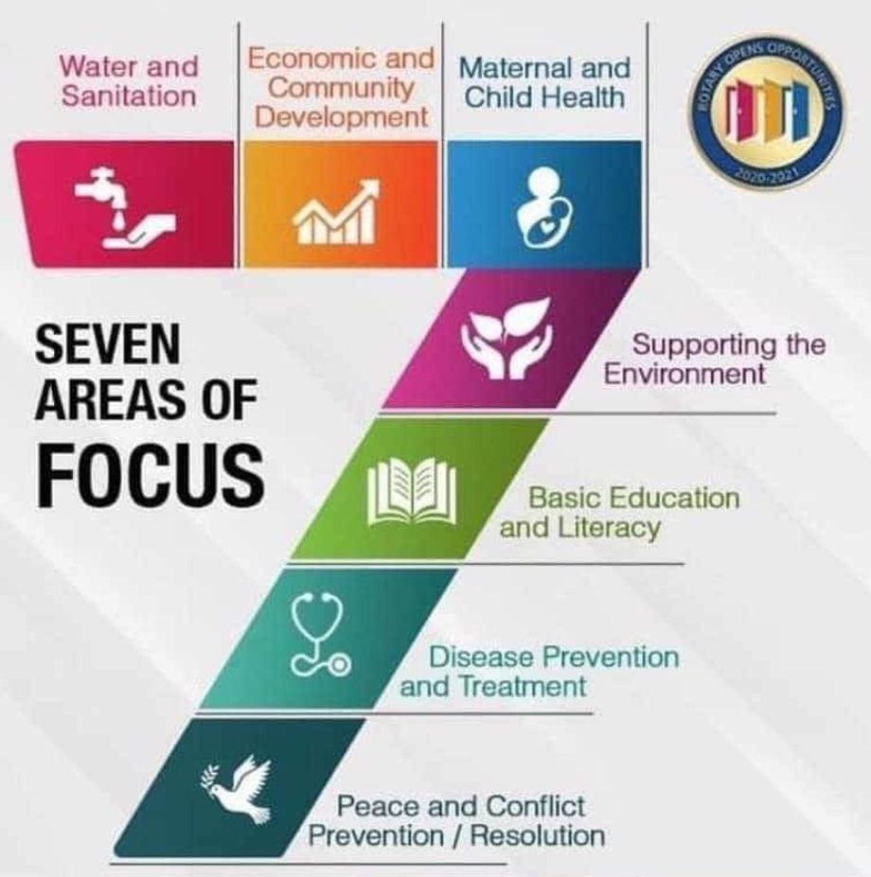
Awareness
Rotary Foundation’s Mission
The Rotary Foundation helps Rotary members to advance world understanding, goodwill, and peace by improving health, providing quality education, improving the environment, and alleviating poverty.
Rotary Foundation is charitable (501c3)
Seven Areas of Focus & Polio
47.5% of Amounts given to Annual Fund return to District
Rotary Foundation is among highest rated charities For the 12th consecutive year, The Rotary Foundation has received the highest rating — four stars — from Charity Navigator, an independent evaluator of the charities in the U.S.
The Foundation earned the recognition for demonstrating strong financial health, low costs and commitment to accountability and transparency

Slide 8
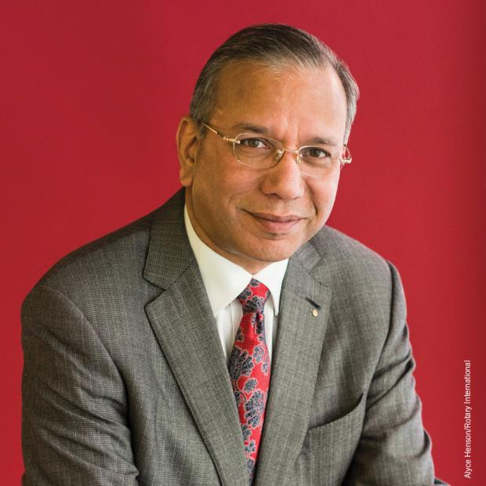
Together, we see a world where people unite and take action to create lasting change – across the globe, in our communities and in ourselves.
Not every Rotarian has the ability to make a large donation, but every Rotarian has the ability to make some donation.
Past RI President K.R. “Ravi” Ravindran

Slide 9
Easy Ways to give to The Rotary Foundation
With each club dues payment
Rotary Direct
District Foundation Dinner Raffle Tickets
District Polio Plus Society
Charitable Deduction and IRA Required Minimum Distribution - Tax Benefits.
Estate Planning - Bequests

Slide 10
How do I help?

Slide 11
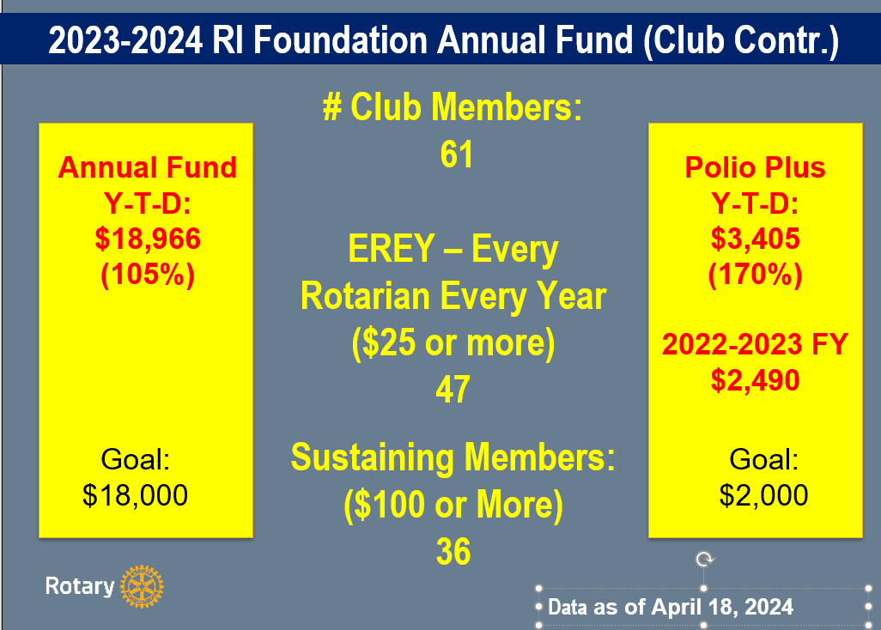
Motivate
Share Goals and Report on Progress
Matching (points or dollars)
Competition

Slide 12
Engagement
Committee Membership
Club Events
Grants – Community and Global
District Programs
World’s Greatest Meal
Pedals Out Polio
Polio Plus Society
Foundation Walk
Foundation Dinner – Raffle Tickets, Auction

Slide 13
Recognition
Paul Harris Fellow Milestones
Rotary Direct
Major Donors
Have District Grant Beneficiaries Speak at your Meeting

Slide 14
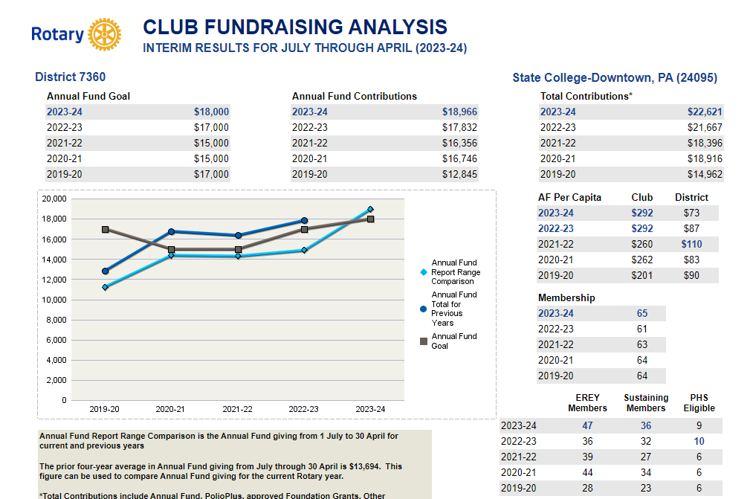
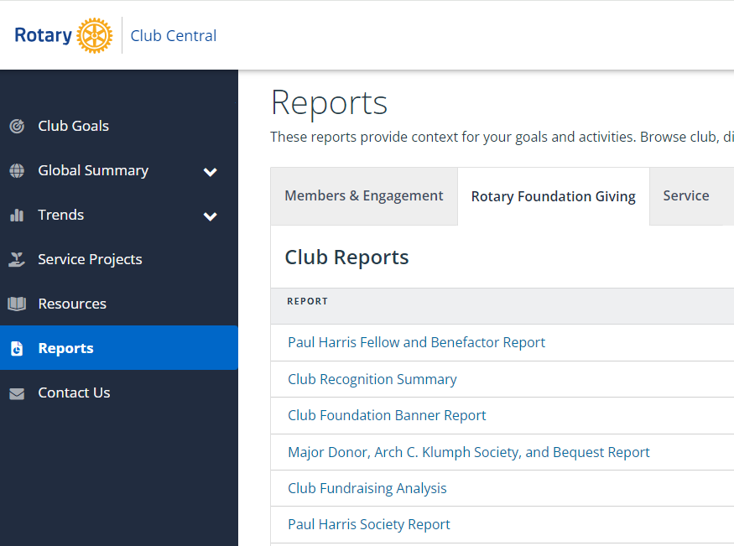
Resources
Rotary Club Central Reports

Slide 15
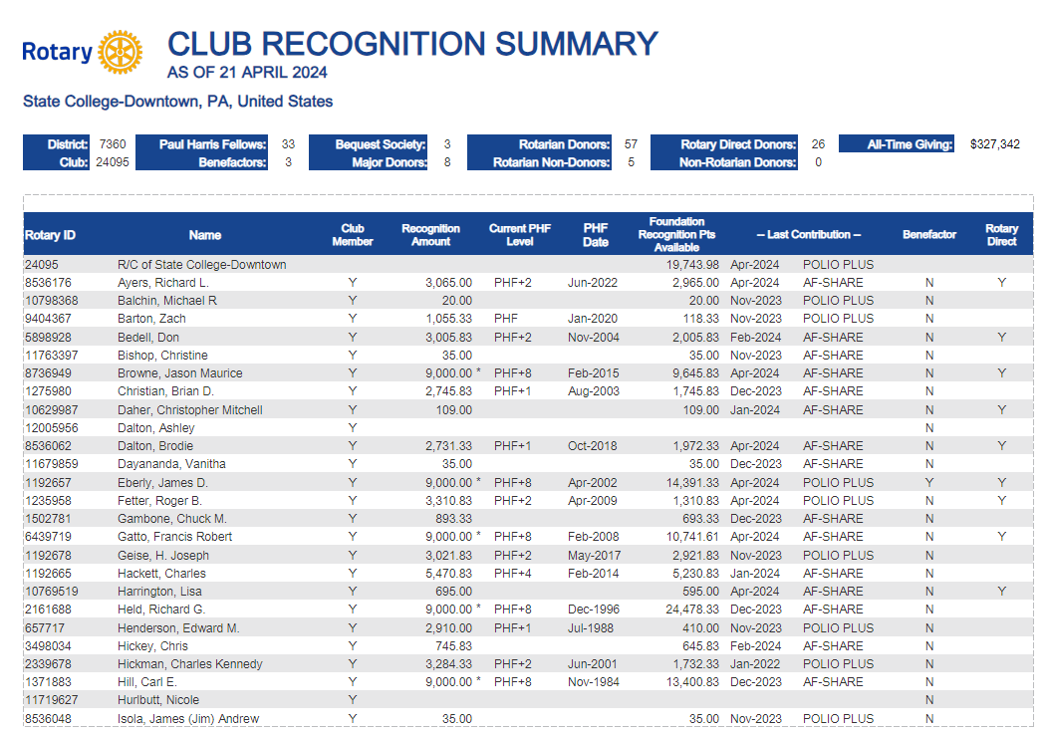
Resources

Slide 16
Resources
Foundation Fact Sheet (available under District Training Assembly Files)
Rotary Foundation Reference Guide (District Training Assembly Files)
District Foundation Committee
My Contact Info
Ken Martin
814-380-4008 (cell)
kpmartin@stamps.org

