Slide 1
Grant Management Seminar Certification District 7360 2024-25
Ken Martin and Kelly Wike, District 7360 Rotary Foundation Co-Chairs Helen Schmitt and Swan Stull, District Grant Management Co-Chairs
revised 3/2/24
Notes:
1

Slide 2
Mission of TRF
The Rotary Foundation helps Rotary members to advance world understanding, goodwill, and peace by improving health, providing quality education, improving the environment, and alleviating poverty.

Slide 3
Learning Objectives
Increase your knowledge about Rotary Foundation District Community Grants
Learn how to apply for District Community Grants
Understand how clubs can use District Community Grants
3
Notes:
3

Slide 4
7360 Foundation Committee Goals
All District Rotarians achieving Every Rotarian Every Year ($25)
Double the number of District 7360 Rotarians enrolled in Rotary Direct from 100 to 200
Every District club enters meaningful goals for Annual Fund and Polio Plus on Rotary Club Central
Every District Club having a lead person for the Foundation and having at least one program on the Foundation annually
20% Increase in number of clubs requesting a District Community Grant (to 40 of 63 clubs)
District achieving $100 Per Capita Giving to Annual Fund and $25 per capita for End Polio Now

Slide 5
TRF Receives Highest Rating
For the 13th consecutive year, The Rotary Foundation has received the highest rating — four stars — from Charity Navigator, an independent evaluator of the charities in the U.S.
The Foundation earned the recognition for demonstrating both strong financial health and commitment to accountability and transparency.

Slide 6
Annual Fund – Share Contributions
$100
Annual Fund – SHARE
contribution
$47.50
World Fund
$47.50
DDF
$5
Operating Expenses
$45
World Fund
$50
District Designated
Funds
$47.50
District Designated
Funds
DDF = District Designated Funds
Notes:
Decision 3: DDF generated from Annual Fund – SHARE contributions will not be impacted until 1 July 2024

Slide 7
District Community Grants
Notes:
7

Slide 8
District Community
Grants (DCG)
Educational and humanitarian activities consistent with Foundation mission
Smaller projects ($400 minimum to less than $30,000)
Project must be completable by May 1, 2025
Fund projects not operating funds
Different projects each year.
Fund both local or international activities, including global grants
Managed by district
8
Notes:
8

Slide 9
Club Responsibilities
Two members to implement, manage and maintain club qualification by attending Grant Management Seminar (5 offered)
Ensure proper stewardship and proper management practices for all grants
No conflicts for individuals involved

Slide 10
District Community
Grants
Club must fund entire cost of project and reimbursed grant amount after completion.
Grant maximum is 50% of cost of project.
Reimbursement made within 15-30 days of project completion and final report approval
10
Notes:
1st Bullet – emphasize!
10

Slide 11
DCG Funds
Check your Club’s Fundraising Analysis for 2021-22 (Rotary Club Central).
Grant minimum of $200.
Maximum 25% of Annual Fund Giving 3 yrs prior per club.
If eligible for more than $1,500, club may apply for two grants, both of which must meet $200 minimum.
11
Notes:
11

Slide 12
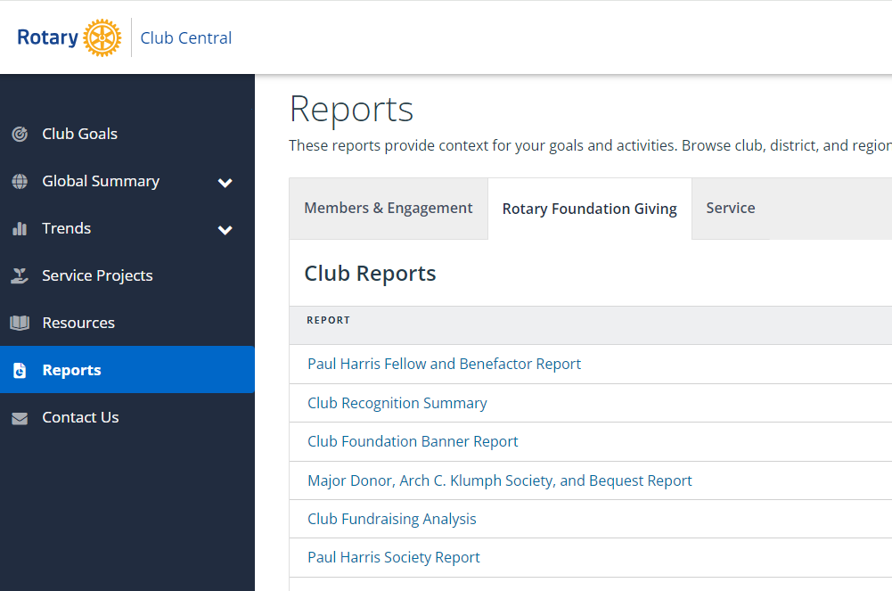
Club Fundraising Analysis
12
Notes:
12

Slide 13
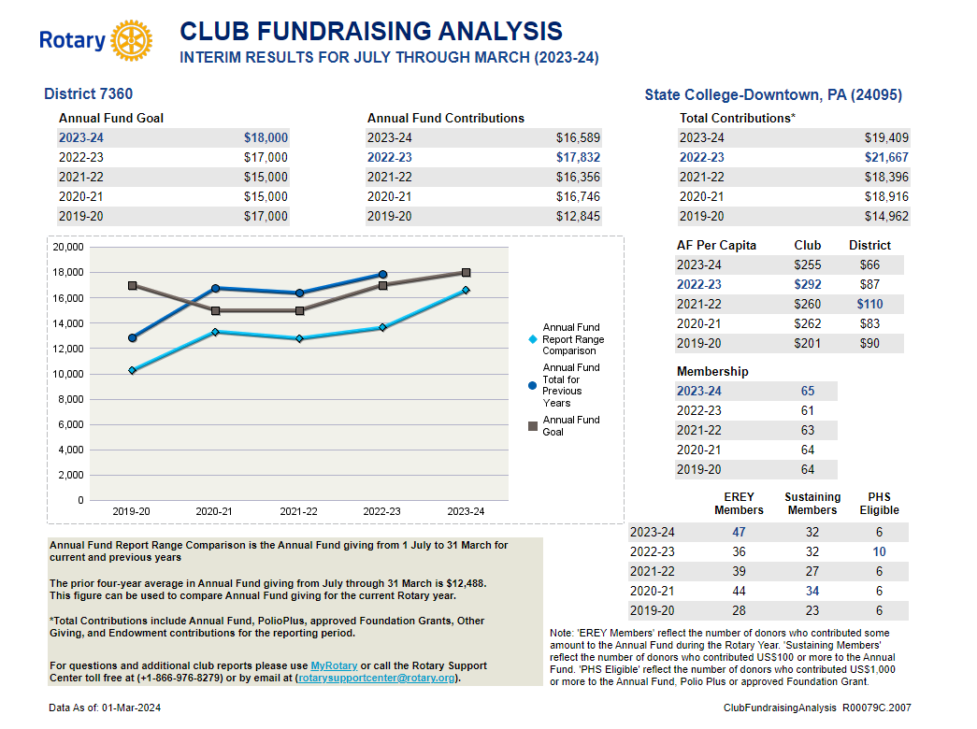
Club Fundraising Analysis
13
Notes:
13

Slide 14
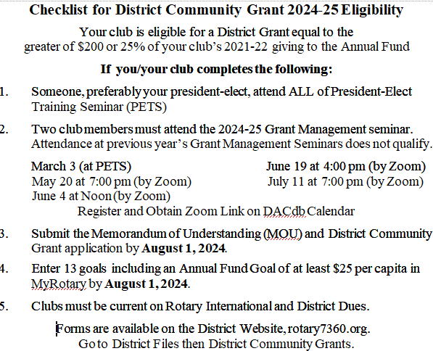
Notes:
Ck list

Slide 15
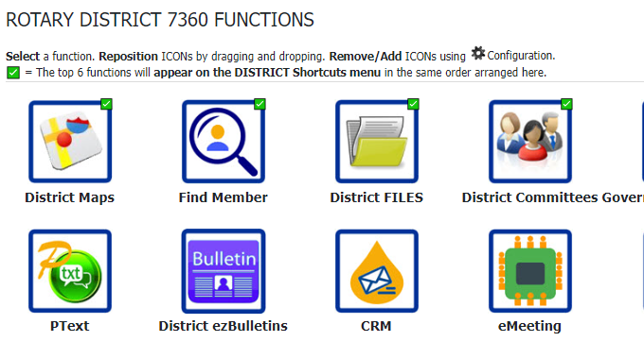
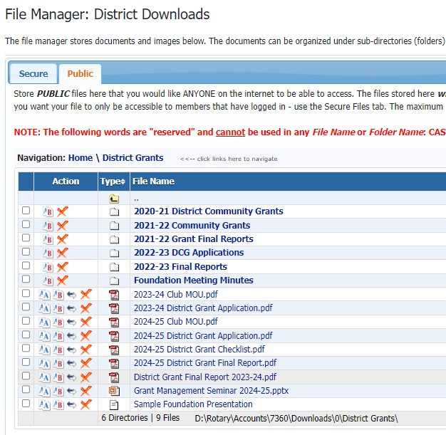
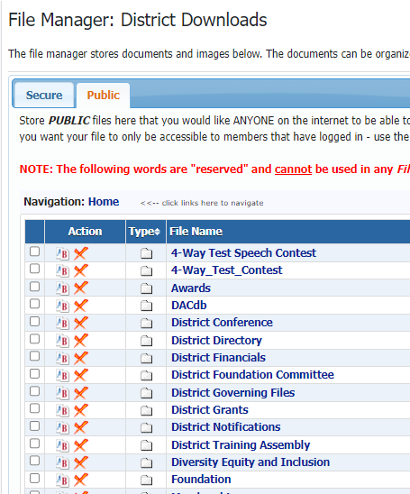
15
Notes:
Explain international & managed by…
15

Slide 16
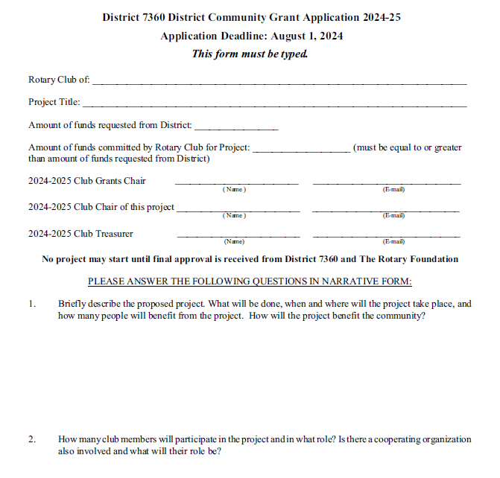
16
Notes:
Explain international & managed by…
16

Slide 17
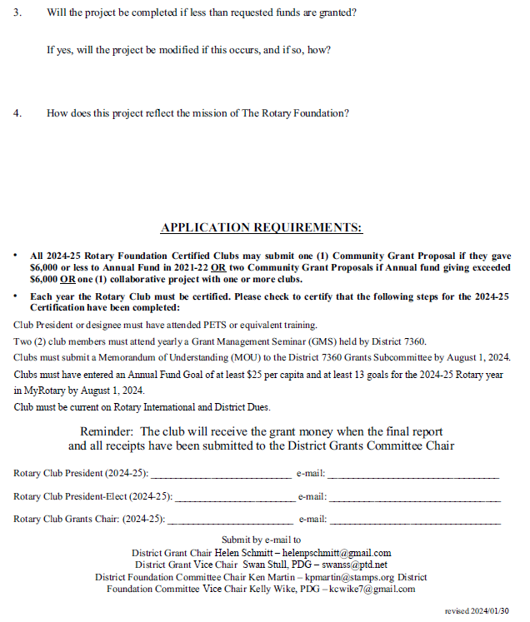
17
Notes:
Explain international & managed by…
17

Slide 18
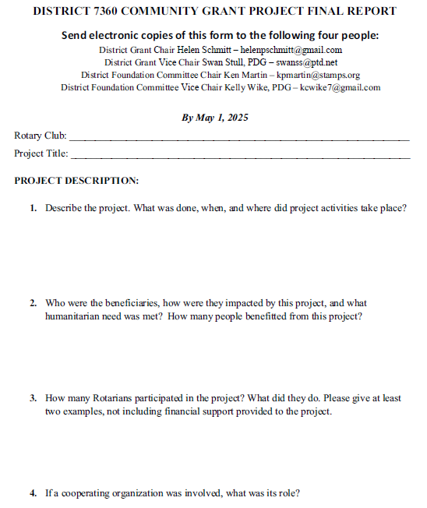
18
Notes:
Explain international & managed by…
18

Slide 19
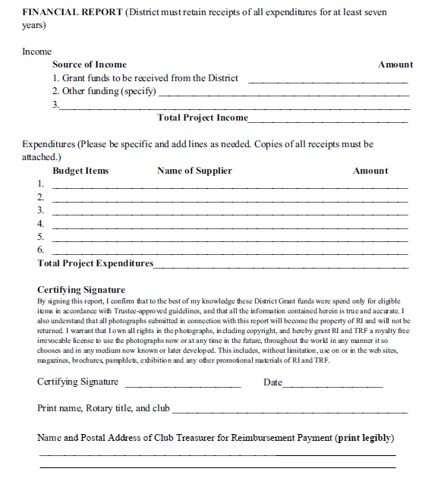
19
Notes:
Explain international & managed by…
19

Slide 20
Documents Retention
Maintained for 7 years and accessible to Rotarians in Club and District (Recommend hard copy and files on Club DACdb)
Documents include:
Application and MOU
Bank information, including bank statements
Financial management plan
Procedure for storing documents and archives
Succession plan for bank account signatories

Slide 21
2024 Grant Seminars
March 3 at PETS
May 20, 7 pm (zoom)
June 4, noon (zoom)
June 19, 4 pm (zoom)
July 11, 7 pm (zoom)
Register on DACdb for any of these seminars.

Slide 22
Deadlines
No project may start until final approval is received from District 7360 (Foundation Chairs & DG) and The Rotary Foundation. Estimated approval is early September.
MOU and Application must be received by August 1st, 2023.
File Final Report by May 1, 2024.

Slide 23
Tips
Address a Community Need
A good project increases awareness of Rotary and may lead to new members
Involve club members in project selection and, if possible, implementation
Clubs may join together on a project increasing resources available

Slide 24
Tips
Check out what other clubs have done by reviewing past project applications and final reports on the District Website
Use a club meeting to report on project and celebrate its success
Editable Powerpoint presentation on Foundation available on District Website
Foundation Committee available to do club presentations.

Slide 25
Thank You Rotarians for all you do!

Slide 27
Committee Structure
District Governor
DG Pam Wagoner
District Foundation
Co-Chairs
Ken Martin and PDG Kelly Wike
International
Service Coordinator
Global Grants
Sub-Committee
Co-Chairs
Grants
Sub-Committee
Co-Chairs
Polio Plus
Sub-Committee
Chair
John Taylor
PDG Carl Askew
Maria Brown
Helen Schmitt
PDG Swan Stull
PDG Jeff Coup
At-large Committee Members
Paul Harris Society
Sub-Committee
Co-Chairs
Stewardship
Sub-Committee
Co-Chairs
Peace Fellowship
Sub-Committee
Chair
Mary Anne Burke
Chelsey Fisher
Sarah Kowalski
DGE Dawn Linn
DGN Sean Murtagh
DG Pam Wagoner
PDG Vicki Zimmerman
Kat Snowe
PDG Dana Orsini
Kat Snowe

Slide 28
Stewardship Committee
Part of the DRF Committee
Two Distinct Functions:
Reporting
Investigation and Local Compliance

