Slide 1
Welcome

Slide 2
YOUR DISTRICT GRANT TEAM
District 7360 Rotary Foundation Co-Chairs
Ken Martin and Kelly Wike
District Grant Management Co-Chairs
Helen Schmitt and Sarah Kowalski
Additional Foundation Committee Members
Jeff Coup, Patrick Irwin, Dawn Linn, Colleen McCloskey, Barb Morgan, Sean Murtagh, Michael Nailor, Dan Orsini, Kat Snowe, Swan Stull, John Taylor, Susanna Tomlinson, Pam Wagoner, Vicki Zimmerman
Revised 03.28.2025

Slide 3
Foundation Committee Purpose
Help Clubs and Increase Foundation Support
Presentations to Clubs
Help you with reports, resources, asks, questions
Provide District programs to help you raise support
Administer District Community Grants and make recommendations on use of District Designated Funds
Recognition of individuals and clubs

Slide 4
District 7360 Foundation Committee Goals
100% Rotarian Participation: Achieve Every Rotarian Every Year with a minimum $25 donation.
Double Rotary Direct: Increase enrollment from 115 to 200 members.
Club Goal Setting: All clubs set Annual Fund and PolioPlus goals in Rotary Club Central.
Foundation Leadership & Programs: Each club appoints a Foundation lead and hosts at least one annual Foundation program.
Increase Community Grants: Raise District Community Grant requests by 20% (from 40 of 63 clubs).
Per Capita Giving: Achieve $100 per capita for the Annual Fund and $25 per capita for End Polio Now.

Slide 5
MISSION
The Rotary Foundation helps Rotary members to advance world understanding, goodwill, and peace by improving health, providing quality education, improving the environment, and alleviating poverty.

Slide 6
Receives the highest ratings
16
For consecutive years, The Rotary Foundation has received the highest rating offered from Charity Navigator, an independent evaluator of the charities in the U.S.
The Rotary Foundation earned the recognition for demonstrating both strong financial health and commitment to accountability and transparency.

Slide 7
Learning Objectives
The Rotary Foundation District Community Grants
Applying for District Community Grants
How to use District Community Grants

Slide 8
Annual Fund SHARE System
$100
Contribution to the Annual Fund
$47.50
World Fund
$5
Operating Expenses
$47.50
District Designated Funds

Slide 9
District Community Grants

Slide 10
District Community Grants
Grant requests must be consistent with The Rotary Foundation mission
Grant projects have a $400 minimum
All projects must be completable by May 1, 2026
Project Funds are not for operating expenses
Must be a different project each year
Funds will allow both local or international, including global grants
All grants are managed by district

Slide 11
District Community Grants
District Community Grants are reimbursement grants
Clubs must fund the entire cost of project and will be reimbursed the grant amount after project completion.
Grant request maximum is 50% of cost of project.
Reimbursement made within 15-30 days of project completion and final report approval

Slide 12
Club Responsibilities
Select two members to over see the grant process
Both members must attend a Grant Management Seminar, multiple offerings
Ensure proper stewardship and proper management practices for all grants
No conflicts for individuals involved
Seminar attendance is mandatory for the club to be eligible to apply for any district community grant

Slide 13
Club DCG Funding
Confirm funding eligibility amount (22-23 year)
Each grant must be for a minimum of $200
Funding is a maximum of 25% of each clubs Annual Fund Giving 3 yrs prior
If club is eligible for more than $1,500 in funds, club may apply for two grants, both of which must meet $200 minimum
To determine maximum amount available to your club, multiply 0.25 by the 2022-23 Annual Fund Support from the Club’s Fundraising Analysis in Rotary Club Central.
DCG = District Community Grant

Slide 14
Club Fundraising Analysis
Rotary Club Central

Slide 15
Club Fundraising Analysis

Slide 16
Is Your Club Eligible?
Note District website address now District Rotary7360.org
This is page 27 in your Guidebook!
14

Slide 17
Grant Documents
These will be updated for 25-26 SOON!
15
15

Slide 18
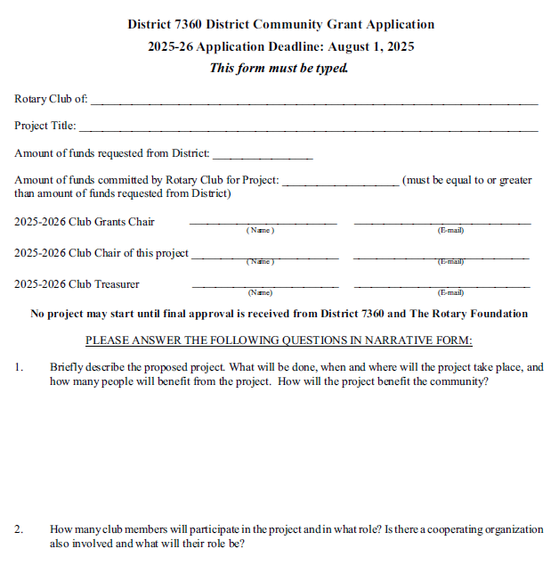
Application

Slide 19
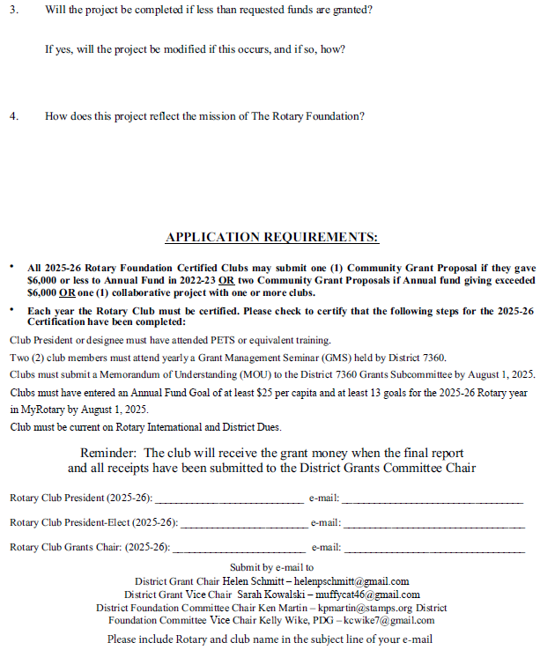
Application
17
17

Slide 20
Final Reporting
18
18

Slide 21
Financial Reporting
19
19

Slide 22
Document Retention
Maintained for 7 years and accessible to Rotarians in Club and District (Recommend hard copy and files on Club DACdb)
Documents include:
Application and MOU
Bank information, including bank statements
Financial management plan
Procedure for storing documents and archives
Succession plan for bank account signatories
20

Slide 23
2025-2026 Grant Seminars
March 9th (PELS)
March 29th (District Conference)
May 20th 7PM (ZOOM)
June 2nd 12PM (ZOOM)
June18th 4PM (ZOOM)
July 9th 7PM (ZOOM)
Registration for these webinars are on DACdb
21

Slide 24
Deadlines
No project may start until final approval is received from District 7360 (Foundation Chairs & DG) & The Rotary Foundation.
Estimated approval is early September
MOU and Application must be received by August 1st, 2025.
File Final Report by May 1st, 2026.

Slide 25
Grant Project Tips
Address a Community Need
A good project increases awareness of Rotary and may lead to new members
Involve club members in project selection and, if possible, implementation
Clubs may join together on a project increasing resources available

Slide 26
Grant Project Tips
Check out what other clubs have done by reviewing past project applications and final reports on the District Website
Use a club meeting to report on project and celebrate its success
Editable Powerpoint presentation on Foundation available on District Website
Foundation Committee available to do club presentations

Slide 27
25

Slide 29
FOUNDATION COMMITTEE
District Governor
DG Pam Wagoner
District Foundation
Co-Chairs
Ken Martin and PDG Kelly Wike
International
Service Coordinator
Global Grants
Sub-Committee
Co-Chairs
Grants
Sub-Committee
Co-Chairs
Polio Plus
Sub-Committee
Chair
John Taylor
PDG Carl Askew
Helen Schmitt
PDG Swan Stull
PDG Jeff Coup
At-large Committee Members
Paul Harris Society
Sub-Committee
Co-Chairs
Stewardship
Sub-Committee
Co-Chairs
Peace Fellowship
Sub-Committee
Chair
Sarah Kowalski
DGE Dawn Linn
DGND Colleen McCloskey
DGN Sean Murtagh
DG Pam Wagoner
PDG Vicki Zimmerman
Kat Snowe
PDG Dana Orsini
Kat Snowe
27

Slide 30
STEWARDSHIP COMMITTEE
Part of the DRF Committee
Two Distinct Functions:
Reporting
Investigation and Local Compliance

Slide 31
Ken Martin and Kelly Wike, District 7360 Rotary Foundation Co-Chairs
Helen Schmitt and Swan Stull, District Grant Management Co-Chairs
Revised 03.2025

