Slide 1
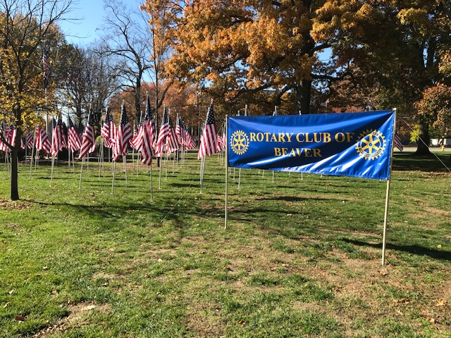
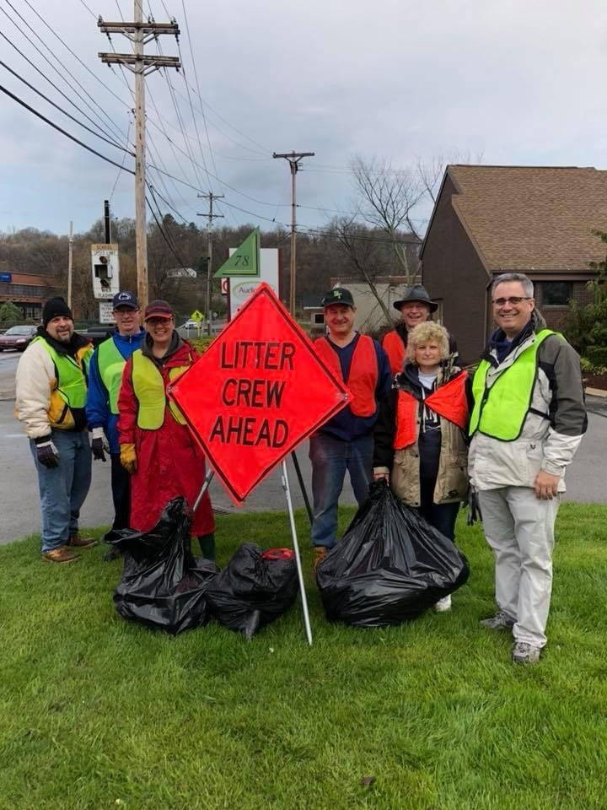
Welcome to the
Rotary Club of Beaver
Where you can find a profession network to support you, our communities and the world
Notes:
Hello, we are delighted to welcome you to Discover The Rotary Club of Beaver. We are an area club and are not limited to people in Beaver. People who work or live in Monaca, Rochester, Midland, Beaver and Center are welcome to join. Of course if meeting schedules are a problem other clubs in Beaver County would love to have you.
w to talk about how Rotary makes a difference in people’s lives around the world and right here at home. We’ll begin with introductions.

Slide 2
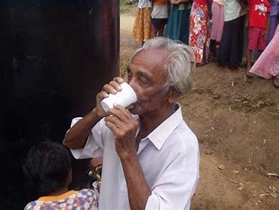
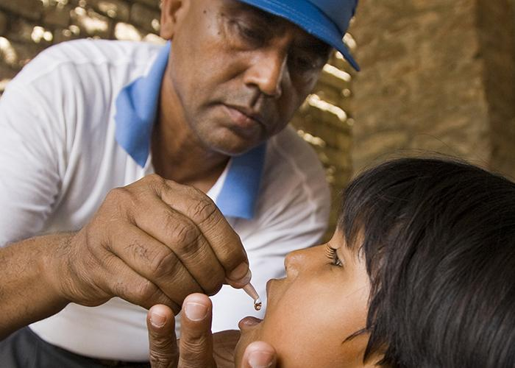
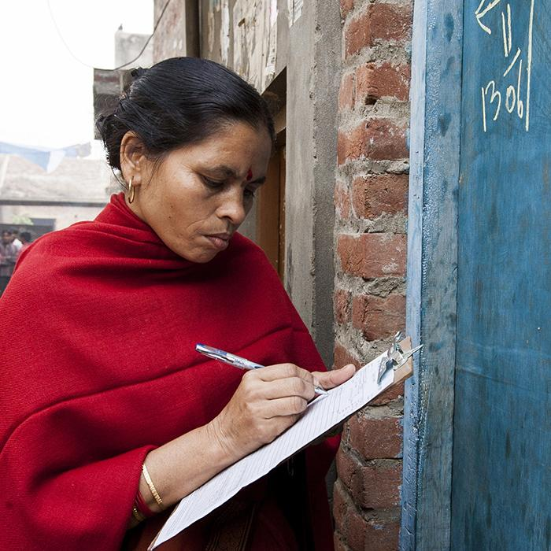
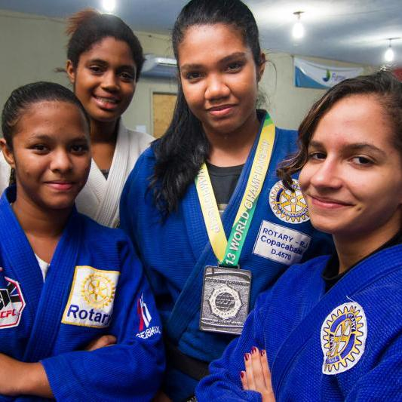
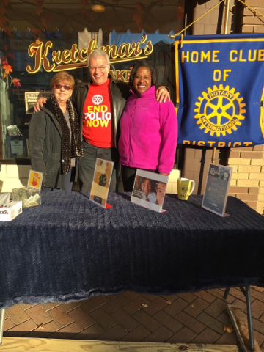
Together We:
Promote Peace
Save Lives
Fight Hunger
Mentor
Learn
Inspire
End Polio
Empower
Connect
Notes:
To answer the question what is Rotary? We are the most financially sound, largest most powerful membership organization whose logo is recognized in more countries than any other logo in the world. Every minute of every day, we feed, we house, we vaccinate, educate, advocate, comfort and provide a variety of services.

Slide 3
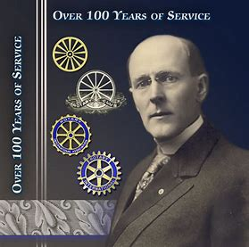
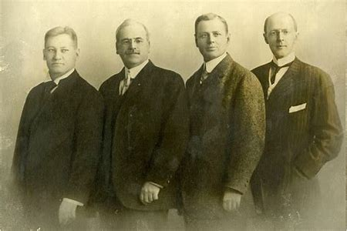
How Rotary Got Started
The first Rotary Club was organized in 1905, by Chicago Attorney Paul P. Harris
The original four member club met for fellowship in rotation at member’s offices…thus the name ROTARY
Their first community service project – a public toilet outside the Chicago City Hall
Paul Harris
People Of Action
From left: Gustavus Loehr, Silvester Schiele, Hiram Shorey and Paul Harris.
Notes:
Rotary got started by Paul Harris an attorney in Chicago who gathered some friends in 1905 for fellowship and it grew from there. Their first reason for being was FELLOWSHIP.

Slide 4
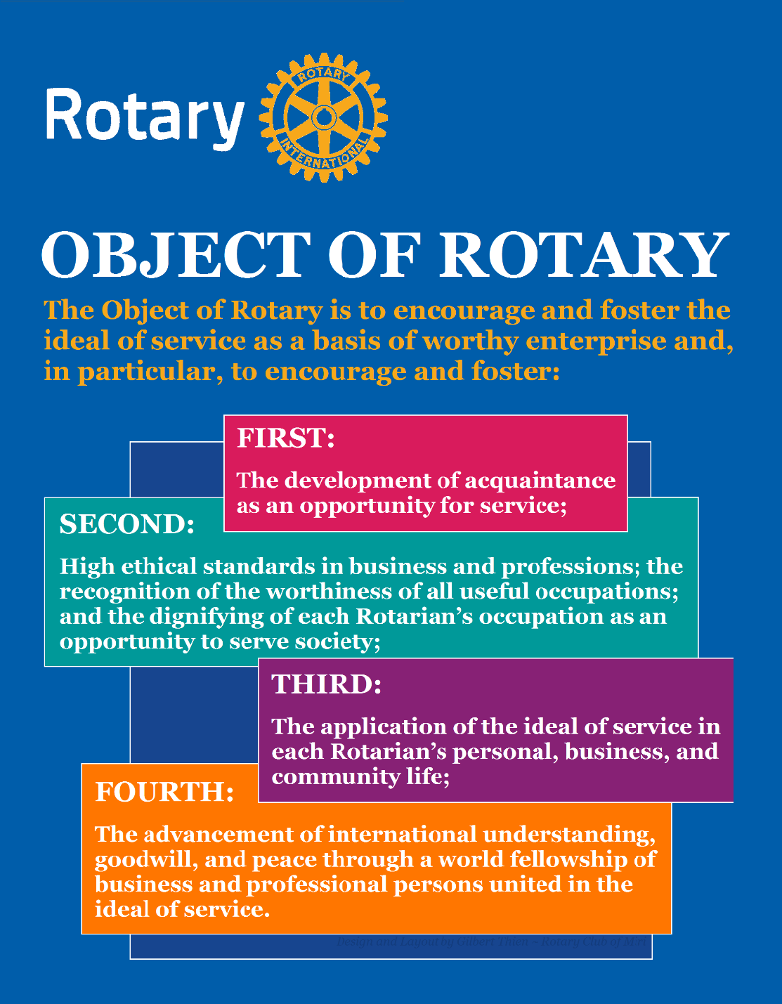
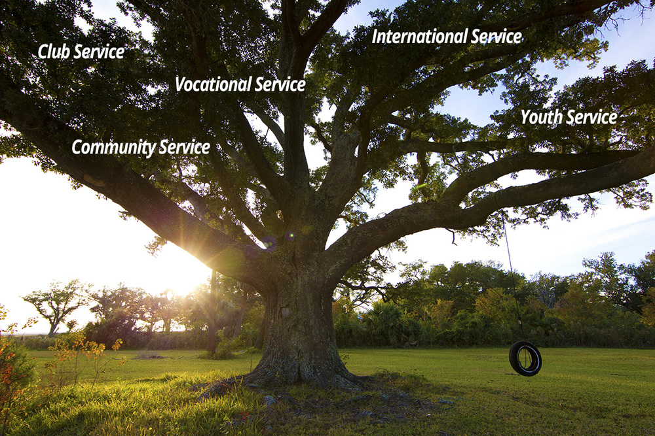
Five Avenues of Service
The Object of Rotary comes to life through Five Avenues of Service
Notes:
The Object of Rotary places great value on service, friendships and high ethical standards. Our occupations and professional skills help us to increase cultural understanding, goodwill and peace through community service. The Object of Rotary comes to life through Five Avenues of Service which are the branches of a deeply rooted membership organization and they are: Club Service, Vocational Service, Community Service, International Service and Youth Service. This is how we reach out and make a difference in people’s lives around the world and right here at home.

Slide 5
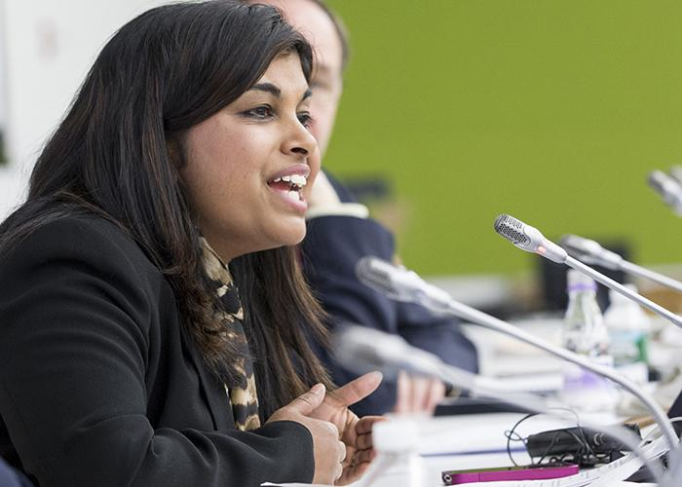
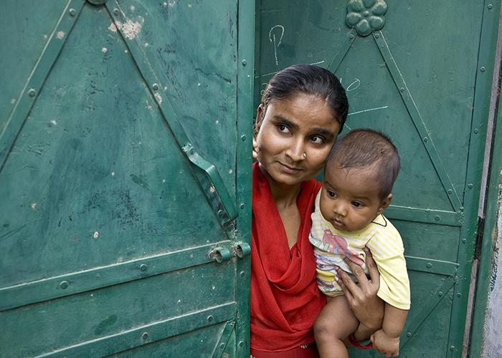
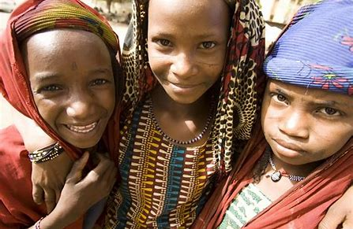
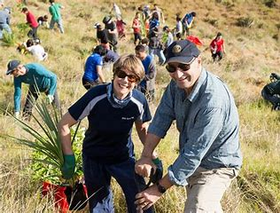
Seven Areas of Focus
Water, Sanitation &
Hygiene
Maternal & Child Health
Peacebuilding & Conflict
Prevention
Disease Prevention &
Treatment
Basic Education & Literacy
Community & Economic Dev.
Support The Environment
Notes:
Our 7 Areas of Focus build international relationships, improve lives, create a better world, support peace and end polio forever. All critical humanitarian causes Rotarians have been working on for many years. They include peacebuilding and conflict prevention, disease prevention and treatment, water, sanitation and hygiene, maternal and child health, basic education and literacy, community & economic development and the newest focus, supporting the environment.

Slide 6
Since it was founded more than 100 years ago the Rotary Foundation has spent more than $4 billion on life-changing, sustainable projects.
Notes:
At the 1917 convention, outgoing RI President Arch Klumph proposed setting up an endowment “for the purpose of doing good in the world.” That one idea, and an initial contribution of $26.50 set in motion a powerful force that has transformed millions of lives around the globe. Arch Klumph planted a seed and thanks to his vision, staunch advocacy and the extraordinary generosity of Rotarians worldwide, the Rotary Foundation has become one of the world’s leading humanitarian foundations.

Slide 7
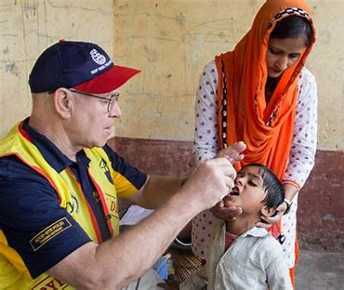
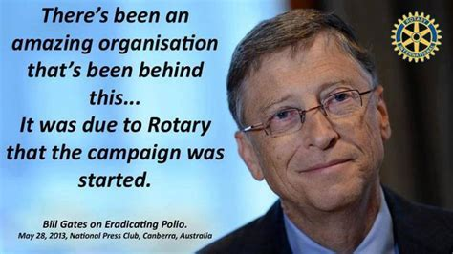
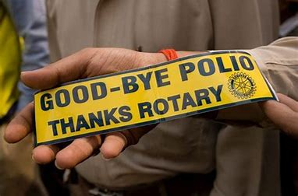
Over 2.5 billion children have been immunized against polio.
Rotarians have contributed $1.9 billion and countless volunteer hours.
There has been a 99.9% reduction of polio cases worldwide.
Notes:
The Rotary Foundation is well known for its work to end polio in the world. Polio Plus was launched in 1985 and has reached a 99.9% reduction in the number of Polio cases worldwide. We are now working on the final countries: Pakistan, Afghanistan and Nigeria. In 2017 Rotary committed to raise $50 million per year with every dollar to be matched with two additional dollars from the Bill and Melinda Gates Foundation bringing the total to $450 million. At last year’s Rotary International Convention Bill Gates announced he will extend the 2-to-1 match for the next three years which will add up to an additional $450 million to fight polio. We have been successful in eradicating polio in 122 countries around the world.

Slide 8
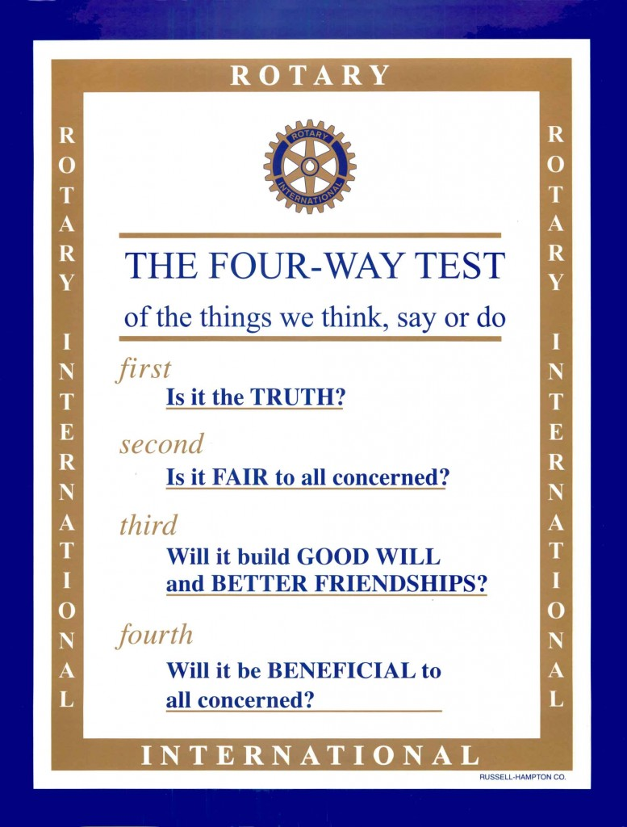
Notes:
The Four Way Test is used by Rotarians world-wide as a moral code for personal and business relationships.

Slide 9
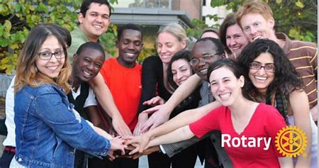
Why Join Rotary?
Friendship, camaraderie and fun
Give back to community
Be part of something larger than yourself
Professional networking
Leadership training
Personal growth and recognition
…..to name just a few of the reasons millions of people around the globe have joined Rotary for 115 years.
(February 23, 1905 – February 23, 2020)
Notes:
There are many good reasons to join Rotary. Life-long friends, making the community a better place, being part of something larger than yourself, networking, leadership and personal growth. These are just a few of the reasons why millions of people have joined Rotary over the past 115 year. In February Rotary celebrated its 115th anniversary.

Slide 10
Beaver Club is a part of Rotary District 7305 we seek members from Center, Monaca, Rochester, Midland and Beaver
We meet most Wednesdays at noon at the Wooden Angel
There are social and work events throughout the year
Some of our projects and support have included:
* Beds for Children - we have provided move than 384 beds to Beaver County
* Women’s Center of Beaver County
* Beaver County Educational Trust
* Food to Midland Center and Faith Restoration in Monaca
* DARE programs
* Student programs and scholarship
* Education of refugee students in Jordan
* Flood relief in West Virginia

Slide 11
How to Join
Membership is by invitation from a Rotarian
Cost of quarterly membership is $150
There is a goal of providing $100 per year to the Rotary Foundation
Submit a membership application
You are inducted into the club and introduced to the membership
Your Mentor will assist & guide you
Notes:
Rotary starts with an invitation to join a club. Cost for quarterly membership is $150 per quarter.. This covers RI, District and Club dues, a subscription to the Rotarian Magazine and club meeting meals. We also have a goal of providing $100 per Rotarian Per Year to Rotary Foundation.

Slide 12
Should you be interested in getting more information on membership or perhaps attending a Beaver Rotary meeting email your interest to:
Vic our membership chair: ragogovs@yahoo.com
Bryan our president: bryand@brightontwp.org

Slide 13
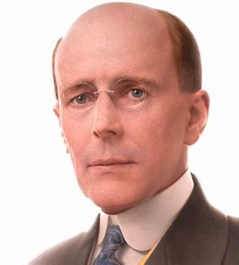
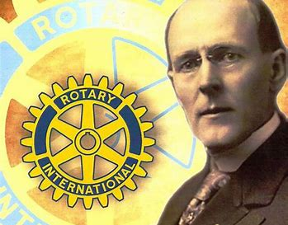
“If you have the love of your fellow men in your heart, my friend, you are a potential Rotarian.”
Paul Harris who organized the first Rotary Club in 1905
Notes:
Paul Harris said it best in describing what it takes to be a Rotarian when he said, “if you have the love of your fellow men in your heart, my friend, you are a potential Rotarian.”

