Slide 1



Slide 2
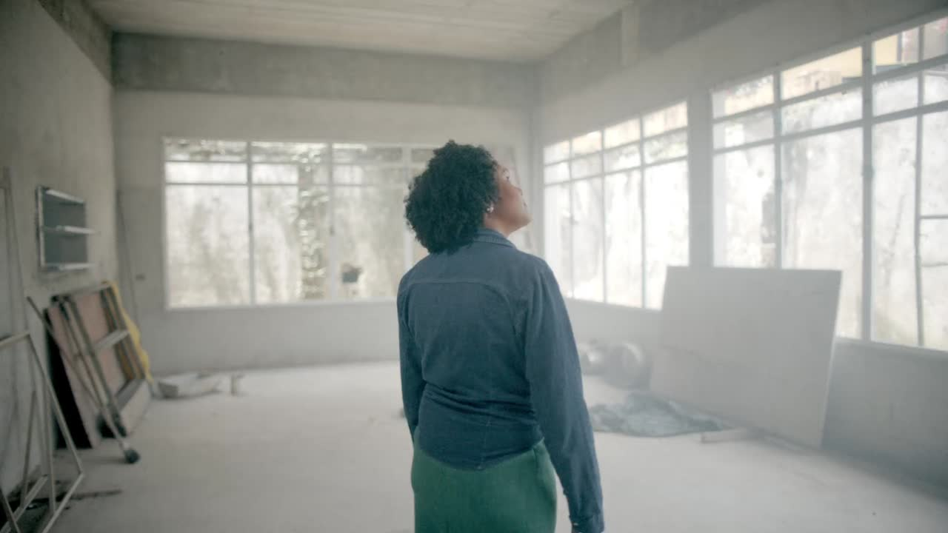

Slide 3


Slide 4



Slide 5
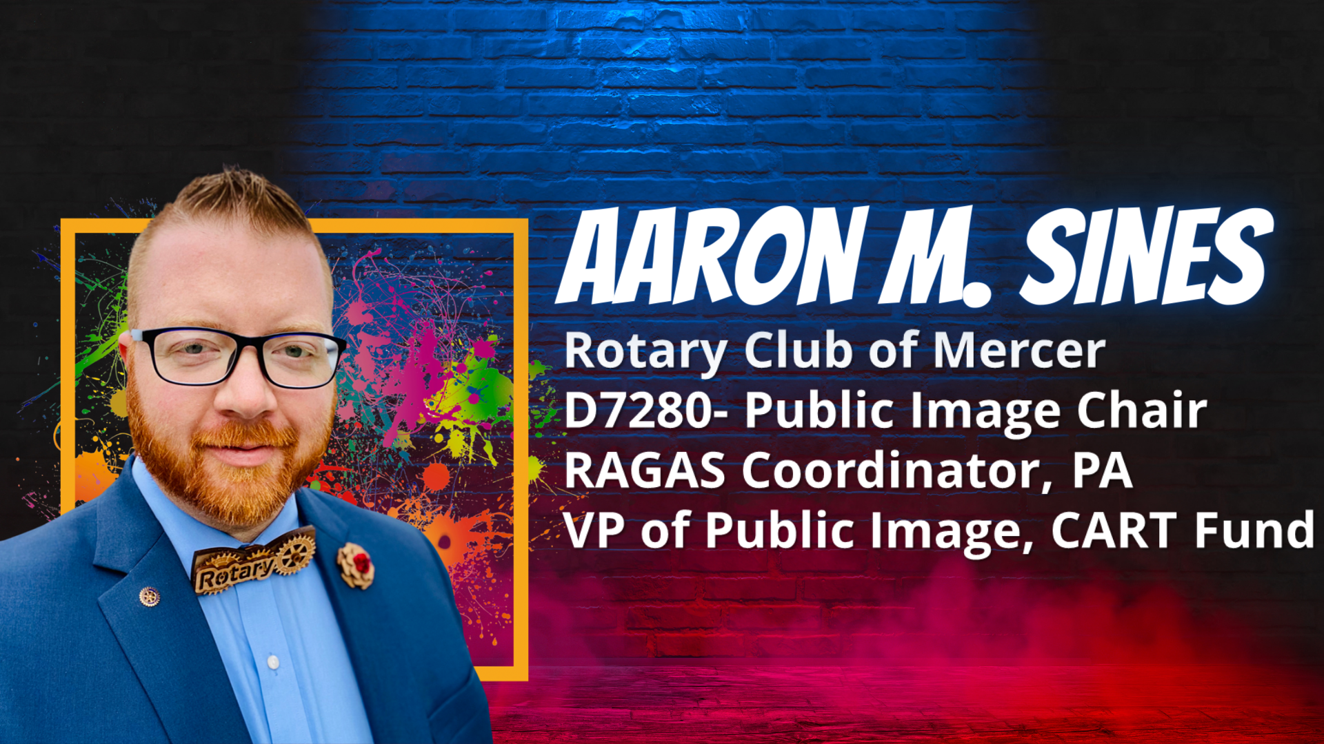

Slide 6


Slide 7
WHAT IS
ROTARY

Slide 8

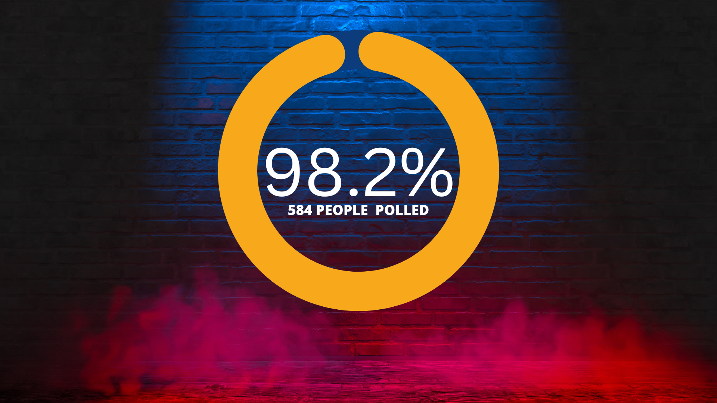
DOES NOT KNOW WHAT ROTARY DOES

Slide 9

WE ARE
ROTARY
WE ARE
PEOPLE OF ACTION

Slide 11
TELL YOUR PEOPLE OF ACTION STORY
In the text of your ad or social media post, tell your People of Action story. Keep it short but informative and inspiring. In as few words as possible:
1.
Say what you did:
What action did you take?
Offer statistics or other proof of the difference you made:
What did you accomplish? How did your club’s action change lives?
2.
Issue a call to action:
Do you want people to donate, participate, or learn more? Make it clear what you want them to do.
3.

Slide 12
OUR IMAGE
NO OTHER ORGANIZATION IS QUITE LIKE ROTARY.
BY USING OUR UNIQUE VOICE
CONSISTENTLY IN ALL OUR MESSAGING, WE CAN ENSURE THAT OUR COMMUNICATIONS REFLECT OUR DISTINCT CHARACTER.

Slide 13




INCORRECT BRANDING SENDS A CONFLICTING MESSAGE

Slide 14


OUR BRAND
SINCE 2013
A BRAND IS MORE THAN A LOGO. ROTARY’S BRAND IS MUCH BIGGER THAN THE WHEEL.
IT’S A PERCEPTION:
IT’S HOW OTHERS THINK ABOUT US, NOT JUST HOW WE SEE OURSELVES.

Slide 15
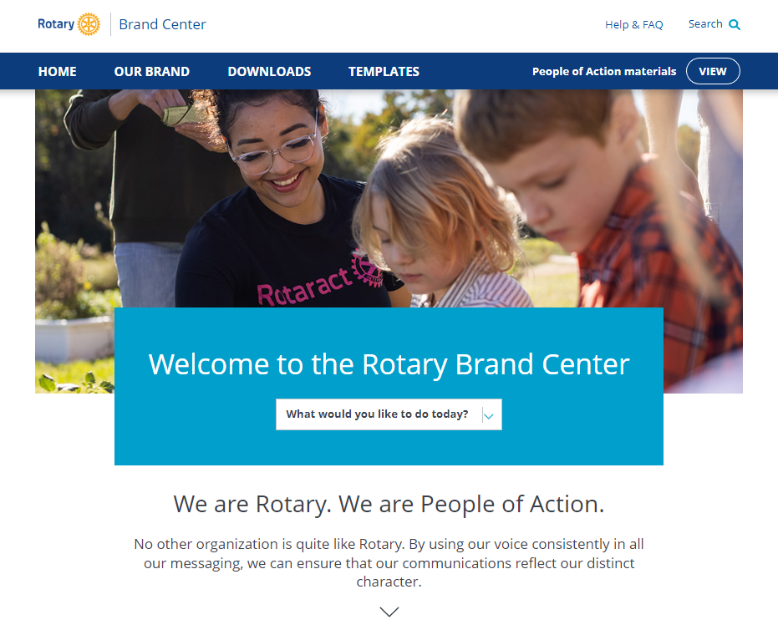

BRANDCENTER.ROTARY.ORG
Notes:
Has anyone visited our new Brand Center Recently? GOOD!
Rotary International has been investing heavily in resources to help us show who we are.
You can sort and find these much easier in the newly upgraded Brand CENTER

Slide 16
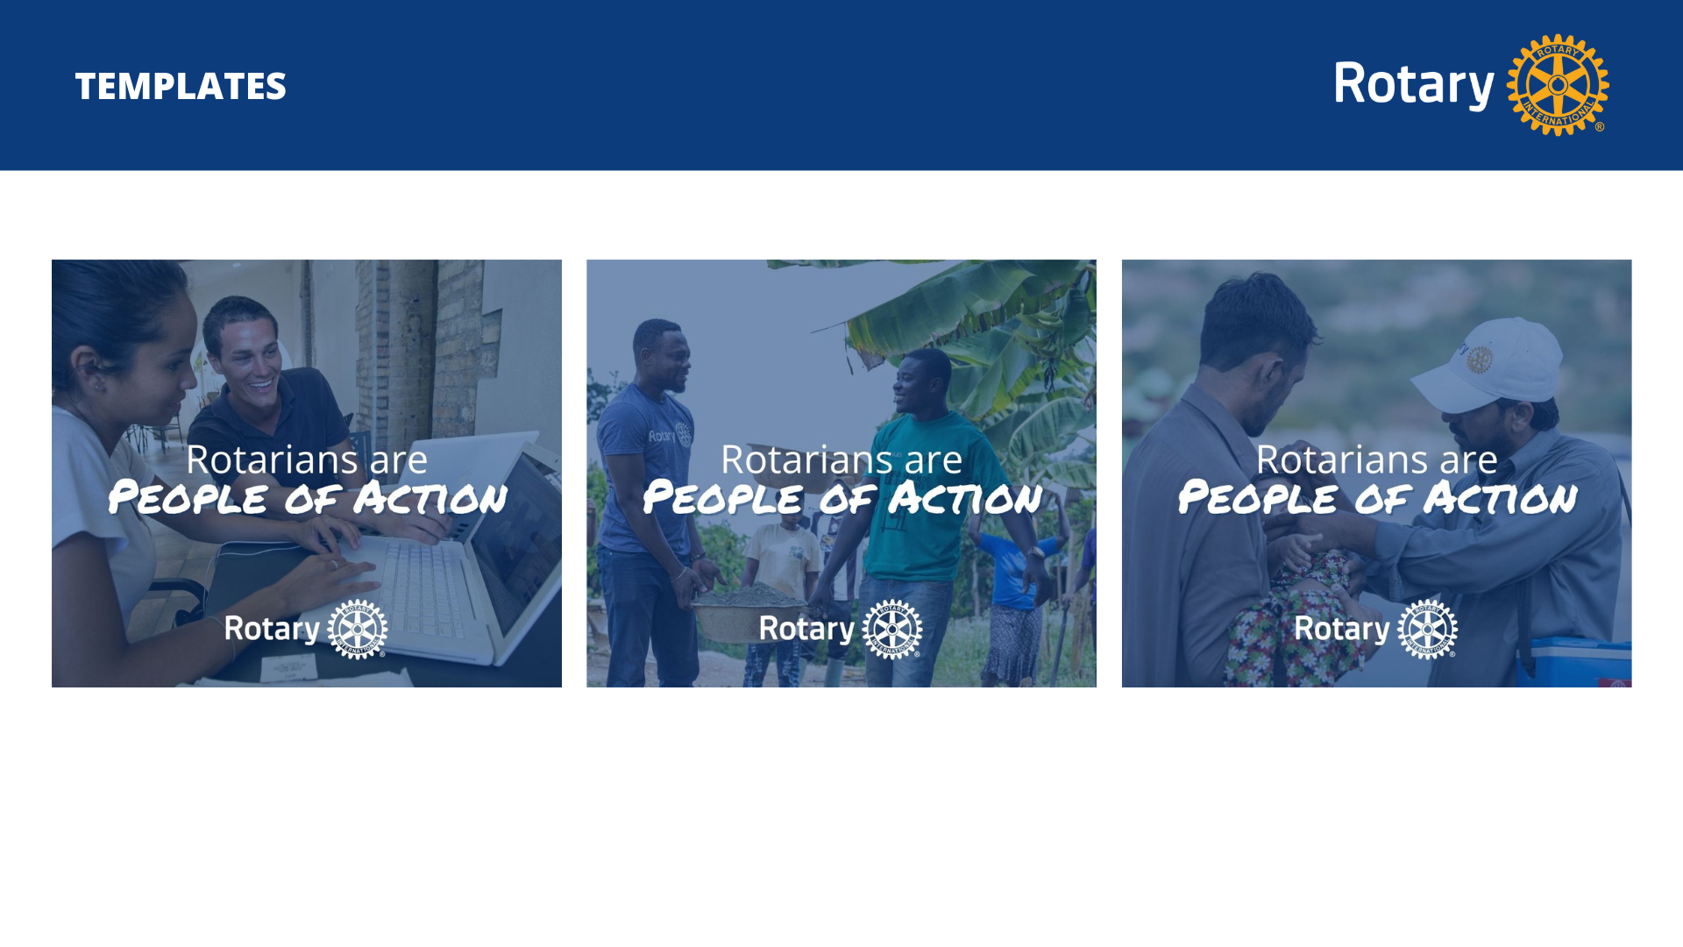

Slide 17
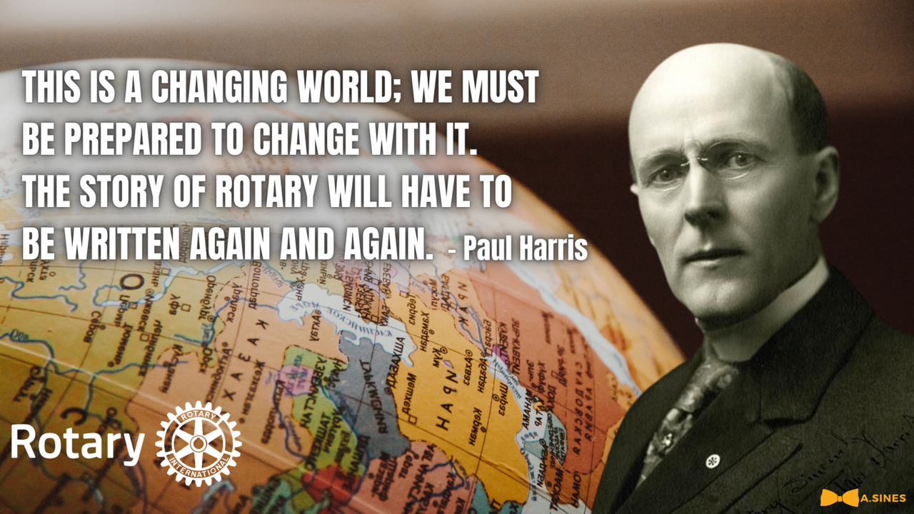

Slide 18


Slide 19

CREATIVITY
CREATES EXCITEMENT
EXCITEMENT
CREATES CHANGE!

Slide 20
SO WHAT IS
ROTARY

Slide 21
QUESTIONS

