Slide 2
HOW IT WORKS
ANNUAL FUND
50%
DISTRICT
DESIGNATED
FUND (DDF)
50%
WORLD FUND
~95% OF INVESTED
DOLLARS GOES TO
GRANTS
ALL GRANTS ARE MATCHED BY
RECEIVER AND MUST MEET
1 OF 7 AREAS OF FOCUS
OTHER
PROGRAM
OPPORTUNITIES
DISTRICT
GRANTS
GLOBAL
GRANTS
DISTRICT
PROGRAM
OPPORTUNITIES
POLIO
PLUS
FUND

Slide 3
District Grants
Funding is based upon District Share/Annual Fund giving 3 years ago.

Slide 5
District Grants
Clubs that have achieved $75.00 per capita in one of the last three years can apply

Slide 6
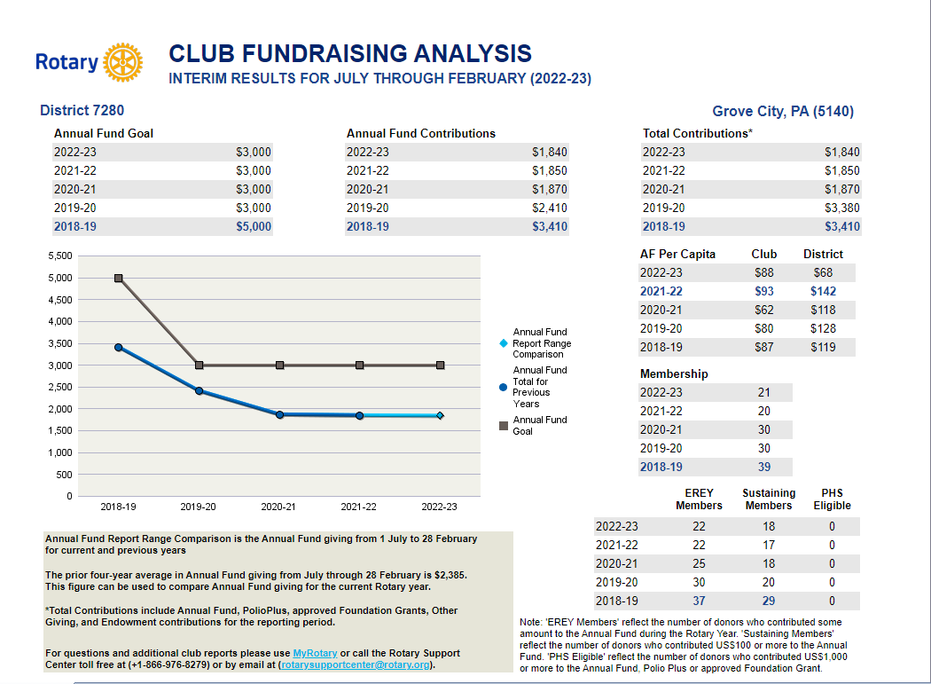

Slide 7
District Grants
District Grants are matching grants 1:1
Must meet the seven areas of focus – Education, Community Development, Disease Prevention, Maternal & Child Health, Peace Building, Water & Sanitation, Environment
Club President Elect and Foundation Chair, or another board member must attend District Grant Training every year

Slide 8
District Grant Training
District Assembly
Saturday, April 22, 2023
Quality Inn, Franklin, PA

Slide 9
THANK YOU

