Slide 1

GROWING ROTARY

Slide 2

GROWING ROTARY
HOW TO INCREASE YOUR CLUB’S VALUE
    ASSESS AND ADAPT
    ENGAGE CURRENT MEMBERS
    CONNECT WITH PROSPECTIVE MEMBERS
    MAKE NEW MEMBERS FEEL WELCOME
    CREATE AN INCLUSIVE CLUB CULTURE
    STRENGTHEN YOUR CLUB
    START A NEW CLUB

Slide 3
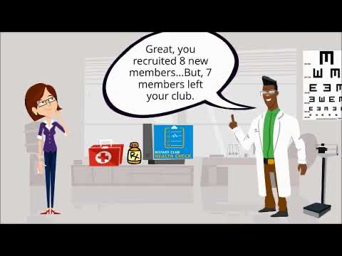

Slide 4
ASSESS AND ADAPT: THE NEW MEMBERSHIP PROGRESS REPORT
Membership Progress Report ^{2/1/2023} Consistent, moderate membership growth requires attracting new members in quantities sufficient to both replace the club’s historical average terminations (attrition) and moderately grow (approx. 5%-10%). • Attrition YTD: Number of terminations since July 1 • Attrition to Go: Number of additional terminations forecast, based on 3-year Average Attrition • Additional New Members to Break Even: Considering those already attracted and lost, additional new members needed to replace Attrition to Go (break even with July 1 member count)
Club Name | July 1 Members | Attrition Year-to- Date | New Members Year-to Date | Current Members | Net Gain (Loss) | Average Attrition | Attrition to Go | Add'l. New Members to Break Even
ABC Club | 16 | -2 | 4 | 18 | 2 | -3 | -1 | 0
XYZ Club | 20 | -2 | 4 | 22 | 2 | -5 | -3 | 1
Five Year History | 1-Jul-18 | 1-Jul-19 | 1-Jul-20 | 1-Jul-21 | 1-Jul-22
 | 21 | 21 | 21 | 20 | 20
ATTRITION … IT’S A HARSH REALITY

Slide 5

ACCESSING THE MEMBERSHIP SUCCESS CENTER
Step 1: Start on the DISTRICT Tab in DACdb
Step 2: Look for the MAP Database ICON
Step 2A: No ICON? Click the ‘CLOG’ ICON – located right beneath your name – to add it
Step 2B: Drag the MAP ICON to your ICON group
Step 2B: Click ‘Set My Configuration’
Step 3: Go Back to DISTRICT tab. Look for MAP ICON
Step 4: Click on MAP ICON, the MAP Database redirect opens.
YOU HAVE ENTERED THE
MEMBERSHIP SUCCESS CENTER!

Slide 6
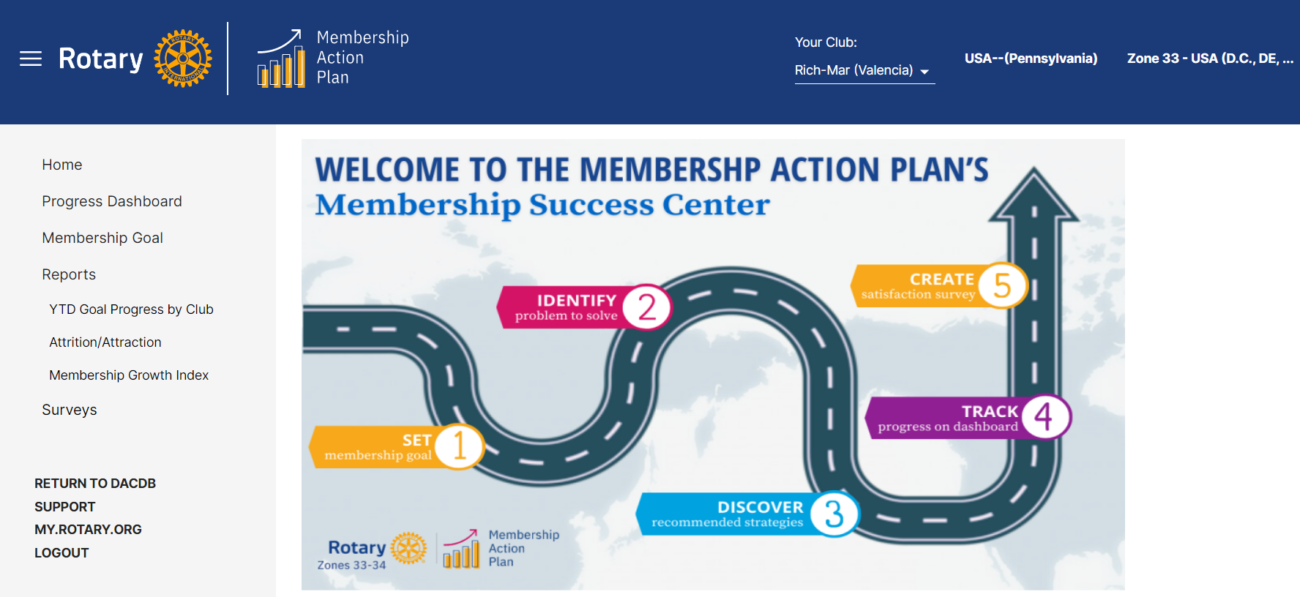
ASSESS AND ADAPT

Slide 7

Create a Membership Pipeline
Connect with Prospects
Become an
Irresistible Club
Meaningful Onboarding
Creating Clubs
for Today
Ask Us Anything

Slide 8

ASSESS AND ADAPT: TAKE THE CLUB HEALTH CHECK SURVEY
QUESTIONNAIRE SECTIONS:
✅
Club Experience
✅
Service & Socials
✅
Members
✅
Image
✅
Business Operations
✅
What’s Next?

Slide 9
ASSESS AND ADAPT
SET MEMBERSHIP GOALS
IDENTIFY ANY PROBLEMS
DISCOVER RECOMMENDED STRATEGIES
TRACK PROGRESS ON DASHBOARD
CREATE A MEMBERSHIP SATISFACTION SURVEY

Slide 10

GROWING ROTARY

Slide 11
GROWING ROTARY
Tools
Keep track of prospective member candidates
View Membership Lead Reports
Track your Club’s progress in DACdb/Rotary Club Central
Rotary support via:
District Membership Committee
District Governor or Area Governor
Regional Membership Officers

Slide 12
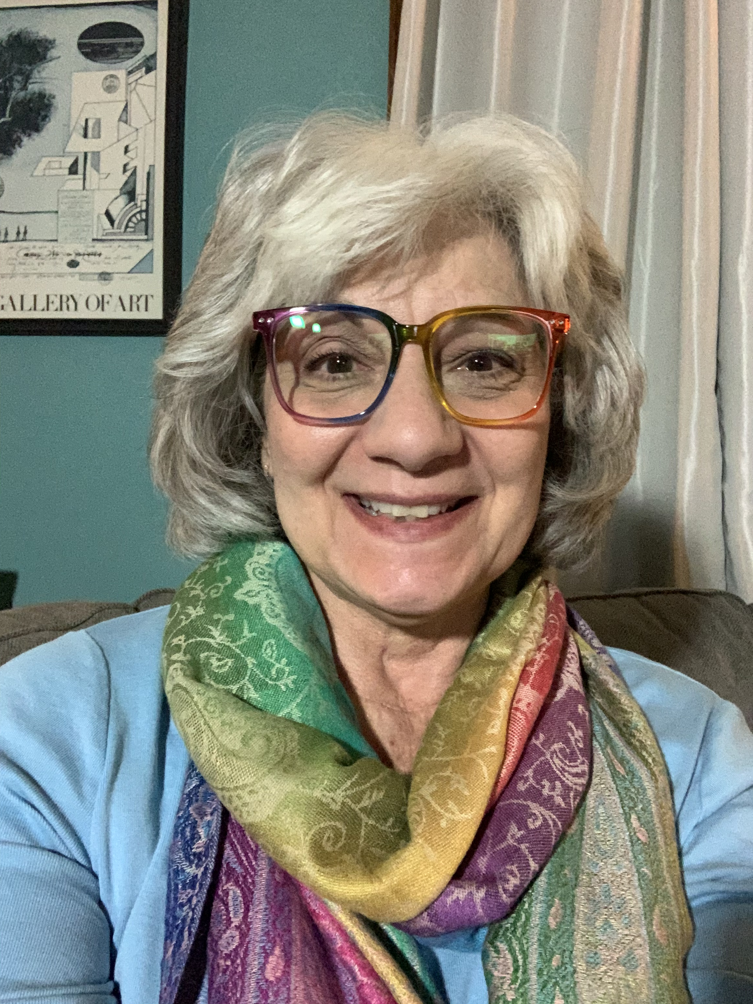
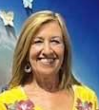
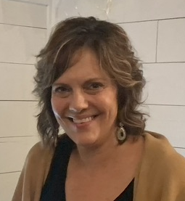
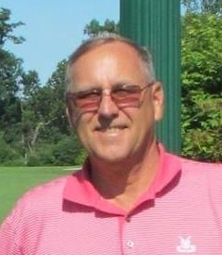
DISTRICT 7280 MEMBERSHIP TEAM
We are available for club programs, DACdb assistance
and just about anything related to helping you to grow Rotary!
KATHY CORCORAN, CHAIR
Zelienople Rotary Club
corcoran7667@gmail.com
724-513-3856
ELAYNE WILHEM
Cranberry Sunrise Rotary Club
FOCUS: MANAGING ROTARY LEADS
elaynepw@yahoo.com
724-462-0637
MICHELLE BAILEY
FOCUS: INNOVATIVE CLUBS
Keystone Satellite Club
michellebailey110@gmail.com
949-426-2244
PDG KEN FLEESON, DACdb GURU
FOCUS: INNOVATIVE CLUBS
Rich-Mar Rotary Club
kfleeson@lectromat.com
724-355-1619

