Slide 1
Rotary on the Web
Susan Crabtree
Reaching out through the Internet
and Social Media

Slide 2

In Brief
Web resources for Rotary members
Our club’s web presence
Other resources on the Web

Slide 3
Resources Available on the Internet for Rotarians

Slide 4
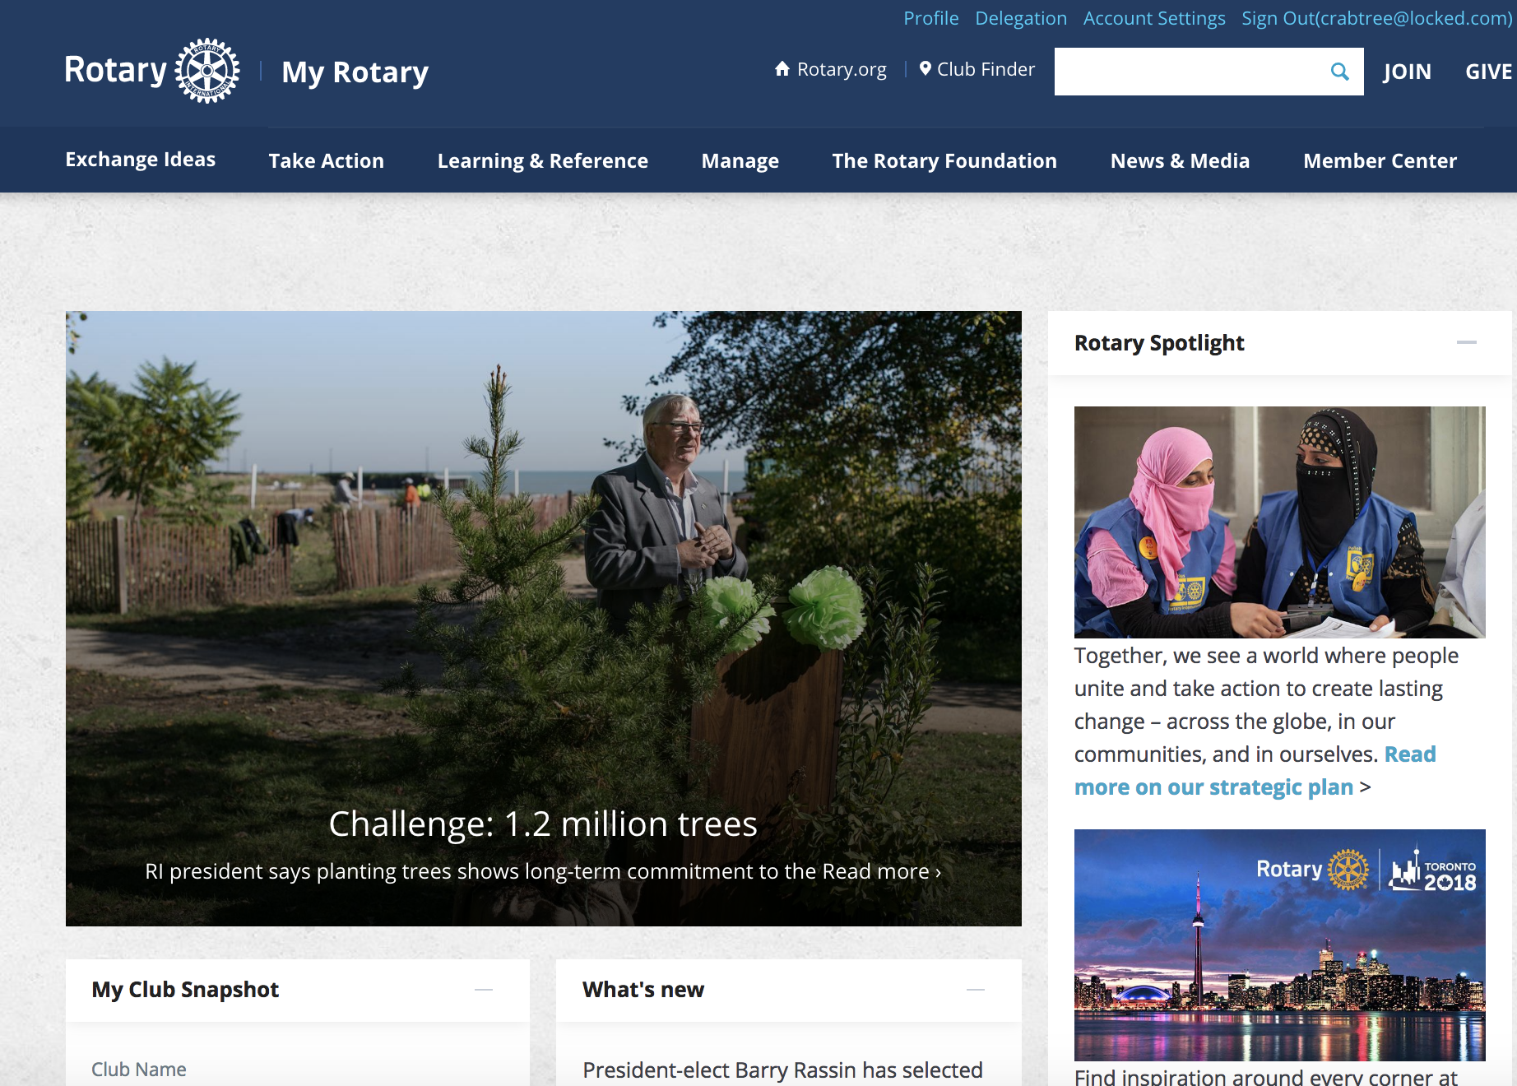
-------------------
Rotary International
------------------- my.rotary.org

Slide 5
-----------------
Rotary International
------------------- my.rotary.org
Requires a Login
WW Discussion Groups & Fellowships
Review Active Club Projects
  There are currently 630 active projects
  Our club can advertise projects here for help with volunteers and fundraising
Grant Center - to apply for and track the status of grants

Slide 6
-----------------
Rotary International
------------------- my.rotary.org
RI in the news
Rotarian magazine online
Branding and media tools
Membership and club resources
Tons of information and resources on RI and official causes

Slide 7
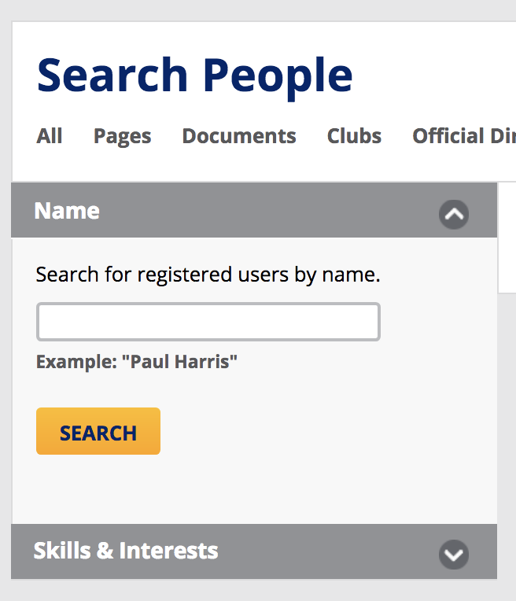
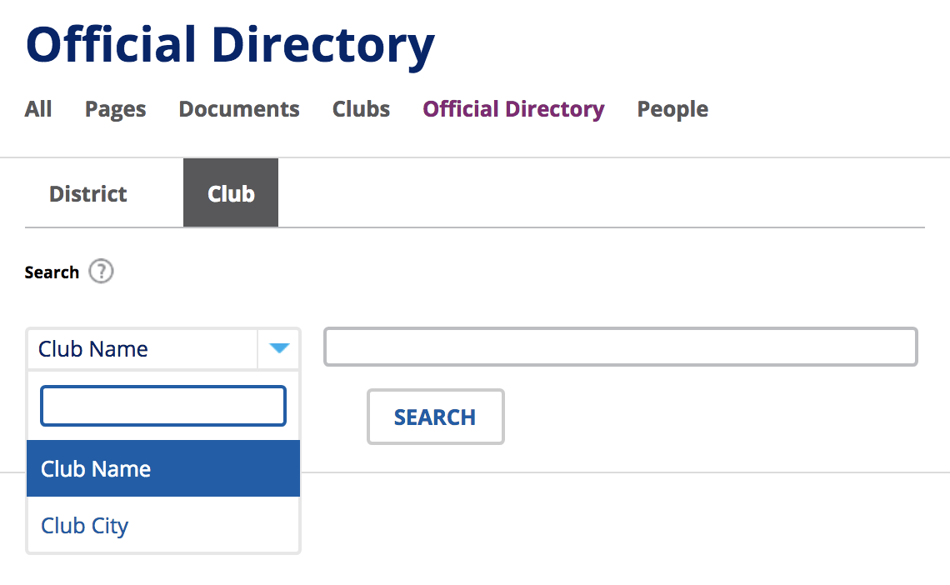
Find People and Clubs from all over the world
-----------------
Rotary International
my.rotary.org

Slide 8
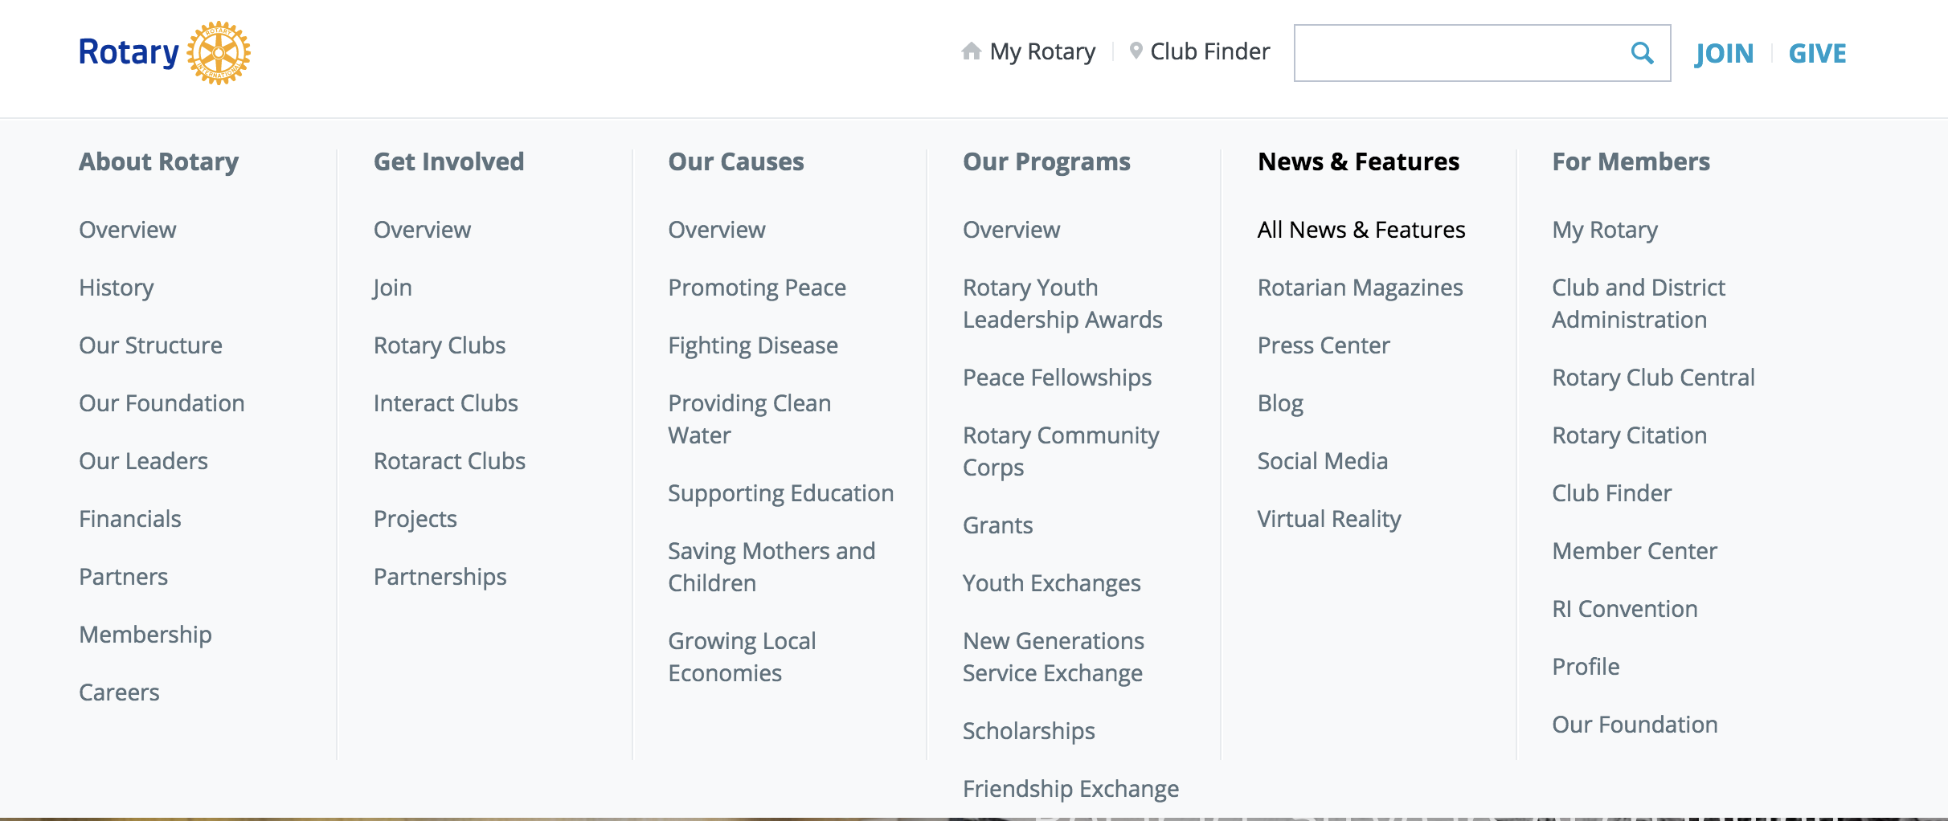

Slide 9
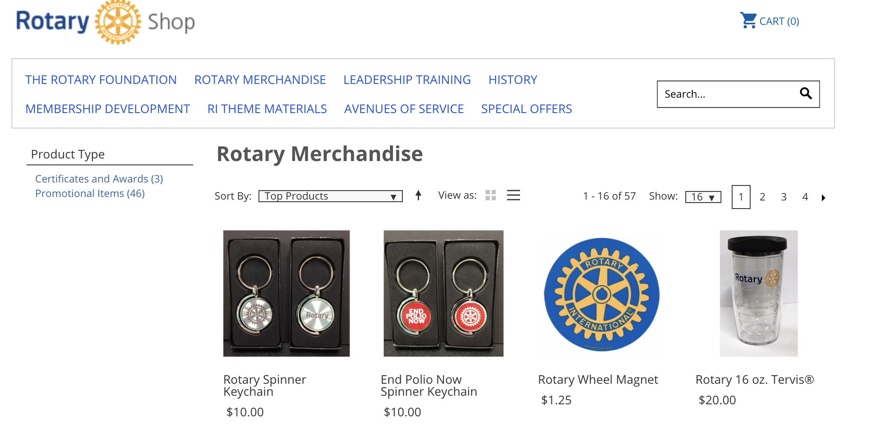
----------------- SHOP!
------------------- shop.rotary.org

Slide 10
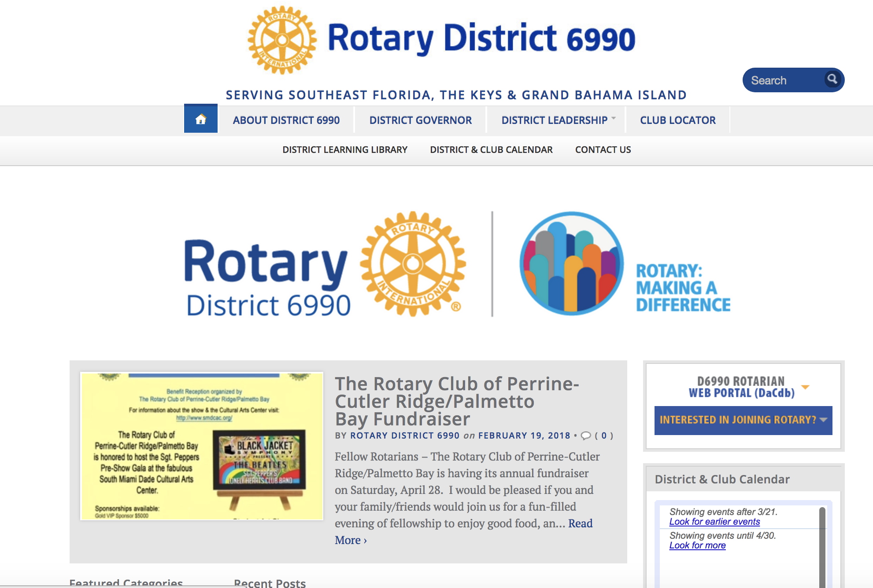
----------------- District 6990
Public Web Site
------------------- ri6990.org

Slide 11
----------------- District 6990
Public Web Site
------------------- ri6990.org
Rotary Club Finder
(links to RI Club Finder)
District Calendar
District Leadership
Front-end to DACdb web portal

Slide 12
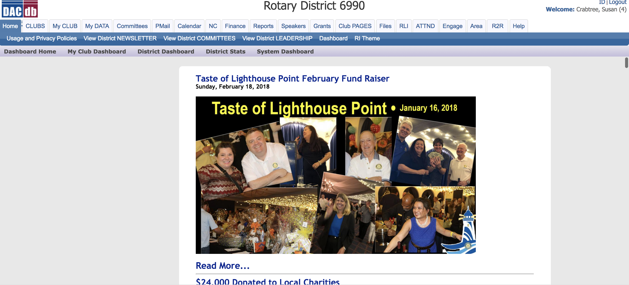
-------------------
District 6990
DACdb Web Portal
------------------- www. directory-online.com

Slide 13
-------------------
District 6990
DACdb Web Portal
------------------- www. directory-online.com
Requires a login
A resource related to our district
Detailed information on other clubs (members, officers, chairs, maps to meetings, newsletters, and more)
Read the district newsletter
Get access to district grant information

Slide 14
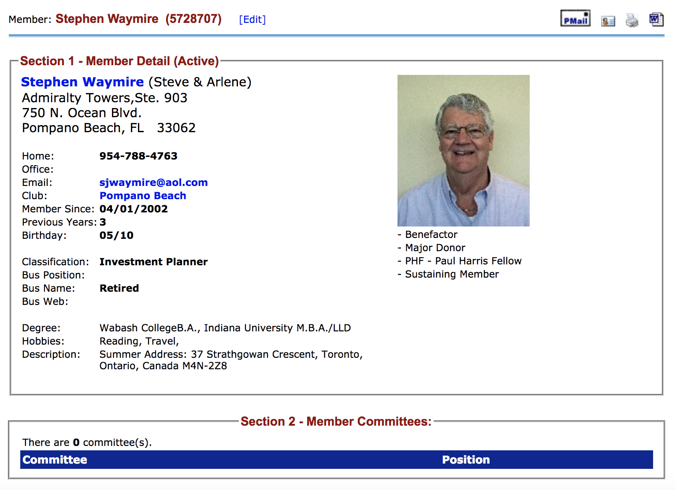
-------------------
District 6990
DACdb Web Portal
------------------- www. directory-online.com
Listing of all clubs in the district
Listing of all members with profiles

Slide 15
-------------------
District 6990
DACdb Web Portal
------------------- www. directory-online.com
Edit your own data – complete your profile
  Add picture, company information, bio
View attendance
See history of dues payments
Track district classes taken (RLI)

Slide 16
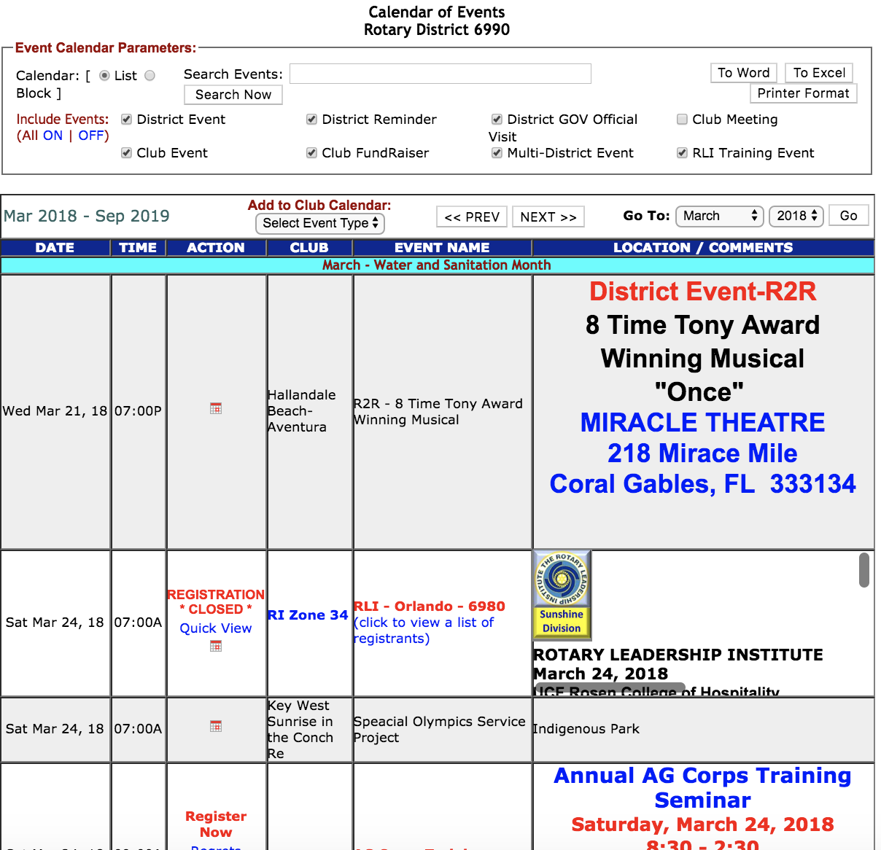
-------------------
District 6990
DACdb Web Portal
------------------- www. directory-online.com

Slide 17
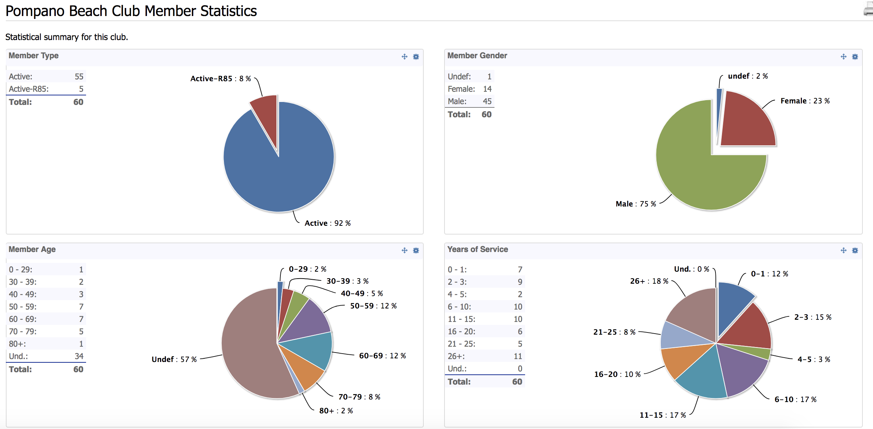
-------------------
District 6990
DACdb Web Portal
------------------- www. directory-online.com

Slide 18
Rotary Club of Pompano Beach on the Web

Slide 19
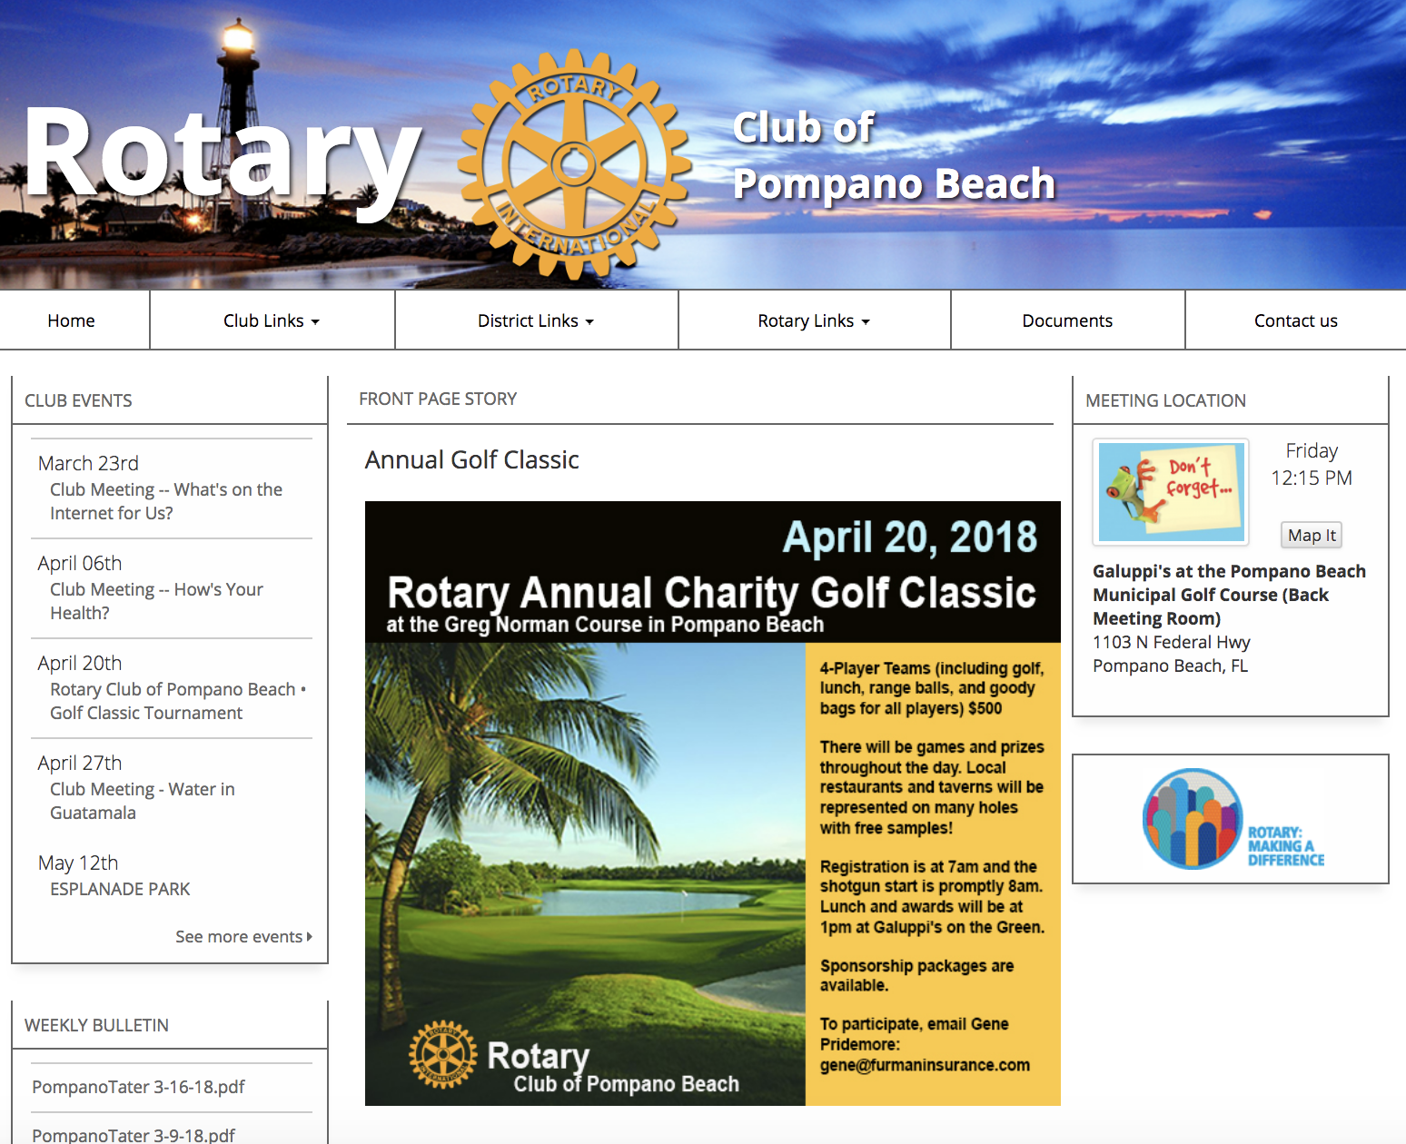
----------------- www.
PompanoBeachRotary
.com

Slide 20
----------------- www.
PompanoBeachRotary
.com
Information on our meetings and speaker
Information on upcoming events
Online copies of the PompanoTator
Stories and pictures
Links to basic Rotary information

Slide 21
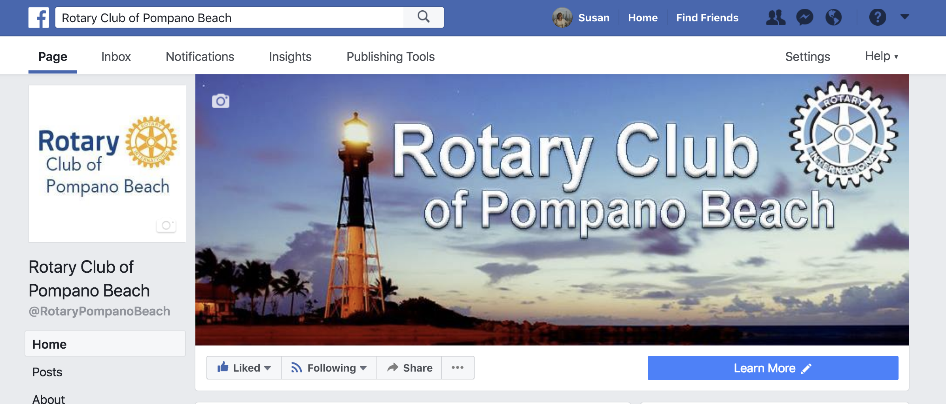

Our Club on Facebook
Like us on Facebook!

Slide 22

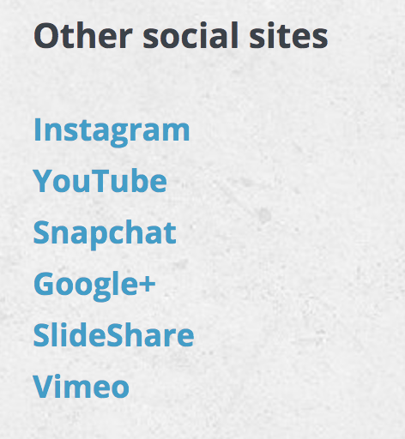
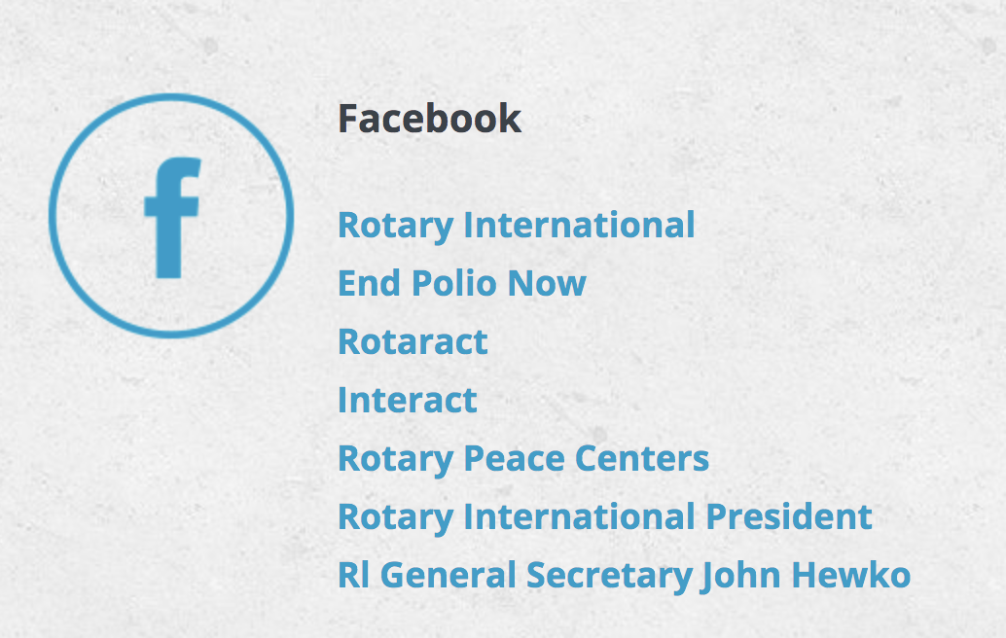

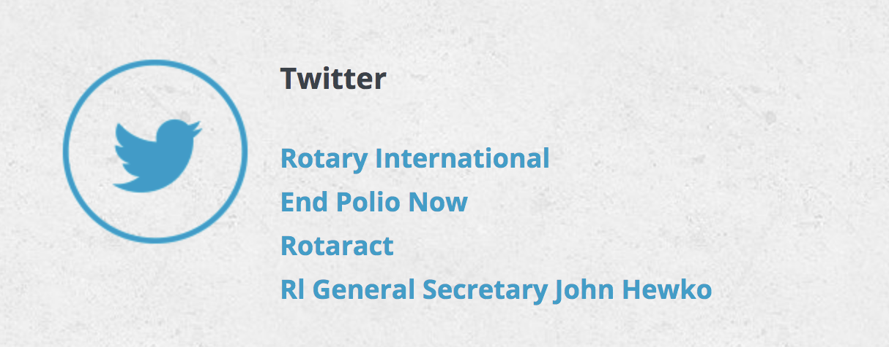
Other Resources on the Web

Slide 23

Thank You!

