Slide 2
Florida Rotary Districts Human Trafficking Prevention and Response Program (FRDGHTPRP)
October 26th, 2024

Slide 3
Problem
Florida’s diverse and growing population, along with its tourism-driven economy, makes it a key target for traffickers.
The state faces challenges due to its large immigrant and transient populations, which are particularly vulnerable to exploitation.
Despite existing efforts, there is still a need for more robust resources and coordination to combat this heinous crime effectively.

Slide 4
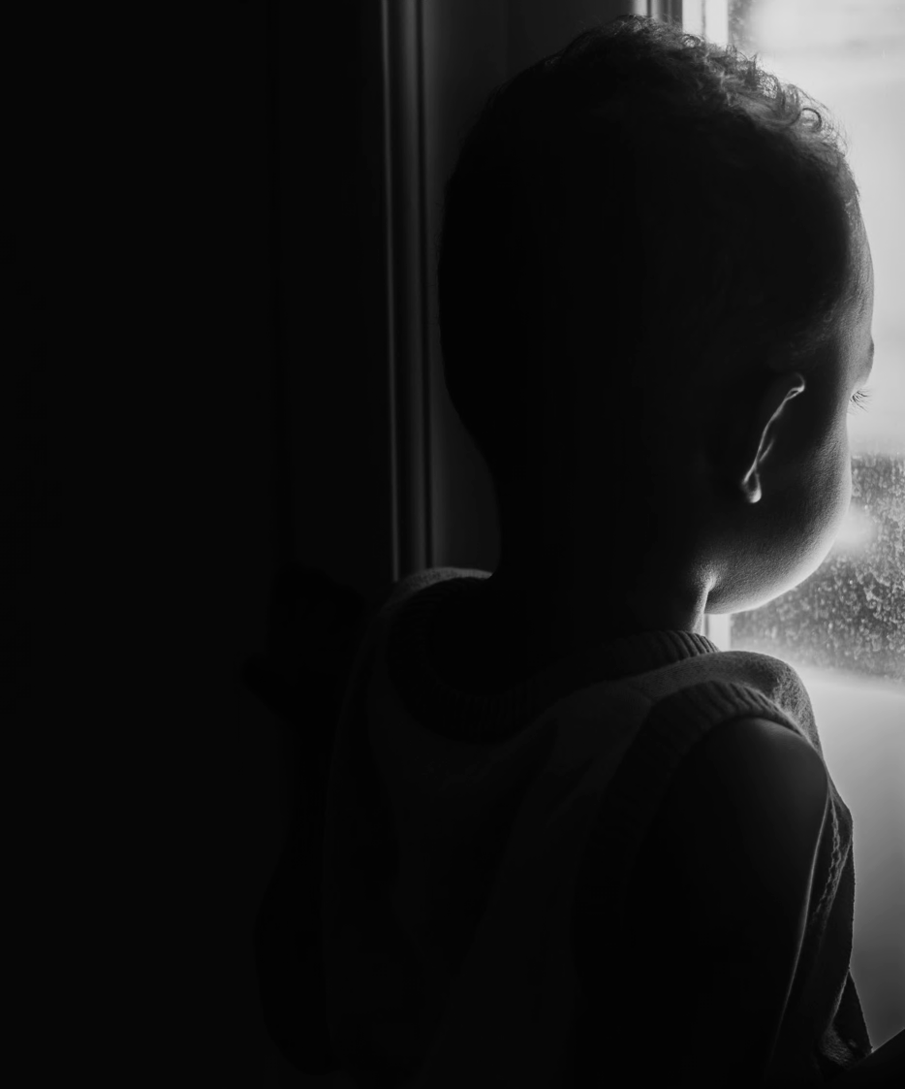
$236 B
Current valuation of the human trafficking industry
49.6 M
Enslaved people in the world today per the International Labor Organization
100 M
National Cyber Tipline reported images, videos and other child exploitation files (NCMEC)
#3
Florida ranks third in the amount of Calls and Reports

Slide 5
24
25

Slide 6
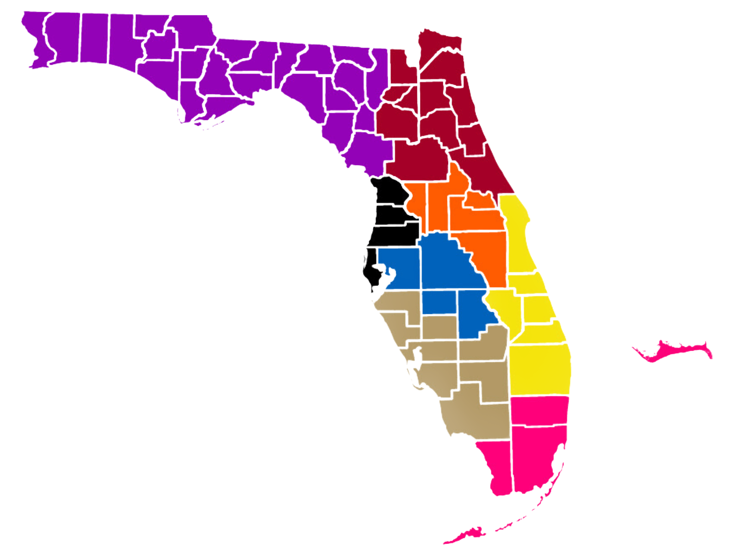
Our Team
3 Years of District Governor Support
Notes:
District 6890 – Central Florida (includes parts of Tampa Bay)
District 6930 – East Central and Southeast Florida (coastal areas including Vero Beach and Palm Beach)
District 6940 – Florida Panhandle (includes Tallahassee, Pensacola, and surrounding areas)
District 6950 – West Central Florida (includes parts of Tampa Bay, Clearwater, and St. Petersburg)
District 6960 – Southwest Florida (Naples, Fort Myers, and surrounding areas)
District 6970 – Northeast Florida (includes Jacksonville and St. Augustine)
District 6980 – Central Florida (includes Orlando and surrounding areas)
District 6990 – South Florida (includes Miami, Fort Lauderdale, and the Florida Keys)

Slide 7
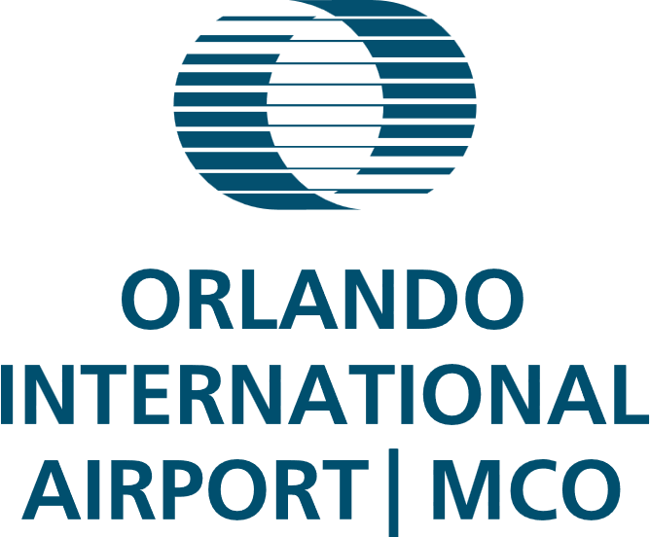
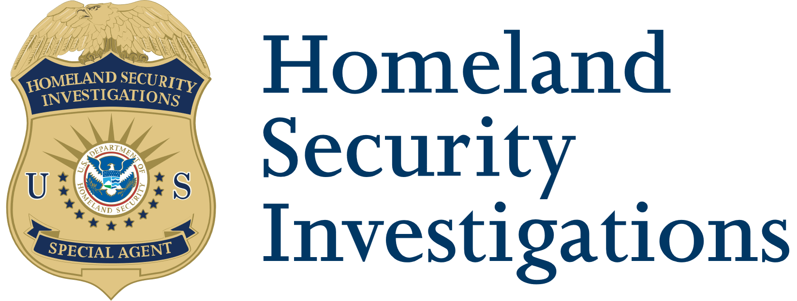
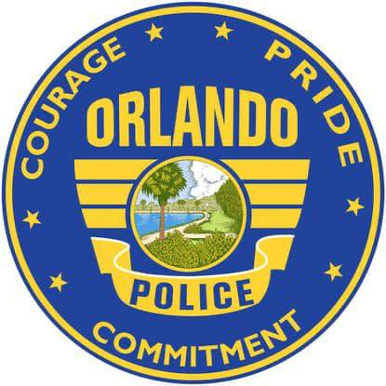
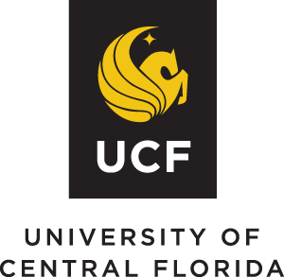
Our Coalition
Our coalition brings together professionals from various fields to coordinate efforts, raise awareness, and implement effective policies.
Notes:
Our coalition brings together professionals from various fields to coordinate efforts, raise awareness, and implement effective policies. This collaborative approach includes law enforcement, NGOs, and community leaders working together to tackle human trafficking from multiple angles. Our current partners include Orlando International Airport, the Orlando Police Department, Homeland Security Investigations, JetBlue Airlines, the University of Central Florida, the University of South Florida, Valencia College, and dozens of NGOs. The Greater Orlando Aviation Authority has generously provided a meeting space at Orlando International Airport,

Slide 8
Objective and Programs
Prevention and Education
Victim Support and Rehabilitation
Law Enforcement and
Prosecution Enhancement
Community Awareness
Notes:
Prevention and Education:
Develop and distribute educational materials to schools, tourism-related industries, and vulnerable communities.
Train at least 2,000 individuals, including law enforcement, educators, and healthcare workers, to recognize and respond to human trafficking.
Victim Support and Rehabilitation:
Establish or enhance support services for trafficking survivors, including housing, counseling, legal assistance, and job training.
Provide comprehensive, trauma-informed care for at least 300 victims over the 24-month project period.
Law Enforcement and Prosecution Enhancement:
Offer specialized training programs for law enforcement and legal professionals to improve investigation techniques and successful prosecutions.
Increase collaboration between local law enforcement, state agencies, and federal authorities to strengthen anti-trafficking enforcement.
Community Awareness:
Launch a statewide public awareness campaign aimed at increasing understanding of human trafficking and encouraging community engagement in prevention efforts.
Programs:
Prevention and Education:
Partner with school districts and community organizations to deliver human trafficking awareness programs to students, teachers, and administrators.
Work with the tourism industry (hotels, airports, etc.) to train staff in identifying potential trafficking victims.
Develop an online platform to provide accessible educational materials and resources.
Victim Support and Rehabilitation:
Collaborate with existing organizations that specialize in trauma care, mental health services, housing, and job placement to create a comprehensive support network for trafficking survivors.
Implement a case management system to track and support victims throughout their recovery process.
Law Enforcement and Prosecution Enhancement:
Conduct quarterly training sessions with law enforcement and judicial professionals, focusing on advanced investigation techniques, victim identification, and the legal aspects of trafficking cases.
Develop inter-agency task forces to foster collaboration between state and federal authorities.
Community Awareness:
Launch a multi-media campaign across television, radio, social media, and print to educate Floridians about the signs of human trafficking and how to report suspicious activities.
Organize community events, workshops, and forums to engage residents in anti-trafficking efforts.

Slide 9
Budget
3
Public and Community Partner Training & Collaboration (20% = $75,000)
Training for Public and Community Partners: $30,000
Florida Task Force Support & Coordination: $20,000
Resource Guides for Public and Community Partners: $25,000
Applicant Name: Florida Rotary Districts
Grant Amount Requested: $393,750
Project Duration: 36 months
4
Advocacy (10% = $37,500)
Advocacy Campaigns: $26,500
Stakeholder Meetings & Summits: $11,000
1
Awareness & Outreach (35% =$131,250)
Digital Media Campaigns: $45,000
Public Service Announcements (PSAs): $45,750
Print & Outdoor Advertising: $25,500
Website Development & Maintenance: $15,000
5
Administrative Costs (10% = $37,500)
Project Management: $15,000
Office Supplies & Operations: $18,000
Compliance & Reporting: $5,000
2
Prevention Programs (25% = $93,750)
Educational Workshops & Training: $43,750
Victim Support Hotlines: $15,000
Educational Materials (Brochures, Flyers, Posters): $35,000
Community-Based Partnerships: $10,000
6
Contingency Fund (5% = $18,750)

Slide 10
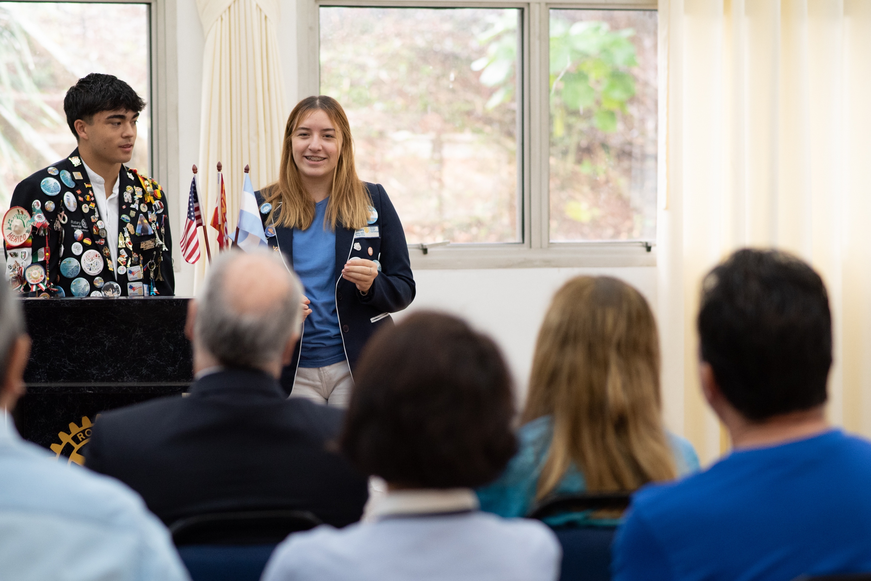
Reporting and Sustainability
Evaluation and Reporting:
Number of individuals trained.
Number of victims identified and assisted.
Law enforcement task forces established.
Number of public awareness materials distributed and engagement rates.
Sustainability:
Florida can make a lasting impact on reducing human trafficking and providing care for its victims.
This grant will enable the eight Rotary Districts in the state to take a bold, coordinated approach.
Notes:
Reporting and Sustainability
Evaluation and Reporting:
Progress will be monitored through key performance indicators such as:
Number of individuals trained.
Number of victims identified and assisted.
Law enforcement task forces established.
Number of public awareness materials distributed and engagement rates.
The project team will submit quarterly progress reports to the state detailing the outcomes and adjustments made to enhance effectiveness.
Sustainability
Working together with communities, organizations, and agencies, Florida can make a lasting impact on reducing human trafficking and providing care for its victims.
This grant will enable the eight Rotary Districts in the state to take a bold, coordinated approach that emphasizes prevention, victim care, law enforcement support, and public awareness.

Slide 11
Impact
“
You may choose to look the other way but you can never say again that you did not know.
~William Wilberforce

Slide 12
If you see something, say and do something.

