Slide 1
District Designated Funds
Presented at
2020
District 6980 Global Grant Seminar
Bob Shydo
DDF Administrator
DDF
July 9, 2020

Slide 2
Agenda
DDF Funding Cycle
How DDF Originates
How DDF is Distributed
DDF Transfer Form
DDF Tracking Form.

Slide 3
How DDF Originates
Club Contributions to the Rotary Foundation Annual Fund
Member Contributions to the Rotary Foundation Annual Fund
Member Commitments to the Rotary Foundation Annual Fund (when disbursed).

Slide 4
…Club Contributions
Club contributions to the Annual Fund
Clubs usually accomplish this by awarding Paul Harris Fellowships to members or by making outright contributions to the Annual Fund.

Slide 5
…Member Contributions
Contributions by club members to the Annual Fund
Member Annual Fund contributions count toward the following recognition opportunities:
Every Rotarian Every Year (EREY)
Rotary Foundation Sustaining Member
Paul Harris Fellow
Paul Harris Society
Major Donor
Arch Klumph Society.

Slide 6
Individual Contribution Form

Slide 7
Multiple Donor Form

Slide 8
…Member Commitments
Members can commit to contribute a fixed or variable amount to the Annual Fund in their will or trust
Benefactor
Commit $1,000 in will or trust
Bequest Society
Commit $10,000 or more in will or trust
note…….
The DDF is credited after the commitment is disbursed
to the Annual Fund.

Slide 9
DDF Funding Cycle
Rotarians and clubs make contributions to the Annual Fund each year.
After 3 Years:
50% of your club’s contributions goes to the World Fund (-5% of original amount to holding acct)
With Revenue Sharing
40% of your club’s original contribution is allocated to your club by the district for use this Rotary Year.

Slide 10
Change in Matching Funds 7/1/2020
Global Grant Matching Funds Change
“The Trustees of The Rotary Foundation have decided that World Fund resources will be used to match only District Designated Fund (DDF) contributions. This match will remain at 100 percent. The match on cash contributions to grants will be eliminated, effective 1 July 2020. Global grant applications that have been submitted but not yet approved on 1 July will still receive the World Fund match for cash contributions.”

Slide 11
DDF Allocation with Revenue Sharing
100% of contributions to Annual Fund
50% allocated to World Fund
50% allocated to the District as DDF
40% of Original Contribution allocated to Club
10% of Original Contribution remains with the District
$7,500
After 3 Years
-$187.50
$3,750
(5% of World Fund Allocation goes into Holding Account)
$3,750DDF
$3,000DDF
Through Revenue Sharing
$750DDF

Slide 12
DDF Transfer Form

Slide 13
DDF Transfer Form
– Transferring Club
Notes:
To work with the forms on this & the following pages you need to have the forms in JPEG format.
Insert – photo from file
Point out that this is a fill-in PDF form that can be saved and/or emailed to the president for printing & signature

Slide 14
DDF Transfer Form – Transferring Club
All sections must be completed correctly for transfer request to be processed
Notes:
To work with the forms on this & the following pages you need to have the forms in JPEG format.
Insert – photo from file
Point out that this is a fill-in PDF form that can be saved and/or emailed to the president for printing & signature

Slide 15
DDF Transfer Form - Example

Slide 16
DDF Transfer Form
– Receiving Club
Notes:
To work with the forms on this & the following pages you need to have the forms in JPEG format.
Insert – photo from file
Point out that this is a fill-in PDF form that can be saved and/or emailed to the president for printing & signature

Slide 17
DDF Transfer Form – Receiving Club
Receiving District and Rotary Club along with the Grant Name or Description and Grant Number are required to be completed correctly for transfer request to be processed.
Notes:
To work with the forms on this & the following pages you need to have the forms in JPEG format.
Insert – photo from file
Point out that this is a fill-in PDF form that can be saved and/or emailed to the president for printing & signature

Slide 18
DDF Transfer Form - Example

Slide 19
DDF Transfer Form – Verification
Notes:
To work with the forms on this & the following pages you need to have the forms in JPEG format.
Insert – photo from file
Point out that this is a fill-in PDF form that can be saved and/or emailed to the president for printing & signature

Slide 20
DDF Transfer Form – Verification Info
“Processed"
Date Processed
DDF Amount
Initials

Slide 21
DDF Transfer Form - Example

Slide 22
DDF Transfer Form - Example

Slide 23
DDF Tracking Form

Slide 24
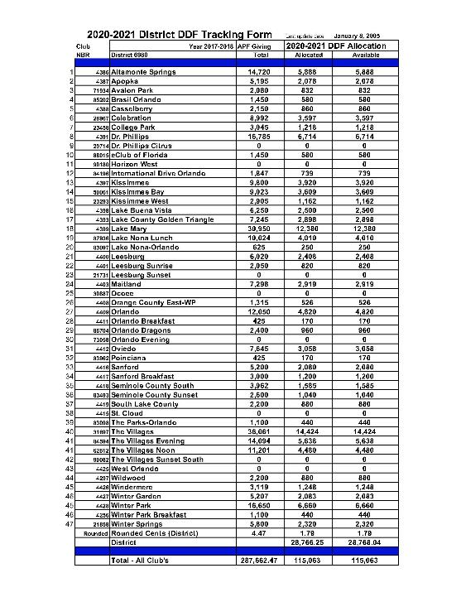
Notes:
Need to convert the PDF file to a JPG file to do an insert photo, then move the DF tracking form to back.

Slide 25
DDF Tracking Form Explained
Rotary year for this DDF allocation Report
Notes:
Crop top of DDF Tracking form and save, then save as JPG, then insert picture from file. Size picture so it looks good and aligns with the arrow and/or move arrow to align properly, then set to view guided, set guides to DDF transfer form boarders so following slides will be aligned the same way.
I found that it may be easier to just create the first instance of this series to the point that the slide appears how you want to present it. Then just go down the line duplicating the slide and copying the title from the next slide and moving the arrow to correspond to the text, then deleting the previous year’s slide.

Slide 26
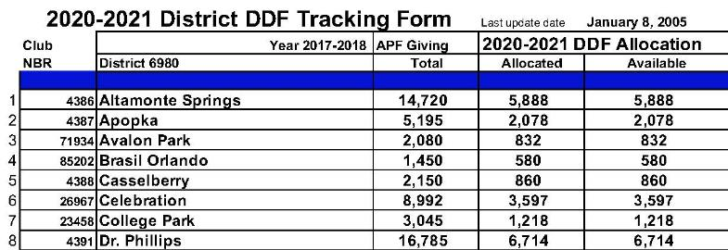
DDF Tracking Form Explained
Date of last DDF Tracking Form update

Slide 27
DDF Tracking Form Explained
Annual Program Fund (APF) contribution year

Slide 28
DDF Tracking Form Explained
Rotary year for this DDF allocation

Slide 29
DDF Tracking Form Explained
Club number

Slide 30
DDF Tracking Form Explained
Club Name

Slide 31
DDF Tracking Form Explained
Club’s contribution amount to the Annual Program Fund (APF)

Slide 32
DDF Tracking Form Explained
Club’s allocated DDF for the designated Rotary year
(APF Giving Total x .40 = Allocated)

Slide 33
DDF Tracking Form Explained
Club’s current available DDF
(Allocated – any DDF transfers (Grants, Polio Plus etc.))
(As of the “Last Update Date)

Slide 34
DDF Tracking Form Explained
Tracking for individual clubs

Slide 35
Just to reiterate
Club’s get 40% of club and member contributions to the Rotary Foundation’s Annual Fund (after 3 years)
Club’s can leverage funding with Global Grants by having other clubs and Districts contribute DDF to their Global Grant
The Rotary Foundation’s World Fund matches 100% of all DDF used in Global Grants

Slide 36
…Why Contribute to Annual Fund
You as a member receive Paul Harris Fellow and ERAY or Sustaining Member Credit
With revenue sharing your club receives 40% of club & member contributions to use for Grants (after 3 years)
Can you name any other 501(c)(3) that returns 40% of your contribution for you to use internationally or locally via grants?.

Slide 37
QUESTONS???
Bob Shydo
rotary@shydo.net
407.497.8111

