Slide 1
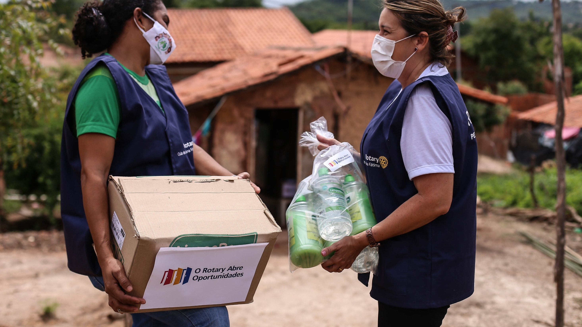
global GRANTS
MICHAEL FRANKLIN (DRFC)
Alex Sacharoff
DISTRICT INTERNATIONAL SERVICE CHAIR
Notes:
Introduction. Alex Sacharoff, Active in many district roles in The Rotary Foundation since 2012
Overview of grantts

Slide 2
GLOBAL Grants PROCESS
  Global Grant applications submitted on rolling basis
  Clubs leading grants must be qualified
  Lead club (international sponsor) is responsible for raising the funds to meet global grant budget
  Clubs with DDF may choose to contribute some of their DDF and or CASH to your global grant
  Other districts in the world including host district may also contribute DDF and or CASH
Notes:
Here is some information on Grants volume:
The average number of grants an RGO oversees from submission to closure: 206
The Global grant approval rate (for RY22 to date): 92% (8% decline rate)
As you can see, we deal with a high volume of grants... Applications are submitted on a rolling basis. We work closely with sponsors to get an application to an approval status because the last thing we want to do is decline a grant application. Turnaround time depends on how complete an application is upon submission.

Slide 3
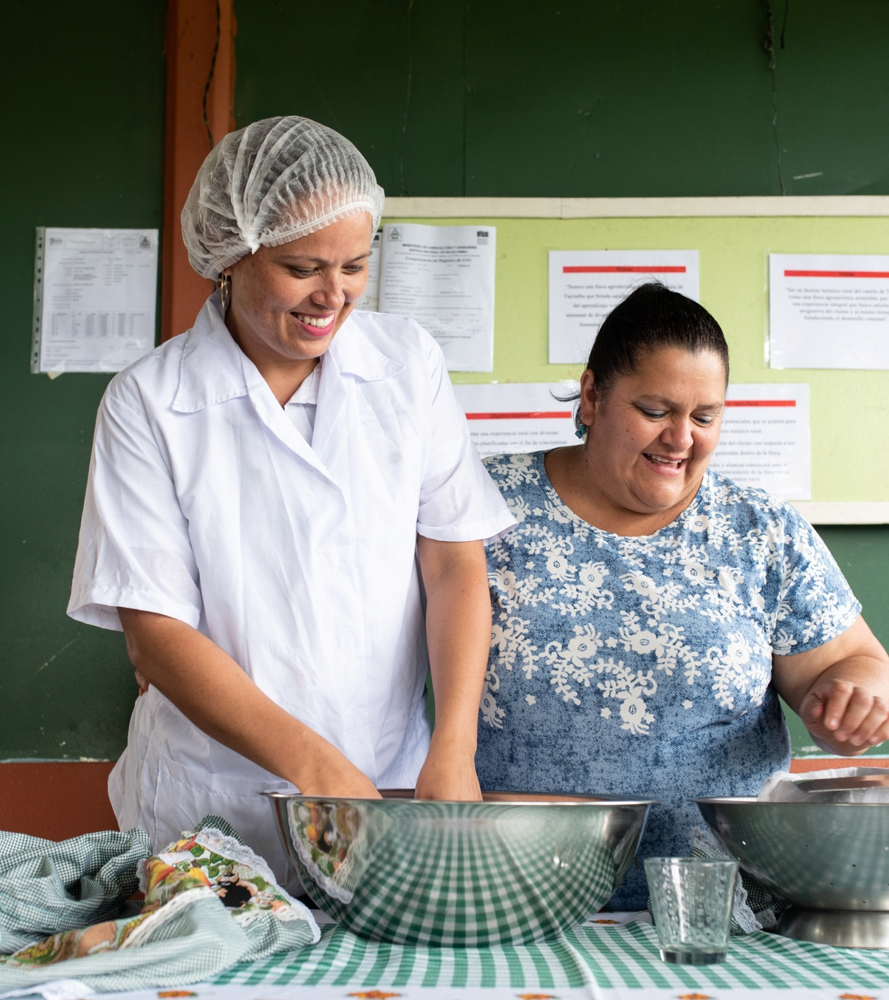
subhead
GLOBAL GRANTS
Must align with an area of focus
Based on community assessment
Sustainable, measurable results (often through human capital)
80% match World Fund : DDF
Minimum budget: US$30,000
15% of contributions (before match) from outside host country.
Notes:
Global Grants support large international activities with sustainable and measurable outcomes in Rotary’s areas of focus.
These activities can be humanitarian projects, scholarships, or vocational training teams. The scholarships support graduate-level academic study for one to four years. Global grant vocational training teams support groups of professionals who travel abroad to provide or receive training.
A key feature of global grants is the partnership between the club or district where the project will take place and a club or district in another country. Both sponsors must be qualified before they can apply for a global grant.
Global grants have a minimum budget of $30,000 and a maximum World Fund award of $400,000. There’s no minimum World Fund award amount. Grant sponsors can use a combination of DDF, cash, or directed gifts and Endowment earnings to fund a global grant. The Foundation will match 80 percent of all DDF contributions. 15% of contributions must come from outside the host country.

Slide 4
GLOBAL GRANT CENSUS
July 2014 until August 2023
Clubs with Global grants in past 9 years | # for each club
Altamonte Springs | 1
College Park | 2
Dr. Phillips | 1
E-club of Florida | 1
Lake Buena Vista | 2
Lake Nona Lunch | 1
Maitland | 2
Oviedo | 1
Seminole County Central | 2
Seminole County South | 1
The Villages | 5
The Villages-Evening | 1
Winter Park | 2
Grand Total | 22

Slide 5

AREAS OF FOCUS
Peacebuilding and conflict prevention
Disease prevention and treatment
Water, sanitation, and hygiene
Maternal and child health
Basic education and literacy
Community economic development
Environment
Notes:
Rotary concentrates on specific causes in order to maximize our local and global impact. These are our areas of focus. Through global grants, we help clubs focus their service efforts these important areas.
Peacebuilding and conflict prevention
Disease prevention and treatment
Water, sanitation, and hygiene
Maternal and child health
Basic education and literacy
Community economic development
Environment
The environment is our newest area of focus, and clubs and districts can apply for global grants for projects that protect the environment.

Slide 6
D6980 Global Grant Activity(9 years)
Global Grants stratified by Area of Focus
Area of Focus | Cancelled | Approved | Closed | Draft | Submitted | Totals
Peace Building and Conflict Resolution | 1 | 0 | 0 |  |  | 1
Disease Prevention and Treatment | 2 | 4 | 7 | 1 | 1 | 15
Water, Sanitation and hygiene |  | 3 | 1 |  |  | 4
Maternal and Child Health | 2 | 4 | 6 | 1 |  | 13
Basic Education and Literacy | 3 | 1 |  |  | 1 | 5
Community economic development | 1 |  | 1 |  |  | 2
Environment |  |  |  |  |  | 0
 |  |  |  |  |  | 40

Slide 7

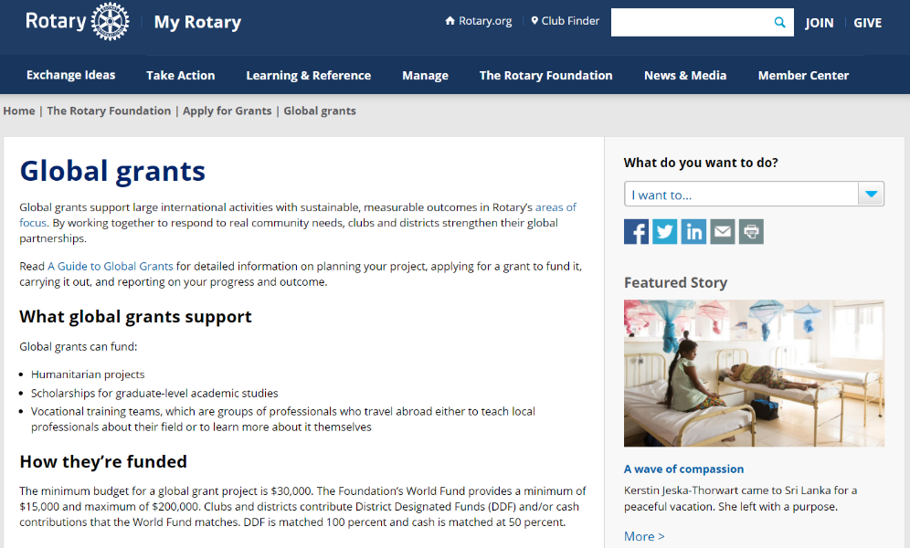
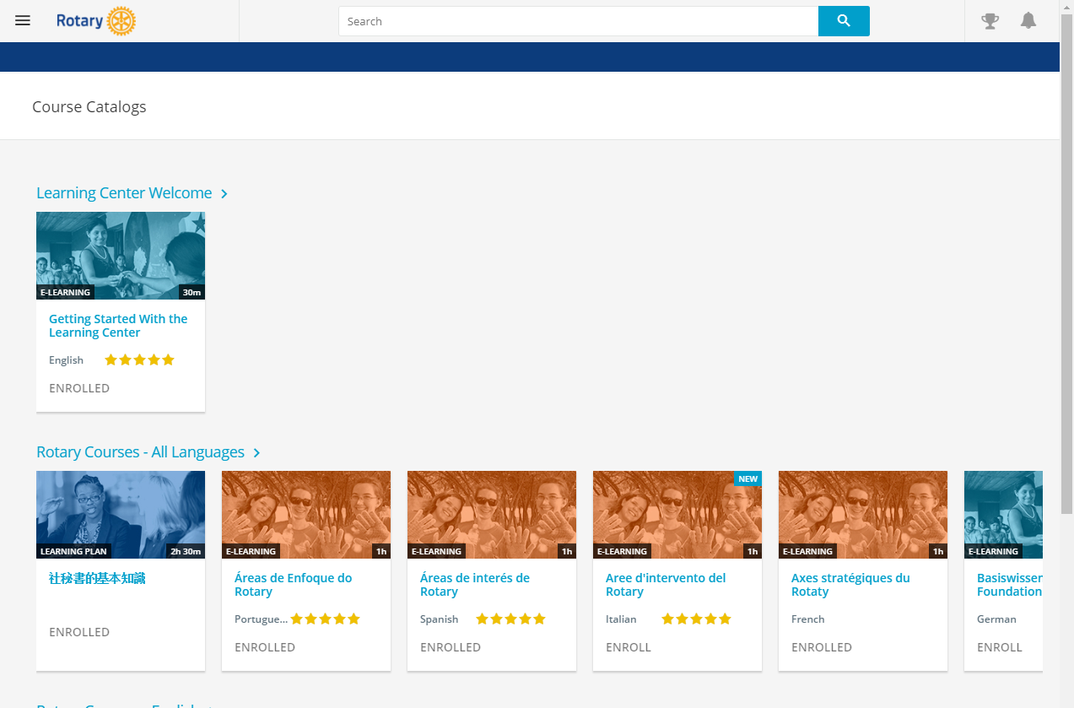
10 Ways to improve your GLOBAL GRANT application
Conduct a Community Assessment
Consult resources
Select an Area of Focus
Request a pre-review
Include an implementation plan
Prepare an itemized budget
Explain sustainability plan
Measurement & Evaluation plan
Cooperating Organization MOU
Provide complete answers
Notes:
The first and most important step when you’re developing a project is to conduct a thorough community assessment. This assessment explores the community’s strengths, weaknesses, needs, and assets. It’s essential to planning an effective project. Rotary’s Learning Center offers training resources on many grant-related topics, including information to help you apply. I encourage anyone interested in applying to take the grant management seminar courses.
Another resource is your district’s Rotary Foundation committee. This committee educates clubs about Foundation grant and fundraising activities, inspires them to participate in grants, helps clubs with the grant process, and can advise about whether certain activities are eligible for grant funding.
You also can talk to members of the Rotary grants staff throughout the process. They can answer questions about global grant eligibility and project design. If you have a general idea about a project you’d like to fund with a global grant, you can ask your regional grants officer to conduct a preliminary review of your application. They’ll let you know if there are issues that need to be addressed before you formally submit your application in the Grant Center. The rest are all the basic requirements of a global grant application, such as the implementation plan, budget, sustainability component such as training, Measurement and Evaluation, and the MOU if your are working with a cooperating organization. Finally, always provide complete answers to the questions in the application.

Slide 8
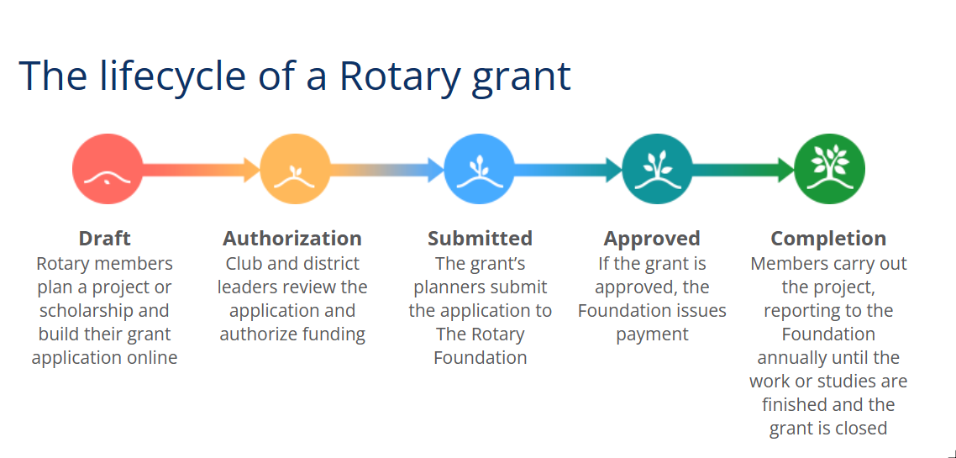

Slide 9
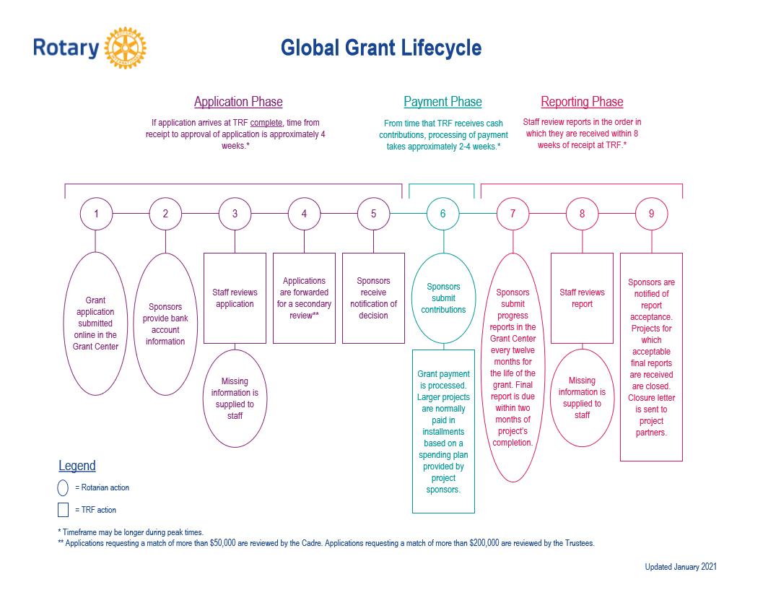

Slide 10
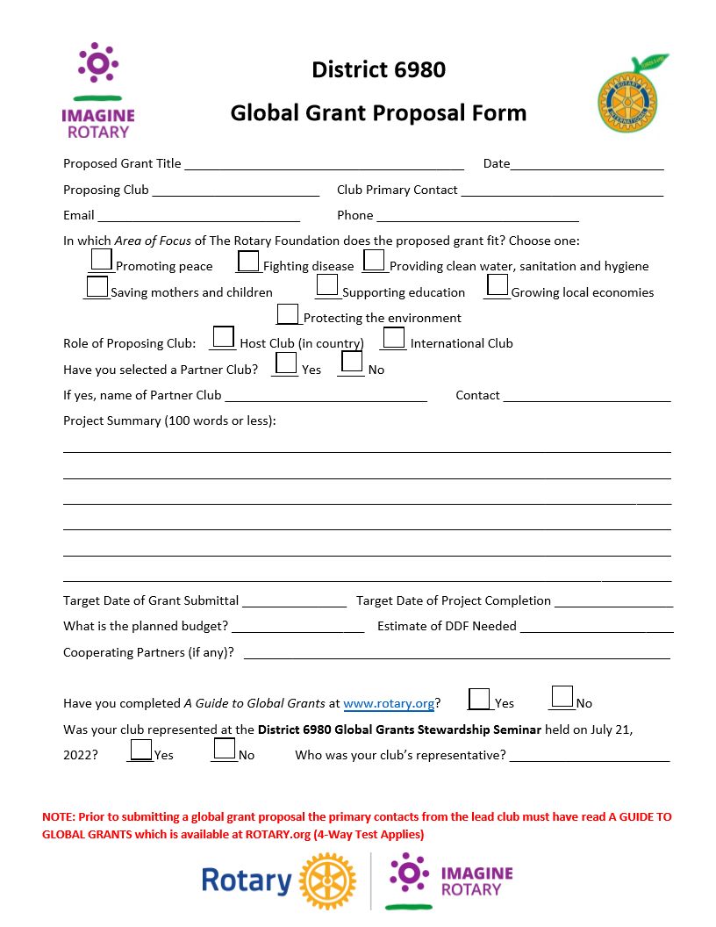
Grant Proposal

Slide 11
OVERALL Best practices for successful applications
  Attend the Grant Management Seminar
  Review Area of Focus Global Grant Guidelines and Area of Focus Policy Statements
  Connect with a Regional Grants Officer (Staff Contact Sheet is on www.rotary.org)
  Connect with a Cadre member and regional or district leaders (cadre@rotary.org)
  Include both a sustainability plan and a robust training plan
  Complete a community assessment
Notes:
Best practices for successful applications: read application before submitting (fields are completed), community assessment (upload community assessment results form to application), have a non-Rotarian review application to see if they have any questions, review AoF global grant guidelines, Guide to GGs, ensure project committee takes GMS in Learning Center, read parameters for eligibility in AoF Policy Statements, reach out to RGO before submitting application/preliminary review, connect with district leaders if you have any questions, connect with Cadre, don't assume project will be approved/don't promise community (can note this for Cadre as well on another slide), submit sustainability component, usually a robust training plan that aligns with the proposed Area of Focus
Background/context on a preliminary review
This is definitely an area where Cadre members can assist with preliminarily reviewing grant applications that are in progress. We often coach more preliminarily and we dedicate more time to helping sponsors design an eligible global grant. We want to coach Rotarians towards developing more sustainable projects rather than trying to have their projects simply fit Area of Focus requirements. We take more calls, have a lot back and forth communication with sponsors. Zoom calls have proven to work very well! Cadre members are experts like our Area of Focus Managers and can also assist with designing applications.

Slide 12
CADRE OF TECHNICAL ADVISERS
  The Rotary Foundation Cadre of Technical Advisers is a group of Rotary members who volunteer to use their professional skills and technical expertise in Rotary’s areas of focus or financial auditing to advise Rotary members who are planning and working on Rotary Foundation grant projects. The Cadre is composed of more than 500 members from 75 countries who speak more than 80 languages.
Cadre members can assist your project by:
Providing project planning advice and implementation guidance
Designing community assessments
Incorporating elements of sustainability into projects
Establishing monitoring and evaluation plans
Answering questions about Rotary’s areas of focus
Providing financial management best practices
The Cadre’s mission is to strengthen the impact of Rotary’s grants by assisting Rotary members in planning projects and safeguarding Foundation funds.
Notes:
Serve as consultants to Rotary staff and Rotary members who are planning and implementing grant projects
Assist The Rotary Foundation Trustees with the grant funding process by reviewing grant applications
Evaluate the implementation of projects that have been funded by Foundation grants to ensure that the funds are being used properly
Perform programmatic audits to ensure that Foundation grant funds are being used in accordance with the terms and conditions for Rotary grants and that stewardship guidelines are followed
Carry out evaluations and interviews associated with Rotary’s Grant Model Evaluation as well as other Rotary initiatives and partnerships

Slide 13

2021-22 GRANT STATISTICS
Global grants
1,197 grants
$76.9 million
Notes:
Here are the statistics from the 2021-22 Rotary year. We awarded:
478 district grants with awards of $28.7 million
1,197 global grants with awards of $76.9 million
228 disaster response grants with awards of $7.9 million

Slide 14
WORLDWIDE Grant statistics as of 30 MARCH 2023 (22-23 Rotary YEAR)
Grant type | Applications approved | World Fund approved | Total funding approved
Global grants | 633 | $10,972,028 | $39,019,232
Notes:
Grants awarded for the 2022-23 Rotary Year so far.

Slide 15
QUESTIONS

