Slide 1
Palatka Member Satisfaction: Any need for change?
July 26, 2016
Results from May 2016 Rotary Satisfaction Survey

Slide 2
Response Rates were better than expected, but lower than desired
A 50% response rate, or above, is desirable to assure that the respondents are representative of the club.
27% of Palatka members responded. (19)
Notes:
The Palatka response rate in 2016 was slightly lower than we had in our 2014 survey (26).
34 clubs exceeded 50% response rate.

Slide 3
DEMOGRAPHICS OF CLUB

Slide 4
About 40% of Palatka Respondents were over 60
This group of retiring Baby Boomers is one of the two new sources of volunteers.
RI is working to make Rotary more attractive to younger people since we will need replacements. Millennials are the biggest generation now.
Notes:
Over 60 members are RED bars

Slide 5
Where will we find new Rotarians?

Slide 6
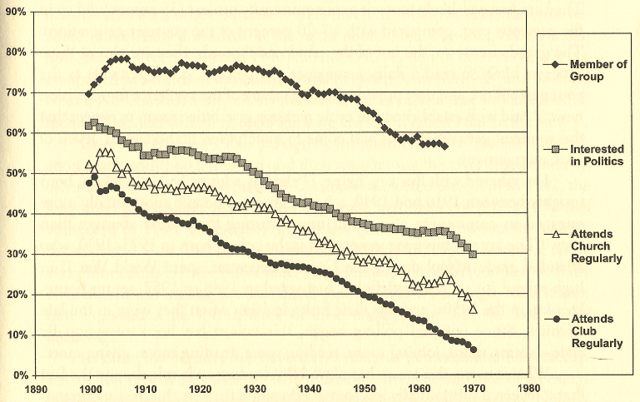
Volunteering has changed: Lack of Engagement Has Affected ALL Areas
Member of Group
Interested in Politics
Attend Church
Attend Club Regularly
Greatest
Silent
Baby Boom
Gen X
1900
1970
”Bowling Alone” Study, Putnam, 2000
Year of Birth

Slide 7
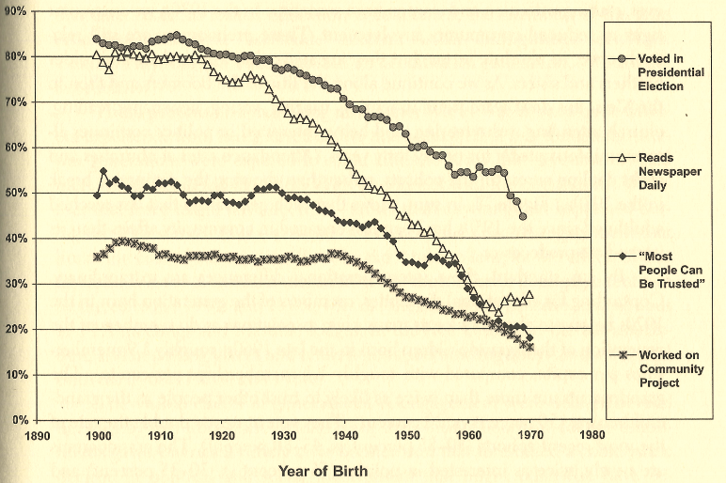
Fewer people expect to get involved
Vote for President
Read Newspaper
“Can trust people”
Work on community project
1900
1970
Year of Birth

Slide 8
The biggest drivers of this change:
Entertainment TV (ability to tune out other channels)
Suburbanization (ability to close the gate and keep “them” out)
Loss of largest volunteer base: Women (especially those forced to enter work force for economic reasons)
Rotary may have to cultivate leaders when they are younger; it can no longer assume they will join when they reach the top of their organization

Slide 9
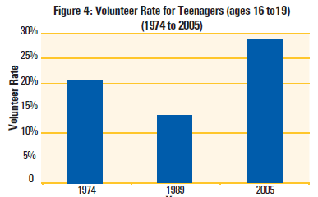
Good News: The Newest Generation Reversed the Trend in Volunteering
Baby Boomers
Gen X
“Millennials” (Gen Y)
2006 AmeriCorps Study with 2004 Census Data
Notes:
2014 studies about Millennials is mixed.
BLS says only 20% of Millennials volunteered in 2014, vs. 30% in the overall population. Other studies find they tend to expect to volunteer more.

Slide 10
Organizations Will Have to Restructure Since Millennials Want:
Focus on Productivity
Fewer formal meetings
Collaborate; Prefer team approach
Use text/facebook/Sharepoint to accomplish tasks with teamwork, but not working at the same time
Want mentoring; if not engaged fast, move on
Prefer shorter commitments
Want full ENGAGEMENT (not token membership)

Slide 11
MEMBERSHIP EFFORTS OF PALATKA

Slide 12
70% of Palatka members bring guests
MEMBER ATTRACTION
Almost 30% of D6970 Rotarians have invited NO guests this year (red bar)
Less RED and more GREEN on chart means club members invite more guests
Notes:
“How many guests have you brought to a club meeting during this last year?”

Slide 13
80% of the club did NOT sponsor a member last year
MEMBER ATTRACTION
70% invited guests, but only 22% sponsored new members.
D6970 Fun Facts:
Only one out of four guests becomes a member.
Over half of new members are sponsored by 8% of members.
One quarter of new members are sponsored by 2% of members!
Less RED and more GREEN on chart indicates club attracts more new members
Notes:
“How many of your guests decided to become members of your club?”

Slide 14
So, if you want success attracting new members…
Think of visitors who are:
Interesting at the lunch table; and
Passionate about your community.
Invite a lot of visitors
Have a good team to track your leads and improve your “close” rate
Improve your Fireside so new members know your expectations (and you know their passions)
Induct them so they feel special, and the club gets to know them
Engage them in their passion immediately

Slide 15
High proportion of new members may indicate a Retention problem
MEMBER RETENTION
If new members (shown in green on slide) are much higher than other categories, it indicates either:
Fast-growing club; or
Club losing new members quickly.
If existing members (in red) are higher than other categories:
Shrinking club; or
Extremely stable, older club.

Slide 16
Satisfying New members requires a different solution than Existing member retention
CONCLUSION: NEW MEMBERS
New Member Retention is a problem with many clubs, and requires work, such as:
Before induction: improved expectation-setting
After induction:
better introduction and welcoming of new members
more emphasis on networking and immediate engagement in service.
Existing Rotarian retention is affected by overall satisfaction, which is covered by this survey.

Slide 17
Why People Joined Palatka Rotary…. ……..and Why They Stay

Slide 18
Why People JOIN Rotary?….
Palatka members tend to JOIN for:
Networking (60%)
Local Service (30%)
So new members may be looking for these.
Notes:
NOTE: PRESENTATION IS LINKED TO V2 FILE
District numbers: Networking (40%)
Local Service (39%)

Slide 19
….the Reason Rotarians STAY often changes
In Palatka, interests change over Rotarians’s career:
interest in Local Service grew from 30% to 50% of Rotarians
Fellowship increased from 5% to 25%
Networking dropped from 60% to 20%
Palatka appears to offer great service opportunities

Slide 20
What does it mean for your club?
CONCLUSION:
Your club needs to appeal to a variety of types:
New members tend to want Networking.
Longer term, members tend to want Service and Fellowship more.
Your club members need to hear what RI and D6970 offer:
RMB [Rotary Means Business] for Networking;
District and Global Grants for Service.
AND your club will eventually have to change to attract Millennials
(there are now more Millennials than Baby Boomers)
Notes:
RMB—Rotary Means Business—a new (2016) cross-district group that gets together D6970 Rotarians who might want to do business with each other
Member Benefits is a new (2015) program that allows any Rotarian to offer discounts to other Rotarians through the Rotary International website

Slide 21
Can Palatka change so more members are VERY satisfied?
SURVEY: MEMBER SATISFACTION
Do Palatka
Rotarians look this?:
Or like this?:
Satisfied
VERY Satisfied
Notes:
Dissatisfied or marginally satisfied: Cynical, have to pry them out of their seat to do anything
Highly Satisfied: Feels welcomed, Engaged

Slide 22
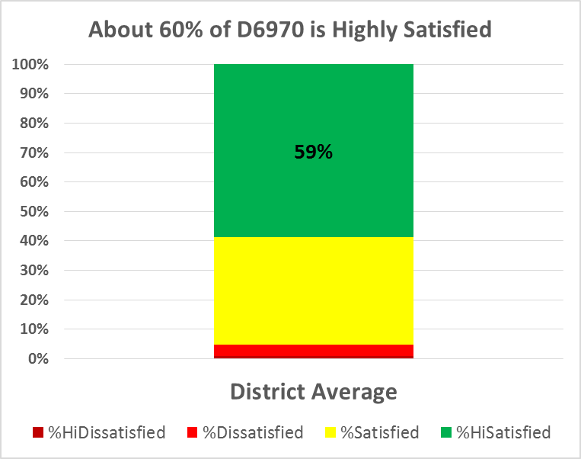
What do Satisfied Rotarians FEEL?
Rotarians who are HIGHLY Satisfied with their club:
99% plan to stay 2+ years
92% feel strongly welcomed by their club
88% feel strongly that they are encouraged to participate
87% feel strongly that service is effective
Notes:
Note on stats: 90% “strongly agree” they will stay two years. 9% more “agree”

Slide 23
What about the Dissatisfied Rotarians?
Dissatisfied members feel:
club leaders don't LISTEN well (56%); and
their club lacks strength in FELLOWSHIP (70%) and SERVICE commitment (67%).
Only 5% of our Rotarians are Dissatisfied. Why?
If they are Dissatisfied, they tend to leave.
More than half of the Dissatisfied Rotarians are considering leaving in the next two years.
Notes:
56% of Dissatisfied felt their club

Slide 24
Here’s how your club compares to D6970:
More Green is good; Red is bad
Notes:
In 2014, Palatka “very satisfactied” was 55%

Slide 25
So what can we do to satisfy members better?
Very Satisfied:
91% feel very Welcome-91%
88% feel very encouraged to participate
87% feel Service is very effective
78% feel leaders Listen very well
65% feel very well Informed
Dissatisfied:
56% feel leaders don’t Listen

Slide 26
How does your club feel?

Slide 28
How to view Strengths and Weaknesses
SURVEY: STRENGTHS AND WEAKNESSES
Remember: Building on strengths has more impact than minimizing weakness.
You may need to emphasize different areas:
Newer Rotarians—strong networking.
Longer term Rotarians—strong service and fellowship.
But, if you want to attract new members while keeping the existing ones, you probably want strong networking, service AND fellowship.

Slide 29
Strengths are listed, in order, based on ratings from Highly-Satisfied members.
STRENGTHS/WEAKNESSES
Notes:
Very satisfied rated the following as Major Strength:
Community Reputation 651
Welcoming club: 591
Effective Charitable Giving 576
Fundraising 571
Service commitment 550
Fellowship 513
Speakers/Programs 454
Dissatisfied rated the following as weak or neutral:
Fellowship 51
Service commitment 49
Speakers/programs 46
Charitable Giving 44
Fund-raising 41
Club welcomes 40
Community Reputation 34

Slide 30
STRENGTHS/WEAKNESSES
Giving
Note: Clubs oriented toward performing service may not rate fund-raising as a strength.

Slide 31
STRENGTHS/WEAKNESSES

Slide 32
STRENGTHS/WEAKNESSES

Slide 33
What to do now?
CONCLUSION:
See where your club’s strengths are.
Build on the strengths of your club first; great organizations aren’t built by minimizing weakness.
Examine weaknesses that could seriously affect your club:
Age? Welcoming? Fellowship?
Team approaches build better commitment to change.
Multi-year plans are most effective to achieve enduring change.
Ask help from the District or Zone, if you want ideas or help.

Slide 34
Questions?
Give us a call if we can help:
District Membership Co-Chairs
Mike Darragh – mikehdarragh@gmail.com
Russ Miller - pdgruss@lazyscape.com
Your Assistant or Area Governors
Zone Rotary Coordinator team - art.macqueen13.14@gmail.com

