Slide 1
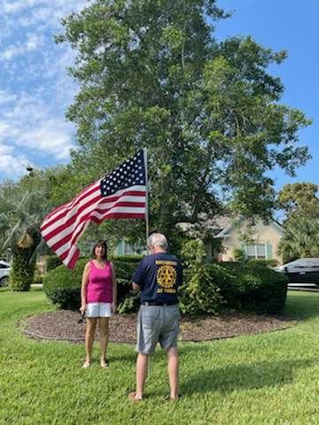
Oceanside Rotary Flag Program
Prospecting for a new Flag Route…

Slide 2
Contact HOA’s Leadership
Who are the HOA Players?
  Call the HOA President – Introduce the Flag Program
Follow up with a Promo Letter of our Flag Program…

Slide 3
Personalized Flag Program Promotion letter…

Slide 4
Ask for inclusion in next HOA Monthly Newsletter…
HOA’s Grounds’ Chair Support…

Slide 5
Send New NEON Flag Sign up Form to potential New Customers that are Interested…

Slide 7
Secure an HOA Map to Layout sensible route
Minimize Backtracking
Assure if someone has to fill in for you that the Route is easy to follow
Minimize time to put Flags out & retrieve them…

Slide 9
Mass E-Mail Flag Customers notice to mark Flag Locations with curb paint...

