Slide 1


TREASURERS TRAINING
July 10, 2021
don snyder

Slide 2
AGENDA
Treasurer’s Responsibilities
RI and District Dues Procedures
2021-2022 RI and District Dues Structure
CART Procedures
Q & A
Adjourn

Slide 7
What To Expect On The RI Invoice
Item | July 2021 | January 2022
RI Dues | $35.00 | $35.00
Subscription to The Rotarian | $6.00 | $6.00
Council on Legislation Assessment | $1.00 | NA
General Liability Insurance | $4.95 | NA
Directors & Officers/Employment Practices Liability | $0.99 | NA
Total: | $47.94 | $41.00
All Amounts Above Are Per Member.
District Dues are the Same as RI Dues.

Slide 8
RI & District Dues July 2021
You should receive your RI Club Invoice, via email, from RI in early July.
1. Each club is responsible for two sets of dues: Rotary International and District 6960
2. They are both paid semi-annually in July and January.
3. The dues are based on the number of active Rotarians (including Leave of Absence members) that RI shows in your club as of July 1st. The number may be different than your records show because of additions and deletions not reflected by RI.
4. Rotary International dues and District dues are both to be paid by July 31st.
5. The RI INVOICE will be sent to all current club officers who are listed with RI to their e-mail addresses. If your club has not received an invoice by mid-July, email data@rotary.org to request a replacement. Include your club name and number and delivery address or fax number. Club dues still must be paid even if you have not received the invoice.

Slide 9
6. District semi-annual dues for July 2021 are $35.00 per active member (per the RI invoice) as of July 1^{st.} There are no additional District fees.
7. The District “WILL NOT SEND YOUR CLUB A DUES INVOICE”. The District does not know how many active members RI is billing you. After you pay your District dues, the RI INVOICE will serve as your District Dues receipt. District dues equal $35.00 multiplied by the number of active Rotarians per the RI INVOICE.
Make the check out to Rotary District 6960.
8. Mail RI dues and charges to: Mail District dues to:
Bank of America Don Snyder, Treasurer
14244 Collections Center Drive Rotary District 6960
Chicago, IL 60693 7352 South Serenoa Drive
Sarasota, FL 34241
9. Pay RI dues & fees online per the RI CLUB INVOICE instructions.
NOTE: it is not possible to pay District Dues online.
Any questions please call for help!!
YIR
Don Snyder, 941-993-5302 cpafl@aol.com

Slide 11
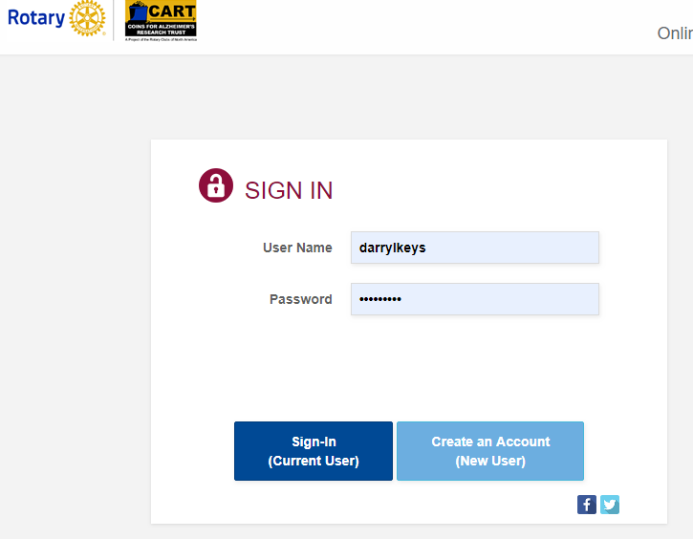
https://www.mycartfund.org
Use your DACdb login

Slide 12
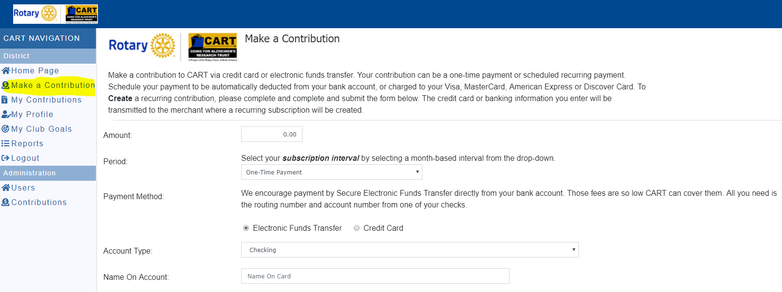

Slide 13

Questions ?

