Slide 1
WELCOME
PRESIDENT ELECT TRAINING SEMINAR

Slide 2
Pledge of Allegiance
4 Way Test
Invocation
Ken Kaplan

Slide 3
Incoming Presidents
30 Seconds
Name
Club Name
Signature Project or What is your Club Known For?
When your year is over what would you like to be known for as your year as President?

Slide 4
Area Governors
Mia Delk
Chris Riesen
Eldon Borhofen
Suzanne Vasbinder
Sam Gupta
Randall Crouch
Mallory Lasorso
Laura Randall
Ken Kaplan

Slide 5
District Staff
Teresa Taft – Chief of Staff
Christi Villalobos -- DacDB
Pete Doragh – Training & General Counsel
Don Snyder -- Treasurer
Alfred Current -- Foundation
Richard Hall – District Grants
David Lusty – Global Grants
Gerard Sola -- Membership
Natalia Armstrong – Diversity & Inclsion

Slide 6
District Staff
Vana Prewitt – Public Relations / Image
Cyndi Doragh – Youth Services
Bob Pfeiffer – Disaster Preparedness
Brian Maddox – Rotary Means Business
Tim Rumage -- Environment
Ladd Waldo – Peace
Dee Fabry – Literacy
NEEDED – ROTARACT GOVERNOR

Slide 7
2021-2022 Presidential Theme

Slide 8
Membership
Gerard Sola
District Membership Chair: 2021 - 2024
Rotary Club of Bonita Beach Sunset

Slide 9
Strategy
Visualize your Club Exercise: Why do members join and existing ones stay? Refer to “Visualize Your Club” handout
Select a strong membership chair and committee
Define your membership goals now: Don’t wait until July.
Utilize all Rotary / District Tools: GrowRotary.org / Membership Leads

Slide 10
Strategy
Utilize all Rotary / District Tools: GrowRotary.org / Membership Leads
Rotarianship Program: Exciting new initiative for clubs and our District
Partner with me! The District Membership team is here to assist!
This is just the beginning! Let’s build a solid foundation together!

Slide 11
The Rotary Foundation
Serving to change lives

Slide 12
Our ‘Why’ is ... how we define our ‘What’.
I want to serve so lives
are changed for the better.

Slide 13
Giving to The Rotary Foundation Changes Lives
I believe that the world can live in peace.
I believe that people should have access to clean water.
I believe that children should come into the world healthy.
I believe that people should be able to read.

Slide 14
Giving to The Rotary Foundation Changes Lives
I believe we should take care of our environment.
I believe that communities should be self sustaining.
I believe that people helping people help people.
I believe that being a Rotarian and using The Rotary Foundation is one of the best ways to change lives.

Slide 15
The Value of a ‘MILLION DOLLARS’
A Polio-free world
A Peaceful planet
A disease-free world
A world that provides clean water for all
A community of healthy children and families
A literate society
A sustainable environment
A vibrant economic community
A source of money to recover from a disaster

Slide 16
If you believe what I believe, will you join me? D6960 Seven Years – One Million Dollars+

Slide 17
FOUNDATION RESOURCES
District Grant Information is found in DACdb under the GRANT icon.
Global Grant Information is found in My.Rotary.org under the FOUNDATION TAB.
Alfred Current – District Rotary Foundation Chair
704.718.0951 | acrotary@alfredcurrent.com

Slide 18
$1,000,000 + District 6960

Slide 19
Goals are critical
You are our future. Your understanding and actions will determine what we can do in three years.
What will be your
Foundation Legacy?

Slide 20
Needed District Culture
Goals in Rotary Club Central -- Annual Fund & PolioPlus
World Polio Day-October 24th – Polio Bike Ride
Foundation event – get all Rotarians to engage
Send all TRF contributions to The Rotary Foundation in a timely fashion.

Slide 21
Needed District Culture
Send all TRF contributions to The Rotary Foundation in a timely fashion.
Move each Rotarian to their next pin level
Communicate weekly with your Foundation Chair - know your numbers
Include a Foundation Moment EACH WEEK – teach the story.

Slide 22
Serving to change lives
Thank you!

Slide 23
Christi Womack Villalobos
2021-22 District DACdb admin
christiwv@gmail.com
941-315-0635
Questions always welcome. Email is best. Start with me; if I can’t help you, I’ll find someone who can.
Check your email for a handy how-to guide about the basics to using the powerful dacdb.com tool.

Slide 24
District 6960 Disaster Preparedness
The District Depends on YOU

Slide 25
Why Form a Disaster Committee?
Rotarians are people of Action
Pre-planning and organization will allow you to act when there is a need
It is too late to plan after a disaster occurs
Be prepared to address the needs of your members in the event they need help

Slide 26
Why Form a Disaster Committee?
Be prepared to address the needs of other Rotarians within the district if they need help
Ability to organize a team to help as second responders for your members, other Rotarians, your community, or other communities in need.

Slide 27
We are Not First Responders
But we can….
Muck houses
Clear debris
Pass out water
Provide supplies
Provide housing

Slide 28
What You Need to Do
Create a Disaster Preparedness Committee (minimum 2 members)
Document Disaster Committee Chair in DACdb
Develop a club communication tree
Use available technical tools to maintain the contact information of all members. (DACDb is an excellent resource)
Maintain backup tools (paper) recognizing that technology may fail in the event of a disaster

Slide 29
District Coordination
Phone Tree reports needs/resources/status to Club Disaster Committee
Club Disaster Committee reports needs/resources/status to Club President
Club President reports needs/resources/status to Area Governors
Area Governors reports needs/resources/status to District Governor
District Disaster Committee coordinates resources for and between clubs

Slide 30
Disaster Committee
Ken Kaplan -- Lakewood Ranch
Mark Midyett – Lakewood Ranch
Bob Pfeiffer -- Bradenton
Jim Colvin -- Cape Coral
John Henshaw – Sanibel Captiva
Darryl Keys – Charlotte Harbor Sunset
Andy Lyman – Sarasota Sunrise
Neil Snyder – Marco Island Sunrise
Rich Kirschner -- Naples

Slide 31
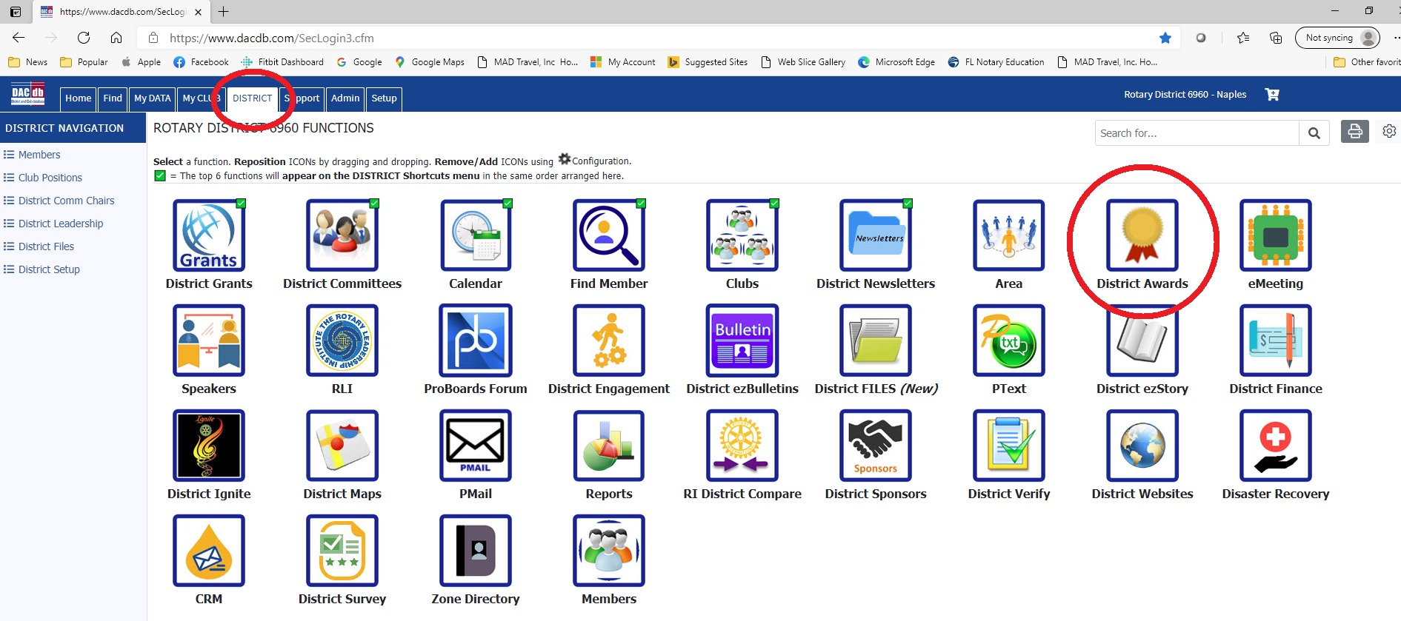
Governor’s Award

Slide 32
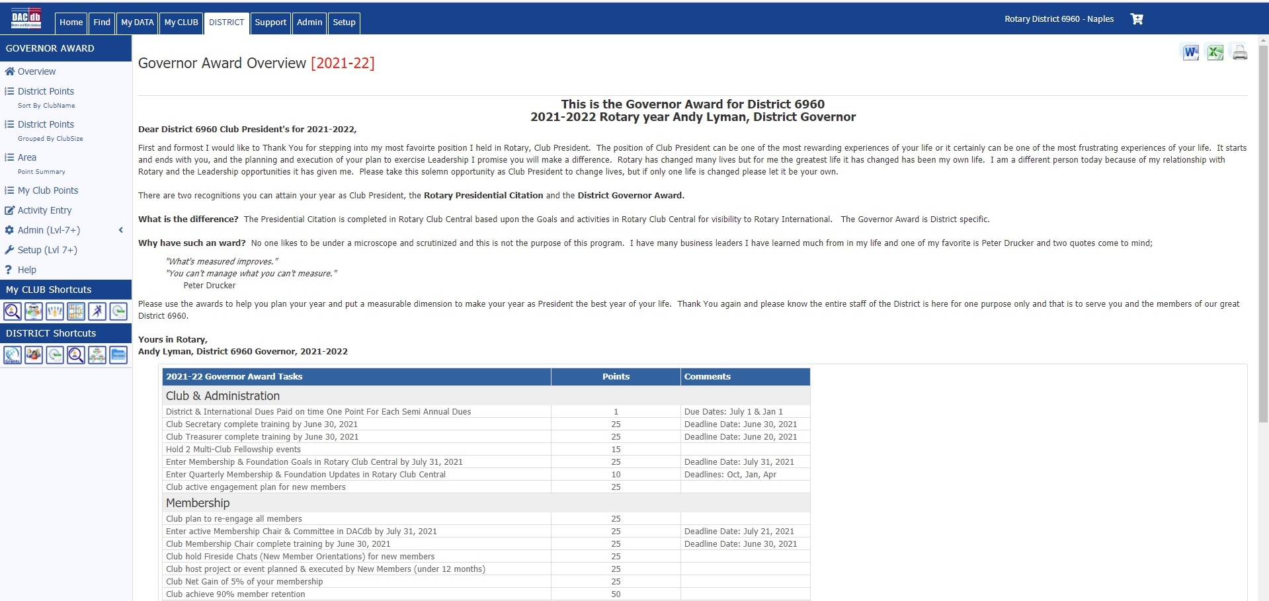
District Awards Page

Slide 33
Points System

Slide 34
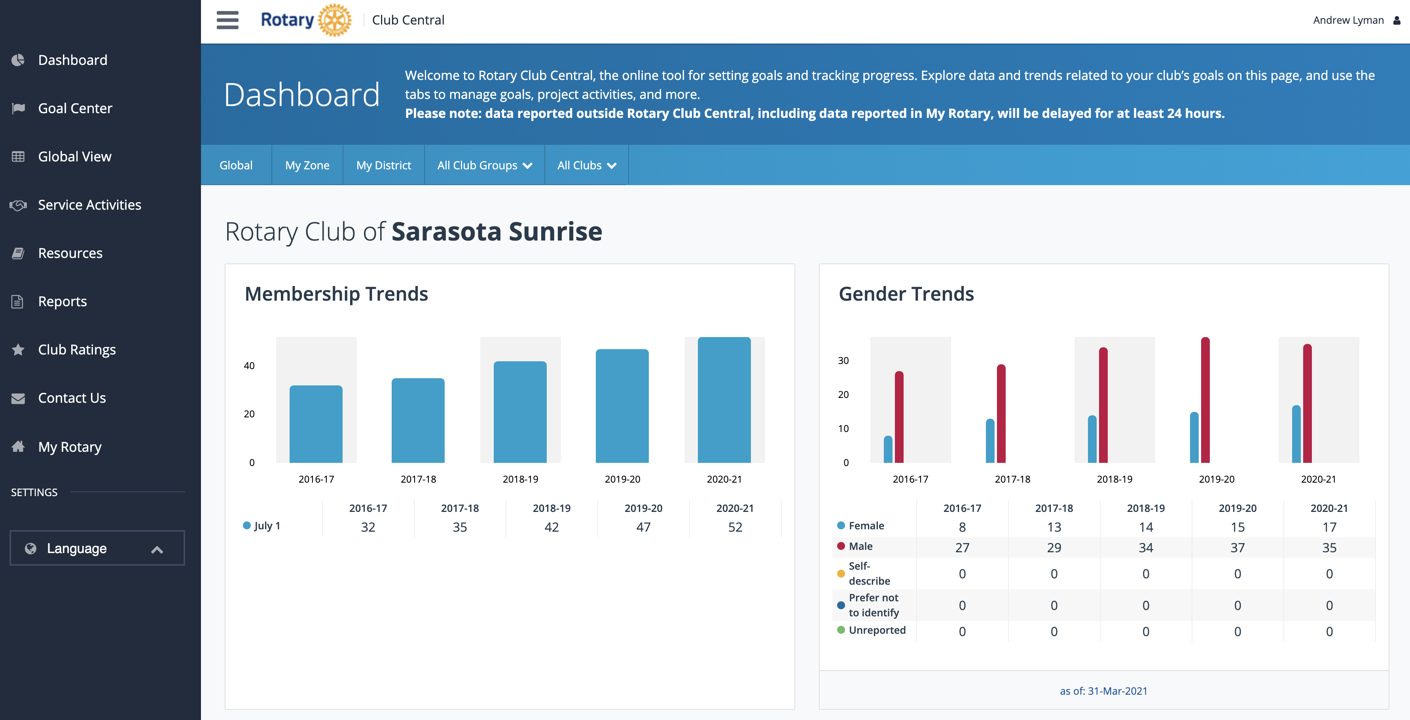
Club Dashboard – Rotary.org

Slide 35
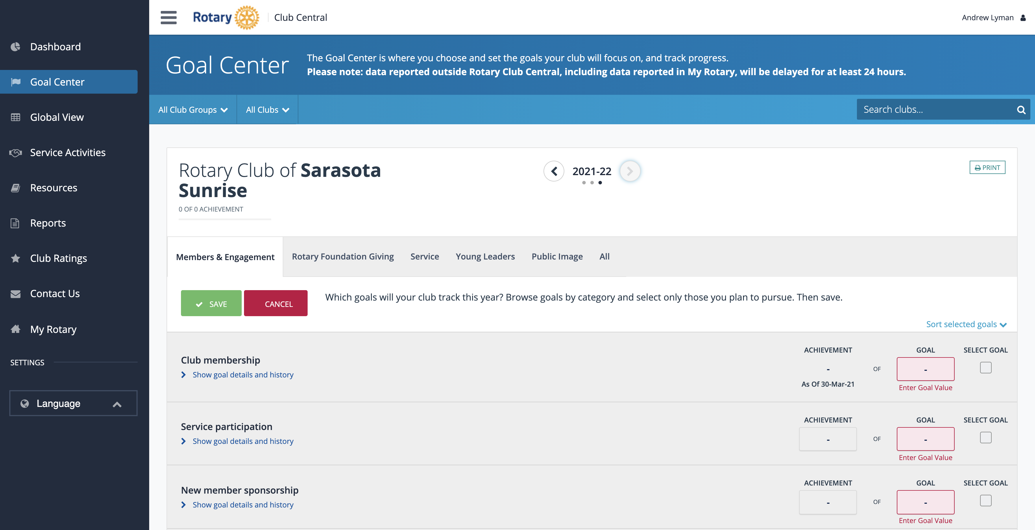
Enter Your Goals - Rotary.org

Slide 36
Dist 6960 Public Relations
2021-2022
Vana Prewitt
Incoming PR Chair
Notes:
Goal for my 10 minutes
Explain the scope of the PR mandate the coming year.
Review roles and responsibilities
Provide specifics on what the PR team will do for clubs, AGs, and committees.
Unveil Gov. Andy’s first District-Wide publicity event

Slide 37
I Live to Serve
Press
Social Media
Marketing / Publicity
Club Support
PR Events
All District Communications
Notes:
Previously called Public Image. I personally found this terminology very confusing because PI is only concerned with branding consistency and we need so much more than that. Standard press releases, radio talk shows, documentation of events, District publicity support for club events, FaceBook ads, web design assistance, review of District communications such as flyers, presentations, event announcements, speeches.
The purpose for this overhaul is to better support our clubs and leaders
Provide communications that stay on message
Consistent look and feel to District documents

Slide 38
PR Team and Leadership Roles
Communication, Communication, Communication
PR Team = District & Club support
AG & Presidents
Committee Chairs
Notes:
PR team
Get your message in front of the intended audience. Lots more coverage in social media, where young people get their information. Provide support for producing effective PR materials. Liaison to the press, arrange for interviews, assist with graphic designs, Rotary brand logos for each club. Review materials and provide coaching for RI branding.
Area Governors, Committee Chairs
Stay connected to the PR team on behalf of your clubs. Plan for Publicity in all things you do.

Slide 39
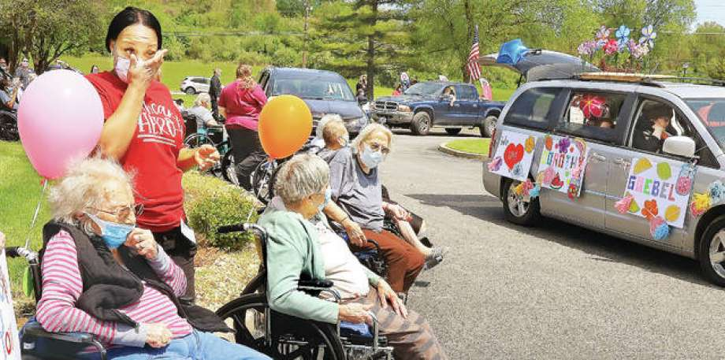
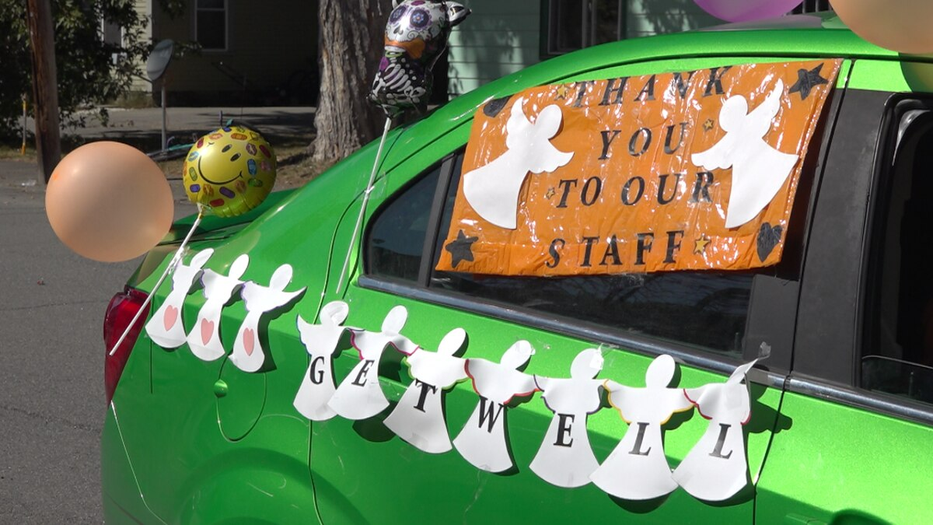
Public Event #1
Nursing Home Parade July 4th, 2021
Participating Rotary Clubs
Florida State Ombudsman
Notes:
Open to any Rotarian or Rotary club.
Events will be scheduled throughout the day in each area choosing to participate to permit photo ops for both organizations trying to recruit members.
Groups (one club, two or more) partner with an Ombudsman to identify suitable nursing homes and long term care facilities for the visit
Rotarians provide balloons, refreshment, party favors (American flags? Patriotic accessories?)
Public, friends, family, Rotarians, and Ombudsmen participate
Active engagement with the media through social media
Advance publicity and day of coverage
Do good event with a deliberate PR angle
Gets great media coverage
Decorate cars
Consider musical routine with boom box
Souza music
Let me know if your club wishes to participate and PR will match you with an ombudsman to work out the details.

Slide 40
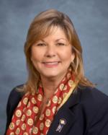
Youth Service
Cyndi Doragh
239-357-5758
cdoragh@ironridgeinsurance.com

Slide 41
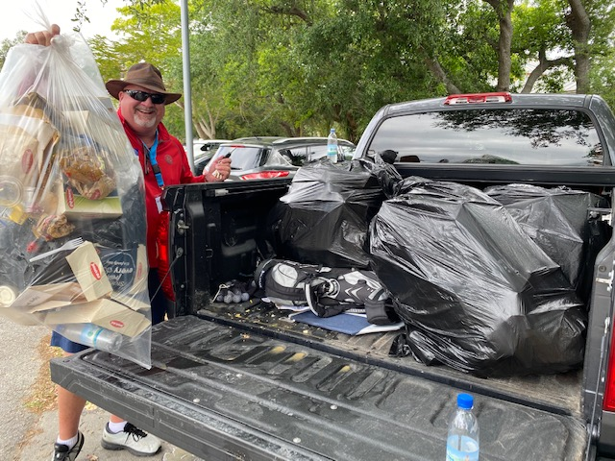
Litter Pick Up

Slide 42
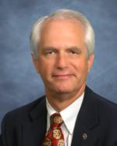
District Training – Re-Imagined
Pete Doragh
pete.doragh@doraghlawfirm.com
239-357-5785

Slide 43
7th Area of Focus - Environment

Slide 44
Rotary Means Business

Slide 45
District Conference 2022 aboard
Freedom of the Seas
May 20-23, 2022
3-Night Bahamas & Perfect Day Cruise
Miami – Perfect Day at Coco Bay, Bahamas – Nassau, Bahamas - Miami

Slide 46
June 4-8, 2022 Houston, TX
Houston RI Convention (houstonri2022.org)
John Smarge, The Rotary Club of Naples
Chairman of the 2022 RI Convention Committee
Notes:
2022 Rotary International Convention
June 4-8, 2022
Houston, TX
Save-the-date now so we can encourage as many Rotarians from District 6960 to attend IN PERSON!
Our own John Smarge, Past Rotary International Director and member of The Rotary Club of Naples, is serving as Chairman of the 2022 Houston Convention Committee. We would love to have a big contingent there to represent our District and to support John.
Registration will open up during this year’s 2021 Virtual Convention in Taipei, Taiwan. Dates are June 12-16, 2021. Make sure to log on to watch this year’s convention and to learn how to register for Houston.
District 6960 is working on a room block so as many as possible from our District can stay at the same hotel. We don’t have any details right now but stay tuned. As soon as they are available, we’ll let you know.
Please bookmark www.houstonri2022.org and check back often for updates!

Slide 47
2022 Convention in Houston
Save the dates June 4-8
Registration will open up during this year’s 2021 Virtual Convention in Taipei
Please bookmark www.houstonri2022.org and check back often for updates!

