Slide 1
District 6960 Disaster Preparedness
The District Depends on YOU

Slide 2
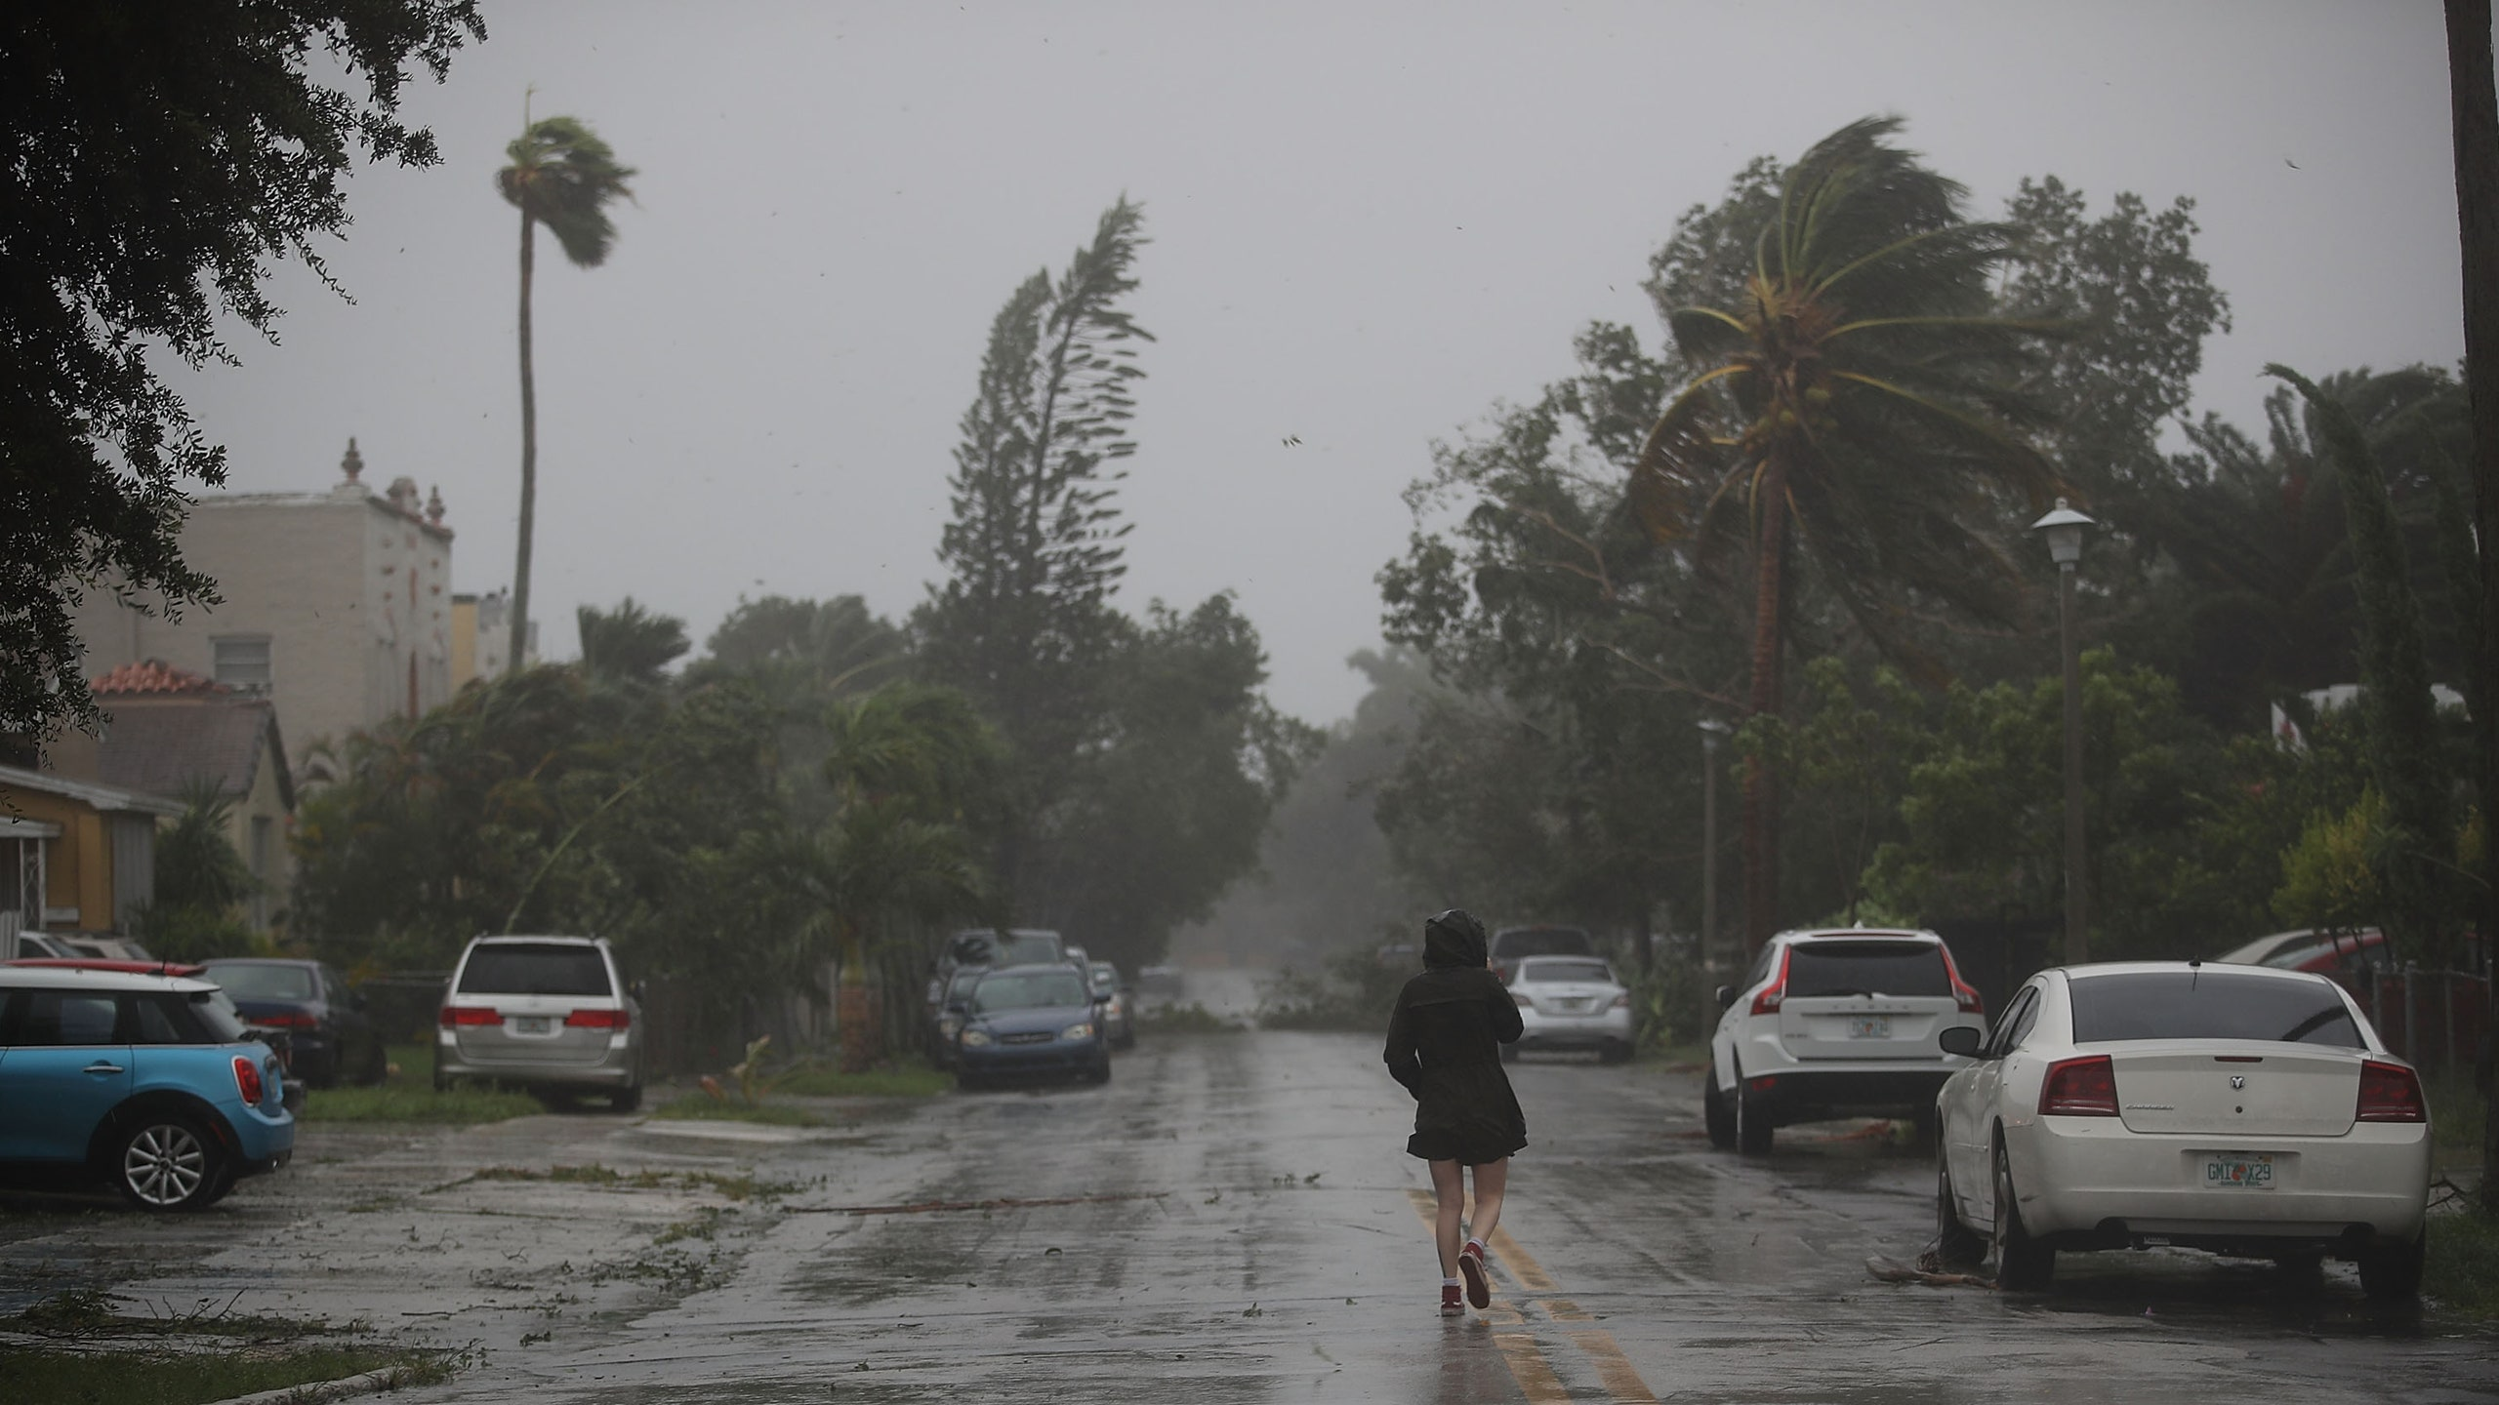
Why Create a Disaster Committee?
First,
Rotarians are people of action
Pre-planning and organization will allow you to act when there is a need
It is too late to plan after a disaster occurs

Slide 3
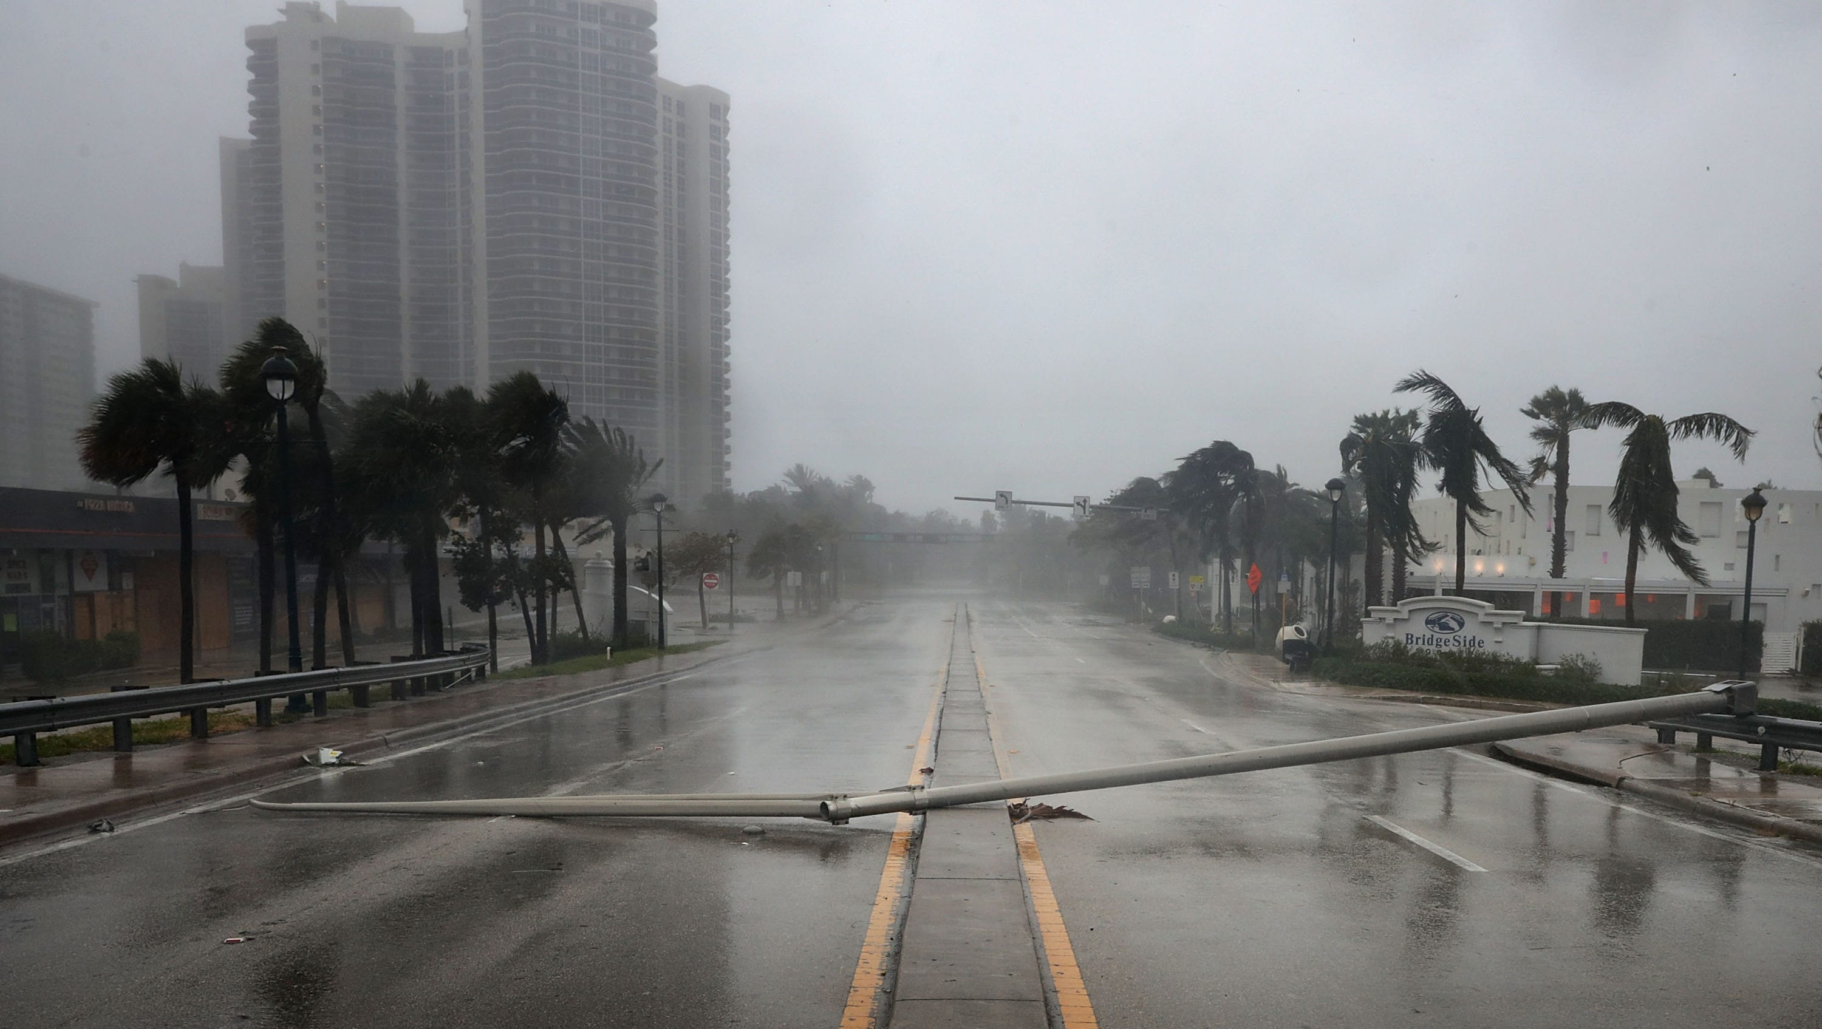
Why Create a Disaster Committee?
Second,
Be prepared to address the needs of your members in the event they need help

Slide 4
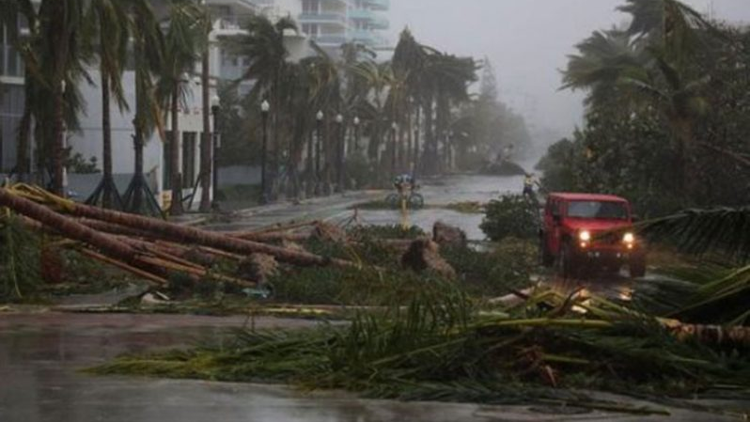
Why Create a Disaster Committee?
Third,
Be prepared to address the needs of other Rotarians within the district if they need help

Slide 5
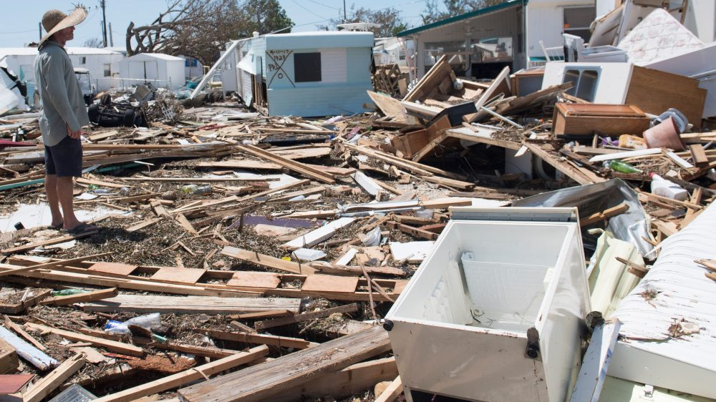
Why Create a Disaster Committee?
Fourth,
Ability to organize a team to help as second responders for your members, other Rotarians, your community, or other communities in need.

Slide 6
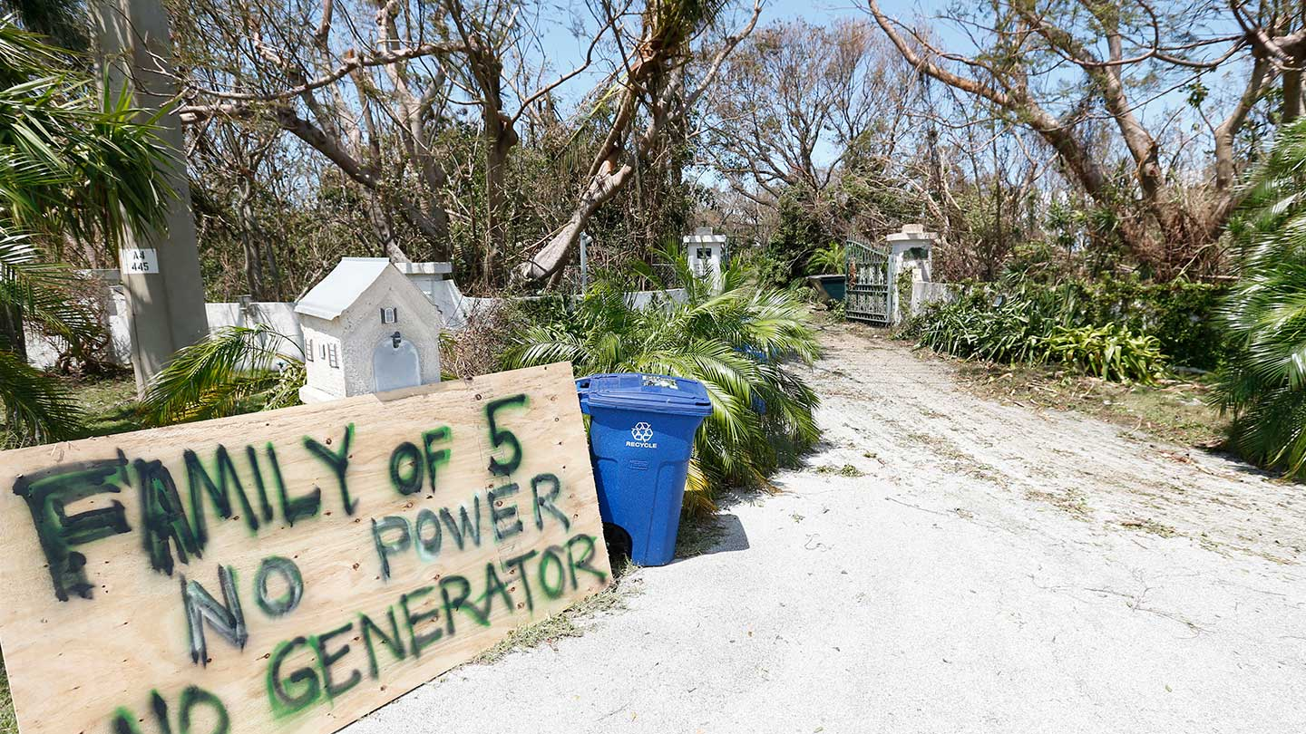
We are not First Responders
But we can:
Muck houses
Clear debris
Pass out water
Provide supplies
Provide housing

Slide 7
What you need you to do
Create a Disaster Preparedness Committee (minimum 2 members)
Document Disaster Committee Chair in DACdb
Develop a club communication tree
Use available technical tools to maintain the contact information of all members. (DACDb is an excellent resource)
Maintain backup tools (paper) recognizing that technology may fail in the event of a disaster

Slide 8
District Coordination
Phone Tree reports needs/resources/status to Club Disaster Committee
Club Disaster Committee reports needs/resources/status to Club President
Club President reports needs/resources/status to Area Governors
Area Governors reports needs/resources/status to District Governor
District Disaster Committee coordinates resources for and between clubs

Slide 9
District Disaster Committee
MEMBER | CLUB | CELL PHONE | ALT PHONE | EMAIL
Ken Kaplan | Lakewood Ranch | 941-351-7021 | 781-820-4040 | KKaplan47@gmail.com
Mark Midyett | Lakewood Ranch | 941-928-7222 | 941-556-5151 | markmidyett@kw.com
Bob Pfeiffer | Bradenton | 941-592-6276 | 941-592-6276 | robwp07@aol.com
Jim Colvin | Cape Coral | 239-218-2460 | 239-574-2302 | jecolvin44@gmail.com
John Henshaw | Sanibel Captiva | 239-851-5254 | 239-395-2023 | John.Henshaw@comcast.net
Darryl Keys | Charlotte Harbor Sunset | 941-214-0150 | 941-629-9742 | dkeys@zypha.com
Andy Lyman | Sarasota Sunrise | 941-321-7899 | 941-343-9999 | andy@allpointpos.com
Neil Snyder | Marco Island Sunrise | 239-398-6886 | 239-398-6886 | nsnyder@hodgeandsnyder.com
Rich Kirschner | Naples | 239-919-4100 | 239-919-4100 | rdkirschner@gmail.com

