Slide 1
ROTARY INTERNATIONAL STRATEGIC
PLAN
Districts 6890 & 6960
Notes:
Lisa – Hello Everyone and welcome to our presentation about Strategic Planning.

Slide 2
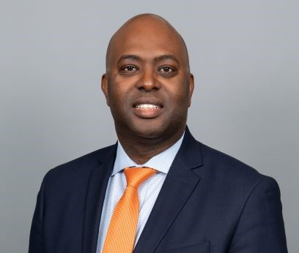
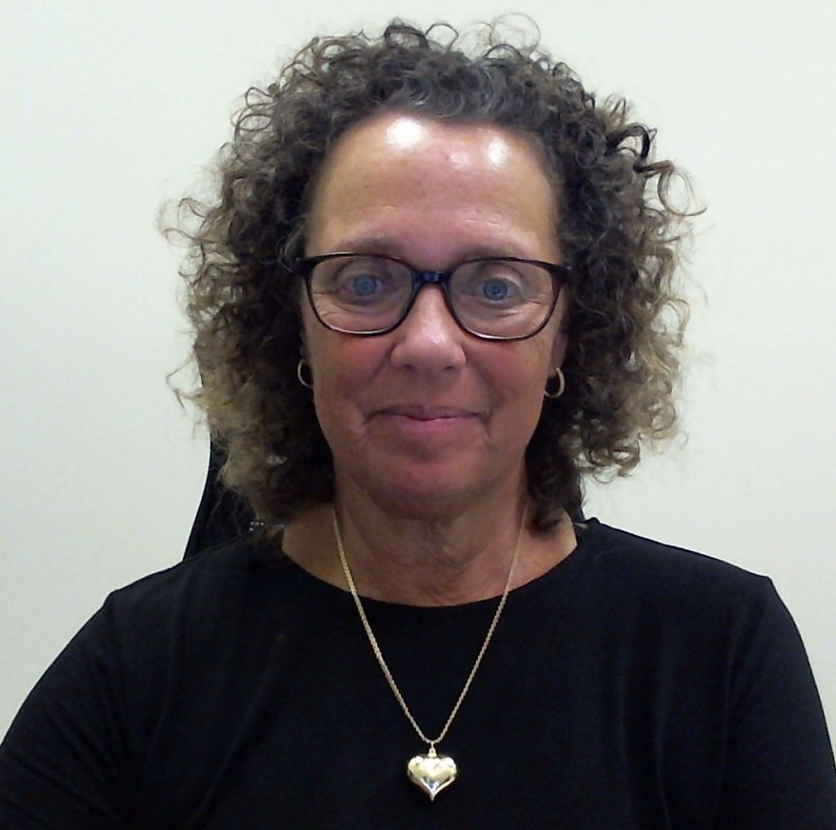
WHO WE ARE
Brian Reeves
District 6890 Trainer
brianreeves@watsonrealtycorp.com
863-899-1986
Lisa McCarthy
District 6960 Trainer
lisa@madtravel.com
239-250-8992
Notes:
Brian – Please tell a little about yourself and then cue Lisa to tell a little about herself.

Slide 3
ROTARY’S VISION STATEMENT
Together, we see a world where people unite and take action to create lasting change – across the globe, in our communities, and in ourselves.
Notes:
Lisa – When Rotary International began to develop a new strategic plan over two years ago, they started by taking a look in the mirror. They asked hard questions as they performed a thorough self-assessment, all the while acknowledging the changing world around us. Once they identified gaps between who they are and who they want to be, they looked to us. They asked more than a million people from across the world to share their input with their Strategic Planning Committee through focus groups and surveys. Each goal in their plan is based on feedback from these leaders, members, and Rotary participants who want the organization to achieve its vision. The new strategic plan is Rotary International’s Action Plan – the organization’s call to action to work together to build a stronger future. This plan will help us realize what’s truly possible when People of Action unite, connect with others who share our values, and commit to creating change in the world and within ourselves. The Action Plan is not about wiping away our tradition or tried-and-true core principles. It’s about making our organization stronger so our values will last for years to come. It’s about using effective tactics to strengthen the organization at all levels. It’s about ensuring that every person who engages with us has a meaningful, valuable and fulfilling experience. It’s about changing more lives and communities for the better.

Slide 4
ACTION PLAN
Notes:
Lisa - As People of Action, we share a strong sense of purpose. More than a century ago, we pioneered a new model of service leadership grounded in person-to-person connections. Today, those connections are a network that spans the globe—bridging cultural, linguistic, generational, and geographic barriers—and shares the vision of a better world. As People of Action, we understand that fulfilling that vision requires a plan. This is Rotary’s plan for the next five years: to increase our impact, expand our reach, enhance participant engagement, and increase our ability to adapt. By helping to realize the goals of this plan, you ensure a stronger and even more effective future for Rotary—a tremendous legacy. Our plan is rooted in our tried-and-true values and builds on the remarkable capabilities and spirit of Rotarians. It is clear-eyed about the challenges that Rotary and the world face. It protects the value of human connection in an age of technology. It lays out a path for bringing great ideas to the forefront of the global imagination of what’s possible. And our plan will provide us with a continuity of vision from year to year, keeping us moving toward fulfilling our shared purpose. This is our Action Plan.

Slide 5
INCREASE OUR IMPACT
Eradicate Polio and Leverage the Legacy
Focus our Programs and Offerings
Improve our Ability to Achieve and Measure Impact
Notes:
Brian - People of Action are effective problem-solvers. Why do Rotarians achieve so much? We invest in relationships. We make decisions grounded in evidence. We know how to mobilize our networks to create solutions that last. And we’re always learning from our experiences in projects, clubs, and careers. Throughout the fight to end polio, we’ve shown what we can do when we draw on our collective strengths. We’ve created solutions that match the people they serve. We’ve evaluated the results to learn from our successes and setbacks. This is a model we will use again and again in pursuit of our audacious goals: educating the world’s children, ensuring equitable access to water and sanitation, helping local economies grow sustainably, and so much more. Let’s seek out new ways to translate our expertise into making a difference—in our communities and across the globe. Let’s prove that our impact on the world has only just begun.

Slide 6
EXPAND OUR REACH
Grow and Diversify our Membership and Participation
Nadege/Rick and Gerard/Duwane – District Assets
Create New Channels into Rotary
Increase Rotary’s Openness and Appeal
Build Awareness of our Impact and Brand
Notes:
Lisa - People of Action activate and inspire one another. We know that our capacity to make a difference is larger when more people unite with us. We want the world to appreciate our ambitious, compassionate, and inclusive spirit—because when they do, they see that Rotary is the source for the person-to-person involvement so many are seeking. Told widely and emphatically, our stories give people hope that the world can change for the better, inviting listeners to imagine themselves as part of that change, too. Let’s build connections and opportunities that will allow people who share our drive to do the same.

Slide 7
ENHANCE PARTICIPANT ENGAGEMENT
Support Clubs to Better Engage their Members
Develop a Participants-Centered Approach to Deliver Value
Offer New Opportunities for Personal and Professional Connection
Provide Leadership Development and Skills Training
Notes:
Brian - People of Action strive to understand the needs of others. Just like the people and communities we serve, our participants need to feel seen and heard. They’re seeking experiences that feel personally and professionally relevant and fulfilling. When they see our dedication to investing in them at every stage of their professional life, our participants are eager to go the distance with us—even at a time when there are many other options for networking and volunteering. Let’s recommit to putting the needs, expectations, and growth of our participants at the center of all we do.
Brian – you’ll want to tie in Diversity, Equity and Inclusion into this slide so everyone sees how we connect the dots to enhance participant engagement.

Slide 8
INCREASE OUR ABILITY TO ADAPT
Build a Culture of Research, Innovation and Willingness to Take Risks
Streamline Governance, Structure and Processes
Review Governance to Foster More Diverse Perspectives in Decision-Making
Notes:
Lisa - People of Action are inventive, entrepreneurial, and resilient. We’ve shown throughout our history that we excel at finding new ways to lead the world to lasting change. And we’ve proven in our own careers that we know how to help organizations of every kind move forward. That’s why new approaches to our organizing principles don’t threaten our sense of who we are. We’re ready to seek out fresh opportunities, create more paths to leadership, open up our conversations to diverse voices, and simplify how we operate—with confidence. Let’s stay true to ourselves and stay ahead of change in our next 115 years.

Slide 9
CREATE A RECIPE FOR A PRODUCTIVE STRATEGIC PLAN WITH YOUR CLUBS
Get Members Involved, Listen to their Input/Opinions and Suggestions
Be Flexible to your Members’ Needs
Notes:
Lisa – While the Action Plan created by Rotary International may focus RI and the corporate-level activities that will drive us toward our vision, it also translates to a club and district level. What does this mean for you as an AG? Take into consideration the priorities and ideas in the plan to help make each of the clubs in your area the best they can be. Keep in mind that every Rotary journey is different and every individual’s own journey may be different at different points in their life. Get members involved, listen to their input, opinions and suggestions. Be flexible to members’ needs. As was pointed out last week, some Rotarians are looking for socialization, some are looking for service opportunities, others are looking for networking and the opportunity to build career skills. Still others just want to go to lunch every week and talk to their friends.

Slide 10
CREATE NEW CLUB FORMATS
Introduce a 10-minute Presentation Format for Club Members to Share what they do Professionally
7-minutes with 3-minute Q&A
Invite Speakers who Have Not had an Opportunity to Speak at your Club
Notes:
Brian – In addition to what is on your slide, please incorporate Deborah’s idea of each Club member being assigned a month to secure the speakers. Include inviting speakers to join Rotary and become club members. Also talk about posting your speakers on DACdb so other clubs can get ideas or secure these speakers for themselves.

Slide 11
HOW DOES THE RI STRATEGIC PLAN LEAD TO A CLUB STRATEGIC PLAN?
Each Club should have the Same Priorities as the Rotary International Action Plan
Make each Club and the Experiences of its Members be the Best they can be
How to Get Started
Assemble a strategic planning team made up of past, present, and incoming club leaders to develop the plan and make sure it’s helping your club achieve its goals.
Ask a non-Rotarian/Rotaractor or a club member that is not in a leadership position to facilitate strategic planning meetings.
Get a variety of perspectives by involving club members who have diverse backgrounds and experiences.
Make sure your club’s vision reflects Rotary’s official strategic vision.
Align your club’s goals to reflect those of your district and RI’s strategic plan.
Notes:
Lisa - Just as a map guides people from one location to their destination, a strategic plan that is rooted in action guides an organization through achieving its goals and, ultimately, fulfilling its strategic vision. Strategic plans are extremely important for individual Rotary clubs. Survey results have shown us that clubs that develop and follow a strategic plan are stronger than clubs that don’t because they have more satisfied members who view their clubs and Rotary more positively overall. Set long-term priorities as well as annual goals that support a club’s strategic vision.

Slide 12
STRATEGIC PLANNING PROCESS OVERVIEW
PHASE 1 – DETERMINE YOUR STATUS:
HOW IS YOUR CLUB DOING NOW?
Identify strategic issues to address
Determine club’s strengths and weaknesses
Assess member satisfaction and needs
Identify opportunities and challenges in the community
Notes:
Brian - Before you set your club’s long-term goals, it’s important to:
• Determine your club’s strengths and weaknesses by gathering comments from members
• Use the Rotary Club Health Check which was sent to you in our original welcome email
• Identify opportunities and challenges in the community by meeting with other community leaders
IDENTIFY STRATEGIC ISSUES - What are the critical issues or concerns the club wants to address? Strategic issues are those critical unknowns that are driving you to embark on a strategic planning process. These
are issues that are looking for a solution or decision. Think about what issues you want to address with this strategic plan.
Potential questions to ask members:
• How will we increase our membership and engage members in our club?
• How can we attract a diverse group of members?
• How can we include more community members in our club activities?

Slide 13
STRATEGIC PLANNING PROCESS OVERVIEW
PHASE 2 – DEVELOP A VISION:
WHAT DO YOU WANT YOUR CLUB TO BE LIKE?
List five to seven characteristics you want your club to have
Create a vision statement
Notes:
Lisa –
CLUB CHARACTERISTICS - Rotary’s vision statement asks us to “unite and take action to create lasting change.” List five to seven characteristics you want your club to have within three to five years that will help realize that vision, e.g. fun, service-oriented, innovative, representative of the community, etc.
VISION STATEMENT - A vision statement defines your desired future and provides direction for what you want your club to be. Write a one-sentence vision statement with your strategic planning team using the list of club characteristics as a reference. Potential questions to consider:
• What will our club look like in three to five years?
• How will we know we’ve succeeded?
• What do we want to achieve?
THE MOST IMPORTANT THING FOR YOU AS AN AG TO REMEMBER IS, NO TWO CLUBS ARE THE SAME. EVERY CLUB IS UNIQUE.

Slide 14
STRATEGIC PLANNING PROCESS OVERVIEW
PHASE 3 – MAKE A PLAN:
HOW CAN YOU ACHIEVE YOUR VISION?
Set strategic priorities
Set annual goals
List the activities, timeline, and resources you’ll need
Notes:
Brian - Your strategic priorities should help you achieve your vision. These priorities answer the question, “How will we succeed?” Develop your most important strategic priorities — those that will have the biggest impact as your club works toward its vision. Consider the following when you develop strategic priorities:
• The Rotary vision statement and strategic plan
• Your club’s strengths and weaknesses
• Your district’s goals
• Your community’s opportunities and challenges
• Your club members’ opinions
• What you can achieve in three to five years
Annual Goals - When you have set your strategic priorities, you can develop yearly goals that support them. Write down your strategic priorities. Then list your annual goals, along with the actions you’ll take, the resources you’ll need, and who will lead the effort to meet each goal. Set a timeline for each. Rotary Club Central can also assist you in setting goals and tracking achievements.
PLAN EARLY!

Slide 15
STRATEGIC PLANNING PROCESS OVERVIEW
PHASE 4 – TRACK PROGRESS:
HOW CLOSE ARE YOU TO YOUR GOALS?
Monitor progress toward your annual goals
If you missed your targets, determine why
Adjust your action plans
Notes:
Lisa - MONITOR PROGRESS - You’ll need to track progress toward your annual goals with your strategic planning team and suggest changes to action plans if needed. You may want to try a new approach or allocate more resources to your goals. Consider the following when monitoring progress:
• How often should we measure progress toward our goals?
• How should we communicate our progress to club members?
• Who should approve changes to action plans or annual goals?
REVIEW AND ADJUST - As you review the progress you’ve made, list your goals, including any goals that were not met and the reasons why. Determine what adjustments or actions should be taken to achieve those unmet goals. Consider the following when identifying and listing your missed targets:
• What goals were met?
• What goals were not met?
• What are the top reasons we fell short of those goals?
• What adjustments need to be made to help us achieve those goals?
Something I want to point out – a strategic plan is very different than by-laws. By-laws are rules and a strategic plan is a vision. That’s why a strategic plan can be altered as information is gathered and best practices are learned. A strategic plan is a living, breathing document and will mature and morph over time. If a strategic plan covers a 3-5 year period, it may change as clubs are handed current situations. I think 2020 is a perfect example of how action plans have to adapt and change.

Slide 16
TAKE ACTION
By helping to realize the goals of this plan, you ensure a stronger and even more effective future for Rotary – a tremendous legacy.
Notes:
Brian – Remember, every Rotarian helped build the Rotary International Action Plan. That Action Plan will strengthen Rotary so that together we can act boldly to help make the world better for generations to come.

Slide 17
THANK YOU!
Brian Reeves
District 6890 Trainer
brianreeves@watsonrealtycorp.com
863-899-1986
Lisa McCarthy
District 6960 Trainer
lisa@madtravel.com
239-250-8992
Notes:
Lisa – Here’s our contact information one more time. Please know we’re here to help and if we don’t have the answers to a specific questions, we’ll make sure to find the person who does. Thanks so much for being here tonight!

