Slide 1
THE
ROTARY FOUNDATION
Districts 6890 & 6960

Slide 2
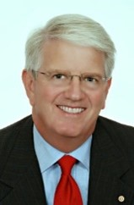
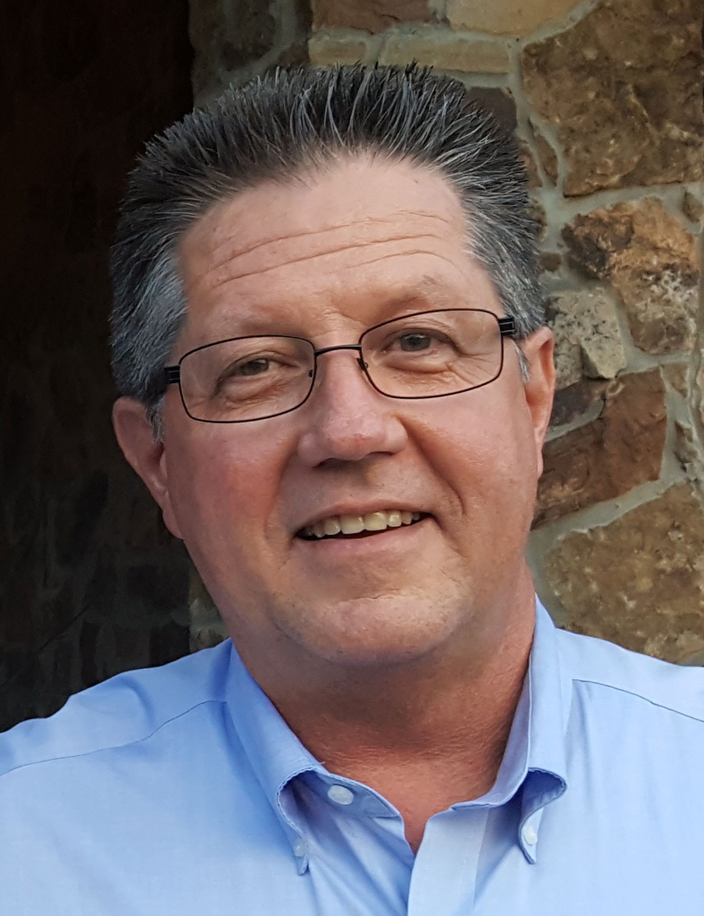
Your Rotary Foundation Chairs
Alfred Current
6960
Tom Wagner
6890

Slide 3
Foundation Basics
(It’s as Easy as 7-3-2)

Slide 4
Brought to You by the Numbers 7, 3 & 2 !
Rotary Foundation Basics – Easy to Remember
7 3 2

Slide 5
7 Areas of Focus
Peace Building & Conflict Prevention
Disease Prevention & Treatment
Water, Sanitation & Hygiene
Maternal & Child Health
Basic Education & Literacy
Community Economic Development
Supporting the Environment

Slide 6
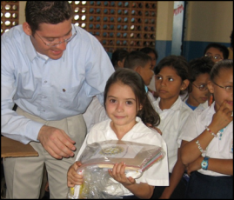
3 Funds to Accept Contributions
Annual Fund
For Support Today
Endowment Fund
To Secure Tomorrow
PolioPlus Fund
End Polio Now

Slide 7
2 Ways Receive Funds
District Grants
Global Grants

Slide 8
Rotary Foundation Basics –
Rotary Foundation Basics – Easy to Remember
7 3 2

Slide 9
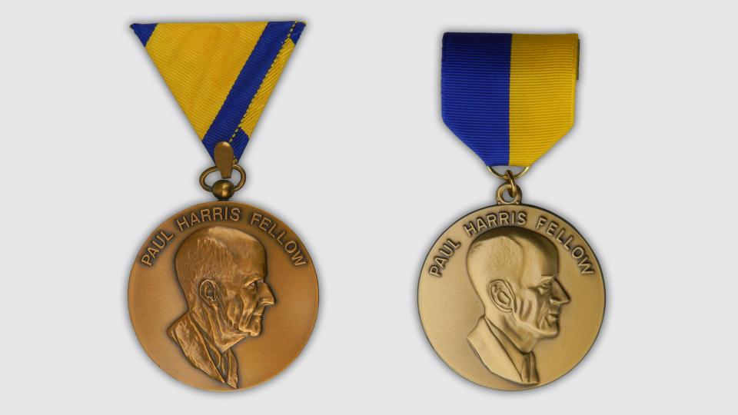
RECOGNITIONS

Slide 10
3 RECOGNITIONS (Past, Future, Present)
Contributions made in the PAST
Contributions promised for the FUTURE
Contributions being made TODAY

Slide 11
3 PAST Recognitions
Paul Harris Fellowship
Major Donor Recognition
Arch Klumpf Society Recognition

Slide 12
1. Paul Harris Fellowship

Slide 13
2. Major Donor Recognition

Slide 14
3. Arch Klumpf Society Recognition

Slide 15
2 FUTURE Recognitions
Benefactor
Bequest Society

Slide 16
1. Benefactor

Slide 17
2. Bequest Society

Slide 18
NOW Recognition
Paul Harris Society
(The ONLY recognition for contributions happening NOW, TODAY)

Slide 19
The Paul Harris Society

Slide 20
The Paul Harris Society

Slide 21
2 Ways Receive Funds
District Grants
Global Grants

Slide 22
1. District Grants
Local or international activities
Local decision making with broader guidelines
Smaller activities and projects
Include active Rotarian participation
Adhere to stewardship guidelines
Demonstrate cultural sensitivity
Align with the Foundation’s mission

Slide 23
2. Global Grants
Align with an area of focus
Respond to a community need
Include active community and Rotarian participation
Strengthen knowledge, skills, resources
Have long-term, sustainable benefits
Have measurable results
Have a budget of at least $30,000

Slide 24
Questions?
Alfred Current
6960
alfred@alfredandcharlies.com
Tom Wagner
6890
tomcwagner6890@outlook.com

