Slide 1


Welcome to Rotary
Rotary Club of Sunset West Pasco
District 6950
Revised March 21, 2019 by Bob Memoli

Slide 2
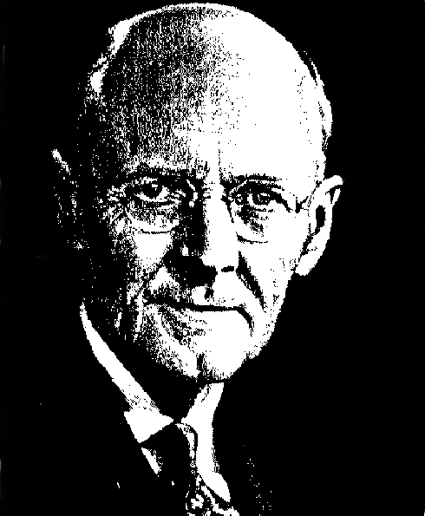
Founded 23rd Feb 1905
Paul Harris (lawyer), Sylvester Schiele (coal dealer), Gus Loehr (mining engineer) & Hiram Shorey (merchant tailor) met in Gus’ office in the Unity Building at 127 North Dearborn St, Chicago. Sylvester was the 1st Rotary club president.
Rotary Founder
Paul Harris
16 Clubs formed the National Organization in 1910
Rotary became International in 1911 with Winnipeg, Canada’s Charter with Paul Harris as RI’s 1st President

Slide 3

The Object of Rotary
First - The development of acquaintance as an opportunity for service;
Second - High ethical standards in business and professions; the recognition of the worthiness of all useful occupations; and the dignifying of each Rotarian’s occupation as an opportunity to serve society;
Third – The application of ideal of service in each Rotarian’s personal, business, and community life;
Fourth – The advancement of international understanding, goodwill, and peace through a world fellowship of business and professional persons united in the ideal of service
Service above Self is our Motto

Slide 4
Rotary is an
International Organization
532 Districts in over 200 countries
  >35,000 clubs
  1.2 million members
Our District 6950
  Covers Pinellas, Pasco, Hernando and Citrus counties
  48 Clubs
  1,800 + members

Slide 5
World Wide Membership
355,000+ North America and Caribbean
308,000+ Europe
202,000+ South and Southeast Asia, India
147,000+ North Asia, Japan and Korea
94,000+ Central and South America
64,000+ Australia, Philippines, Pacific Realm
38,000+ Africa and Southwest Asia

Slide 6

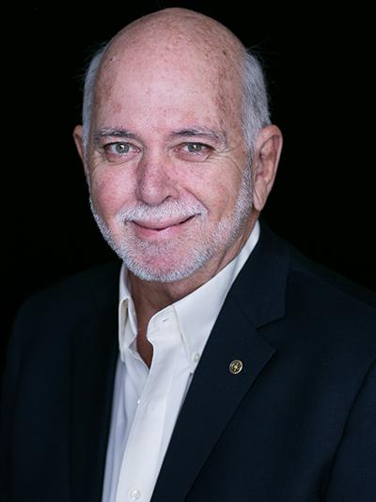

Governed by a President, President -Elect and a Board
of 17 Directors
Elected from all over the world
Each District elects a District Governor
Each club is an autonomous group
  Club President
  District 6950 Governor
Rotary International 2018-2019
President – Barry Rassin
New Providence, Bahamas

Slide 7
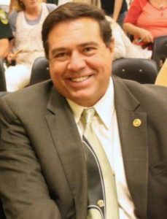
Rotary International District 6950
“Become a Better Rotarian Rotary”
Dr. Eloy Nunez
2018-2019
District Governor

Slide 8

The Four Elements of Effective Clubs
Effective Clubs
are able to..
Sustain
and
Grow Membership
Develop
Club
Leaders for
Beyond
Club Level
Implement
Successful
Service
Projects
Support
The Rotary
Foundation
Efficient Club Administration

Slide 9
We implement the
Object of Rotary through the
Club Leadership Plan and the Five Avenues of Service : Club, Vocational, Community, New Generations, and International Service

Slide 10

The Rotary Foundation
“World Peace through Understanding”

Slide 11
The Rotary Foundation’s Mission:
Fulfill the Object of Rotary and Rotary’s Mission
Achieve World Understanding and Peace

Slide 12
The Rotary Foundation
Promotes World Understanding and Peace
Works for a polio-free world
Cares for the children of the world
Feeds the hungry of the world
Provides educational opportunities
Preserves planet earth

Slide 13
Club Leadership - Officers
  President Frankie Roman
  President-Elect Rich Allen
  Secretary Nikki Connell
  Treasurer Bob Memoli
  Sergeant at Arms Esther Jones
  Maryann Senderling Director Membership
  Len Gravitz Director International
  Liaison Trish Kley
  All positions in Rotary change on July 1

Slide 14
Tools for Reaching these Goals
Local, National and International
  Cultural Programs
  Educational Programs
  Humanitarian Programs

Slide 15
Educational Programs
Ambassadorial Scholarships
Rotary Grants for University Teachers
Group Study Exchanges (GSE)
Rotary Centers for International Studies in Peace and Conflict Resolution

Slide 16
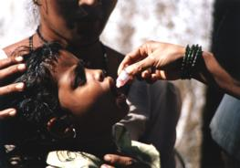
Humanitarian Programs
PolioPlus Program
  2018 Rotarians, The Bill Gates Foundation, many countries and world organizations have
  committed over $1.5 billion for global polio
  eradication called the Polio Eradication Initiative
  “Bill Gates, co-chair of the Bill & Melinda Gates Foundation, said ending polio would be one of the world’s greatest achievements.”

Slide 17
The Source of Rotary Foundation Funding
Districts
Clubs
You

Slide 18
PAUL HARRIS FELLOW
$1,000 DONATION
RECOGNITION
FUNDS FOUNDATION
OPEN TO NON-ROTARIANS
SUSTAINING PROGRAM
Rotary Founder
Paul Harris

Slide 19
Our Rotary Club
Chartered March 11th, 2019
26 Chartered Members
27 Members in Our Club
First evening Club in West Pasco

Slide 20
Fundraising
Fundraising
Supporting the Community
Supporting the World
Helping People
Operations On-Going

Slide 21
Rotary Club of Sunset WP
  Endowment Fund - Future
  Scholarships
  S4TL
  Future Leaders for Tomorrow

Slide 22
Support and Service Projects
Joining Hands/Metropolitan Ministries

Slide 23
International Projects
Serving the World
    Providing Clean Water, Sanitation and Hygiene
    Education
    Promoting Peace
    Fighting Disease
    Saving Mothers and Children
    Growing Local Economies
    Eradicating Polio

Slide 24
Social Events
Chasco Street Parade
Mixers
Holiday Party
Dog track and Rays Games
Family Picnics
Installation Dinner
District events

Slide 25
Rotary Events
President Elect Training Seminar (PETS)
District Assembly
District Conference
International Convention
Foundation Seminar
Rotary Leadership Institute

Slide 26
The Privileges of Rotary
Friendship with Leaders
Giving Service to your Community
Developing International Goodwill & Understanding
Building Higher Ethical Standards in your Vocation
Through the Common Bond of Rotary

Slide 27
Your Obligations in Rotary
Assist with Club fundraising
Attend weekly meetings (makeup's)
Join in community work
Attend social functions
Participate in Club and District activities
Build goodwill and friendships

Slide 28
Attendance Requirements
Meetings – First & Third Wednesdays of Each Month
  a minimum of 80% is expected.
You can maintain your attendance levels by
  Making up at another Rotary Club within 14 days
  Making up on-line
  Participating in a planning meeting or fellowship
  Attending a District event or a RI Convention
  Attending a monthly Board Meeting

Slide 29
Your Financial Obligations
Initiation Fee $100
Dues (incl. Meals) $200/qtr
R. I. Foundation (Paul Harris) $25/qtr
Total $225/qtr
plus variables:
Good Natured Fines $50/year
Fellowship Events $60/year
Plus optional events and charity:
e.g., District Conference, International Convention, Celebrations, Fundraisers, Foundation Contributions

Slide 30
Participate…
for friendship
for service
for fellowship
for knowledge
for international understanding
Remember You Are Rotary!

Slide 31
The 4 Way Test*
(of things we say, think or do)
1. Is it the TRUTH ?
2. Is it FAIR to all concerned ?
3. Will it build GOODWILL and BETTER FRIENDSHIPS ?
4. Will it be BENEFICIAL to all concerned ?
* Created by Rotarian Herbert J. Taylor in 1932

Slide 32
Closing Pledge
“One who profits most who serves best
Service above Self”

Slide 33
What’s Next?
Steps for Becoming a New Member
Complete the Member Worksheet
Fireside Chat
Payment of Dues
Induction Ceremony
Join a committee – what suits you best?
Trial Period

Slide 34
Proposing a Member
Is the candidate's character above reproach?
Is the reputation of the candidate's firm exemplary?
Is the candidate “Service Minded”?
Can candidate meet the financial obligation?
Can the candidate meet attendance requirements?
Is the candidate an established Citizen of Our Community?
Is the candidate willing to work on a committee and give of themselves?
Is the candidate willing to work our fund raising activities?

Slide 35
For Membership Information
Please contact…
Maryann Senderling - Director of Membership
  Phone (727) 992-4009
  E-mail maryann@whitcoinsurance.com
Bob Memoli
  Phone (727) 992-9898
  E-mail RotaryBob4@yahoo.com

Slide 36
Who Touched You
Rotary and our club cannot survive and provide for others without members. It is the responsibility of every Rotarian to enlist other members.
This responsibility is vital if we are to continue our mission locally and world wide.
Remember who brought you into the club.
Remember who touched you.

Slide 37
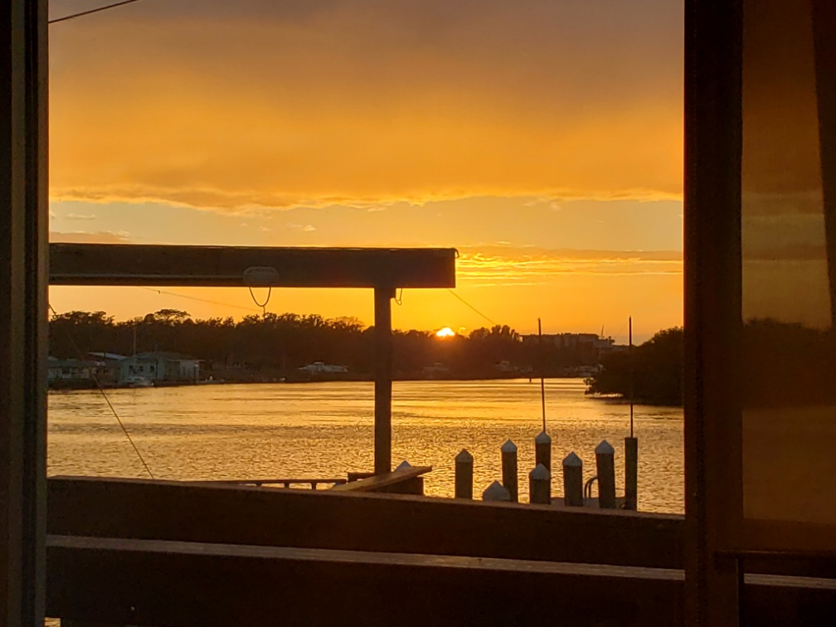
Welcome to the …
Rotary Club of
Sunset West Pasco

