Slide 1
Membership, The Magical Mystery Tour
Membership – Attract and Engage Members
Dan Sulger
March 2018

Slide 2
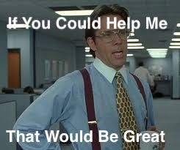
I NEED You

Slide 4
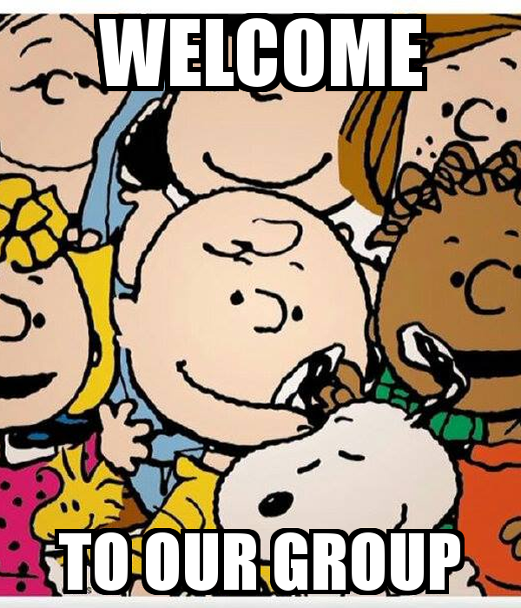
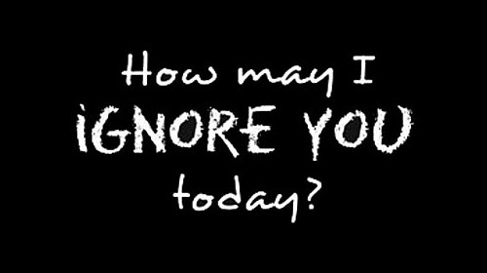
Membership Attractions – Some Things to Think About
You Don’t Get a Second Chance to Make a First Impression
What is the first impression of a visiting potential member?
What is the second impression of a visiting potential member?
What is the induction experience like for a new member? What does it look like to a visitor?
Why should someone join Rotary?
Why should someone join Your Rotary club?
Or

Slide 5
A Simple Question

Slide 6
We are People Who Believe We Can Make a Difference and WE DO

Slide 7
What We Do

Slide 8
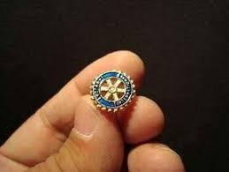
Service Above Self
According to the Past RI President, Bob Barth, a Rotary Pin says this about the wearer:
You Can Rely on Me
I am Dependable
I am Available
I Give More than I Take
I Add Value
I Serve

Slide 9
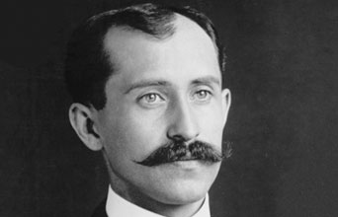
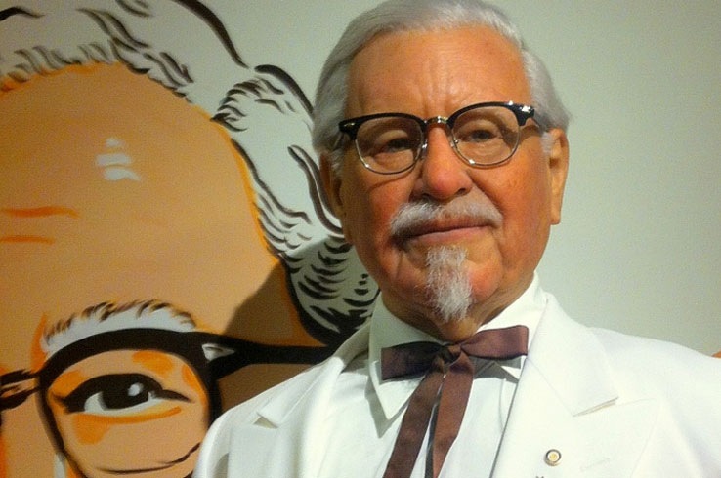
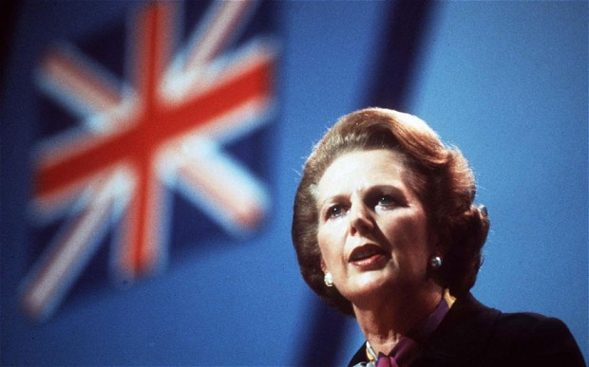
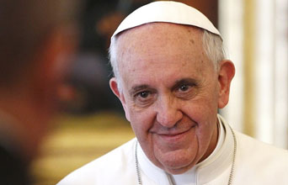
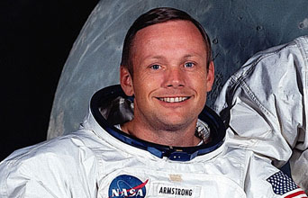
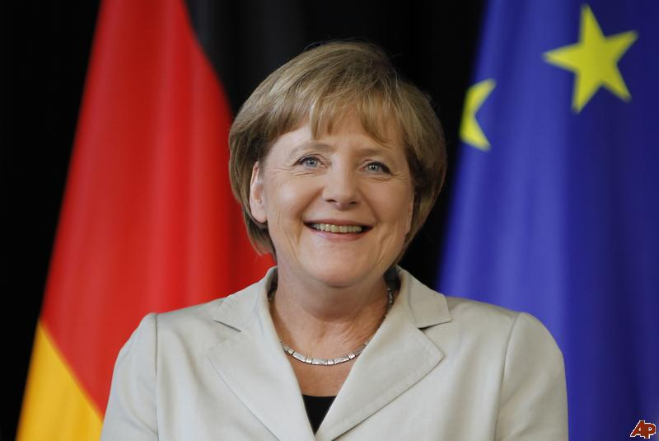
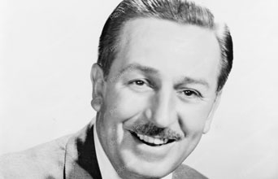
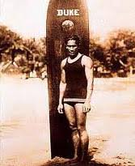
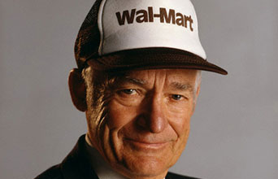
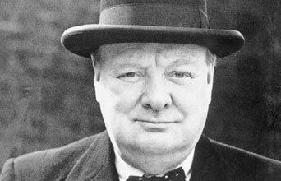
Do you Recognize These Folks

Slide 10
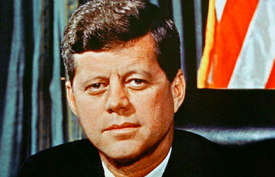
Do you Recognize These Folks
Rotarians Prove This EVERY Day
“One Man Can Make a Difference and Every Man Should Try”

Slide 11
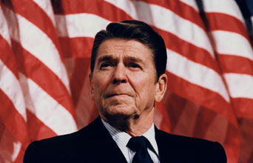
Do you Recognize These Folks
“Some people spend an entire lifetime wondering if they made a difference in the world. But, the Marines don't have that problem.”

Slide 13
Did You Know??
The Average Rotary Club loses 10% of its membership each year
Half of all new members leave within 5 years

Slide 14
Membership Engagement – How do we do it??
Investigate
Passions
Community
Active Members
Exiting Members
Honor Members
Rotary /Personal/Professional Accomplishments
Opportunity
Service Events
Social Events
Educate/Inform
Members
Find what your members are passionate about

Slide 15
Member Engagement – Did You Know??
Your MEMBERS will Tell You How to Engage Them
If You Ask!!!

Slide 16
Remember This ?!??

