Slide 1

Welcome to Rotary
New Member Orientation

Slide 2
Orientation Materials
This Is Rotary
The ABC’s of Rotary
You & Your Rotary Foundation
How to Propose a New Member
New Member Checklist
List of Club
Officers, Directors, and Committees
Club Bylaws
Paul Harris Fellow Information
Webpage

Slide 3
Rotary International is …
an international service organization whose stated human rights purpose is to bring together business and professional leaders in order to provide humanitarian services, encourage high ethical standards in all vocations, and to advance good will and peace around the world.

Slide 4
In the beginning…
The first Rotary Club was organized in Chicago in 1905 by Paul P Harris
The club, with four members, met in rotation at the offices of the members – thus the name Rotary.
There are approximately 1.2 million members in over 34,000 clubs worldwide.
Rotary Founder
Paul Harris

Slide 5
Service Above Self
Rotary was not long to recognize that fellowship alone would not keep a group together - there needed to be a purpose.
Rotary became the world’s first service club. Examples of world-wide service projects
Rotary’s first service project was public restrooms in downtown Chicago, IL.
Rotary, along with our partners, reduced polio cases by 99.9 percent worldwide wince our fist project to vaccinate children in the Philippines in 1979.
In rural Ghana, Rotary members supply clean water and sanitation facilities to prevent the spread of infectious diseases.
The Rotary Foundation helps bring pre- and postnatal care to mother in rural Haiti.
Nearly 1.4 billion employed people live on less than $1.25 a day. Our members promote economic and community development and reduce poverty in underserved communities through job training, well[paying jobs, and access to financial management institutions.

Slide 6
Core values of THE Rotary 4-WAY TEST
Rotary's core values of the Four Way Test represent the guiding
principles of the organization's culture, including what guides
members' priorities and actions within the organization.
Of the things we think, say, or do …
Is it the TRUTH?
Is it FAIR to all concerned?
Will it build GOODWILL and BETTER FRIENDSHIPS?
Will it be BENEFICIAL to all concerned?

Slide 7
OBJECT OF ROTARY
These principal have been developed over the years to provide Rotarians with a strong, common purpose and direction. They serve as a foundation for our relationships with each other and the action we take in the world.
FIRST: The development of acquaintance as an opportunity for service.
SECOND: High ethical standards: worthiness and dignifying of all occupations
THIRD: Application of the ideal of service to personal, business, and community life
FOURTH: Advancement of international understanding, goodwill, and peace through a
united fellowship

Slide 8
Mission Statement
Through our focus on Humanitarian Service, we are volunteers who work locally, regionally, and internationally to:
• combat hunger,
• improve health,
• attain clean water and sanitation,
• provide literacy and education,
• promote peace through world understanding,
• support the Next Generation (Youth),
• and eradicate polio under the motto Service above Self through sustainable
projects.

Slide 9
Five Avenues of Service
Club Service
Those things that a Rotarian does to help make successful the running of the local club.
Vocational Service
The promoting of the “ideal of service” throughout the business and professional world.
Community Service
Urges every Rotarian to participate in all activities that make the community a better place in which to live.
International Service
Encourages and fosters the advancement of understanding and good will among people of the world.
Youth Service
Recognized the importance of empowering youth and young professional through leadership development programs such as Rotaract, Interact, Rotary Youth Leadership Awards, and Rotary Youth Exchange.

Slide 10
an International Organization
Rotary is made up of four parts:
Heart of Rotary – our local clubs including us! The Rotary Club of Lynn Haven
Rotary International supports Rotary Club worldwide by coordinating global programs, campaigns and initiative.
The Rotary Foundation uses generous donations to fund projects by Rotarians and our partners in communities around the world. As a nonprofit, all of the Foundation’s funding comes from voluntary contributions made by Rotarians and friends who share our vision of a better world.
Together, Rotary clubs, Rotary International, and the Rotary Foundation work to make lasting improvements in our communities and around the world.

Slide 11
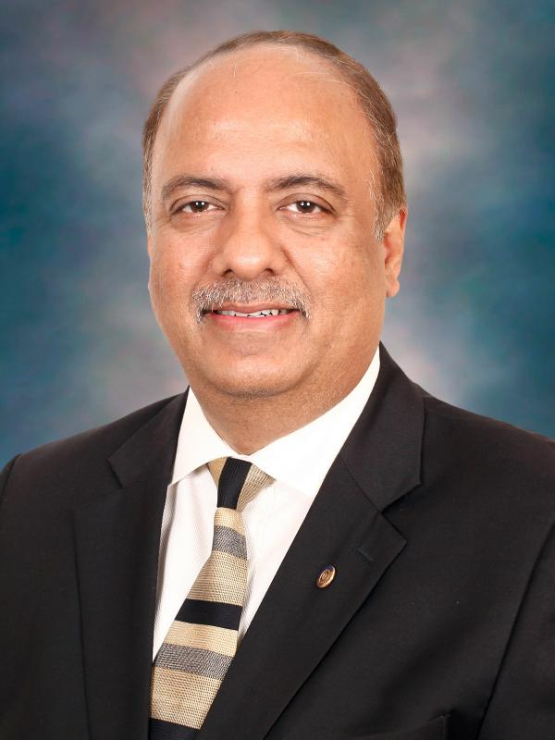

Rotary Hierarchy
Rotary International is governed by a president and a board of directors elected from all over the world.
SHEKHAR MEHTA
Rotary International President
2021-2022
Rotary Club of Calcutta-Mahanagar,
West Bengal, India

Slide 12

The Rotary Foundation
“Doing good in the world”

Slide 13
Paul Harris Fellows & Benefactors
The Rotary Foundation is essential to securing and growing Rotary programs throughout the world. We recognize donors and offer individual and club recognition, as well as naming opportunities that let you honor a friend or family member with a named or endowed gift.
Rotary Foundation Sustaining Member, $100 or more per year to the Annual Fund.
Benefactor, when you include the Endowment Fund as a beneficiary in your estate plans or when you donate $1,000 or more to the fund outright. Benefactors receive a certificate and insignia to wear with a Rotary or Paul Harris Fellow pin.
Paul Harris Fellow, $1,000 or more to the Annual Fund, PolioPlus, or an approved Foundation grant. To recognize someone else as a Paul Harris Fellow, you can give that amount in their name. You are recognized as a Multiple Paul Harris Fellow with each additional gift of $1,000.
Paul Harris Society member, when you give $1,000 or more annually to the Annual Fund, PolioPlus, or an approved Foundation grant.

Slide 14
Paul Harris Fellows & Benefactors continued
Disaster Response Fund, Your gift helps Rotary clubs provide disaster recovery and support rebuilding efforts. Contributions are combined into one fund and made available through Rotary Disaster Response Grants; they cannot be directed to a specific disaster.
Major Donor, The $10,000+ giving level does not include Paul Harris Fellow recognition point but does include amounts given in combination to both the Annual and Permanent Funds.
Bequest Society was established to recognize our support for the Permanent Fund of The Rotary Foundation through bequests – gifts at death. The Bequest Society’s growing membership includes Rotarians, family members, and friends who have each committed to give $10,000 or more in their estate plans to The Permanent Fund of The Rotary Foundation

Slide 15
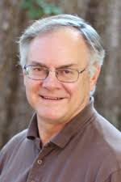
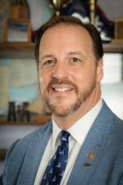
District 6940 GOVERNORS
2021-2022 District Governor
Dr. Larry Kubiak, Rotary Club of Tallahassee
2022-2023 District Governor Elect
Dan Sulger, Rotary Club of Navarre

Slide 16
Rotary Club of Lynn Haven
2021-2022 OFFICERS
Elizabeth ‘Liz’ MacLean – President
Michael Lovchuk – President-Elect
Irvin Clark- Secretary
Harold Beyer – Treasurer
Tim Farrell – Sergeant At Arms
Irvin Clark – Immediate Past President
A new board is elected to take office on 1 July of each year.

Slide 17
History of the Rotary Club of Lynn Haven
Chartered in 1973
Over 32 Current Members
District Recognition and Involvement
  District Governor Citation
  Rotary International Citation, Gold

Slide 18
Signature projects
Support of Literacy – Dolly Parton Literacy Grant
Support for the Environment – Trees in Lynn Haven
Supporting Lynn Haven Schools (Lynn Haven Elementary – Mowat Middle - Mosley High – Bay Haven Charter – North Bay Haven Charter) and Rutherford High
Support for Disabled Persons - ARC of the Bay
Support for Children in the Community – Interact & Rotaract (NOW EARLYACT)
Support for International Community – Polio PLUS
Support for First Responders - City of Lynn Haven
Support for Military - Volunteers for the Military Welcome Center at the airport

Slide 19
Rotary Fees
Quarterly Dues - $ 190 includes
  District Dues
  International Dues
  Cost of Breakfasts
Social Events – as attended

Slide 20
Rotary Protocol: Attendance
Attendance is a condition of membership
50% Attendance required (In-Person or On-line)
Make-ups are allowed
      Another Club anywhere in the world
      E-Club
      Service projects
      Committee meetings
      Trainings
      NOTE: The hosting Club will give you a form to confirm your attendance that you submit to the Secretary of your home club.

Slide 21
Rotary Communication
Club Bulletin – Rob Delaney
District Quarterly Newsletter
The Rotary Magazine
Websites:
- Club http://lynnhavenrotary.org/ - District http://rotary6940.org/ - Rotary International (www.rotary.org)

Slide 22

Welcome to Rotary
New Member Orientation

