Slide 1
PETs I Training 2017
Membership – The Reader’s Digest Version
Dan Sulger
11/2/2017

Slide 2
Where are We Today??
Club Name | Total Members @ 1 July 2017 | + | - | + /- | Current Members | Total Goal Members | Member Count Over (Under) Goal
Panama City | 115 | 1 | -1 | 0 | 115 | 110 | 5
Pensacola Suburban West | 90 | 3 |  | 3 | 93 | 90 | 3
Pensacola-Cordova | 33 | 5 |  | 5 | 38 | 35 | 3
Crestview | 38 | 2 | -3 | -1 | 37 | 35 | 2
Marianna | 65 | 4 | -1 | 5 | 70 | 66 | 4
Pensacola-Five Flags | 158 | 3 | -1 | 2 | 160 | 158 | 2
Williston | 24 | 1 |  | 1 | 25 | 23 | 2
Port St. Joe | 10 | 2 |  | 2 | 12 | 11 | 1
Tallahassee Southside | 17 | 0 |  | 0 | 17 | 16 | 1
Club Name | Total Members @ 1 July 2017 | + | - | + /- | Current Members | Total Goal Members | Member Count Over (Under) Goal
Apalachicola | 8 | 0 |  | 0 | 8 | 12 | -4
Pensacola | 202 | 3 | -4 | -1 | 201 | 205 | -4
Quincy | 31 | 0 |  | 0 | 31 | 35 | -4
Cantonment | 42 | 1 | -3 | -2 | 40 | 45 | -5
Tallahassee (Sunrise) | 83 | 3 | -3 | 0 | 83 | 88 | -5
Emerald Coast (Panama City Beach) | 18 | 2 | -1 | 1 | 19 | 25 | -6
Lake City | 70 | 4 |  | 4 | 74 | 80 | -6
Milton | 24 | 2 | -2 | 0 | 24 | 30 | -6
Fort Walton Beach | 64 | 0 | -1 | -1 | 63 | 72 | -9
Mid-Bay Bridge (Choctawhatchee Bay) | 48 | 1 | -6 | -5 | 43 | 53 | -10
Tallahassee Sunset | 18 | 0 |  | 0 | 18 | 28 | -10
Pace | 39 | 1 | -1 | 0 | 39 | 50 | -11
Club Name | Total Members @ 1 July 2017 | + | - | + /- | Current Members | Total Goal Members | Member Count Over (Under) Goal
Blountstown | 19 | 0 |  | 0 | 19 | 20 | -1
Chattahoochee | 7 | 0 |  | 0 | 7 | 8 | -1
Chiefland | 34 | 0 |  | 0 | 34 | 35 | -1
DeFuniak Springs | 20 | 0 | -1 | -1 | 19 | 20 | -1
Dixie County | 9 | 0 |  | 0 | 9 | 10 | -1
Gulf Breeze | 116 | 9 | -1 | 8 | 124 | 125 | -1
Mayo | 19 | 0 |  | 0 | 19 | 20 | -1
Pensacola North | 59 | 1 |  | 1 | 60 | 61 | -1
Pensacola Seville | 51 | 5 | -1 | 4 | 55 | 56 | -1
Tallahassee | 220 | 4 | -6 | -2 | 218 | 219 | -1
Club Name | Total Members @ 1 July 2017 | + | - | + /- | Current Members | Total Goal Members | Member Count Over (Under) Goal
Lake City Downtown | 8 | 0 |  | 0 | 8 | 10 | -2
Madison | 27 | 1 |  | 1 | 28 | 30 | -2
Navarre | 23 | 2 | -1 | 1 | 24 | 26 | -2
Niceville-Valparaiso | 23 | 1 | -2 | -1 | 22 | 24 | -2
Panama City Beaches | 66 | 4 | -5 | -1 | 65 | 67 | -2
Perdido Key | 23 | 1 |  | 1 | 24 | 26 | -2
Tallahassee Northside | 40 | 0 |  | 0 | 40 | 42 | -2
Wakulla County | 22 | 2 | -3 | -1 | 21 | 23 | -2
Branford | 14 | 1 | -3 | -2 | 12 | 15 | -3
Destin | 51 | 0 | -1 | -1 | 50 | 53 | -3
Live Oak | 55 | 0 |  | 0 | 55 | 58 | -3
South Walton County | 16 | 1 | -1 | 0 | 16 | 19 | -3
Suwannee Valley Chiefland | 27 | 2 |  | 2 | 29 | 32 | -3
Tallahassee (Capital) | 25 | 0 |  | 0 | 25 | 28 | -3
Trenton | 35 | 1 |  | 1 | 36 | 39 | -3
Total Members @ 1 July 2017 | + | - | + /- | Current Members | Total Goal Members | Member Count Over (Under) Goal
2,327 | 77 | -52 | 25 | 2,354 | 2458 | -104

Slide 3
What is Your Club All About
Take a Look at What Your Club is Know for in Your Community. Ask Yourself Some Questions
What is your core mission?
What is your unique story in your community?
What are you known for in your community?
What do your members think about your club?
What is the plan you are going to use promote your Brand within your Community?
Service Events
Brochures
Marketing

Slide 4
Rotary – The Famed Elevator Speech
30 Second Version
"Rotary is the world's oldest and most important service organization with
over 1,200,000 members in more than 30,000 clubs spread throughout 160
countries. Rotary provides clean water to those without it, feeds the hungry,
battles crippling, debilitating and disfiguring diseases and helps people learn
to read and write so they can compete in the modern workplace. Rotarians
are business and professional leaders who aspire to the highest ethical
standards in their vocations and who not only help those in need in their own
communities but who also seek to advance the cause of peace,
understanding and goodwill worldwide through scholarships, youth and adult
exchanges and humanitarian projects."
10 Second Version
"Rotary is the world's oldest and most important service organization. It
provides clean water to those without it, feeds the hungry, battles crippling,
debilitating and disfiguring diseases and helps people learn to read and write
so they can compete in the modern workplace."

Slide 5
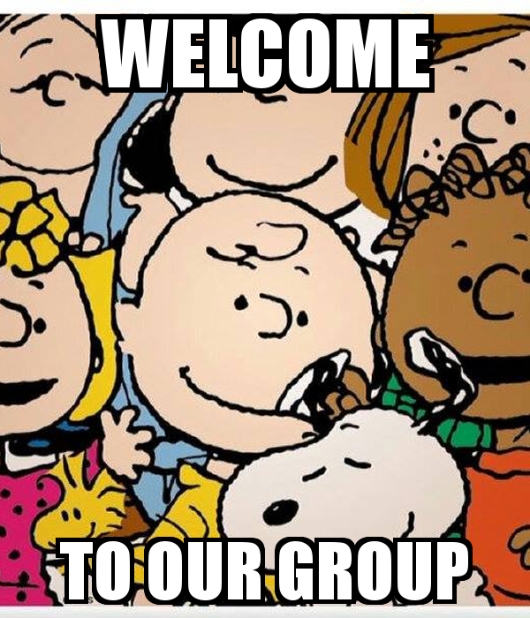
Membership Attraction – The Basics
You Don’t Get a Second Chance to Make a First Impression
What is the first impression of a visiting potential member?
What is the second impression of a visiting potential member?
What is the induction experience like for a new member? What does it look like to a visitor?
Why should someone join Rotary?
Why should someone join Your Rotary club?
Or

Slide 6
Membership Attraction – Some Suggestions
Plan Strategically
Strategic plans have value only if they are actually implemented
They are catalyst for positive change
The plans can help organizations define priorities
Reduce Meetings – Increase Service
Focus your meetings
Club Assembly
Speakers
Social Events
Service Events

Slide 7
Member Engagement – Did You Know??
Interesting Tidbits
The Average Rotary Club loses 10% of its membership each year
Half of all new members leave within 5 years
Members who attend a Rotary Leadership Institute (RLI)
*Normal retention rate: 46.3
*RLI Participants rate: 72.6
*Difference: 26.3
Your MEMBERS will Tell You How to Engage Them
If You Ask!!!
* From 1995 RLI Zone 33/34 meeting

Slide 8
Open Discussion

