Slide 1
Rotary Grants Training
For
District 6940
Club Leaders
August 2017

Slide 2
Why does Rotary offer grants?
Doing Good in the World
… to enable Rotarians to advance world understanding, goodwill, and peace through the improvement of health, the support of education, and the alleviation of poverty

Slide 3
Types of Rotary Grants
District Grants
Global Grants
Scholarships
Club Grants
Special Grants

Slide 4
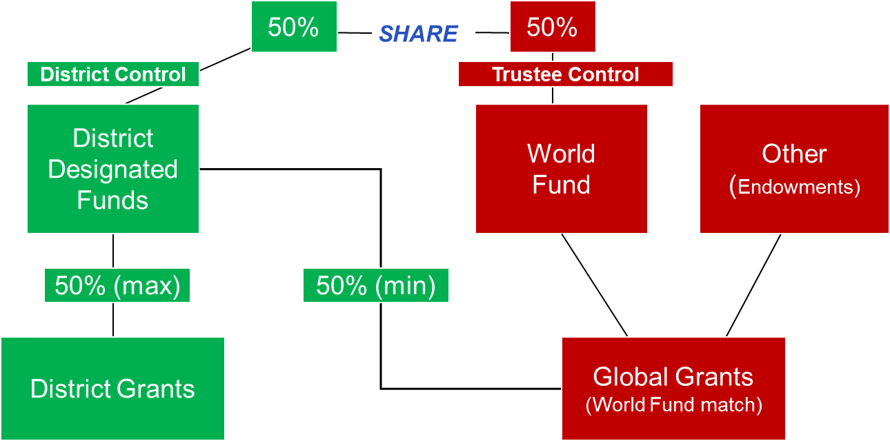

Slide 5
How grants help your club
Create service opportunities
Encourage member participation
Promote philanthropy
Offer leadership opportunities
Build good will and friendship
Support the Rotary mission

Slide 6
Rotary grants compared
DISTRICT GRANTS
GLOBAL GRANTS
International service projects
Rotary partners in 2 countries
Align with Area
of Focus (AOF)
Sustainable Impact
Measurable Results
Longer Time & Bigger Budgets
Emphasize Education and Training
Mostly local service projects
Club or District sponsored
Hands-on Rotarian activity
Done in one year
Support Rotarian Exchange – any where and any kind
Support youth projects like RYLA, Interact, Rotaract, and scholarships

Slide 7
District Grants
What are they and how do they work?

Slide 8
What are District Grants?
Projects funded with District Designated Funds (DDF) from annual Block Grant
D-6940 awards club-sponsored grants
Implemented under district guidelines
Mostly local projects with one-year timeline
Rotary partners not required
Can be used for scholarships or youth projects
Opportunity to pilot future global grant

Slide 9
Criteria for district grants
Address community need or problem
Modest budget with measurable impact
Short timeline – one year or less
Must include Rotarian service
Clubs contribute to their grant
Community involvement helps
Club support for TRF matters

Slide 10
Plan your district grant
President-elect has lead role
Start early – look for opportunities
Avoid “expected” and “re-run” projects
Work with other clubs & local community
Expand your project with non-Rotary funding
Build on what your club is already doing
HANDOUT: Grant Activity Calendar

Slide 11
District grants create opportunity
Support youth programs: Interact, Rotaract, RYLA, Youth Exchange, Scholarships.
Offer more project flexibility and less stringent documentation.
Allow some construction − Shelter Box and renovation of existing buildings.
Fund some Rotarian travel. TRF restricts travel to certain locations.
Collaborate with nearby clubs
Opportunity to pilot future Global Grant.

Slide 12
Recent D-6940 grant projects
Newspapers in Education for Students
Rotary Readers at Schools
Porta-cribs for Babies in Foster Care
Weekend Food Backpacks for Needy Students
Rotary Scholarship at Technical College
Food, Clothes & Resources for Homeless Teens
Inmate Literacy & Vocational Training
Rotary Youth Exchange

Slide 13
Using DACdb for Grants
District And Club database

Slide 14
What in the world is DACdb?
DACdb = District And Club database
DACdb-Grants is online system that supports administration and records for district grants.
All District Grant activity done on DACdb
Permanent storage site for D-6940 grant records
Access to DACdb-Grants limited to: President, President-elect, Grants Chair, Project Manager
➔ Global Grant information is on TRF website

Slide 15
Find your club grant on DACdb
Log-in to our DACdb site at:
www.directory-online.com/Rotary/SecLogin3.cfm
Click GRANTS tab (top) & open Club Grants (left)
Review current grant by clicking eye icon
To print grant info, click on Project Name
Start new application at Rotary Year / New Request
Answer all questions and Save work as you go
➔ Do not change Grant Status

Slide 16
Global Grants
Get involved in international service projects

Slide 17
Global Grants are multi-club, international projects that produce measurable impact and sustainable outcomes in TRF Focus Area.

Slide 18
What’s different about global grants?
Replace old Matching Grants - not identical!
Budgets of $30,000 to $200,000
Rotary Partners from 2+ different countries
Must align with TRF Area of Focus
Partners & Sponsors contribute DDF & Cash
Non-Rotarian contributions can be matched
Emphasize Sustainability, Training, Education

Slide 19
What are TRF Areas of Focus?
Peace and Conflict Resolution
Disease Treatment & Prevention
Water and Sanitation
Maternal and Child (Infant) Health
Basic Education and Literacy
Economic & Community Development

Slide 20
How are global grants funded?
Contributions matched from World Fund
Cash matched 50 cents per dollar
DDF matched dollar for dollar
Non-Rotary contributions can be matched
Rotarians get PHF credit for contributions to specific global grant.
In-Kind donations not matched, but count toward overall project budget.
TRF processing fee for handling cash contributions sent there by clubs or districts.

Slide 21
Get started on a global grant
Find Project and Partners you can work with
Start early – grant planning takes time!
Develop detailed Plan, Budget, Timeline
Confirm Partner Eligibility and Qualification
Get District Approval in advance
Create grant application online at: My Rotary / Foundation / Grant Application Tool
Gather required documentation beforehand
HANDOUT: Global Grant Pre-Application

Slide 22
What are VTTs?
Vocational Training Teams (VTTs) are sustainability component for global grants. They provide expert training and resources to enable beneficiaries to continue activity after the grant ends.
Grant budget covers cost of VTT travel, lodging, materials, equipment
VTT must have Rotarian leader and 2+ members
Preference for Rotarian experts on VTT
Qualifications must be documented
Detailed Training Plan & Curriculum required
VTT Resources: RAGs and Cadre of Experts

Slide 23
Combine global grant and scholarship?
YES -- comply with special TRF requirements:
For graduate studies at accredited university
Degree/Program must relate to AOF
Recipient should have undergrad study or work experience in relevant field
Recipient must be admitted to study program
Scholar must be involved in the GG project
Grant plan must emphasize education and training

Slide 24
Plan your global grant project
Choose known and reliable partners
Form Project Committee and assign roles
Identify eligible Project linked to AOF
Review AOF criteria carefully
Develop Plan, Budget and Timeline
Agree on Goals and Evaluation plan
Involve beneficiaries in planning
Set funding goal and recruit donors
Seek non-Rotary support

Slide 25
Global grant eligibility and deadlines
Global grants can be district-sponsored or club-sponsored.
All districts and clubs involved must be Qualified, Eligible & in Good Standing.
D-6940 clubs must submit GG Pre-App before starting any activity.
Applications accepted on rolling (continuous) basis – no set deadlines.
DDF availability determines when most GG applications are submitted.

Slide 26
Tips and Tactics
Improving success in getting Rotary grants

Slide 27
How are district grants paid?
D-6940 uses two Payment Options:
Full Payment on Project Completion
Pay-as-You-Go Installment Plan
Installment Plan is more work (reports), but helps clubs with limited resources.
Both options require submission of signed report and financial documentation.
Club submits Grant Payment Request with full bank info for electronic payment.
No payment without documentation.

Slide 28
Clubs must be Grant Qualified
President appoints Club Grant Chair
Grant Chair & PE complete Grants Training
President-elect must attend PETS
Club submits Grants MOU every year
Club fulfills qualification requirements
separate bank account for grants
adopt grant management plan
inform members about grant activity
no overdue reports or projects

Slide 29
What is the Grants MOU?
Memorandum Of Understanding − agreement between TRF/District/Clubs confirming obligations for Rotary grants.
Rules & Procedures for Rotary grants
Confirms club eligibility for grants
Submitted annually (June) – good for 1 year
Signed by club president & president-elect
Do you need MOU if your club has no grants?

Slide 30
Rotary Grant No-Nos
No Deals: Beneficiaries cannot agree to provide local funds in exchange for receiving Rotary grant.
No Hand-Off: Rotary grant funds cannot be turned over to another organization.
No Major Construction: Grant funds cannot be used to purchase land or construct new buildings.
No Salaries: Grantees can contract for labor or pay for direct service; no funding for on-going salaries.
No Religious Activity: Grantees can work with faith-based organizations, but grant funds cannot be used to promote religion or religious purpose.
No Money Left Behind: Any grant funds not spent must be returned to TRF.

Slide 31
What happened to exchanges and scholarships?
Rotary Exchanges did not go away – they are done as district grants.
Types of Rotary Exchange projects:
✓Youth ✓ Vocational ✓ Training ✓ Friendship
Named Rotary scholarships did stop, but clubs and districts can use grants for:
Local scholarships – TSIC, College, Technical School
International – Graduate study linked to global grant
Peace Scholars – TRF program (contact Kathy Suerkin)

Slide 32
HELP – DACdb is not working!
DACdb is an electronic information system, so expect occasional glitches.
DACdb serves many districts and some Grant functions are not used by D-6940.
When you encounter issues …
Check for updates on DACdb homepage
Advise District Grants Chair of problem
Avoid DACdb-Grants “Help” function
Refer to notes from Grants Training

Slide 33
Grant Management
Leadership, Oversight, Records, and Reporting

Slide 34
Grant management matters
Use established business practices and principles to implement grant projects.
Practical financial controls and policies
Rotarian oversight and transparency
Avoid conflict-of-interest
Measure results objectively
Ensure good stewardship of TRF funds
Affirm value of Rotary philanthropy

Slide 35
Club grant management plan
Statement of responsibility and procedures
Required component of the club MOU
Club adopts plan and submits to District
Review and update club plan as needed
Applies to all types of grants
Districts have a Grant Management Plan
Handout: Model Grant Management Plan

Slide 36
Manage grant plans and reports
Describe partner roles and activities
State what will be done and when
Explain beneficiary training and education
Describe goals, outcomes, evaluation process
Show alignment with Area of Focus
Document all funding and expenditures
Provide feedback from beneficiaries
Detailed records and oversight
Report problems and get approval for change

Slide 37
District grant payment process
Clubs with approved grant can start project activity now, using club contributions.
Move all club (and community ) contributions into your grant account before spending.
Documentation includes bank statements and expense records -- checks, receipts, invoices, purchase orders.
For long-term project, spend club contributions and submit complete Progress Report for partial payment.
For project with short duration, complete activity and submit complete Final Report to receive grant payment.
Submit signed Grant Payment Request with complete bank information for electronic payment.
Handout: Grant Report and Payment Request form

Slide 38
Use your grant bank account
Use separate bank account for grants
Try local bank, credit union, or online bank
Low-fee, limited transaction account
Club provides opening account deposit
Use account for all grant activity
Keep account open continuously
Involve and inform the club treasurer

Slide 39
Record retention for grants
What documents should clubs retain?
District Grant application
Bank account statements
Expenditure documentation (POs, invoices)
Check copies for contributions
Project reports and photos
Documentation of Rotarian participation
Interim and Final Reports

Slide 40
Permanent grant records & files
Our District’s permanent grant records storage site is on DACdb/6940.
Each club grant has a file on DACdb-Grants
Audit Committee reviews all grant records
Club MOUs are posted on DACdb
Reminder to upload your records from 2017
To add club records, log-on DACdb and open: FILES / 2016-17 / Foundation / Public Files

Slide 41
Grant Planning for Next Year
6940
District Grants
in RY-2019

Slide 42
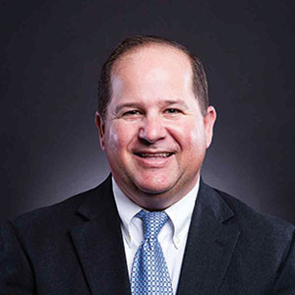
Challenge from DGE John Medina
“Lets have more district grants than ever before!”

Slide 43
Key Grant Dates 2018
Jan – Feb
Feb 12 - Mar 30
March 1-30
Mar 1-3
March 16
April 1-5
April 7
May 6
May 26
June 16
June 28
August
Clubs develop RY-2019 grant projects
Clubs submit District Grant applications
Clubs submit Global Grant Pre-applications
Florida PETS Training for PEs
Status reports due for current district grants
New grant applications reviewed & finalized
District Share Committee meets
Grants for RY-2019 announced
District Spending Plan finalized
Final Reports due for current district grants
Club Grant MOUs due
Grant Training Workshops

Slide 44
What is the District spending plan?
District Spending Plan allocates our DDF for district grants, global grants, Polio, and Rotary Peace Scholars.
Governor-elect submits the Annual Spending Plan to TRF in June, stating how district will spend its DDF allocation in the following year.
Annual Spending Plan encourages advance planning and strategic use of DDF.
District and Clubs must plan ahead!

Slide 45
RY-2018 District Spending Plan
District Grants
Global Grants
$68,550 DDF
Expect 30 projects
$350,000 impact
Average grant $2000
$85,000 DDF
$50,000 from clubs
8 projects
$2.5 million impact
Project Areas:
Education & Literacy
Job Skill Training
Wheelchairs
Water & Sanitation
Medical Care
Plus $21,00 for Polio

Slide 46
What is Share Committee?
Reviews grant applications and recommends grant awards and DDF allocation.
SHARE Committee Members
District Governor District Foundation Chair
Governor-Elect Governor-Nominee
Club Representatives:
- Top 2 Clubs Total Giving
- Top 3 Clubs Per Capita Giving
Non-Voting members:
Stewardship Committee Chair and District Grants Chair

Slide 47
Going from Good to Great with Grants
Plan ahead
Plan ahead for your club’s grant activity
Complete
Complete Grant Qualification requirements
Manage
Manage grant funds and activity well
Complete
Complete projects and submit reports on time
Promote
Promote Rotary in community through grants
Inform
Inform club members about grants activity
Encourage
Encourage club members to support TRF

Slide 48
How to learn about Rotary grants?
TRF Grants website
Grant Training
E-learning modules
Assistant Governors
Zone Leader
District Grants Chair
www.rotary.org/TRF
This workshop
TRF website
Informed & Helpful
Ivan Johnson
Christine Isham

Slide 49
Where to get forms and handouts
Find this presentation with handouts and basic grant forms on our DACdb site. Log in, open FILES tab and go to: 2017-2018 / Lisa Weeks/ 6940 Grants Training.
For help with specific grant projects or problems. send email to Christine at crisdanish@gmail.com

Slide 50
Thanks for Your Participation!
Follow @crisdanish on Twitter for grant tips and updates.

