Slide 1


Slide 2


Rotary Learning Institute
It’s not just for those who wish to become club or district leaders
Save the Dates:
August 24th 2024
January 18th 2025
***We can also schedule “area” session if we get enough registered.

Slide 3



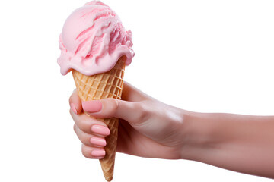

Worlds Greatest Meal
In October have an ice cream social with your local ice cream shop to raise $$ for Polio

Slide 4

District Conference 2024-2025
Learning on Land
November 2, 2024
Keiser University - Port St. Lucie
***This IS also the required Grants Seminar which will include membership and Public Image breakouts as well

Slide 5

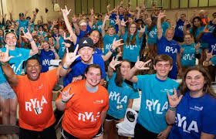
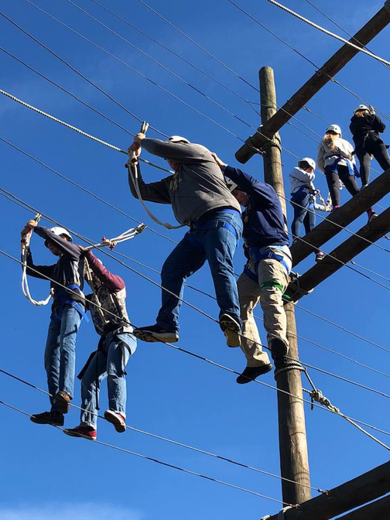
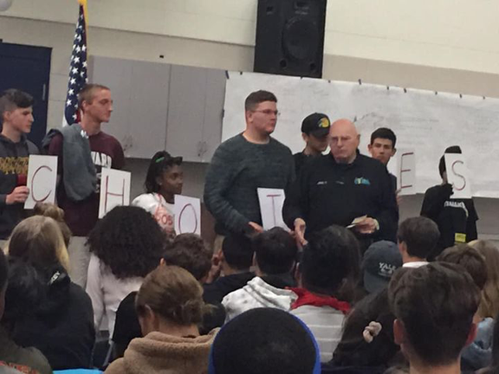
November 20-24, 2024

Slide 6

District Goals

Slide 7

Foundation
Bronze 2+ Silver 3+ Gold 5+
+++To qualify all clubs must identify a Rotary Foundation Chair in DACdb By 8/1/2024
  Have a Rotary Foundation Program at a Club Meeting in November
  Have a minimum of 2 members attend the fall Grants Seminar
  Have 10% of members reach the next level of giving
  Have 5% of members become Paul Harris Society
  Have a Polio Awareness event in October such as Worlds Greatest Meal
  Increase combined club giving to Annual Fund by 10% by May 31, 2025
  Participate by sponsoring or giving to a Global Grant
  Leadership Gift to the Rotary Foundation of cash or bequest

Slide 8
Membership
+++To qualify all clubs must identify a Membership Chair in DACdb By 8/1/2024
Silver Club
  Have at least 3 members attend a MAP Seminar
  Have a NET growth by 3
  At least 3 member attend District Membership Seminar
Bronze Club
  Have at least 1 member attend a MAP Seminar
  Have a NET growth by 1
  At least 1 member attend District Membership Seminar
Gold Club
  Have at least 5 members attend a MAP Seminar
  Have a NET growth of 5
  At least 5 members attend District Membership Seminar
  Sponsor a new club

Slide 9
Public Image
Bronze 2+ Silver 3+ Gold 5+
+++To qualify all clubs must identify a PI Chair in DACdb by 8/1/2024
  Your club website is current and using current Rotary Graphics
  Your club Social media sites are up to date with current LOGO etc.
  Add your newsletter to your club website or Social Media
  Post to social media at least once per month
  Have a non-Rotarian Post about your club
  Post a foundation event such as the ice cream social
  Post when you install a new member at least once
  Post about your Foundation speaker during November
  Congratulate a member on a life event on social media
  Post your area District Governor Visit

Slide 10

Pre-Pets Plus
President-Elects Prep for PETS
Plus
Learning for the membership
January 2025

Slide 11
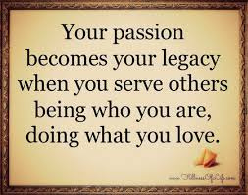

Legacy Magic
Join PRIP Holger Knaack for an Evening Of Legacy Magic
March 28th 2025
Join the many Rotarians and friends who have made commitments to improving and enriching lives around the globe by creating your personal legacy with The Rotary Foundation.

Slide 12

District Awards
and Assembly
Date: Spring 2025

Slide 13


Slide 14
It’s up to you to show your community the magic of Rotary with every project completed, every dollar donated and every new member inducted.
RIP Stephanie Urchick

