Slide 1
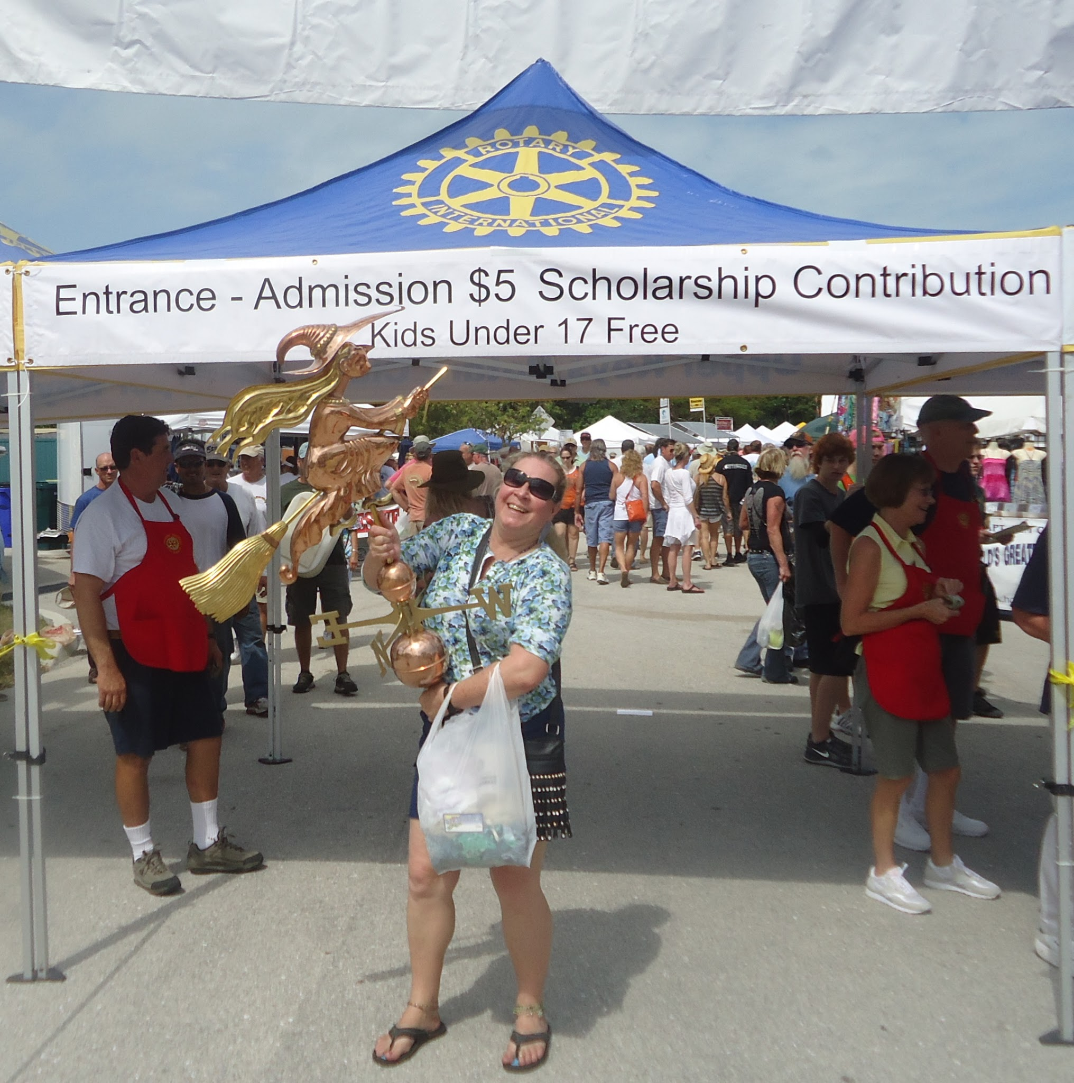
Upper Keys Rotary
Gigantic Nautical
Flea Market
An Easy Way to Show Your Product
to 15,000 Qualified Buyers

Slide 2
Presidents’ Day February holiday. It’s cold up north and the Keys are full.
After the Miami Boat show. We get the best vendors. (NOT a “Flea” Market!)
An Easy Way to Show Your Product
to 15,000 Qualified Buyers

Slide 3
- Goals of the marketing program: - Raise money for the Upper Keys Rotary and Key Largo Rotary scholarship programs - Create attendees - Encourage sponsorships - Support the vendors - Raise / reinforce the image of Rotary in the community - Contribute to the health of the two Rotary clubs (100+ members combined)

Slide 4
Strategies to Meet Those Goals: -- Newspaper ads and Editorial
-- Special Demographic Print Edition
-- Radio ads and talk show interviews
-- Road Signs
-- Facebook videos, YouTube videos, & Google ads -- Instagram Videos, Stories, & Reels -- Magnetic Car Signs -- Handbill Posters & “Leave Behinds” -- Vendor map + searchable database online

Slide 5
Headcount of adults:
Saturday 10,192
Sunday 5,472
Plus over 300 volunteers
An Easy Way to Show Your Product
to 15,000 Qualified Buyers

Slide 6
756 Entry interviews --Top line items:
38 states outside Florida (25 ea Michigan, New York, New Jersey)
12 foreign countries
27% Upper Keys, 28% Miami/Dade, 8% lower Keys, 37% outside SE FL
People who credited any newspaper: 164
People who credited any radio: 84
People who credited any Internet: 93
People who saw signs along the road: 151
People credited Word of Mouth (friends): 276
An Easy Way to Show Your Product
to 15,000 Qualified Buyers

Slide 7
-- Handbills -- Newspaper Ads: -- Keys Weekly -- 2 x Free Press

Slide 8
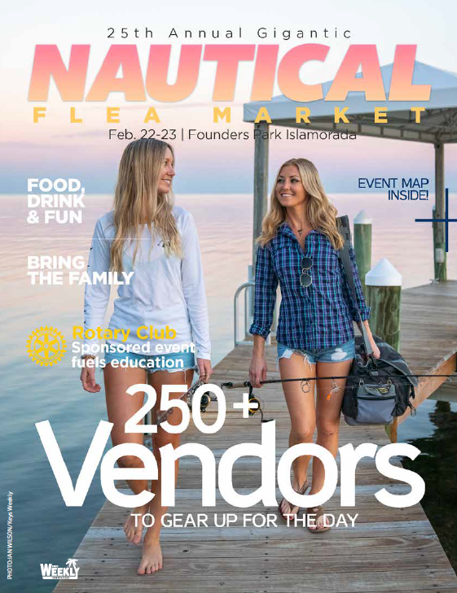
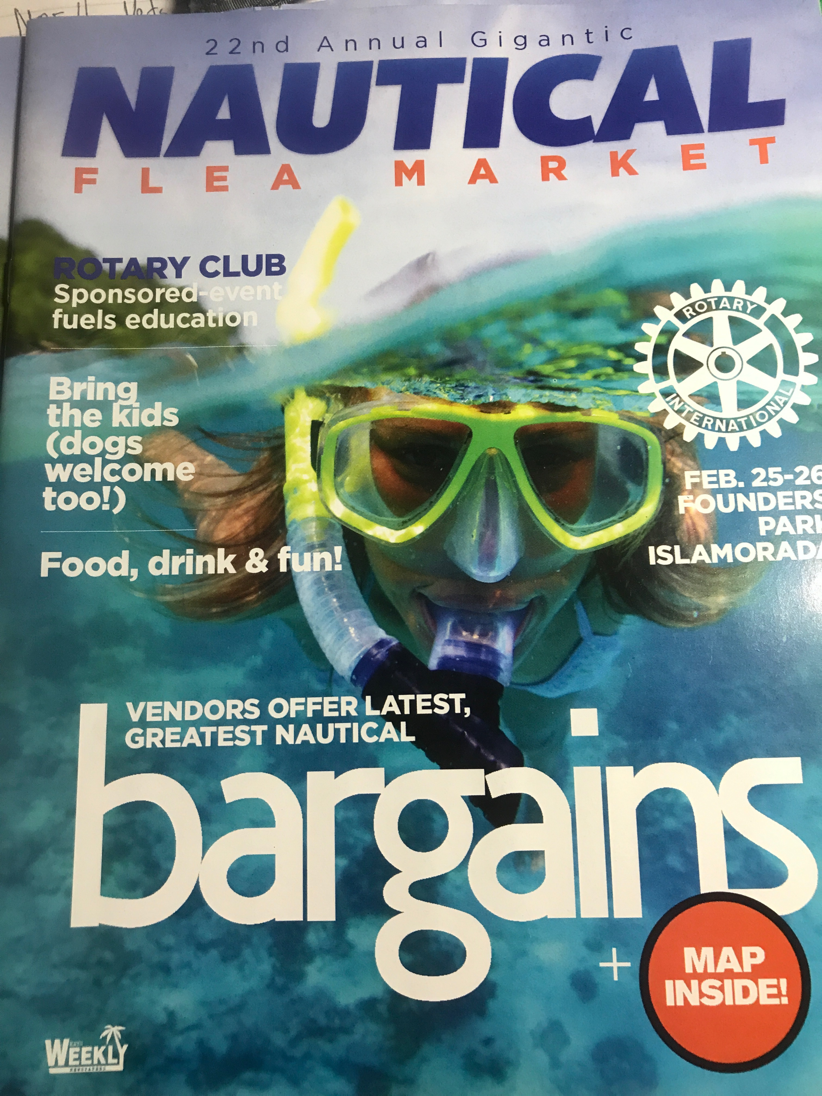

Slide 9
-- Magnetic Car signs -- 50+ in the Keys -- Two sizes

Slide 10
-“Promoted” Videos on Facebook, Instagram and YouTube - Similar ads on radio - Google ads

Slide 11
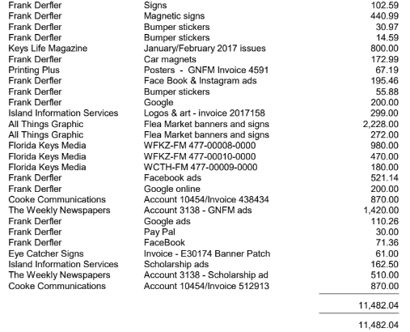
2017 for
Example
Only
EXPENDITURES:
Note that this listing includes banners.
In 2019 “Marketing” was about $9,000 w/o banners.
>Show Signs
NOTE: That’s about 5% of Gross →

Slide 12
SEQUENCE OF EVENTS
Forever: Work with Rotarians finding sponsors
November: Coordinate with Keys Weekly on Special Pub
November: Contact Sue Beal with a plan
Early December: Email blast students asking for Photo and Paragraph. Use list of $$ scholarships from 2019. DUE 1/14
December: Review prepare videos: English & Spanish
January: Order new mag signs and date patches for old
Early January: Bug the students again (!)
January: Sue Beal for Posters.. Order posters
January: Coordinate w/ President on Shirts

Slide 13
SEQUENCE OF EVENTS
Early January: Develop/Edit Special Edition Content
Early January: Solicit students to ride buses
Jan 14: Beg Students. Edit/crop student photos and ‘graphs
Mid January: Decide on radio … create/ place? Spanish?
Late January: Coordinate with Rotarians finding sponsors
Late January: Coordinate with Sue Beal on Sponsors
Early Feb: Place Free Press ads: Sue Beal ?Homestead?
Feb 1: Launch mag car signs: 3 Clubs
Early Feb: Finalize students riding buses
Early Feb: Slow Launch Facebook: English & Spanish
Mid Feb: Boost Facebook, Google, Instagram, YouTube

Slide 14
SEQUENCE OF EVENTS
President’s Day Onward: Push social Media.. New content
Create “Thank You Sponsors” w Sue Beal & Keys Weekly
Final Coordination with Student volunteers
Decide if doing gate survey and or gate count
EVENT: Watch coordinate bus loadings
POST EVENT: “Thank You Sponsors” ad in Keys Weekly
Get all invoices paid

