Slide 1


Slide 2

≈Ç

Slide 3
≈Ç
GUIDING PRINCIPLES
Motto: Service Above Self
Moral Code: The 4-Way Test
- Is it the TRUTH
- Is it FAIR to all concerned
- Will it build GOODWILL and
BETTER FRIENDSHIPS?
- Will it be BENEFICIAL to all concerned
Friendship ~ Ethical Standards ~ Service ~ Int’l Peace/Goodwill

Slide 5

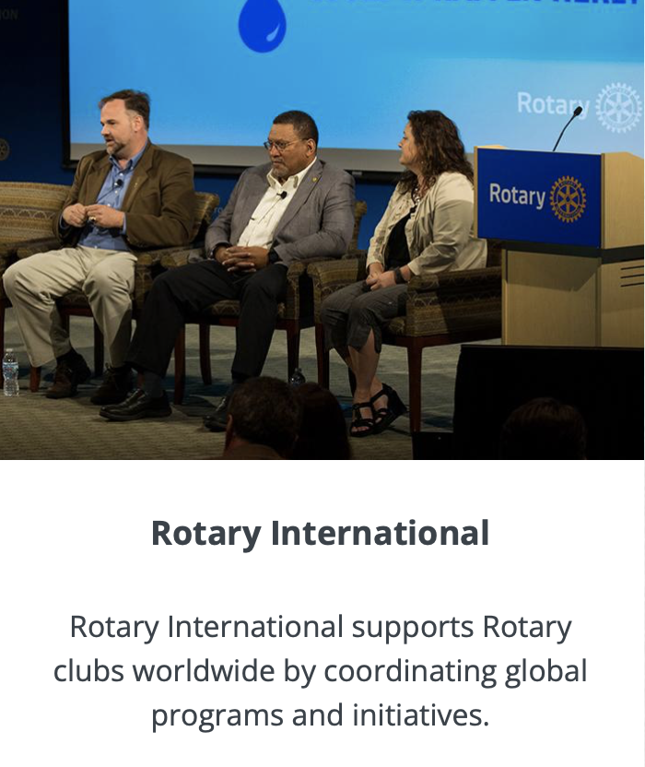

STRUCTURE OF ROTARY
Rotaract Clubs (18+): Bring together young people ages 18+ with a focus on service, leadership and fellowship.
Interact Clubs (12-18): Youth ages 12-18 connect and learn about their communities through service and activities.

Slide 6

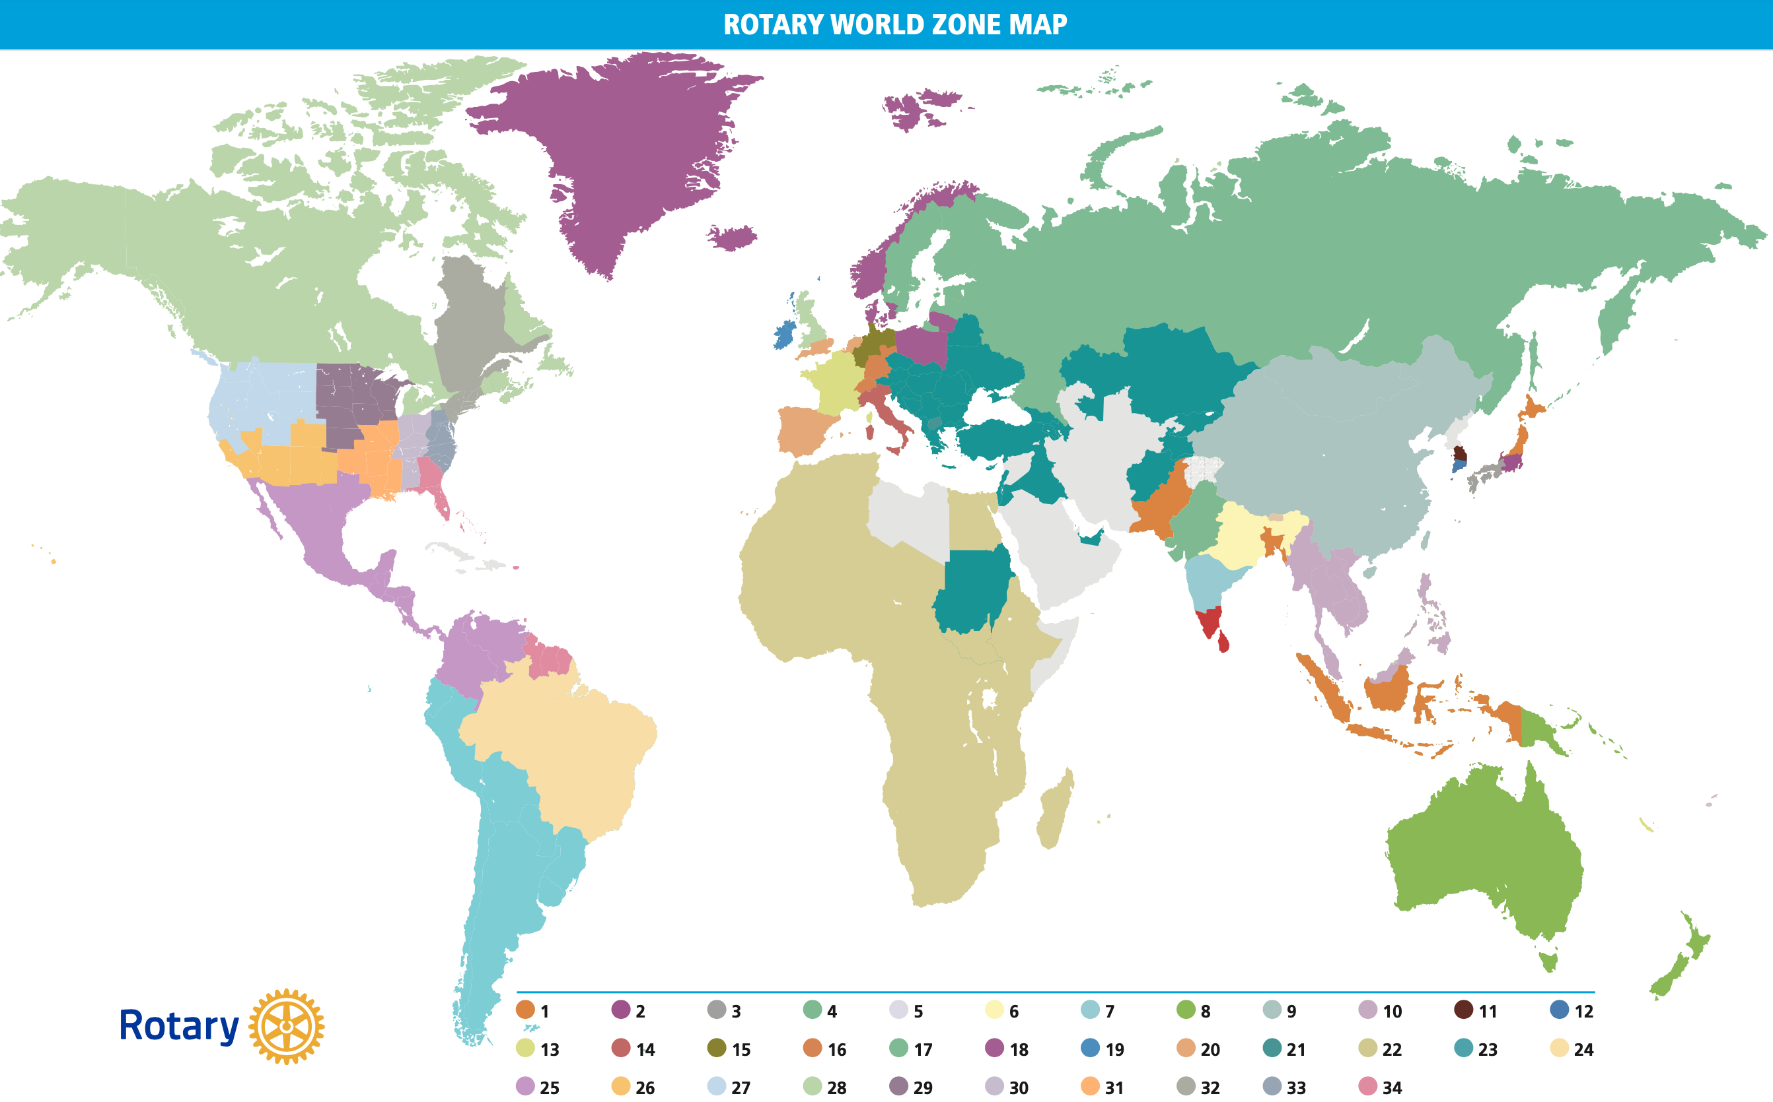

Slide 7
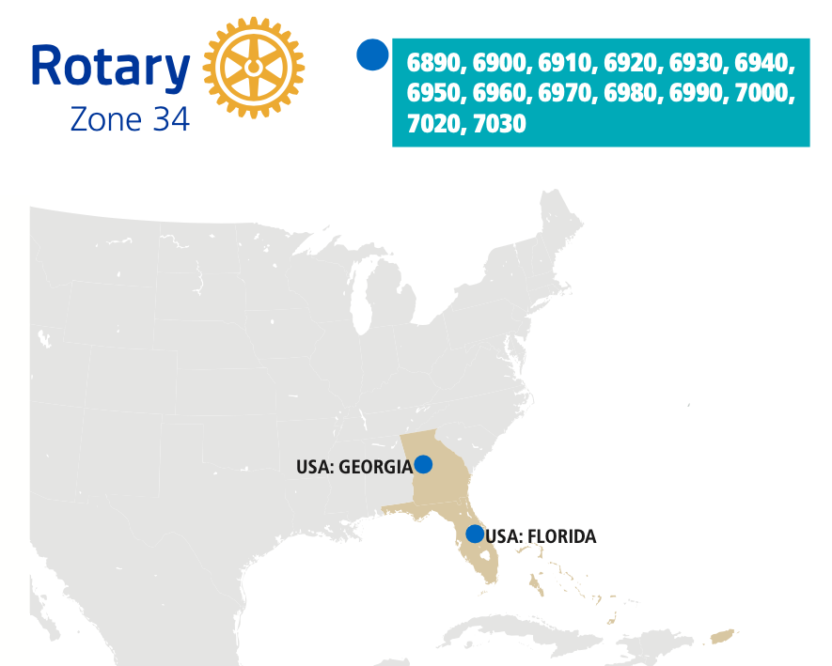
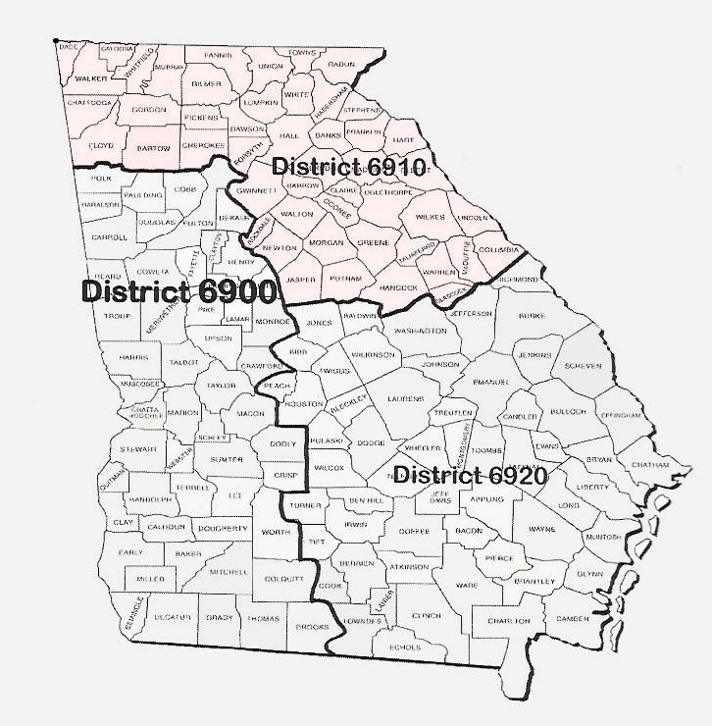
OUR CLUB
Zone 34
District 6910

Slide 8
Active Individual: 31
Active Corporate: 11
Active R85: 3
Total Active: 45 members
        (6 Honorary)

Slide 9
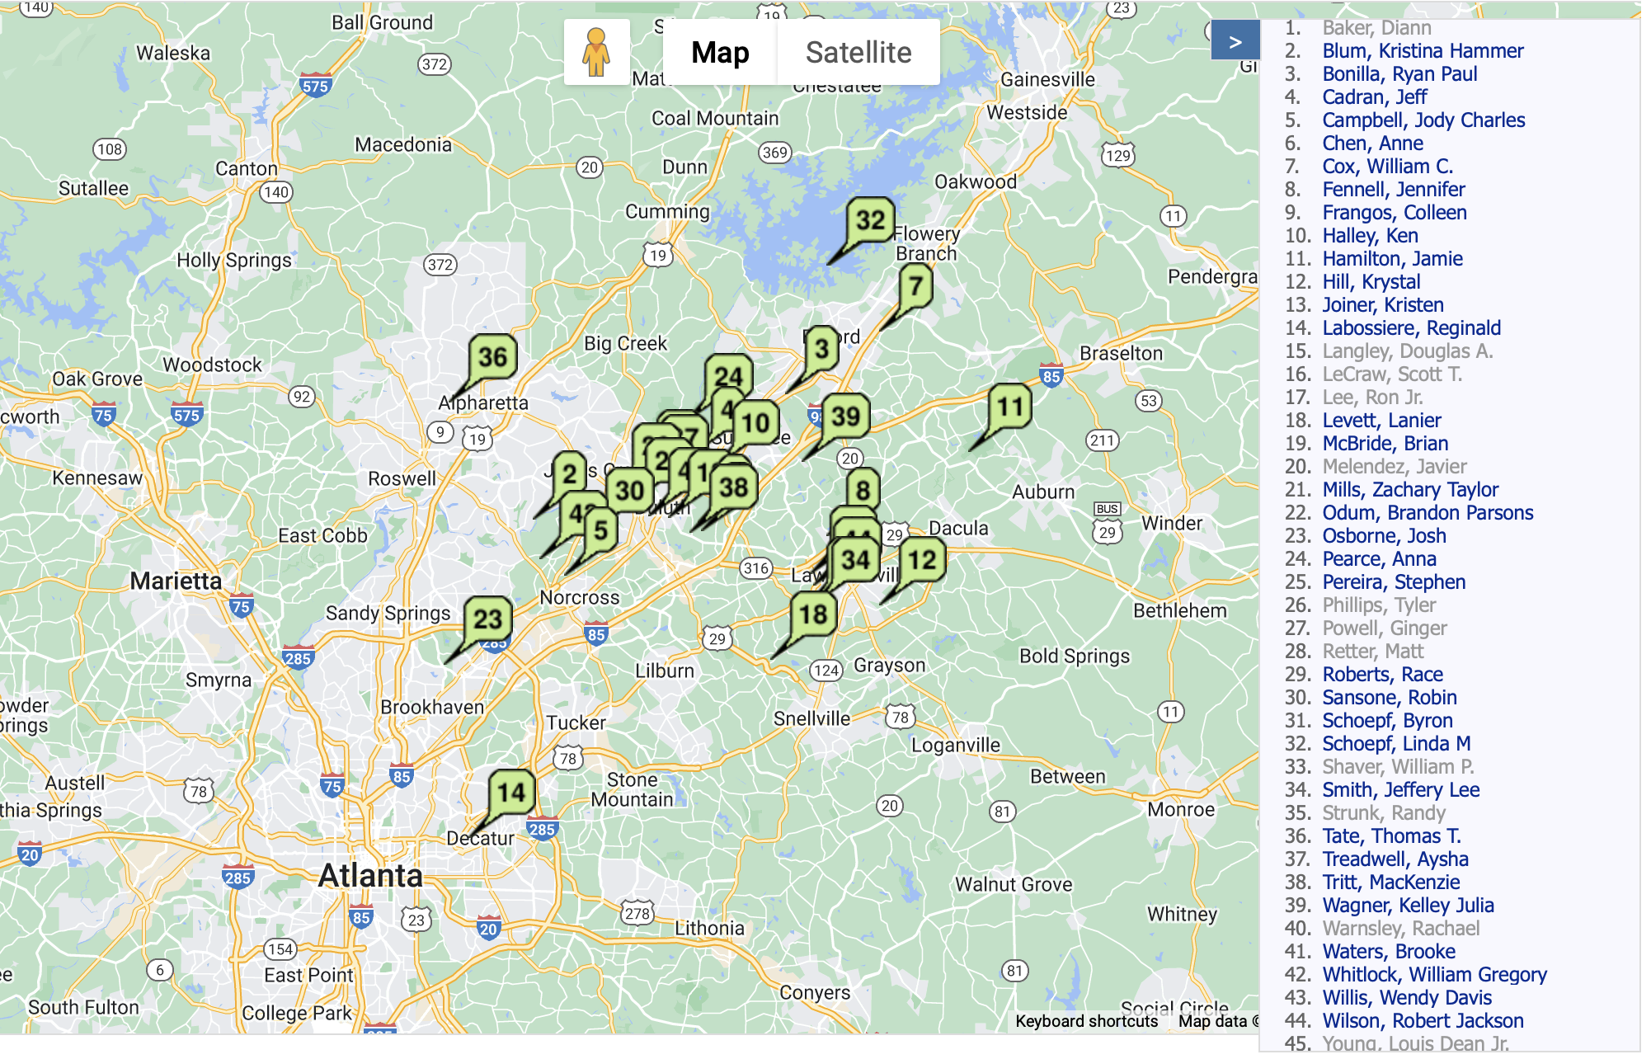
MEMBER
MAP
Active Individual: 31
Active Corporate: 11
Active R85: 3
Total Active: 45 members
        (6 Honorary)

Slide 10
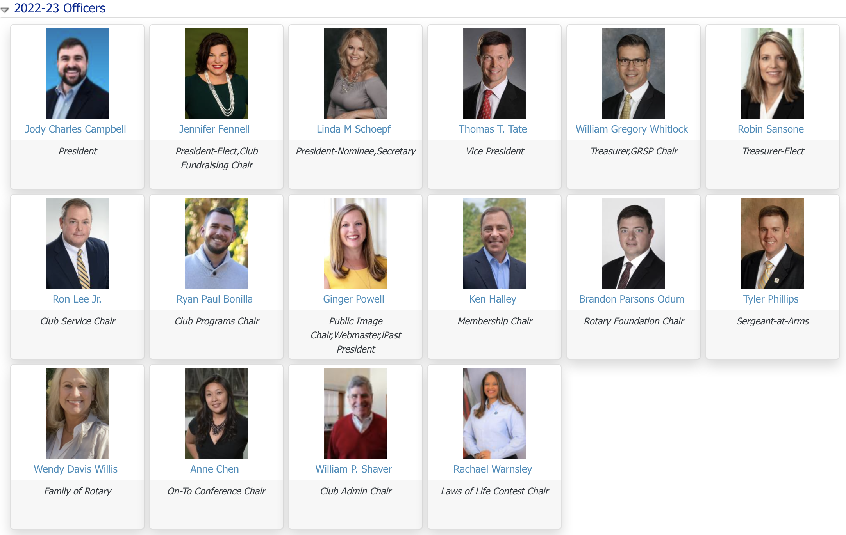
2022-23 CLUB LEADERSHIP

Slide 11
$30,000/yr

Slide 12
House painting with Habitat for Humanity
Read to students at BB Harris Elementary every month
Serve Thanksgiving dinner at Boys & Girls Club
Pack meal boxes with Nothing But the Truth Ministries
Ring bells for Salvation Army
Serve Christmas Eve lunch to Annandale Village
Book Drive for BB Harris Elementary
Host a Family Fun Day for Rainbow Village kids
Paint it Pink 5K
Mosaic Rotary Bowl-a-Thon

Slide 19
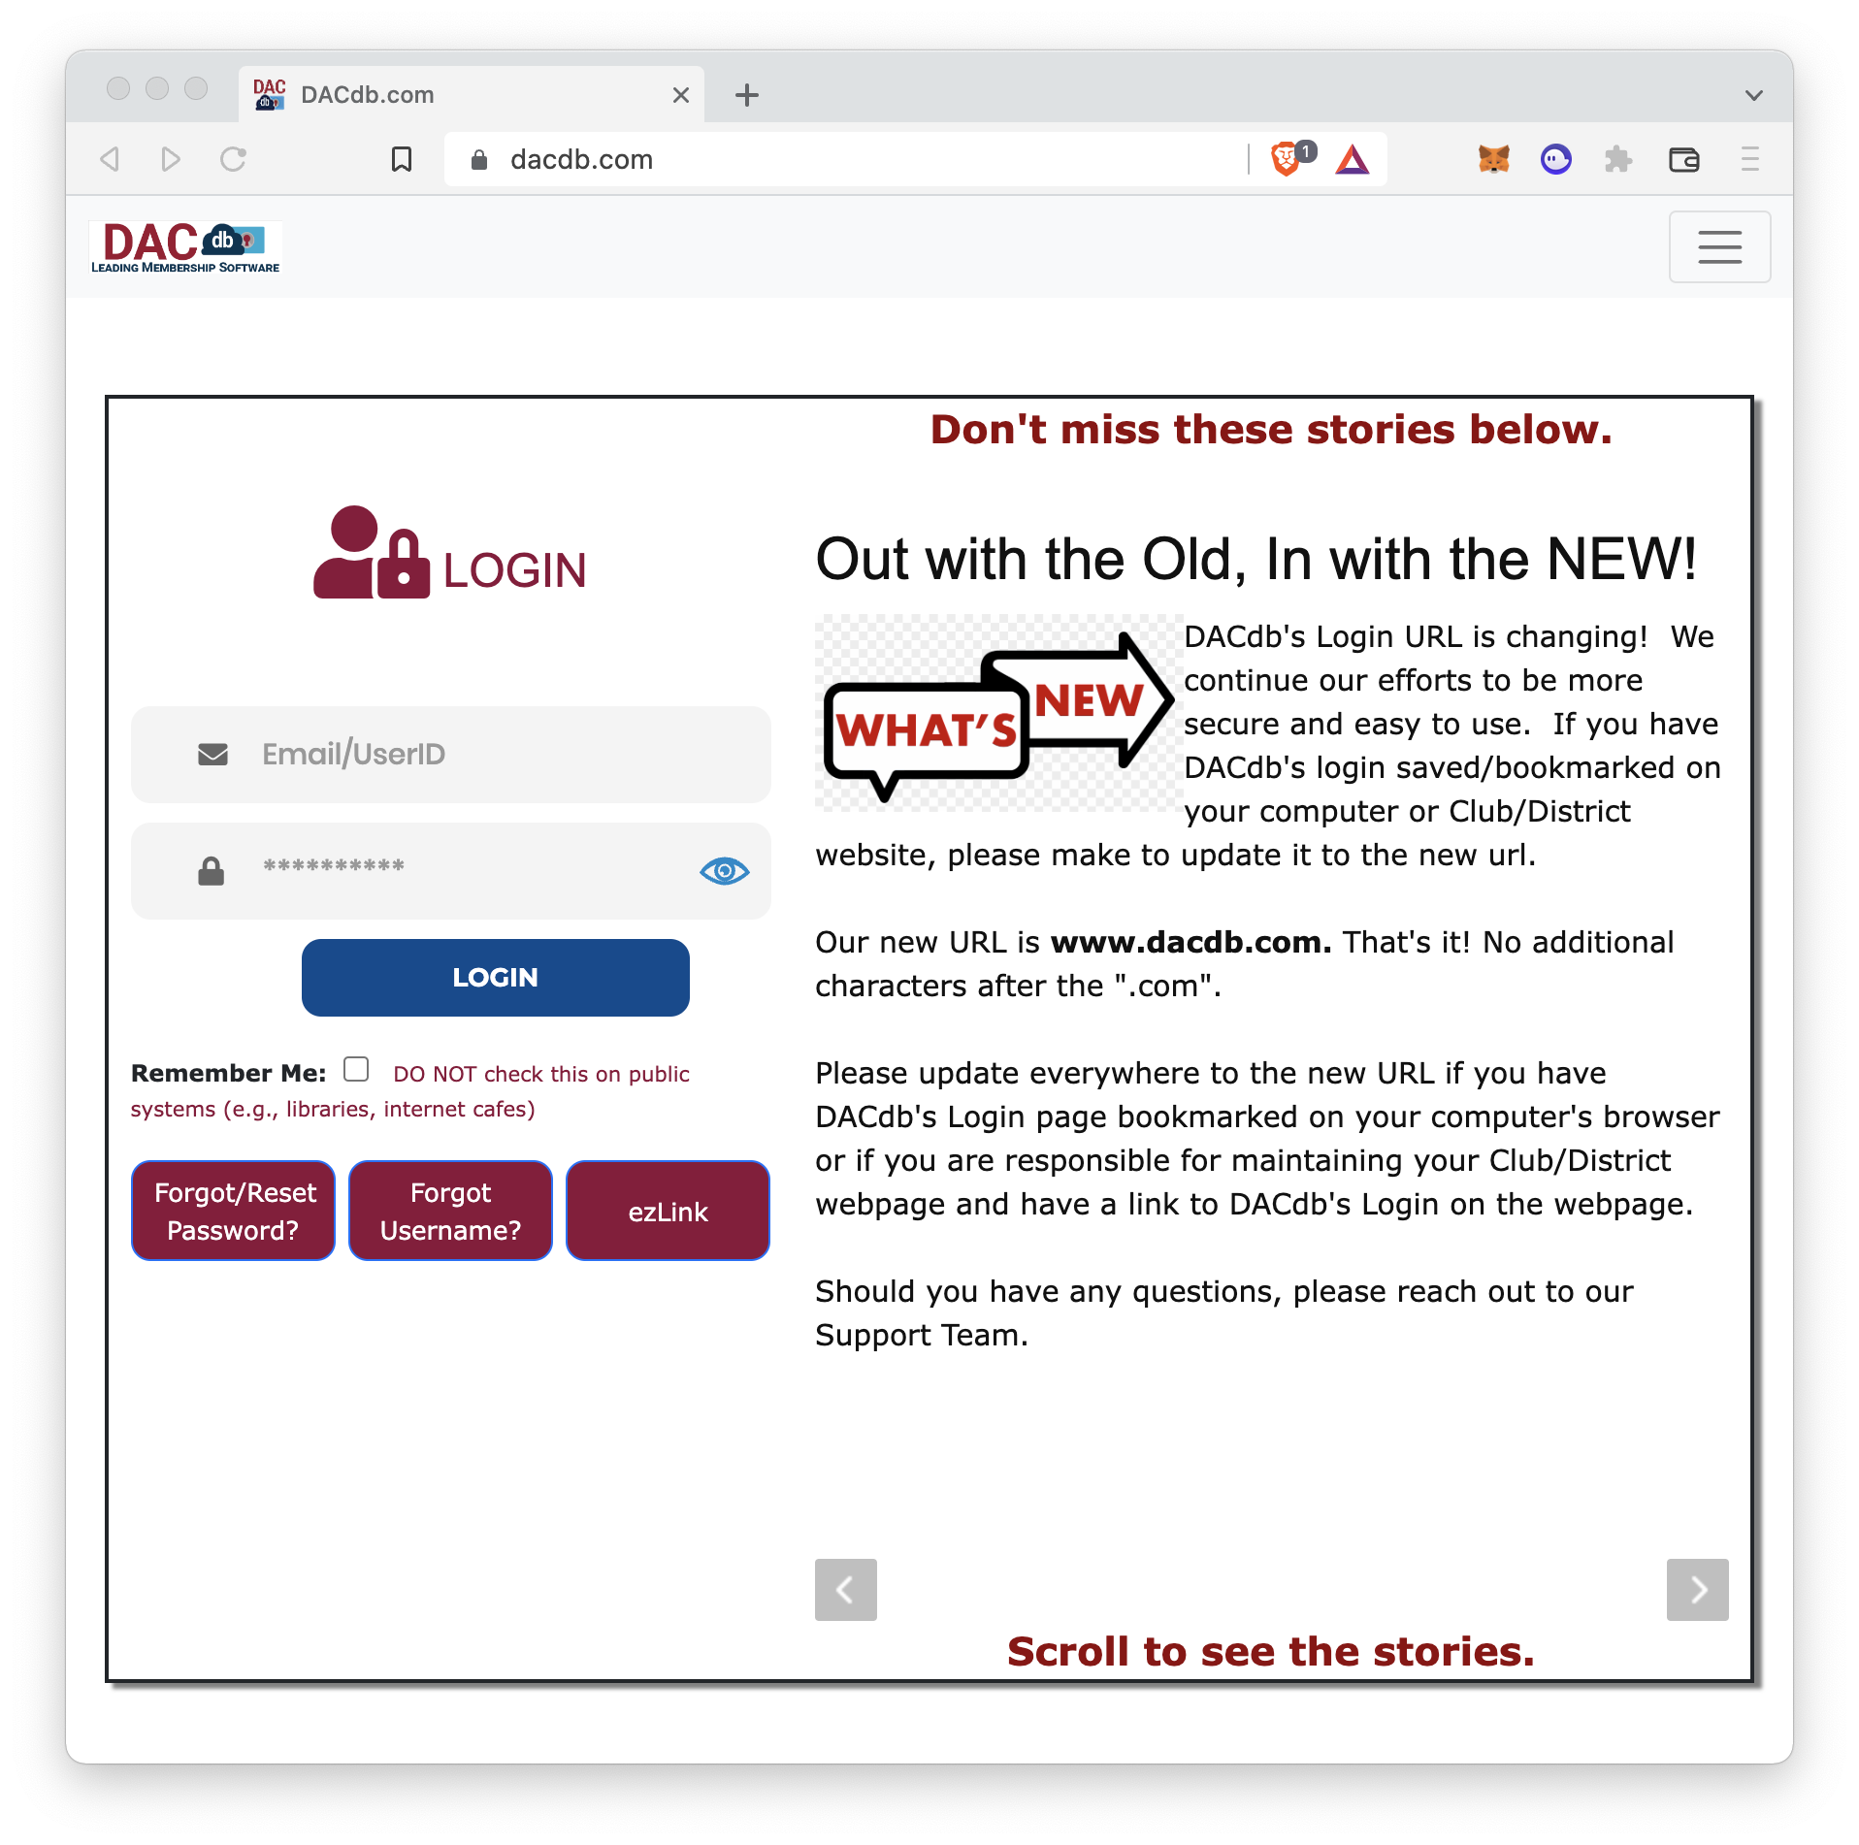
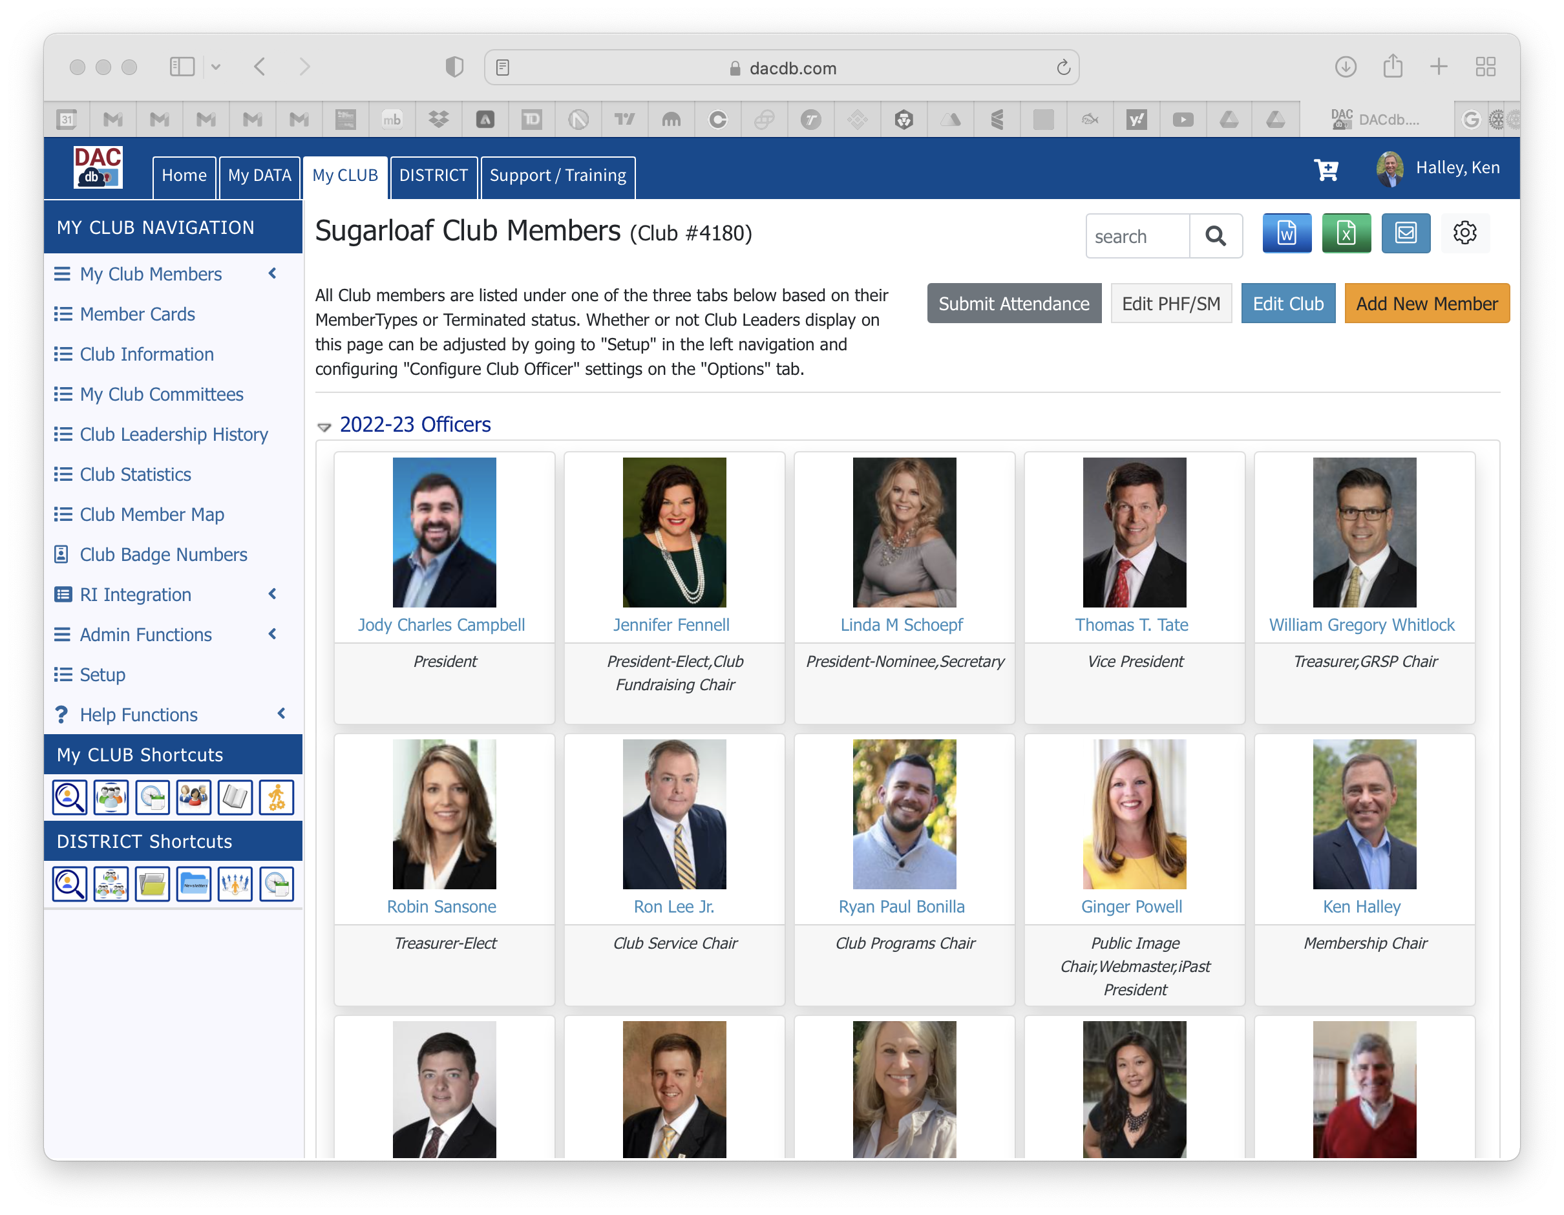
DACDdb
www.dacdb.com

