Slide 1
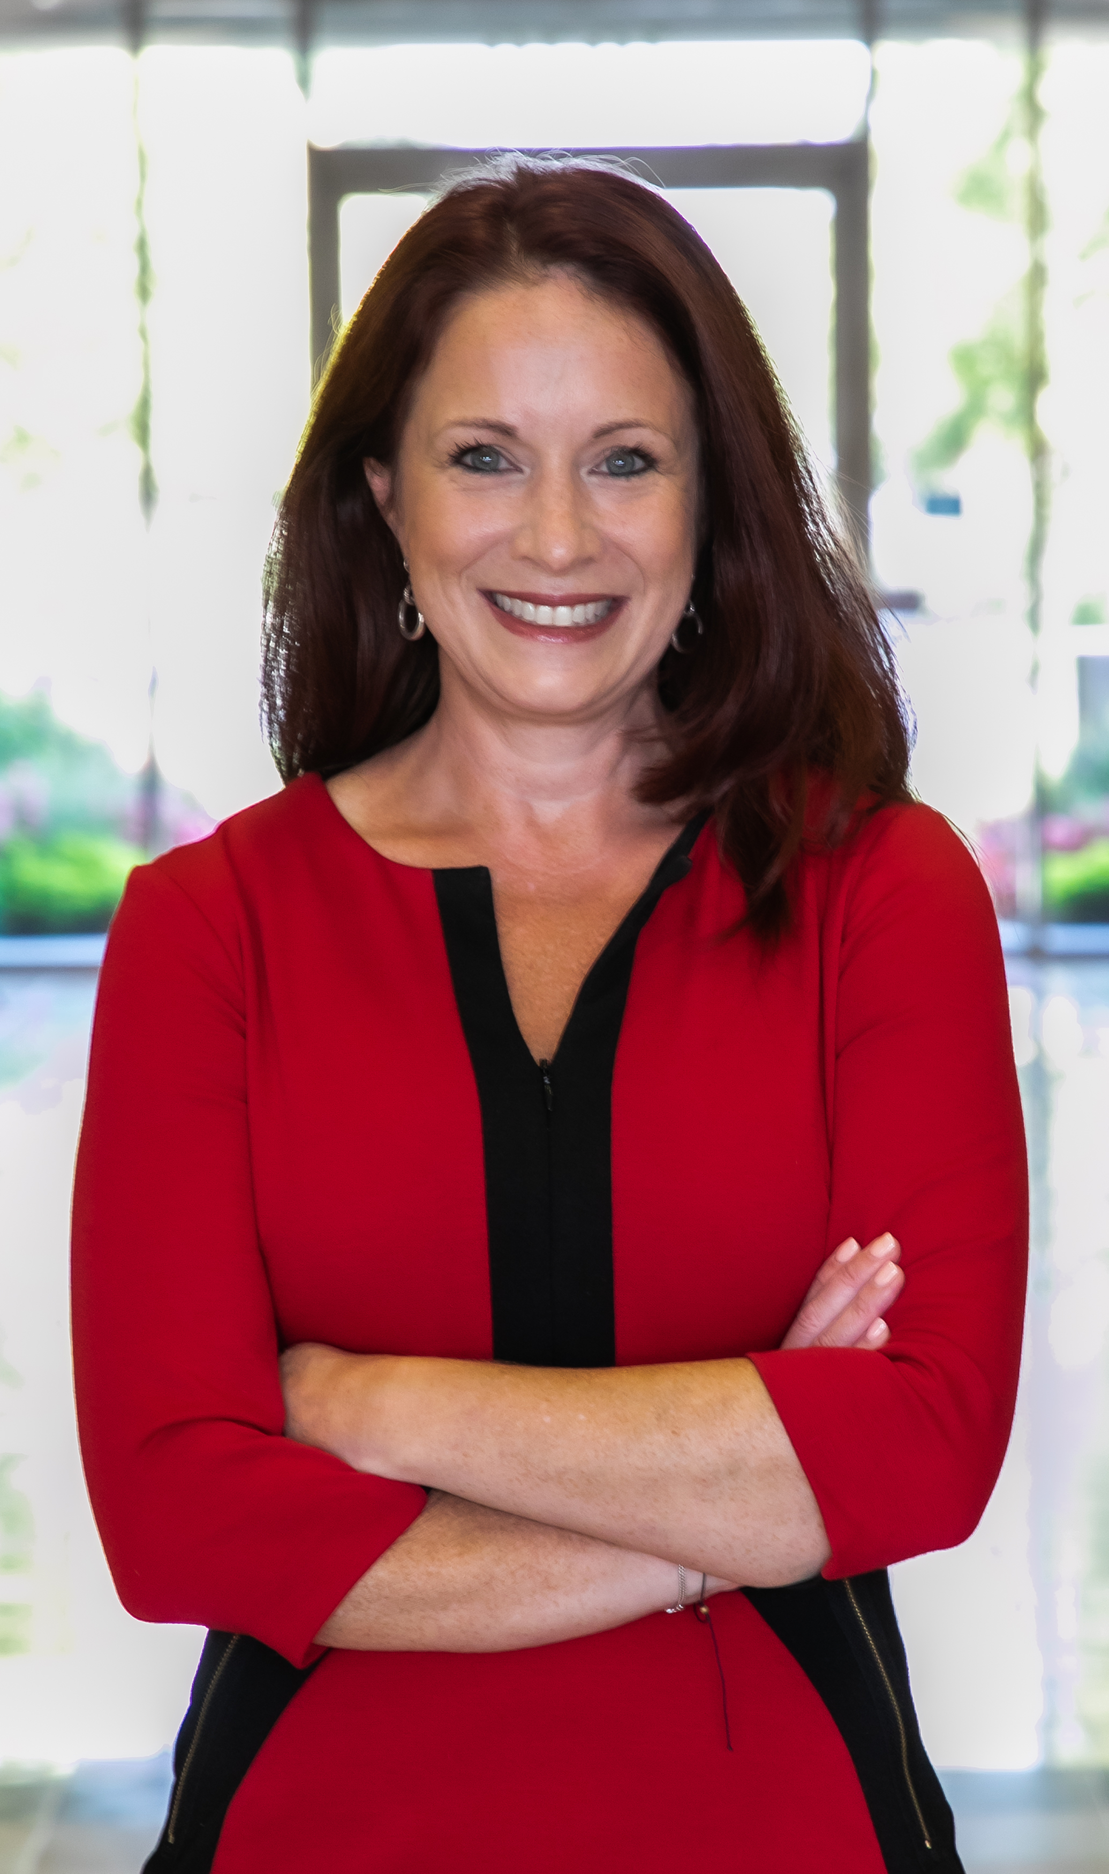
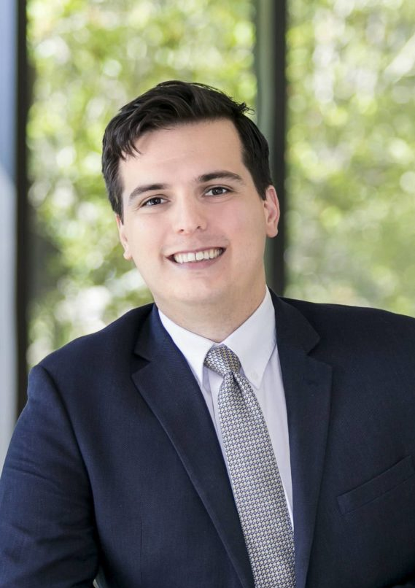
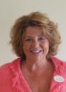
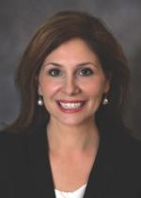
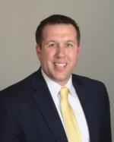
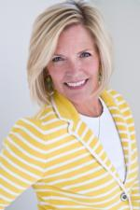
Club Leadership for 2021-2022
Erica McCurdy
President
Bill Diehl
President Nominee
Susan Slack
Treasurer
Ann Barham
Membership
Co-Chair
Brad Kluesner
Membership
Co- Chair
Jill Rice
Immediate
Past President

Slide 3
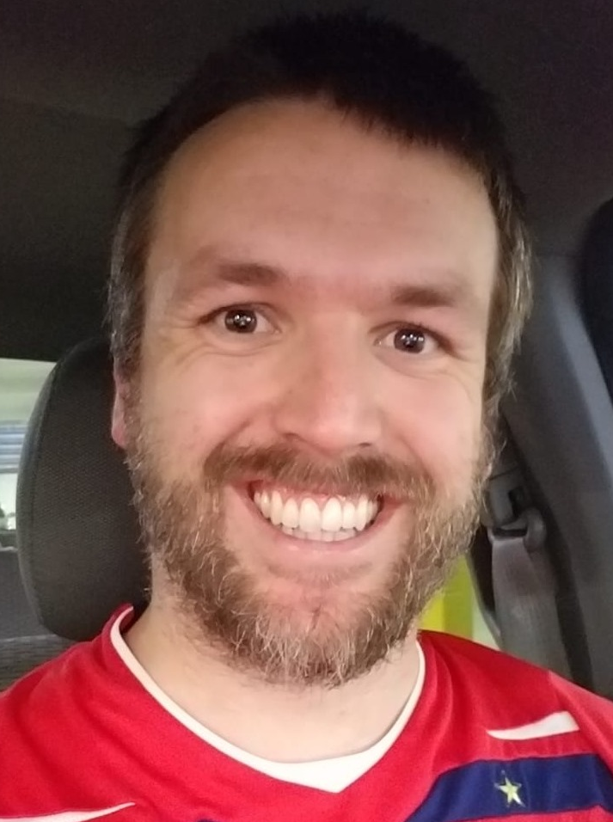
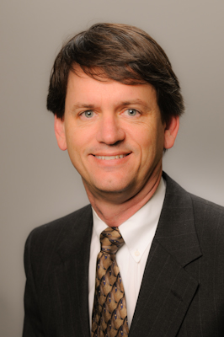
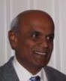
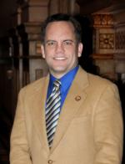
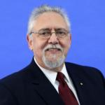
Club Leadership for 2021-2022
Peter Foster
Secretary / Admin
Dr. Brian Schwenk
Social Media
Eric Walls
Foundation Chair
Ranjan Raj
Sergeant at Arms
Curt Thompson
Program Chair
Marvin Kliman
Honorary/
VP At Large Advisor

Slide 5
Club Leadership 2021-2022
President | Erica McCurdy |  | Membership Co-Chair | Brad Kluesner
President Nominee | Bill Diehl |  | Membership Co-Chair | Ann Barham
Social Media | Dr. Brian Schwenk |  | Sergeant at Arms | Ranjan Raj
Secretary | Peter Foster |  | Family of Rotary | Julie Rousseau
Treasurer | Susan Slack |  | GRSP Chair | Robert Hilburn
Programs Chair | Curt Thompson |  | Career Expo Chair | Weare Gratwick
Rotary Foundation | Eric Walls |  | Interact Chair | Jim Blum

Slide 7
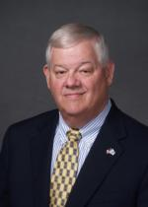
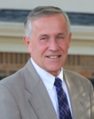
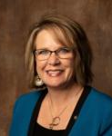
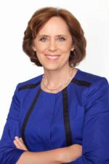
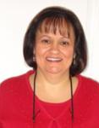
District Leadership
Michael Berg
District Governor
Gerry Taylor
District Governor Elect
Brandy Swanson
District Governor Nominee
Barbara Myers
Assistant Governor
Lynn Epps
District Treasurer

Slide 9
Club Past Presidents
1981-1982 Henry Howard
1982-1982 Rans Black
1983-1984 Gordon Kay
1984-1985 Jim Smullian
1985-1986 Mike McCarthy
1986-1987 Brooks Coleman
1987-1988 Johns Wells
1988-1989 Carl Lusted
1989-1990 J.P. Harrington
1990-1991 Bruce Morine
1991-1992 Larry Smith
1992-1993 Chip Mohme
1993-1994 Roy Threatt
1994-1995 Von Starkey
1995-1996 Ron Toms
1996-1997 Ed Poitras
1997-1998 John Johnson & Becky Munteanu
1999-2000 Joe Daniels
2000-2001 Robbie Stedford
2001-2002 Harvey Snider
2002-2003 Mike Sweigart
2003-2004 Bill McCargo
2004-2005 Ranjan Raj
2005-2006 Carolyn Collins
2006-2007 Bud Mingledorff
2007-2008 Debbie Sutton
2008-2009 Larry Reed
2009-2010 John Dorr
2010-2011 Marvin Kliman
2011-2012 Randall Jackson
2012-2013 Jim Blum
2013-2014 Todd Evans
2014-2015 Sam Evans
2015-2016 Mark Thornell
2016-2017 Robert Mann
2017-2018 Corrie Thrasher
2018-2019 Robert Hilburn
2019-2020 Jim Woods
2020 – 2021 Jill Rice

Slide 13
Club History
In early 1981 the Gwinnett Rotary Club began plans to sponsor a new club in the Peachtree Corners area. On June 11, 1981 the club began with thirty-five charter members. Five or six members of the Gwinnett Club transferred to this new club. Among them were Henry Howard and Rans Black.
Henry was elected as our first President in 1981-1982, with Rans as President-Elect for the year 1982-1983. Most of our time in the early years was spent learning the various duties that Rotary members must perform. Henry led by example, and was personally responsible for inducting most of our new members. Rans excelled in getting us to learn and teach the facts about Rotary to new members. Everyone entering the club was involved in one or more comprehensive training sessions. After two successful years with Henry and Rans at the helm, we all worked hard and in our third year became the small Club of the Year.
The Norcross Rotary Club began in 1992, and its membership grew rapidly; however, in the late 1990's civic clubs fell on hard times. Both Peachtree Corners and Norcross club membership declined, and the clubs decided to combine. John Johnson of Peachtree Corners and Becky Munteanu of Norcross served as Presidents of their respective clubs in 1997-1998 and then as Co-Presidents after the merger in 1998-1999. The new combined club, Peachtree Corners, had approximately 80 members. The chemistry worked well, and all made good friends.

Slide 15
Upcoming Meeting Schedule
July 19 | No meeting – Summer Social the next weekeng on the PTC Town Green
July 24 | CLUB SOCIAL ON THE PTC GREEN
July 26 | Meeting at Firebirds – Tour of Veterans Monument
August 2 | Weekly Club Meeting
August 9 | Weekly Club Meeting

Slide 17
HAPPY BIRTHDAY!
July 26 | Robert Hilburn
August 2 | Erica McCurdy
August 9 | Brian Schwenk
October 28 | Jim Blum
October 29 | Susan Slack
November 3 | Mary Beth Bender
November 14 | Marvin Kliman
December 15 | Curt Thompson
December 28 | Eric Walls
HAPPY ROTARY ANNIVERSARY
July 23, 2007 | Marvin Kliman
September 10, 2018 | Brad Kluesner
September 12, 2016 | Jill Rice
September 14, 2009 | Jim Blum
September 18, 2017 | Julie Rousseau
October 14, 2021 | Bill Diehl
October 29, 2019 | Ann Barham
November 16, 2020 | Peter Foster
November 30, 2020 | Mary Beth Bender
December 10, 2018 | Eric Walls
December 12, 2015 | Susan Slack
Birthdays
and Anniversaries

