Slide 1
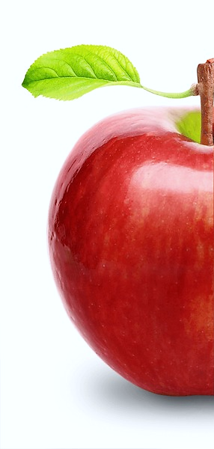
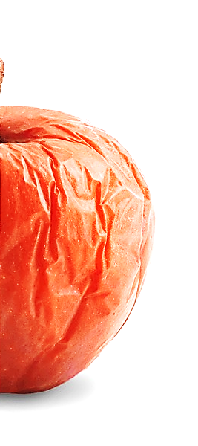
L I F E S P A N
H E A L T H S P A N
. The horsemen .
.
. The knights .
.
. The tools .

Slide 2
medicine
1 Out of 20

Slide 3
THE FOUR HORSEMEN .
ATHEROSCLEROTIC CARDIOVASCULAR DISEASE (ASCVS) 32%
CANCER 18%
NEUROLOGICAL DISEASE 10%
METABOLIC SYNDROME 5%
(ALL OTHER) 35%
2 Out of 20

Slide 4
THE FOUR KNIGHTS.
EXERCISE (MOST POWERFUL)
DIET
SLEEP (LEAST VALUED)
BIOMARKERS BLOOD, URINE, DNA
3 Out of 20

Slide 5
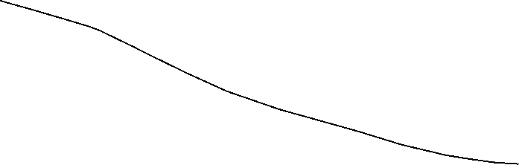
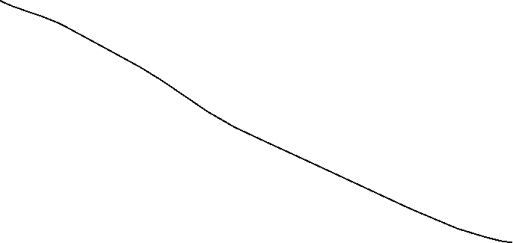





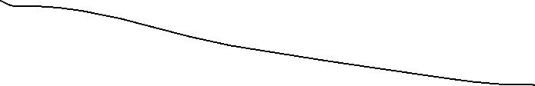



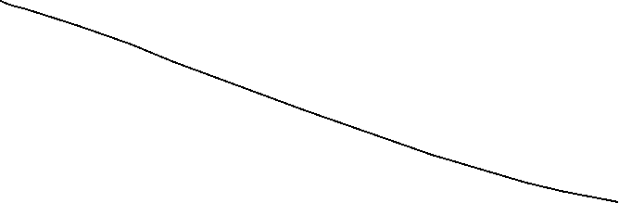
HORSEMEN vs.
KNIGHTS
ASCVS |  | EXERCISE
CANCER |  | DIET
NEUROLOGICAL |  | SLEEP
METABOLIC |  | BIOMARKERS
4 Out of 20

Slide 6
THE KNIGHTS - details .
EXERCISE (MOST POWERFUL) STRENGTH - STABILITY - CARDIO
DIET
SLEEP
BIOMARKERS
5 Out of 20

Slide 7
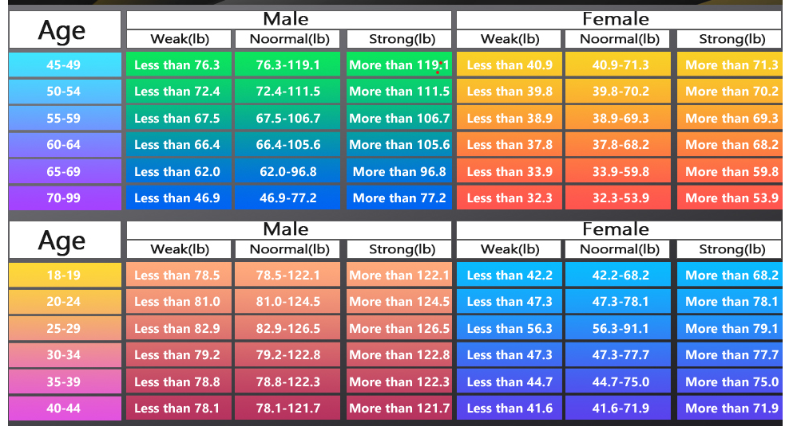
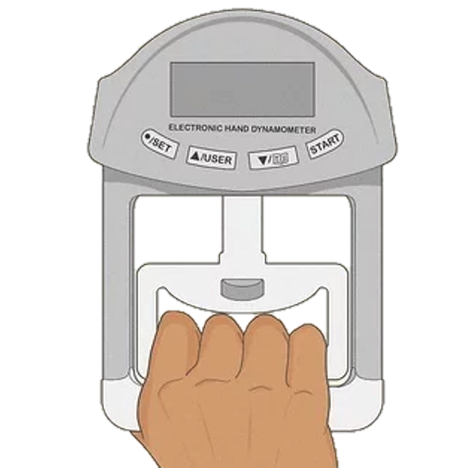
THE KNIGHTS - details .
EXERCISE (MOST POWERFUL) . STRENGTH . - STABILITY - CARDIO
Grip Strength Test Lbs
6 Out of 20

Slide 8
THE KNIGHTS - details .
EXERCISE (MOST POWERFUL) . STRENGTH . - STABILITY - CARDIO
STRENGTH TO DEMENTIA
CONNECTION
7 Out of 20

Slide 9
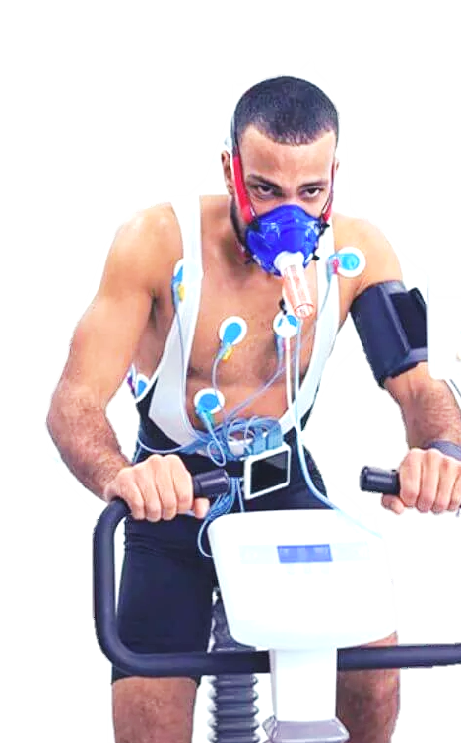
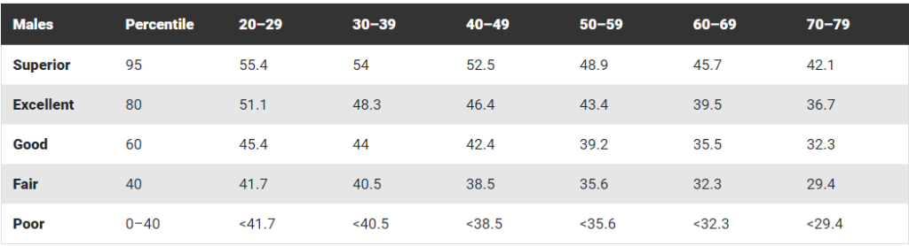
THE KNIGHTS - details .
EXERCISE (MOST POWERFUL) STRENGTH - STABILITY - . CARDIO .
VO2 Max Test … mL/kg/min
8 Out of 20

Slide 10
THE KNIGHTS - details .
EXERCISE (MOST POWERFUL) STRENGTH - STABILITY - CARDIO
DIET ENERGY BALANCE – GLUCOSE MANAGEMENT – EAT LESS
SLEEP
BIOMARKERS
9 Out of 20

Slide 11
THE KNIGHTS - details .
EXERCISE (MOST POWERFUL) STRENGTH - STABILITY - CARDIO
DIET ENERGY BALANCE – GLUCOSE MANAGEMENT – EAT LESS
SLEEP (LEAST VALUED) ) 7-8 HOURS – BALANCED rem, light, deep
BIOMARKERS
10 Out of 20

Slide 12
THE KNIGHTS - details .
EXERCISE (MOST POWERFUL) STRENGTH - STABILITY - CARDIO
DIET ENERGY BALANCE – GLUCOSE MANAGEMENT – EAT LESS
SLEEP (LEAST VALUED) ) 7-8 HOURS – BALANCED rem, light, deep
BIOMARKERS BLOOD, URINE, DNA : Diet, pharmaceuticals, Sups
11 Out of 20

Slide 13
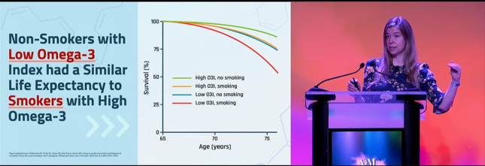
THE KNIGHTS - details .
BIOMARKERS BLOOD, URINE, DNA : Diet, Pharmaceuticals, Sups
12 Out of 20

Slide 14
The tools …
EXERCISE (MOST POWERFUL) STRENGTH - STABILITY - CARDIO
Resistance, Grip/Toe, Balance, Yoga, Dance, Zones 2-5, Hit, VO2
DIET
SLEEP
BIOMARKERS
13 Out of 20

Slide 15
The tools …
EXERCISE (MOST POWERFUL) STRENGTH - STABILITY - CARDIO
Resistance, Grip/Toe, Balance, Yoga, Dance, Zones 2-5, Hit, VO2
DIET ENERGY BALANCE – GLUCOSE MANAGEMENT – EAT LESS
CR, Low Sugar/Starches, Low Visceral Fat, DEXA SCAN, CGM
SLEEP
BIOMARKERS
14 Out of 20

Slide 16
The tools …
EXERCISE (MOST POWERFUL) STRENGTH - STABILITY - CARDIO
Resistance, Grip/Toe, Balance, Yoga, Dance, Zones 2-5, Hit, VO2
DIET ENERGY BALANCE – GLUCOSE MANAGEMENT – EAT LESS
CR, Low Sugar/Starches, Low Visceral Fat, DEXA SCAN, CGM
SLEEP (LEAST VALUED) 7-8 HOURS – BALANCED REM, LIGHT, DEEP
DARK COOL QUIET, NO ALCOHOL EATING CAFFINE ELECTRONICS, AIDS
BIOMARKERS
15 Out of 20

Slide 17
The tools …
EXERCISE (MOST POWERFUL) STRENGTH - STABILITY - CARDIO
Resistance, Grip/Toe, Balance, Yoga, Dance, Zones 2-5, Hit, VO2
DIET ENERGY BALANCE – GLUCOSE MANAGEMENT – EAT LESS
CR, Low Sugar/Starches, Low Visceral Fat, DEXA SCAN, CGM
SLEEP (LEAST VALUED) 7-8 HOURS – BALANCED rem, light, deep
DARK COOL QUIET, NO ALCOHOL EATING CAFFINE ELECTRONICS, AIDS
BIOMARKERS BLOOD, URINE, DNA -Diet, Pharmaceuticals, Sups
INSIDE TRACKER, DIET, SUPPLEMENTS
16 Out of 20

Slide 18
10 HALLMARKS OF AGING
DNA DAMAGE /CELLULAR DISFUNCTION
TELEMERE SHORTENING
DNA SEQUENCE ALTERATIONS
DAMAGED PROTEINS
NUTRIENT SENSING DISRUPTION
MITOCHONDRIAL DISFUNCTION
CELLULAR DETERIORATION
STEM CELL EXHAUSTION
LOSS OF INTERCELLULAR COMMUNICATION
INCREASED INFLAMMATION
17 Out of 20

Slide 19
AGING
MEDICINE 1.0, 2.0 AND 3.0
CHRONOLOGICAL vs. BIOLOGICAL AGE
PHARMAS AND SUPPLEMENTS - RAPAMYCIN, METFORMIN, NMN
REFERENCES, PODCASTS, READING
18 Out of 20

Slide 20
The experts
PETER ATTIA OUTLIVE, THE DRIVE PODCAST
DAVID SINCLAIR LIFESPAN
MATT WALKER WHY WE SLEEP
RHONDA PATRICK TRAINING TO AGE BETTER
ANDREW HUBERMAN HUBERMAN LAB PODCAST
KELLYANN NOITIS PREVENTIVE NEUROLOGIST
COURTNEY CONLEY FOOT GURU
19 Out of 20

Slide 21
. Live well .
20 Out of 20

