Slide 1



Rotary International District 6890 Presents:
A Celebration of
Our Veterans - 2021

Slide 2
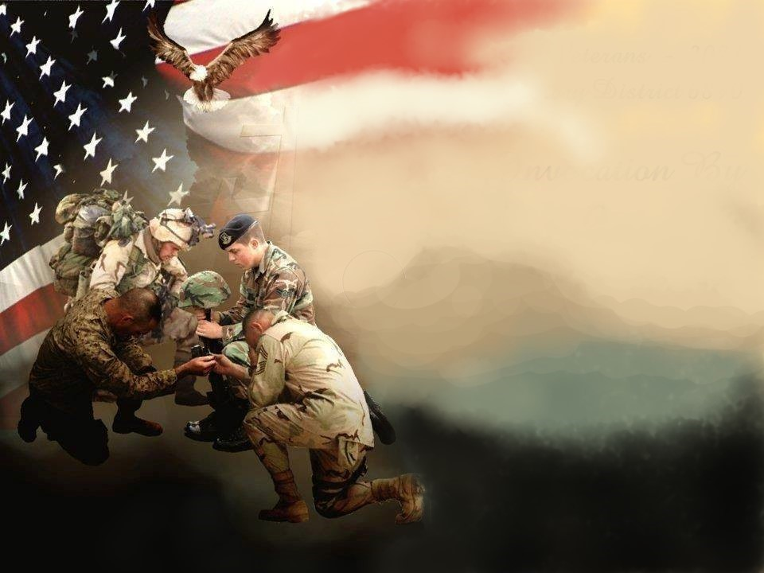


A Celebration of Our Veterans - 2021
Rotary District 6890
Invocation By
Mike Louden
Lakeland Club Member
District Chaplain

Slide 3
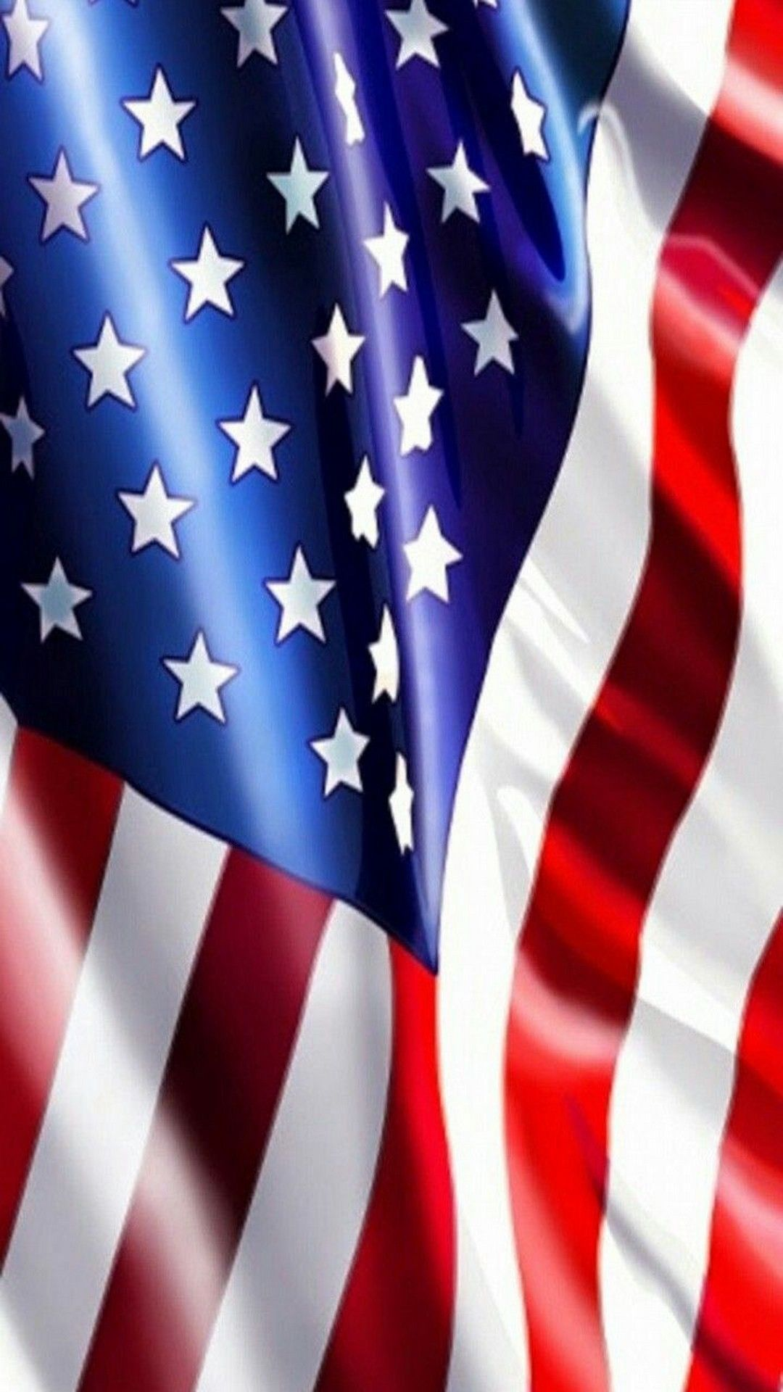

Celebration of Our Veterans
Rotary Club of Auburndale
John Bockover | Army | Imagery Analyst | 19.5 Years
Jim Johnson | Army | Spec. 4 | 3 Years
David Kersey | Air Force | Sgt. | 4 Years
Mike Littles | Navy | Spec. 3rd | 10 Years
Earnest Mercer | Navy | Comm. Tech | 3.5 Years
James Nichum | Navy | E5 | 4 Years
Bill Sterling | Air Force | Captain | 4 Years
Coach Wiley | Navy | E5 | 4 Years
Paul Yamilkoski | Navy | E3 | 3 Years

Slide 4
Celebration of Our Veterans
Rotary Club of Avon Park
Harold (Bud) Worden | Army |  | 1953-1955
Alan C. Ball | USMC | Corporal | 1968-70
William Yoder | Navy | LTJG | 1951-55
Stanley Wells | Nat. Guard |  | 1967-74
Sam Dunn | Army |  | 1970-72
Edward E. Davidson | Army | Sgt. | 1968-97
Tom Amos | Army |  | 1963-65
Kenneth Long | USMC |  | 1960-64

Slide 5

Celebration of Our Veterans
Rotary Club of Bartow
Laura Diaz | Army | E4 | 3 Years
John DeYoung | Army | Corporal | 1.5 Years
Wally Edwards | USMC | Corporal | 3 Years
S.I. Frisble | Army/Nat. Guard | Colonel | 30 Years
James Heppel | Navy | Petty Officer | 4 Years
Terry Hunter | Army | Lieutenant | 3 Years
Marlene Hyde | Air Force | Airman 1st | 3 Years
Tom Jennings | Navy | E6 | 3 Years
John Lawrence | Army | Lieutenant | 3 Years
Gene Meler | Army/ Nat. Guard | Sgt. | 6 Years
Pat Patrick | Army | Private | 6 Years
Leslie Pickett | Navy | Radio | 2 Years
Vincent Pickett | Navy | Lt. Senior | 3 Years
William Stevens | Army | Sgt. | 9 Years

Slide 6
Celebration of Our Veterans
Rotary Club of Brandon
John Sellers | USAF | Lt. Col | 22 Years
Taylor Bell | Navy | Petty Officer 3rd. | 1964-1967
David Issacson | Army | Warrant Officer
Robert Ura | USAF | Sgt. | 1989-1993
Pat Skidmore | Navy | 2nd. BT | 4 Years
Alan Feldman | Navy | Seaman | 1 Year
Julian Craft | Army |  | 4 Years

Slide 7
Celebration of Our Veterans
Rotary Club of
FishHawk-Riverview

Slide 8
Celebration of Our Veterans
Rotary Club of Haines City
Thomas Broadway | Army | Colonel | 25 Years

Slide 9
Celebration of Our Veterans
Rotary Club of
Hardee County
Lacey Jo Barton | Army/Nat. Guard | E1 | 2 Years
Gene Davis | Army Reserve | E5 | 7 Years
J. Harold Davis | Army | SP 4th | 3 Years
John M. Eason | Air Force | Airman 1st | 4.5 Years
Ken Evers | Army | Sgt. E5 | 3 Years
Wm John Gill | Army | Colonel | 40 Years
Alfred Hodge | Army | Sgt E5 | 26 Years
Lawrence McNaul | Army | Captain | 23 Years

Slide 10
Celebration of Our Veterans
Rotary Club of Lakeland
Richard Mason | Navy | LCMDR | 1953-67
Brock Self | Navy Air | Seaman | 1966-71
Ralph Allen | USMC | Corporal | 1962-68
David Moss | Army | E5 | 1963-65
Joe McDonough | Army | CW5 | 1965-2003
William Chase III | Army | Lt | 1966-68
Deane Hart, III | Navy | Petty Officer | 1966-70
Jim Esmond | Air Force | SSGT | 1966-70
Ken Ferris | Navy | Petty Officer | 1967-71
Gary Clark | Air Force | Colonel | 1967-93
Greg Robinson | Navy | CW4 | 1968-99

Slide 11
Celebration of Our Veterans
Rotary Club of Lakeland
Alan Rich | Army | Major | 1968-70
Dorsey Hightower | Airforce | Captain | 1969-73
Don Salvage | USMC | Colonel | 1969-99
Bob Eckenroth | USAF | Lt | 1970-74
CJ Marcello, Jr. | USAF | Lt. Col | 1972-91
Joe Ruthven | Navy | LCMDR | 1972-75
Robert Denney | Air Force | SSGT | 1978-84
Michael Huff | Air Force | Ltc | 1980-2004
Virginia Harris | Air Force | TSGT | 1981-91

Slide 12
Celebration of Our Veterans
Rotary Club of Lakeland
Chuck McDanal | USMC | Lt. Corp | 1983-89
Scott Franklin | Navy | Commander | 1986-2012
Scott LaRonda | Army | Lt Col | 1994-2015
Keith DeLoach | Army | Major | 1994-2015
Christopher Russo | Air Force | Cadet | 1999-2001
Calvin Arter | Army
Dan Hill | Army
James Ring | USAR | USAR
Chuck Irvin | Army |  | 2008-2013

Slide 13
Celebration of Our Veterans
Rotary Club of
Lake Placid Sunrise
John Causey | Air Force | Major O4 | 1971-85
Norm Church | Army | E5 | 1968-74
Nancy Davis | Army | Major O4 | 1981-92
Jack Richie | Air Force | Airman 1st | 1952-56
Larry Sapp | Army | E3

Slide 14
Celebration of Our Veterans
Rotary Club of
Lakeland Sunrise
Tonia Oldham | Air Force | Ch Mast Sgt | 23 Years
Albert Dotson | Army | 1st LT | 3 Years
Michael Angotti | Navy | 2nd Petty Officer | 2 Years
Jarel Eaton | Army | Sgt E 5 | 3 Years
Richard Johnson | USMC | Colonel | 35 Years
Thomas Kurrac | Navy | LT 05 | 5 Years
Michel Carew | Army | SFC | 22 Years

Slide 15
Celebration of Our Veterans
Rotary Club of
Lake Wales Breakfast
Eugene Filtz | Navy/Army | 1st Sgt | 1968-95
Karl Gould | Army/Air Force | Captain | 1955-1979
Tommy Griffin | Army Nat Guard | E5 | 1972-79
Richard Howell | Army | E5 | 1967-69
Earnie Leavell | Navy | CTT2 | 1967-74
Manny Rios | Army | E6 | 1977-97
Robert Shields | Navy | E5 | 1976-80
Preston Troutman | Army | Captain | 1960-64
Jim Weaver | Army | 1st Lieutenant | 1968-69
James Bell | Air Force | Colonel | 1960-89

Slide 16
Celebration of Our Veterans
Rotary Club of
Lake Wales Noon
Vince Mee | Air Force | Chief E9 | 1962-93
Robert Peppel | Navy | Lt | 10 Years

Slide 17
Celebration of Our Veterans
Rotary Club of
New Tampa Breakfast
Joseph Ellison III | Army | Lt Colonel | 23 Years
William Moore | Air Force | Maj. Gen. | 31 Years
Lynn Grinnell | Air Force | LT Col | 20.5 Years
Ashvin Mahara | Coast Guard | E5 | 8 Years
Jon Caudle | Army | Captain | 5 Years
Doug Andrews | Army | LTC | 40 Years
Anandi Thompson | Air Force | SGT | 7 Years
Robert Thompson | Air Force | SGT | 8 Years

Slide 18
Celebration of Our Veterans
Rotary Club of
New Tampa Noon
Dylan Flanagan | Navy | Lieutenant | 6 Years

Slide 19
Celebration of Our Veterans
Rotary Club of
Plant City Daybreak
George Banning | USAF | Airman 1st | 1958-1965
Allen Gray | USAF | Major | 1963-1988

Slide 20
Celebration of Our Veterans
Rotary Club On the Ridge
Michael Baccus | USAF | Sgt. | 1970-1976
Tiffany Davis | Army | Sgt. | 2002-2018
Sara Irvine | Army | E5; Sgt | 1987-1991
Mary Walkup | Navy | Clerk 2nd. | 1973-1978

Slide 21
Celebration of Our Veterans
Rotary Club of
Plant City Noon
Felix Haynes | Army | Captain | 1969-72
Martyn Clay | Army | Major | 20 Years
Charles White | Army | Captain | 1969-77
William Hughes | Air Force | Sgt | 1991-95
Tom Davis | Army | Specialist | 1966-69
Steve Soloman | Navy | Petty Officer | 5 Years
Ed Bozeman | Army | Specialist | 4 Years
Ron Gainey | Navy | Petty Officer | 6 Years
Adam Snyder | Navy | E5 | 7 Years

Slide 22
Celebration of Our Veterans
Rotary Club of
Sebring Sunrise
Chip Boring | Navy | Quartermaster E5 | 5 Years
Dan Payne | Navy | M6
Gary DeLatorre | USMC | E6 | 10 Years

Slide 23
Celebration of Our Veterans
Rotary Club of Sebring Noon
Gilbert Riordab | Navy | E4 | 3 Years
Robert Chapman | Army | Wo4 | 4.5 Years
Thomas Nunnallee | Air Force | LTC | 21 Years
George Hensley | Navy | Captain | 23 Years
Robert Livingston | Army | Major | 20 Years
Carlos Ramon | Army | Major | 20 Years
Elizabeth Fischer | Army | E4 | 4 Years
James Ladd | USMC | Corporal | 6 Years
Lenard Carlisle | Army | E4 | 2 Years
Edward Nichols | Army | E4 | 7 Years

Slide 24
Celebration of Our Veterans
Rotary Club of Sun City Center
Jim Wilmouth | Army | E5 | 1966-69

Slide 25
Celebration of Our Veterans
Rotary Club of Tampa
Carrollwood
Jack C. Crutchfield | USMC | Lt. Col | 22 Years

Slide 26
Celebration of Our Veterans
Rotary Club of Tampa
Sunny Alexander | Army | Captain | 6 Years
Ralph Arnhym | Army Infantry | Colonel | 20 Years
Scott Beene | Army | Corporal | 4.5 Years
Larry Brown | Army | Lt. Colonel | 20 Years
Dave Luhrsen | USMC |  | 6 Years
Larry Marfise | Navy | Petty Officer | 6 Years
Gary Nash | Air Force | Sgt | 6 Years
Bill Snyder | Army | Sgt | 6 Years
Jack Spangler | Navy |  | 4 Years
Jean Yadley | Army/Air Corps | Sgt | 4 Years

Slide 27
Celebration of Our Veterans
Rotary Club of Tampa North
Mike Adcock | Air Force, Army | E3 | 1968-72
Richard McVean | Air Force Reserve | Sgt | 1969-76
Douglas Barler | Army Nat Guard | Sgt | 1959-75
John Sheahen | Army | Spec. E5 | 1966-1978
Michael Streeper | Army Nat. Guard | E6 | 1966-68

Slide 28
Celebration of Our Veterans
Rotary Club of Temple Terrace
Perry Jacobsen | Army | 1st Lieutenant | 3 Years

Slide 29
Celebration of Our Veterans
Rotary Club of Ybor City
Charles Cernuda | Air Force | Sgt | 2 Years
Steven Bennett | Air Force | Major | 6 Years
Bruce Zimmerman | Army | Lieutenant | 5.6 Years
Fred MacFawn | Air Force | Captain | 4 Years

Slide 30
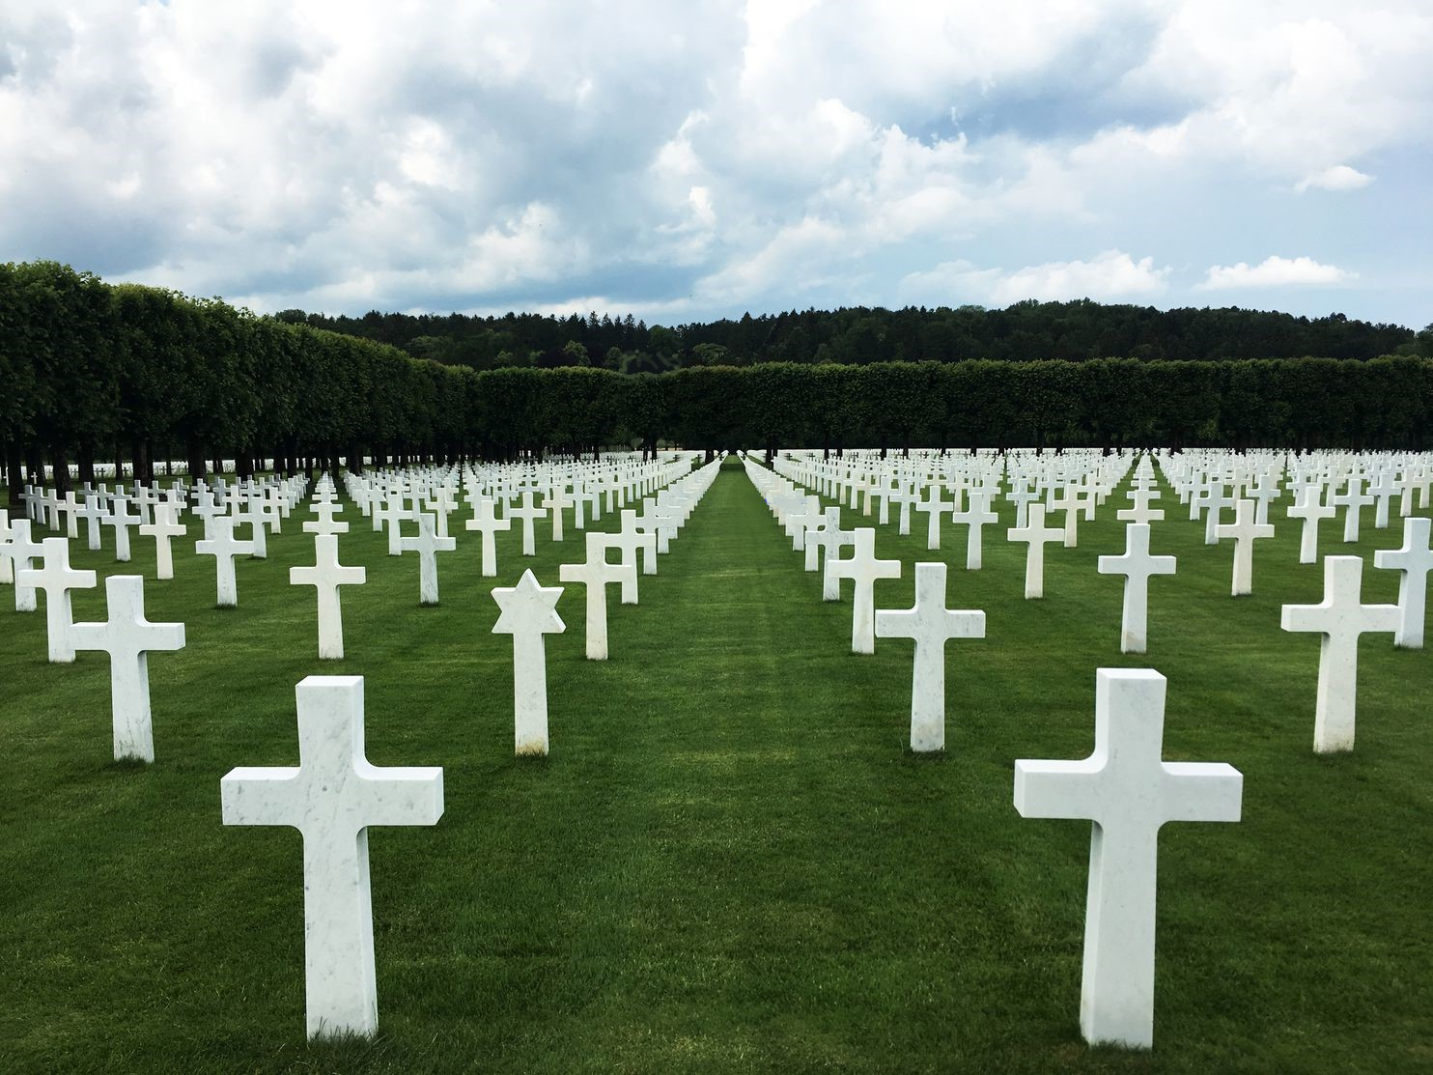

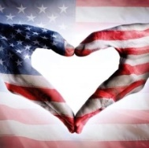


Rotary District 6890
Our Veterans Who Have Passed – In Remembrance
Charlie Talley,Sgt.,Brandon
Vince Ferraro, Army, Bandon
Jackie Gauger, Hardee County
Duane Kopta, Army, Avon Park
Harry Dunlap, Air Force, Brandon
Jim Thomason, Air Force, Brandon
Don Cheek, Pvt. Army, Auburndale
William Maxwell, Air Force, Avon Park
Jim Bockover , Sgt. Air Force Auburndale
PDG Donald Griffing, Air Force, Avon Park
Farley Sparks, Air Force, Lake Wales Breakfast

Slide 31


A Celebration of Our Veterans
Rotary District 6890
Honor / Freedom Flights
Our Mission:
To transport America’s Veterans to Washington, D.C.
to visit those memorials dedicated to honor their
service and sacrifices.
Priority is given to WWII Veterans, along with those other Veterans who may be terminally ill.
Our NO COST mission continues as we fly our Korean, Vietnam and all Veterans on future missions.

Slide 32
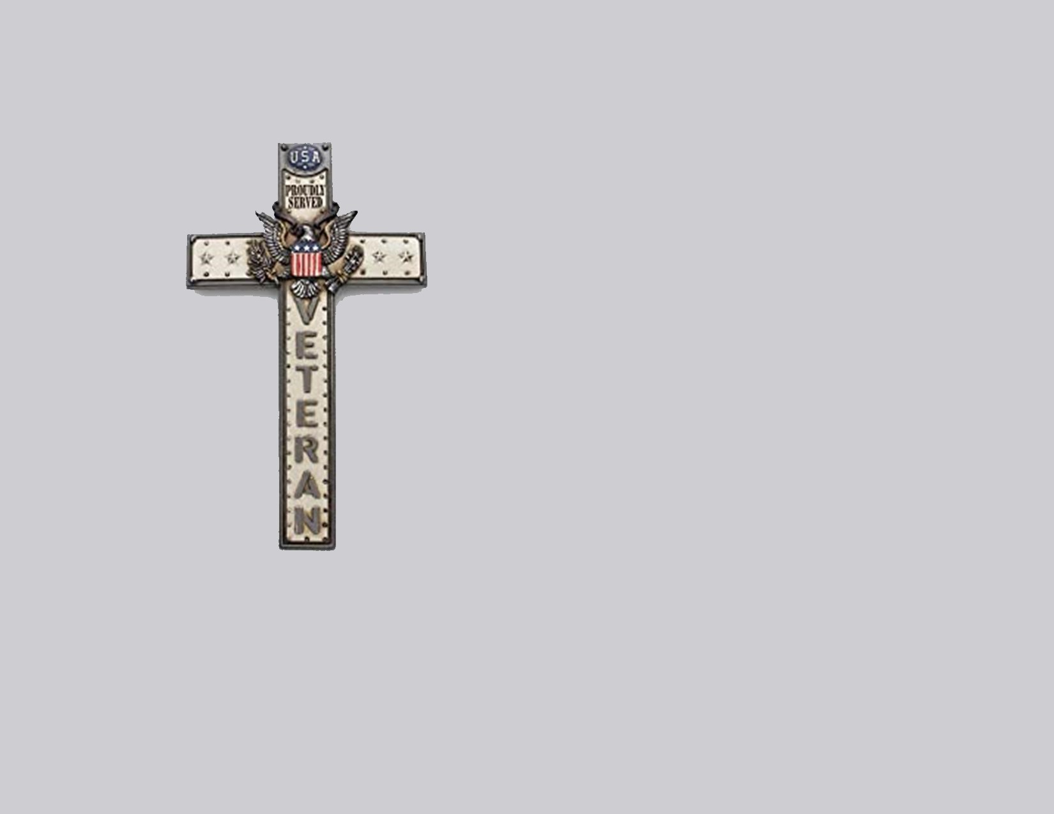

A Celebration of Our Veterans - 2021
Rotary District 6890
Benediction By
Mike Louden
Lakeland Club Member
District Chaplain

