Slide 1


Slide 2
The Rotary Foundation
Tom Wagner, PDG
District Rotary Foundation Chair 2016-20

Slide 3

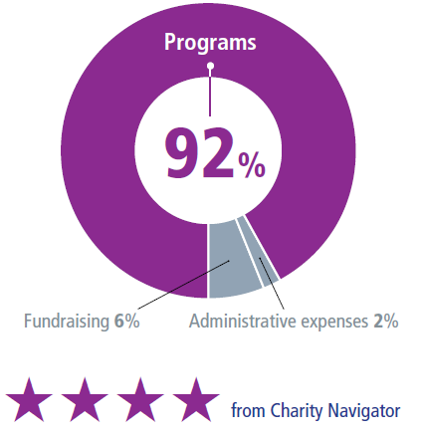
DOING GOOD IN THE WORLD
THE ROTARY FOUNDATION’S EXPENDITURES GO TO...
OUR LONG-TERM STRATEGY...
Ensure that we have sufficient funds to operate our Foundation
Maintain a fully funded operating reserve
Transfer surplus funds to the Endowment Fund
Notes:
Rotary’s unique funding model strengthens our future by building on a stellar record of efficient use and stewardship of the financial resources entrusted to us. For example, when we look at our annual expenditures over the last 10 years, we’ve minimized our fundraising and administrative expenses and dedicated 88 to 89 percent of our total spending to programs.
The Foundation’s sound financial management and its commitment to accountability and transparency are also recognized as exceptional, year after year, by independent evaluators of not-for-profits. Rotary’s website provides detailed information on the Foundation’s finances.
In fiscal year 2013-14, only 2 percent of Foundation expenditures went to administrative expenses and 6 percent to fundraising. The Foundation directed 92 percent of its spending to programs, far exceeding the benchmarks that independent charity-rating services view as a measure of high efficiency.
The recent recession demonstrated to the philanthropic community that maintaining a strong financial base that includes operating reserves is necessary in order to weather increased volatility in financial markets.
Beginning 1 July 2015, five percent of contributions to the Annual Fund are earmarked for operating expenses or to build the operating reserve to three times annual operating expenses, when needed.
This change will have no impact on District Designated Funds, but will provide a more predictable level of financial support for programs and the operating expenses it takes to make them successful.
With a solid financial base and restored reserves, we’ll have an organization that is able to support the good work that Rotarians do in the world — even as the economic and financial environment remains unpredictable.

Slide 4
OUR MISSION
“The mission of The Rotary Foundation is to enable Rotarians to advance, World Understanding, Goodwill and Peace through the Improvement of health, the support of education and the alleviation of poverty.”
World Understanding • Goodwill • Peace
Notes:
“The mission of The Rotary Foundation is to enable Rotarians to advance, World Understanding, Goodwill and Peace through the Improvement of health, the support of education and the alleviation of poverty.”
We accomplish this by using the expertise and compassion of Rotarians who foster effective and sustainable projects around the world. We are looking to the future and incorporating projects within the 6 areas of focus bringing us closer to our mission while supporting the amazing work of Rotarians. Through OUR Foundation, we reach out to both our local and international communities enriching the lives of millions.

Slide 5
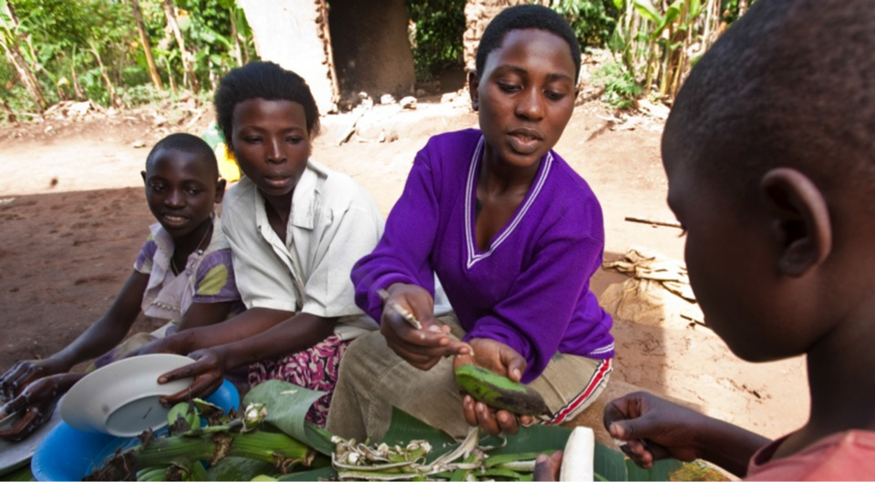
OUR MISSION
World Understanding • Goodwill • Peace
Notes:
“The mission of The Rotary Foundation is to enable Rotarians to advance, World Understanding, Goodwill and Peace through the Improvement of health, the support of education and the alleviation of poverty.”
We accomplish this by using the expertise and compassion of Rotarians who foster effective and sustainable projects around the world. We are looking to the future and incorporating projects within the 6 areas of focus bringing us closer to our mission while supporting the amazing work of Rotarians. Through OUR Foundation, we reach out to both our local and international communities enriching the lives of millions.

Slide 6
OUR FOCUS
Peace and Conflict Prevention/Resolution
Disease Prevention and Treatment
Water and Sanitation
Maternal and Child Health
Basic Education and Literacy
Economic and Community Development
Notes:
Whether it’s eradicating polio in India, digging water wells in the Philippines, providing dictionaries to a local elementary school, or educating a scholar in peace and conflict resolution, Rotary creates the environment and circumstances to promote peace throughout the world.
So I ask you, what makes Rotary special?
[Encourage Audience Participation]
The Rotary Foundation
-Addresses all of the greatest educational and humanitarian needs
-Its world reach is greater than the United Nations
-We can go where politicians and religious groups cannot
Thank you for your comments. I encourage you to share your stories with your fellow Rotarians, and with The Rotary Foundation – so we may share them with the world.

Slide 7

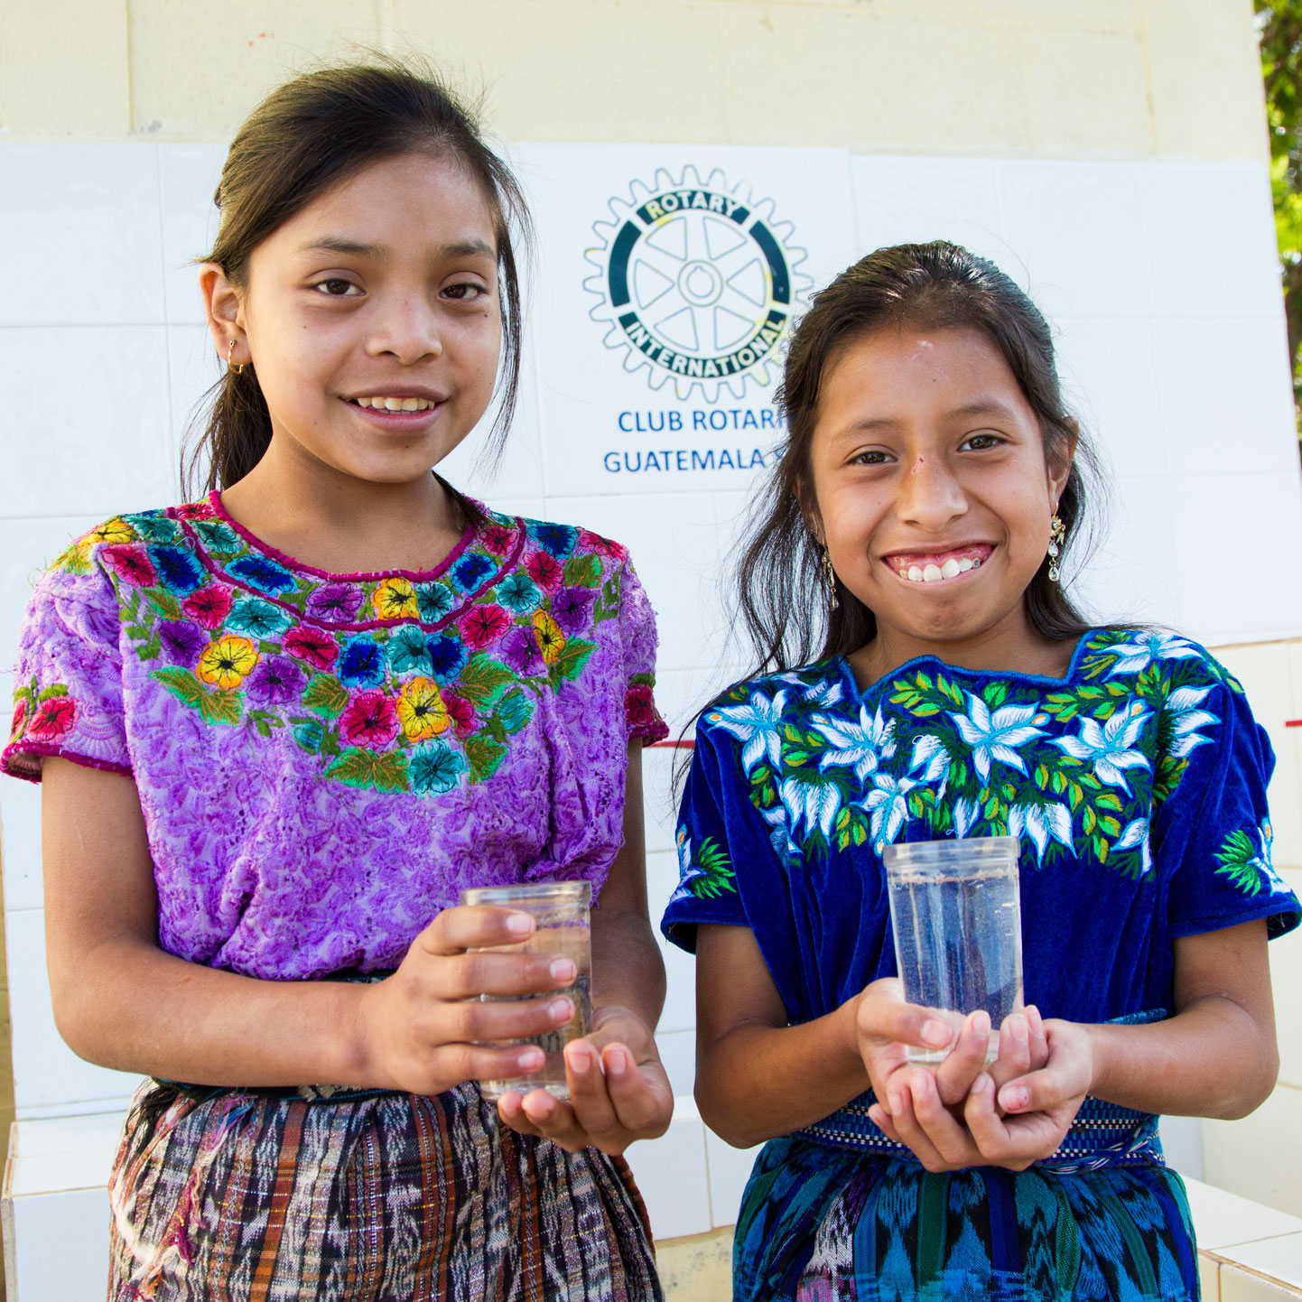
BENEFITING FROM THE ROTARY FOUNDATION
District Grants
Global Grants
Notes:
Rotarians support our Foundation through:
The PolioPlus Fund, dedicated to global polio eradication
The Annual Fund, primary source of funding for Foundation grants and activities
The Endowment Fund, which supports the Foundation in perpetuity

Slide 8
FEATURES OF A DISTRICT GRANT
A single block grant awarded annually for club and district projects
Local or international activities
Local decision making with broader guidelines
Smaller activities and projects
Notes:
District grants are single, annual block grants made to districts in amounts up to 50 percent of their District Designated Fund (DDF).
The district grant can fund multiple club and district projects, which may be local or international.
District grants allow local decision making, with minimal restrictions, for smaller-scale activities and projects.

Slide 9
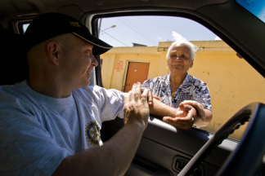
DISTRICT GRANT ACTIVITIES
Include active Rotarian participation
Adhere to stewardship guidelines
Demonstrate cultural sensitivity
Align with the Foundation’s mission
Notes:
Activities funded by district grants must:
Include active Rotarian participation
Adhere to stewardship guidelines
Demonstrate cultural sensitivity
Be consistent with the mission of The Rotary Foundation (but they need not be related to an area of focus)
ASK: What types of projects or activities do you think are possible when using The Rotary Foundation mission as a guide?

Slide 10
GLOBAL GRANTS
Align with an area of focus
Respond to a community need
Include active community and Rotarian participation
Strengthen knowledge, skills, resources
Have long-term, sustainable benefits
Have measurable results
Have a budget of at least $30,000
Notes:
Global grants fund large-scale projects and activities that:
Align with an area of focus
Respond to a need the benefiting community has identified
Include the active participation of the benefiting community
Include the active participation of Rotarians
Strengthen local knowledge, skills, and resources
Are designed to enable the benefiting community to address its own needs after the Rotary club or district has concluded its work
Have measurable results
The minimum grant award is $15,000 (for a total budget of at least $30,000). The DDF allocation is matched 100 percent, and cash is matched at 50 percent from the World Fund. A global grant project is sponsored by a host club in the project country and a club outside the project country.

Slide 11
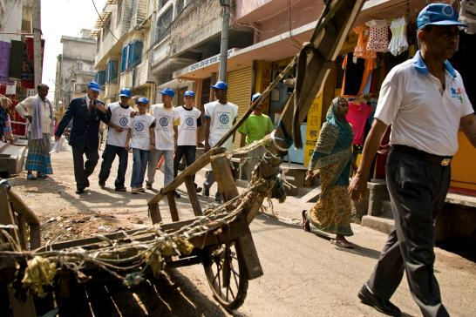
BUILDING SUSTAINABLE PROJECTS
Community participation
Materials and technology
Funding
Knowledge
Motivation
Evaluation
Notes:
Global grant funding is an investment in lasting change. Sustainable projects can take many forms, but all display the following elements:
Community participation: Sustainable projects are well planned, involve the collaboration of multiple project participants, and suit the needs and values of beneficiaries.
Materials and technology: Sustainable projects employ durable materials that are accessible, ready to use, and environmentally sound.
Funding: Sustainable projects ensure that a reliable source of funding exists to continue project outcomes after the grant is complete.
Knowledge: Sustainable projects increase capacity by helping communities acquire new skills, knowledge, and behaviors.
Motivation: Sustainable projects provide tangible incentives for community ownership of project activities and outcomes.
Evaluation: Sustainable projects are designed to ensure clear and measurable outcomes.
Let’s look at the steps in planning a sustainable global grant project.

Slide 12
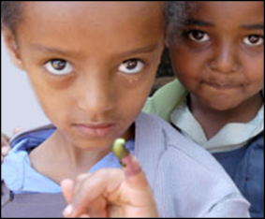
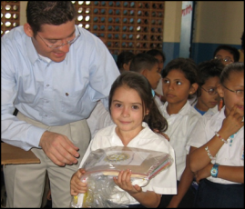

SUPPORTING THE ROTARY FOUNDATION
PolioPlus Fund
End Polio Now
Annual Fund
For Support Today
Endowment Fund
To Secure Tomorrow
Notes:
Rotarians support our Foundation through:
The PolioPlus Fund, dedicated to global polio eradication
The Annual Fund, primary source of funding for Foundation grants and activities
The Endowment Fund, which supports the Foundation in perpetuity

Slide 13
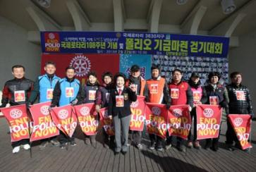

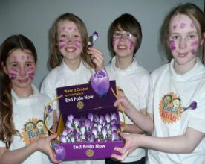
END POLIO NOW: MAKE HISTORY TODAY
Notes:
Rotary’s own financial support for PolioPlus will be magnified by an agreement with the Bill & Melinda Gates Foundation.
From 2013 to 2018, every $1 that Rotary commits in direct support of polio immunization (up to $35 million per year) will be matched by an additional $2 from the Gates Foundation. This means contributions to Rotary’s PolioPlus program will have three times the impact.

Slide 14
ANNUAL FUND
Primary funding source for Foundation grants and activities
Supports local and international grants through the SHARE system
Contributions are credited to donor’s club and applied to club’s goal
Notes:
Contributions to the Annual Fund support local and international grants and activities through the SHARE system.
Contributions are credited to the individual donor and the donor’s club and counted toward the club’s and district’s Annual Fund goals.

Slide 15
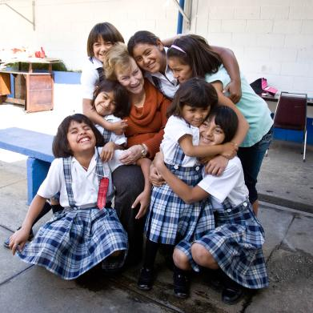
ENDOWMENT FUND
Contributions are professionally invested
Only the earnings are spent
Notes:
Gifts to the Endowment Fund are held in perpetuity as part of an endowment. They are professionally invested, with a portion of the earnings used each year for purposes specified by the Trustees and the donors.
The Endowment Fund offers donors a way to create their own lasting legacy through Rotary.

Slide 16
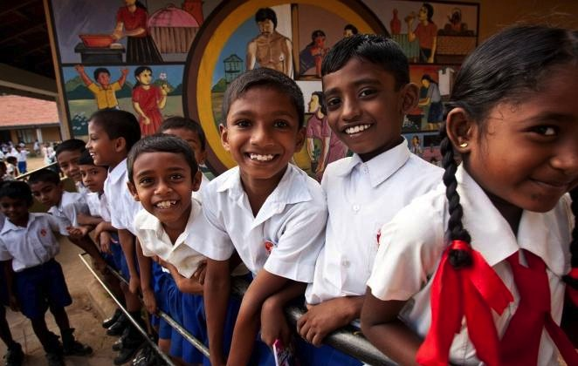

HOW WE FUND PROGRAMS – SHARE SYSTEM
50%
District Designated Fund (DDF)
50%
World Fund
Notes:
To review: when we contribution to Annual Fund – SHARE, fifty percent (50%) of our contributions come back to our district through District Designated Funds (DDF) in three years to spend on educational and humanitarian activities chosen by us; even grants that may be used for projects in our local community.
The 5 percent that is earmarked to potentially pay for the Foundation’s operating expenses will come from the World Fund. It will be used only if it is needed to pay expenses when net investment returns are not sufficient, or to fully fund the operating reserve (up to three times annual operating expenses). If funds are not needed for these purposes, they will remain in the World Fund until the World Fund is measured to ensure sufficient funds for programs.
In the final step, the World Fund will be measured to ensure that it contains 50 percent of the three prior years’ worth of contributions, plus $5 million – a growth factor. Then and only then, surplus funds will be transferred to the Endowment Fund.
This funding model:
Builds our financial strength by ensuring that resources are available to meet current needs: programs and operating expenses.
Establishes a reserve to provide for unusual financial events (a rainy day fund): the operating reserve.
Ensures an increase in future programs through increased returns on the Endowment Fund.

Slide 17
The Rotary Club of Brandon ‘86
2015-16: Club gave $4,285 to Annual Fund–SHARE
2018-19: Club allocated $2,142 DDF
  Up to 50% ($1,071) available for District Grant
  Club used $1,071 to purchase dictionaries for elementary schools in the Brandon area

Slide 18
The Rotary Club of Brandon ‘86
2016-17: Club gave $3,250 to Annual Fund–SHARE
  2019-20: Club will be allocated $1,625
2017-18: Club gave $2,175 to Annual Fund–SHARE
  2020-21: Club will be allocated $1,088

Slide 19

RECURRING GIVING: ROTARY DIRECT
    Safe, secure, and easy
    Give monthly, quarterly, or annually
    Enroll at www.rotary.org/give
Notes:
One of the easiest and most secure ways for us to support our Foundation is through Rotary’s recurring giving program, Rotary Direct. Select an amount, frequency (monthly, quarterly or annually), and contribution method that is convenient for you.
Enrollment is integrated with the Foundation’s secure online contribution system and is available in multiple currencies.
Efficient, convenient and secure.
The Rotary Foundation will send you one annual statement of Rotary Direct contributions for tax purposes (where applicable).

Slide 20

THANK YOU!
www.rotary.org/give
Notes:
As a Rotarian, I hope you feel proud about what you are helping accomplish. I hope you now understand why every gift, from every Rotarian, does a world of good.
Please join ME and Every Rotarian in supporting OUR Rotary Foundation, Every Year.
Thank you.

