Slide 1
President-Elect Training Seminar
February 28, 2025
The Rotary Foundation
Join Leaders • Exchange Ideas • Take Action

Slide 2
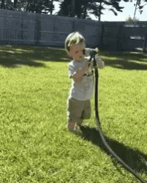
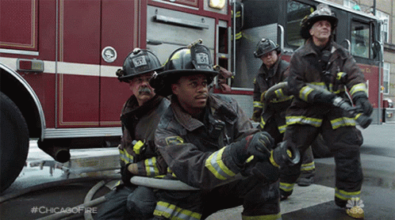
Counting Down: 123…122…121… (days)
Drink from
the hose
(of knowledge) NOW
and enter
next year
with a PLAN!
Spend the next YEAR putting
out fires
OR…
Florida PETS • February 28, 2025
Join Leaders • Exchange Ideas • Take Action
20

Slide 3
A Quick Refresher from PETS (1)
Florida PETS • February 28, 2025
Join Leaders • Exchange Ideas • Take Action
19

Slide 4
NOW
Last Month!
List Club TRF Chair on Rotary.org
• Occasional email & invitations from RI
• Access to important TRF club reports
List Club TRF Chair on DACdb
• Receive monthly District TRF Newsletter
• Additional access to p-mail features
Florida PETS • February 28, 2025
Contact District 6890 International Service Chair
IRMA COLE (Lakeland RC) for help entering data on Rotary.org and DACdb
(978) 394-2661 • RtnIrmaCole@yahoo.com
Join Leaders • Exchange Ideas • Take Action
18

Slide 5
Soon
Really Soon!
Develop a WRITTEN Club TRF Giving Strategy
• Club TRF assessment – “current state”
> Number of club members contributing annually
> Per capita Annual Fund giving
> Separate PolioPlus commitment (RI asks $1,500 per club)
• Set 2 or 3 realistic GOALS to work on
> Keep it SIMPLE (e.g., “Increase AF giving to $100 per capita”)
> Define 2 or 3 specific ACTION STEPS to support each goal
> Share with club membership and provide regular UPDATES
Florida PETS • February 28, 2025
SPEND Your DDF (District & Global Grant Funds)
• DISTRICT Grant deadline is May 31, 2025 (Yes, BEFORE the new year!)
• GLOBAL Grant deadline is August 31, 2025
Join Leaders • Exchange Ideas • Take Action
17

Slide 6
Early in the New Rotary Year
(Sooner than you Think!)
TALK About The Rotary Foundation (a LOT)
• Regular project mentions from Rotary magazine or Rotary.org (or newsletters)
• Include TRF Giving in new-member orientations (Fireside Chats)
• Invite speakers to share TRF-related topics (ideally one per quarter – or more)
• Participate in International Service (multiple ways to contribute…not just money)
Florida PETS • February 28, 2025
Join Leaders • Exchange Ideas • Take Action
16

Slide 7
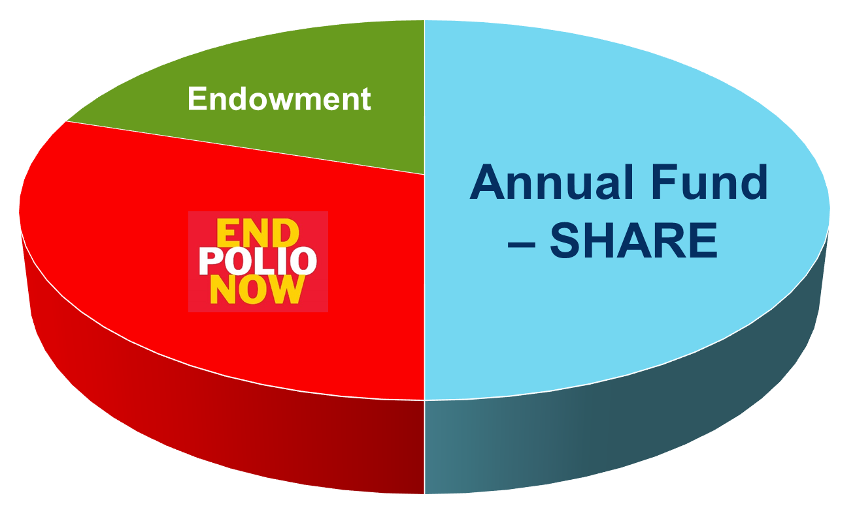
THREE Key TRF Elements
Florida PETS • February 28, 2025
Join Leaders • Exchange Ideas • Take Action
15

Slide 8
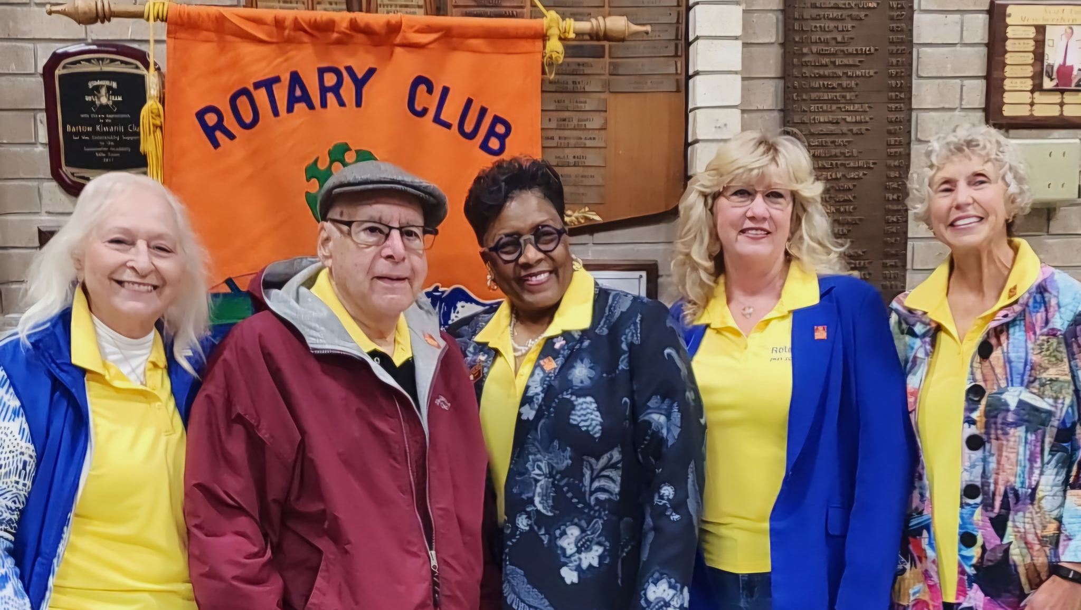
PolioPlus
PolioPlus
Florida PETS • February 28, 2025
District 6890 Rotarians PDG Mark Scolnick, PDG Deborah L. Williams, DISC Irma Cole,
AG Clarice Roth, and Dori Huntoon
Joined a National Immunization Day (NID)
in India, February 2025!
Join Leaders • Exchange Ideas • Take Action
18
14

Slide 9
PolioPlus
Rotary’s single, greatest pursuit – Global Polio Eradication Initiative (GPEI). Since 1979: Rotarians have donated >$2.1B ($10B from governments worldwide) • Over 3 billion children protected against polio in 122 countries • Polio reduced 99.9%
PROGRAM
TARGETS
Minimum donation of $1,500 per club (may be combination of cash & DDF)
PolioPlus Society members pledge to give at least $100 per year
Florida PETS • February 28, 2025
District TRF Newsletter (PolioPlus contributions listed quarterly)
Monthly Contribution Report (Rotary.org / My Rotary >> Contribution & Recognition)
PolioPlus Report (Rotary.org / My Rotary >> Contribution & Recognition )
TRACKING
www.EndPolio.org
D6890 PolioPlus Co-chairs, PDG Mark Scolnick & PDG Nick Hall
Rotary.org / My Rotary >> Learning Center
LEARNING
Join Leaders • Exchange Ideas • Take Action
13

Slide 10
PolioPlus
Florida PETS • February 28, 2025
Join Leaders • Exchange Ideas • Take Action
12

Slide 11
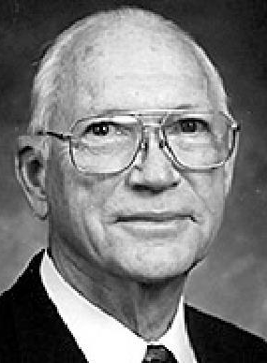
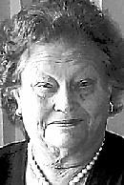
Endowment
William “Bill” Hammontree
1926 – 2018
Florida PETS • February 28, 2025
Janet Richwine
1930 – 2009
Include THE ROTARY FOUNDATION in your estate plans
to be part of ROTARY’S LEGACY of “Doing Good in the World”
Join Leaders • Exchange Ideas • Take Action
18
11

Slide 12
Endowment
Rotary’s “Permanent Fund” holding money in perpetuity to generate annual spendable earnings (~4%). Named funds ($25k min.) may be created by individuals or clubs, with earnings directed to the donor’s preferred Rotary cause.
PROGRAM
Benefactors pledge minimum $1,000 legacy gift, “Promise Club” = 100% Benefactors
Bequest Society members pledge minimum $10,000 legacy gift
Contributions may be direct to the Endowment or as part of estate plan
TARGETS
Florida PETS • February 28, 2025
Club Recognition Summary (CRS) shows Benefactors and number of Bequest
Major Donors, Arch C. Klumph Society and Bequest Society Report
Paul Harris Fellow and Benefactor Report (includes former members)
TRACKING
www.Rotary.org/en/Rotary-Endowment
D6890 Major Gifts Chair, Gerry Gutenstein
Rotary.org / My Rotary >> Learning Center
LEARNING
Join Leaders • Exchange Ideas • Take Action
10

Slide 13
Endowment
Endowment CHALLENGE #1
Who will be District 6890’s FIRST “Promise Club?”
• 100% of members pledge > $1,000 to Rotary’s Endowment
Endowment CHALLENGE #2
Which District 6890 Rotary club will create
the FIRST “Named Fund?”
• $25,000 Endowment contribution is eligible for Named Fund
• $100,000 Endowment contribution (proceeds to SHARE) is
eligible to have DDF earmarked for YOUR CLUB each year
Florida PETS • February 28, 2025
Join Leaders • Exchange Ideas • Take Action
9

Slide 14
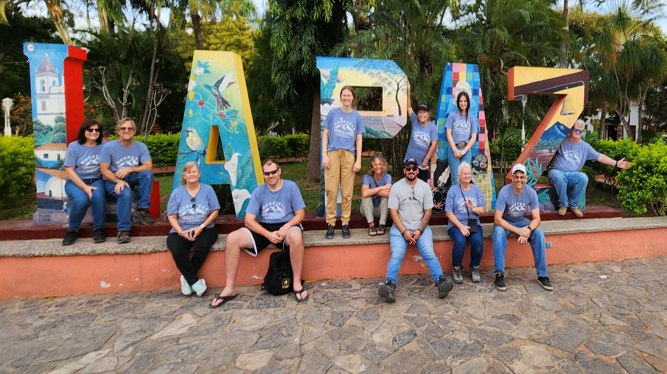
Annual Fund – SHARE
District 6890 Rotarians have been serving in Honduras for over 15 years!
Contact: Jim Weaver (Lake Wales Breakfast), Irma Cole (Lakeland),
Christy Young (Tampa Westchase), Ed Odom (FishHawk-Riverview)
Honduras Mission Trips
8

Slide 15
Annual Fund – SHARE
Primary program for TRF contributions. Funds are held in “escrow” for 3 years, earnings used for administration and fund raising. Roughly half of funds are returned to districts (earmarked for clubs in 6890) to be applied to eligible grants.
PROGRAM
Minimum donation of $100 per member (sustaining TRF member)
Paul Harris Society members pledge minimum $1,000 per year
EREY (Club averages $100 per capita AND each Rotarian gives at least $25)
TARGETS
Florida PETS • February 28, 2025
Monthly Contribution Report (Rotary.org / My Rotary >> Contribution & Recognition)
District TRF Newsletter (Annual Fund – SHARE contributions listed quarterly)
Club Recognition Summary (Rotary.org / My Rotary >> Contribution & Recognition)
TRACKING
https://My.Rotary.org/en/Annual-Fund
D6890 Annual Fund Chair, Taylor Bell
Rotary.org / My Rotary >> Learning Center
LEARNING
Join Leaders • Exchange Ideas • Take Action
7

Slide 16
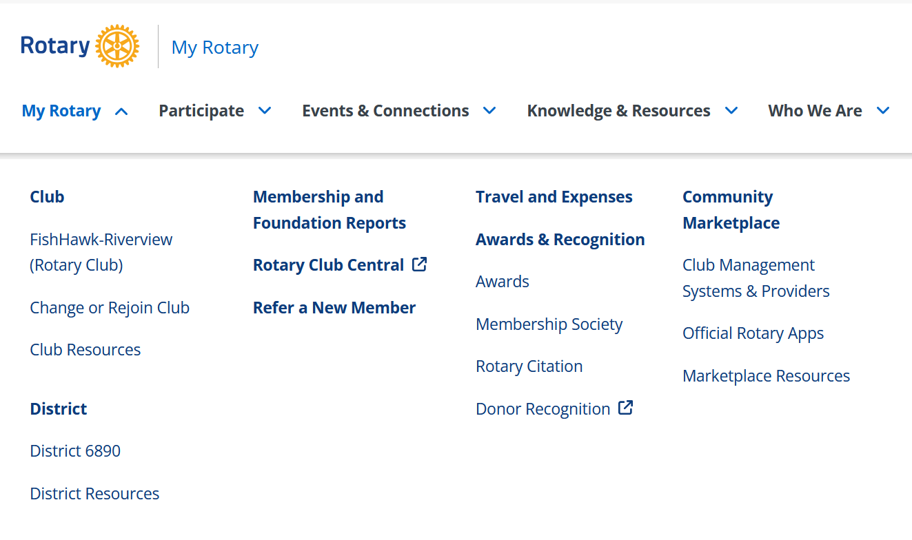
Know Your Numbers
Club Officers can access a variety of TRF, Membership, and other reports at Rotary.org (My Rotary). Log-in required.
Florida PETS • February 28, 2025
Join Leaders • Exchange Ideas • Take Action
6

Slide 17
CRS – Best Report for PHF Recognition
Recognition Amount
(Dollars Given AND Points Received)
Recognition Pts Available
(Points Available for Transfer ONLY)
Paul Harris Fellow Status
(Up to PHF + 8 MAX)
CRS is available to Club Presidents, Presidents-Elect, Secretaries, and TRF Chairs at Rotary.org (My Rotary). Log-in required.
Join Leaders • Exchange Ideas • Take Action
5

Slide 18
Fundraising Analysis – Best Report for Club TRENDS
Annual Fund Total
(Prior Years)
Annual Fund to Date
(This Year and Prior Years)
Florida PETS • February 28, 2025
Annual Fund Goal
(This Year and Prior Years)
Club Fundraising Analysis is available to Presidents, Presidents-Elect, Secretaries, & TRF Chairs at Rotary.org (My Rotary). Log-in required.
Join Leaders • Exchange Ideas • Take Action
4

Slide 19
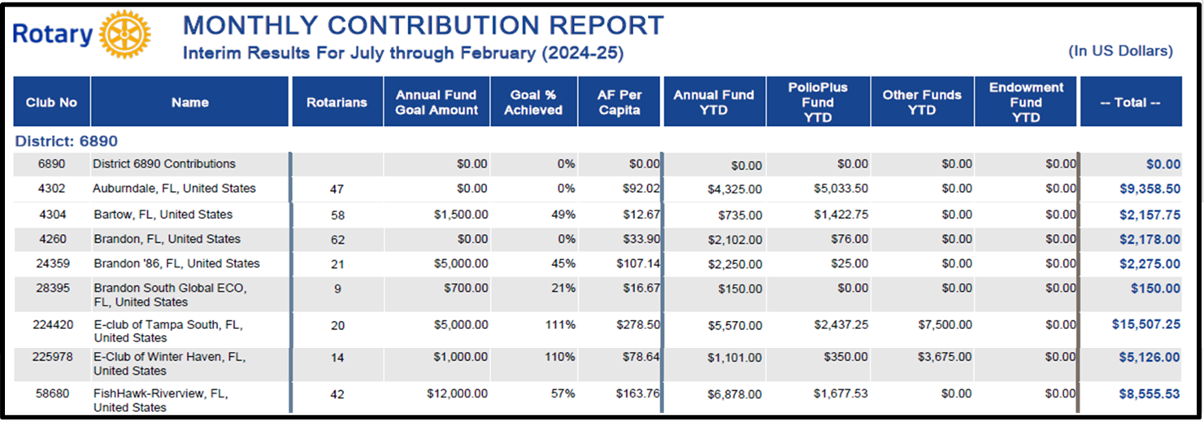
Monthly Contribution – Best for 3 Key Elements
Florida PETS • February 28, 2025
Your Legacy, Rotary’s Promise
Join Leaders • Exchange Ideas • Take Action
3

Slide 20
Surely in your calendar from PETS 1…
District 6890
Rotary Foundation Gala
November 5, 2025
Florida PETS • February 28, 2025
Bonnet Springs Event Center, Lakeland
Details T.B.D. – More to come!
Join Leaders • Exchange Ideas • Take Action
2

Slide 21
Additional Resources
District 6890 Rotary Foundation Chair
PDG Ed Odom (813) 351-9723, EdOdom01@gmail.com
District 6890 SHARE Committee Chair
Jason Lewis (303) 731-7300, Jason.Lewis1979@gmail.com
District 6890 Grants Chair
PDG Tom Wagner (813) 843-2494, TomCWagner6890@Outlook.com
PolioPlus Committee and PolioPlus Society
PDG Mark Scolnick (863) 944-3497, MarkScolnickDistrict6890@gmial.com • PDG Nick Hall (813) 230-5112, RotarianNick@gmail.com
Annual Fund Giving Paul Harris Society
Taylor Bell, (813) 955-1016, TaylorBell01@gmail.com Doug Roderick, (813) 283-2941, DARoderick5@aol.com
District 6890 International Service Chair
Irma Cole, (987) 394-2661, RtnIrmaCole@yahoo.com
www.Rotary.org/MyRotary (log-in required for many areas)
Knowledge & Resources > Learning Center (numerous TRF topics)
My Rotary > Membership & Foundation Reports (access limited by position)
Florida PETS • February 28, 2025
Join Leaders • Exchange Ideas • Take Action
1

Slide 22
President-Elect Training Seminar
February 28, 2025
Thank You!
Join Leaders • Exchange Ideas • Take Action

Slide 23
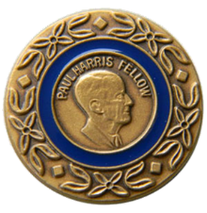
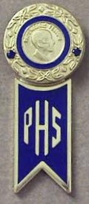
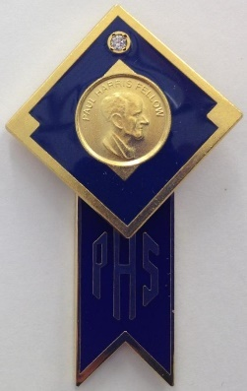
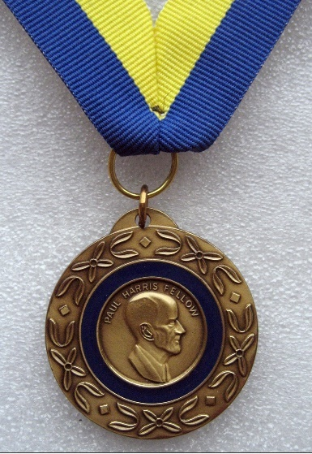
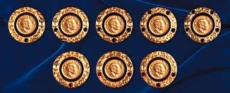
Recognition for TRF Giving
Paul Harris Fellow Pin & Medallion
= $1,000 Total to Qualifying TRF Programs
PH Society Tabs,
Major Donor Pins
& Crystals
Subsequent Paul Harris Fellow Pins
Bequest Society
& Benefactor Pins
(for Legacy Pledge or Endowment Giving)
(From top left: PH+1, PH+2, PH+3, PH+4, PH+5,
from bottom left: PH+6, PH+7, PH+8)
Join Leaders • Exchange Ideas • Take Action
4

