Slide 1
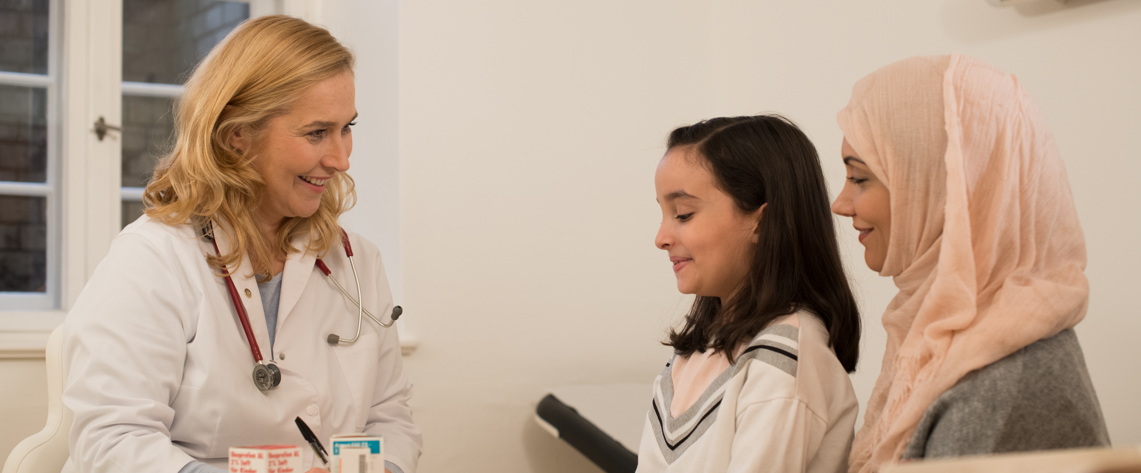
THE ROTARY FOUNDATION
Unlocking the Secrets of The Rotary Foundation
Notes:
We are always looking for a simple clear presentation about the foundation basics here we have such a presentation we hope you enjoy it.

Slide 2

Outstanding performance
92% of funds are spent on program awards and operations
#1 on Charity Navigator’s ‘10 of the Best Charities Everyone’s Heard Of’
We’re an organization you can support with confidence. We’ve dedicated about 90 percent of our total spending to programs over the past 10 years, far exceeding the efficiency standards set by independent charity-rating services.
Notes:
Our Foundation is carefully overseen by your fellow Rotarians, the Trustees of The Rotary Foundation. They ensure that your donations are invested well and spent wisely so they’ll do good in the world.
The generosity of our members and the good work that Rotary does haven’t gone unrecognized. We received top ratings from Charity Navigator, the leading evaluator of nonprofits in the U.S. It rated the Foundation No. 1 of “10 of the Best Charities Everyone’s Heard Of,” in recognition of our exceptional impact, accountability, and transparency.
And for the second consecutive year, CNBC named us one of the top 10 charities changing the world.
In addition to these accomplishments, the Foundation celebrated its centennial in 2016-17 — a milestone that few other organizations reach.
*Statistics are from Rotary’s 2018-19 annual report.

Slide 3
Today is Brought to You by the Numbers 7, 3 & 2
Rotary Foundation Basics – Easy to Remember
7 3 2
Notes:
Today is brought to us by the numbers 7, 3 and 2. That’s right, three simple numbers that will help us to unlock the secrets of The Rotary Foundation. To help us with these numbers we have brought in our friend the Count.

Slide 4
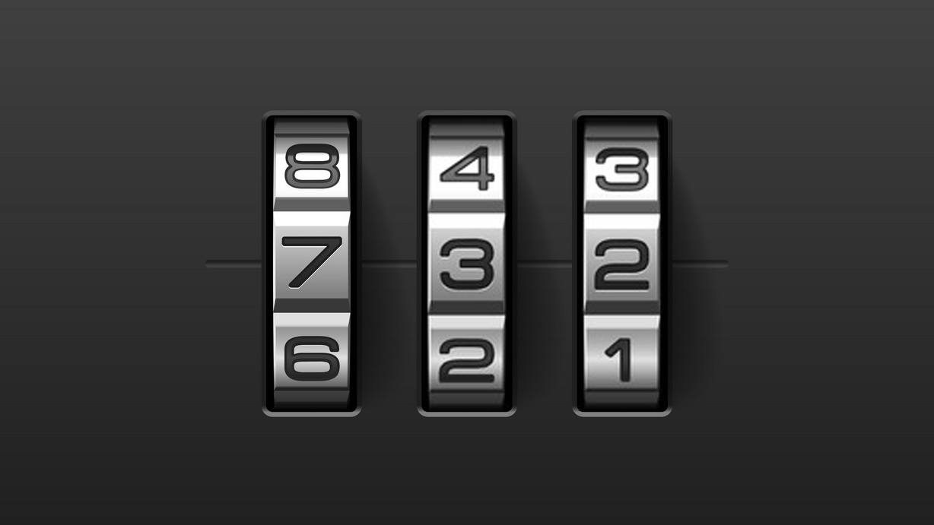
UNLOCK THE SECRETS OF
THE ROTARY FOUNDATION

Slide 5

Today is Brought to You by the Numbers 7, 3 & 2
Rotary Foundation Basics – Easy to Remember
7 3 2
Notes:
Today is brought to us by the numbers 7, 3 and 2. That’s right, three simple numbers that will help us to unlock the secrets of The Rotary Foundation. To help us with these numbers we have brought in our friend the Count.

Slide 6
Rotary Foundation Basics –
– Easy to Remember
7
Notes:
First let’s talk about the number 7, what does the number 7 have to do with The Rotary Foundation?

Slide 7







7 Areas of Focus
Peace Building & Conflict Prevention
Disease Prevention & Treatment
Water, Sanitation & Hygiene
Maternal & Child Health
Basic Education & Literacy
Community Economic Development
Supporting the Environment
Notes:
Well, there are 7 Areas of Focus of The Rotary Foundation. An Area of Focus is simply a CAUSE that Foundation Trustees have identified as an area in which they wish for us to focus our efforts.
These 7 Areas of Focus are:
Peacebuilding and Conflict Prevention
Disease Prevention and Treatment
Water, Sanitation and Hygiene
Maternal and Child Health
Basic Education and Literacy
Community Economic Development and finally
Supporting the Environment.

Slide 8
Rotary Foundation Basics –
– Easy to Remember
3
Notes:
Now, the number 3 what does the number three tell us about the Rotary foundation?

Slide 9
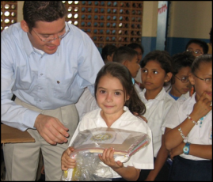

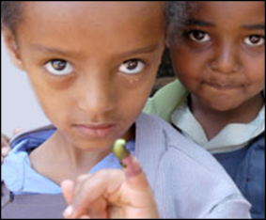
3 Funds Accept Contributions
Annual Fund
For Support Today
Endowment Fund
To Secure Tomorrow
PolioPlus Fund
End Polio Now
Notes:
Well, there are 3 PRIMARY FUNDS to accept contributions made to The Rotary Foundation. Now there are probably hundreds of ways to give to The Rotary Foundation and in fact if you want to give a large enough contribution today to The Rotary Foundation, I’m sure that we could come up with a brand new way just for you to give today! ☺
But primarily there are 3 funds that receive all our contributions. They are:
The Annual Fund. That’s the fund where we fund our projects for today. Our Global Grants and District Grants all come from the Annual Fund.
The Endowment Fund. This fund secures the projects of tomorrow. Contributions to the Endowment fund are never spent. They are invested and the spendable earnings roll into the Annual Fund each year to fund our many projects. And then finally
The Polio Plus Fund. This is the fund that provides for all our efforts to End Polio Now.

Slide 10
Rotary Foundation Basics –
– Easy to Remember
3

Slide 11
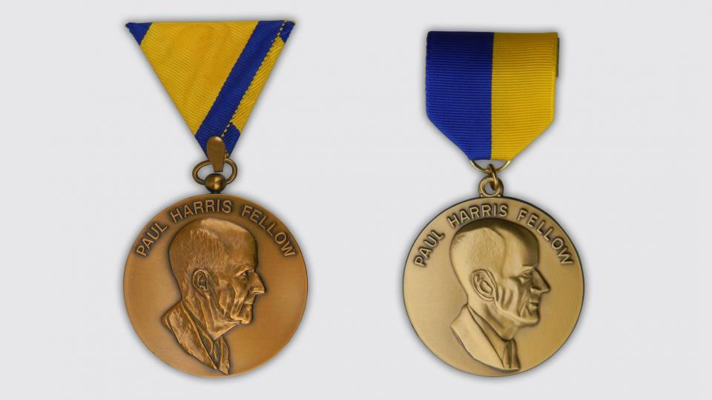
RECOGNITIONS

Slide 12
3 types of RECOGNITION
(Past, Present, Future)
Contributions made in the PAST
Contributions promised for the FUTURE
Contributions being made TODAY
Notes:
The Rotary foundation recognizes it’s donors and there are three basic types recognition provided by the Rotary foundation. They are first recognition of past giving second recognition of future promises and recognition of current giving giving today

Slide 13
3 Recognitions for past giving
Paul Harris Fellowship
Major Donor Recognition
Arch Klumpf Society Recognition
Notes:
Recognition of past giving includes the Paul Harris fellowship major donor record recognition and the arch club society recognition.

Slide 14
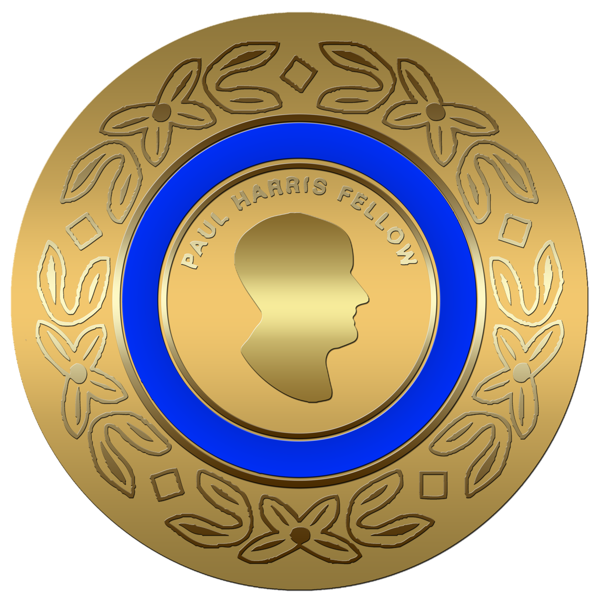
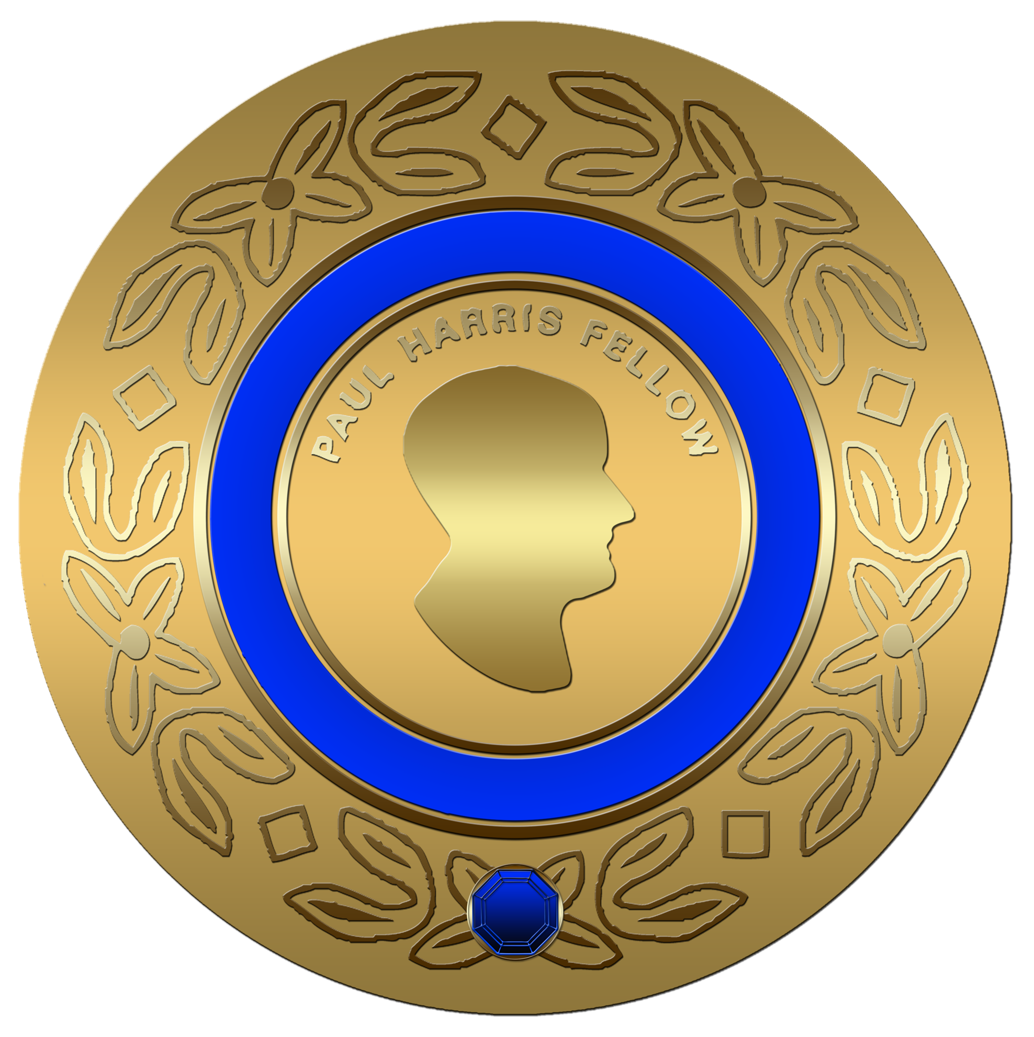
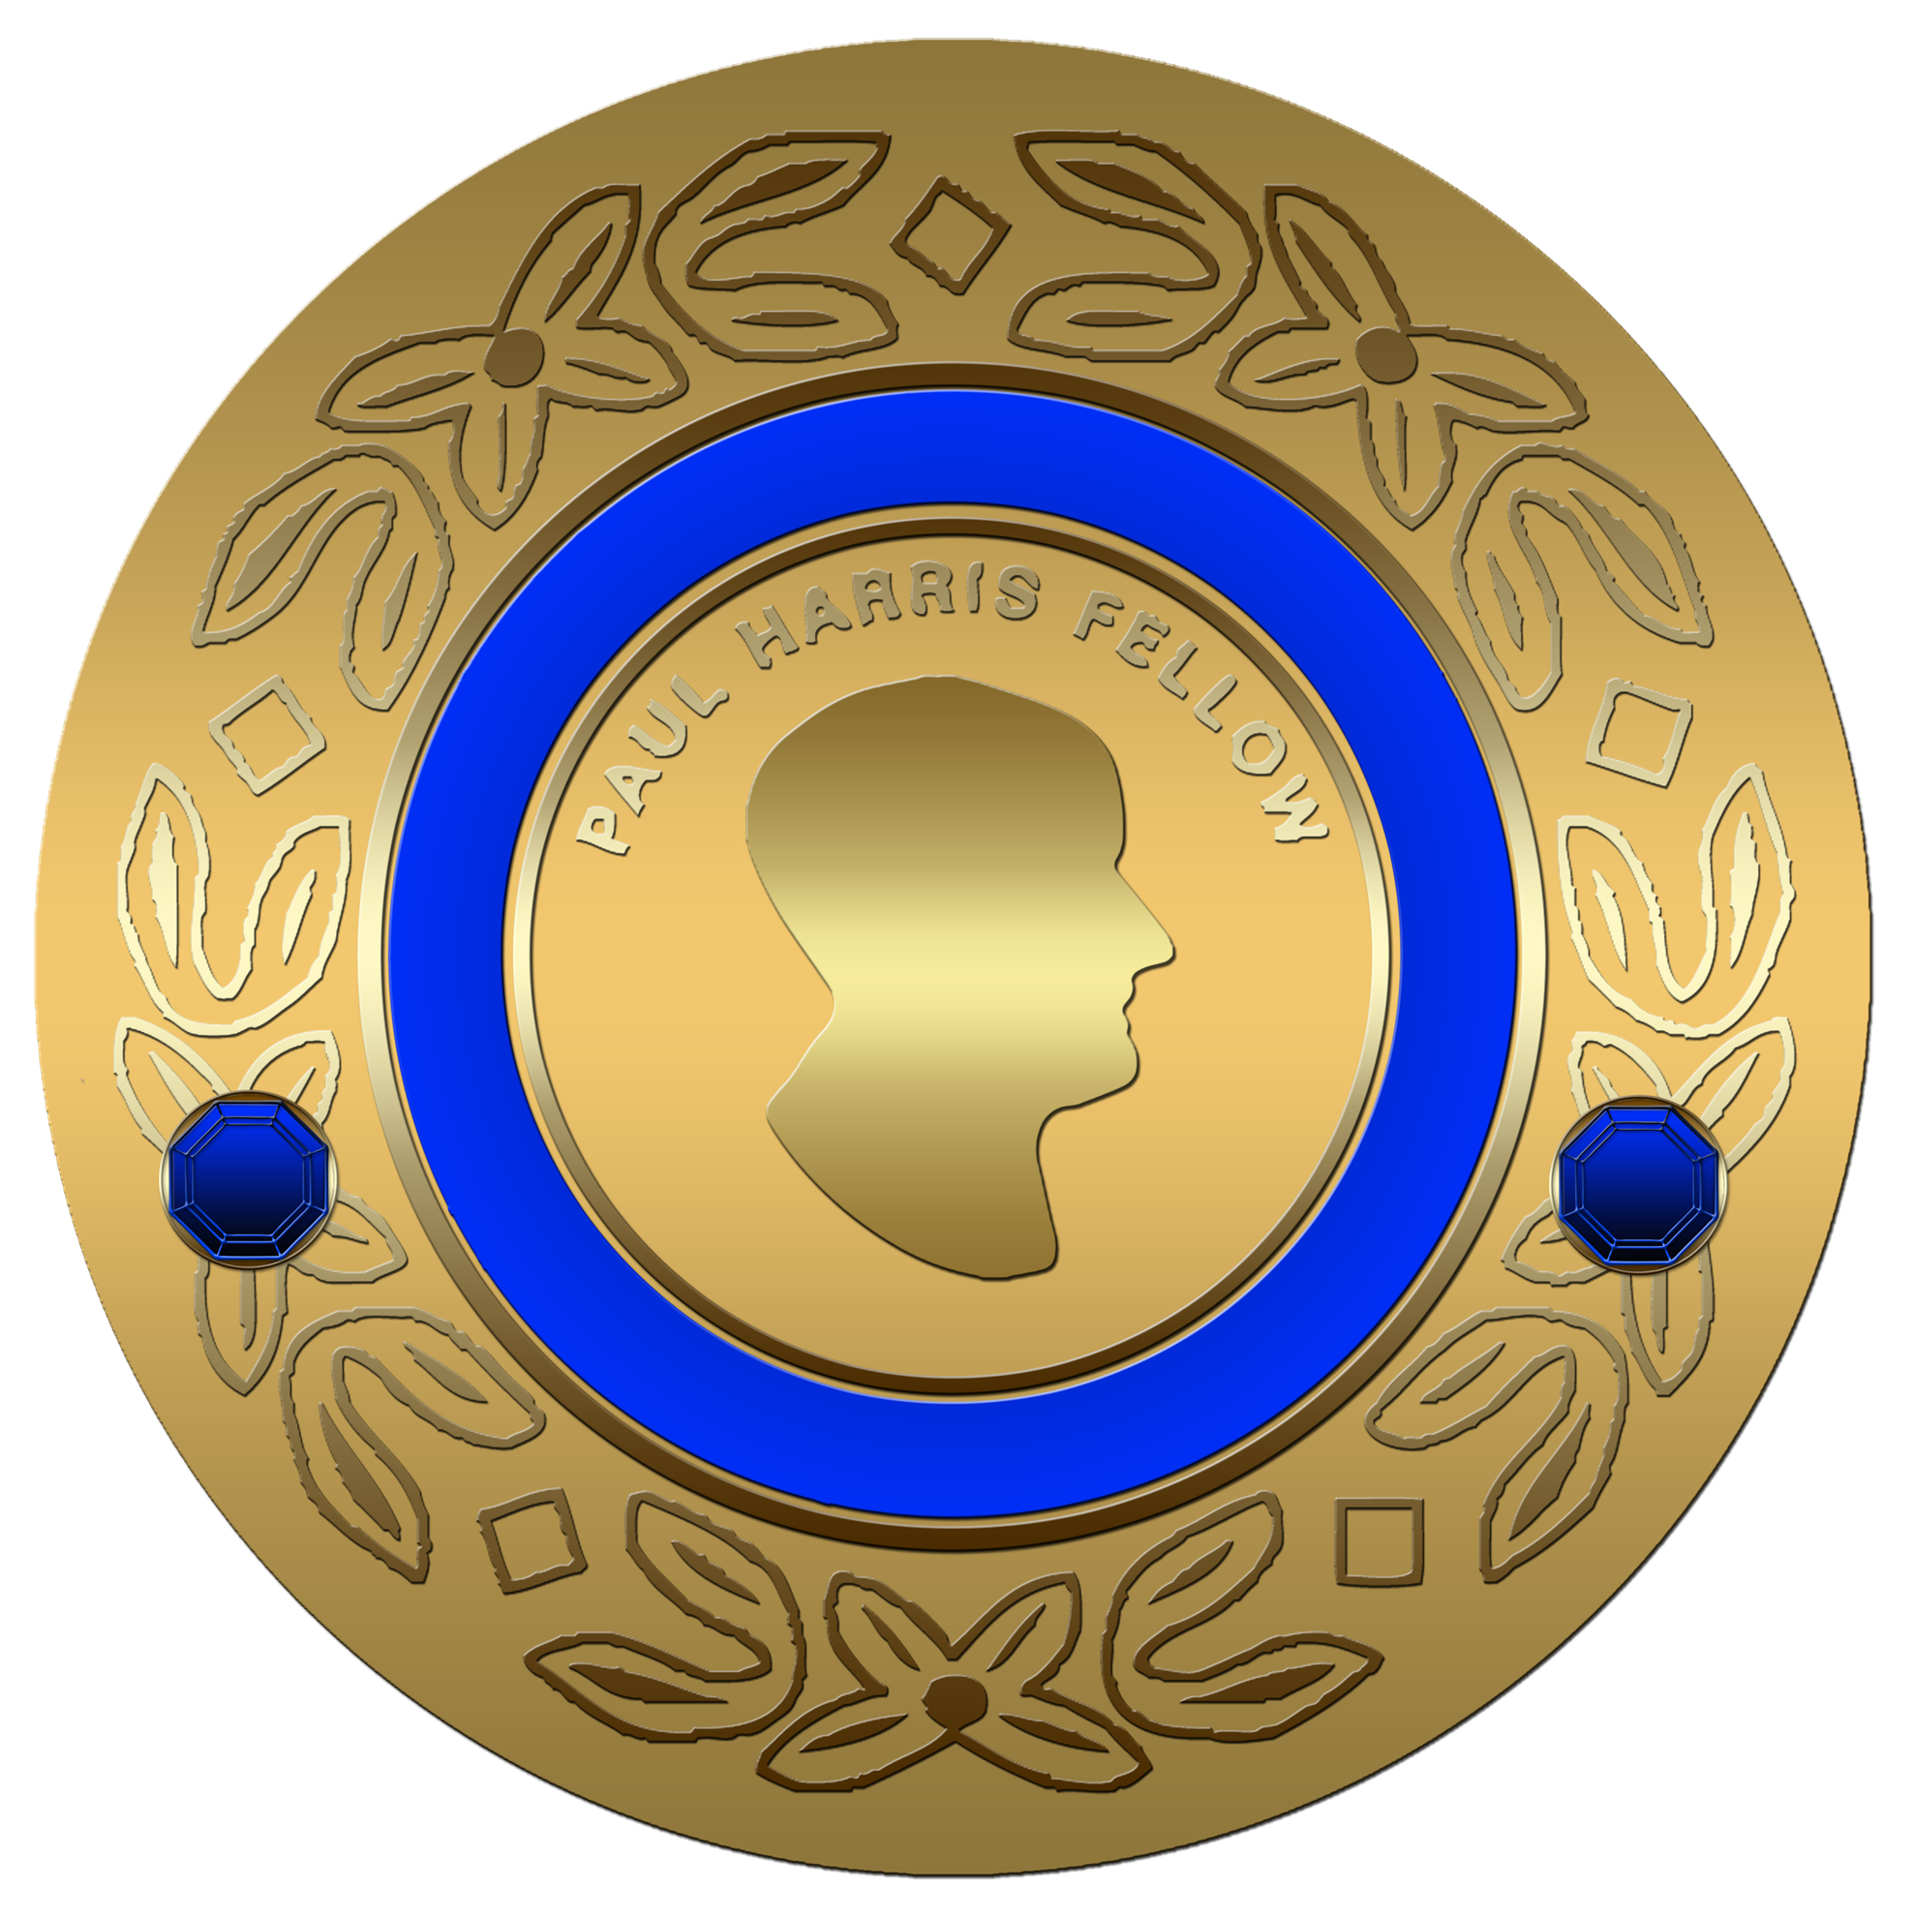
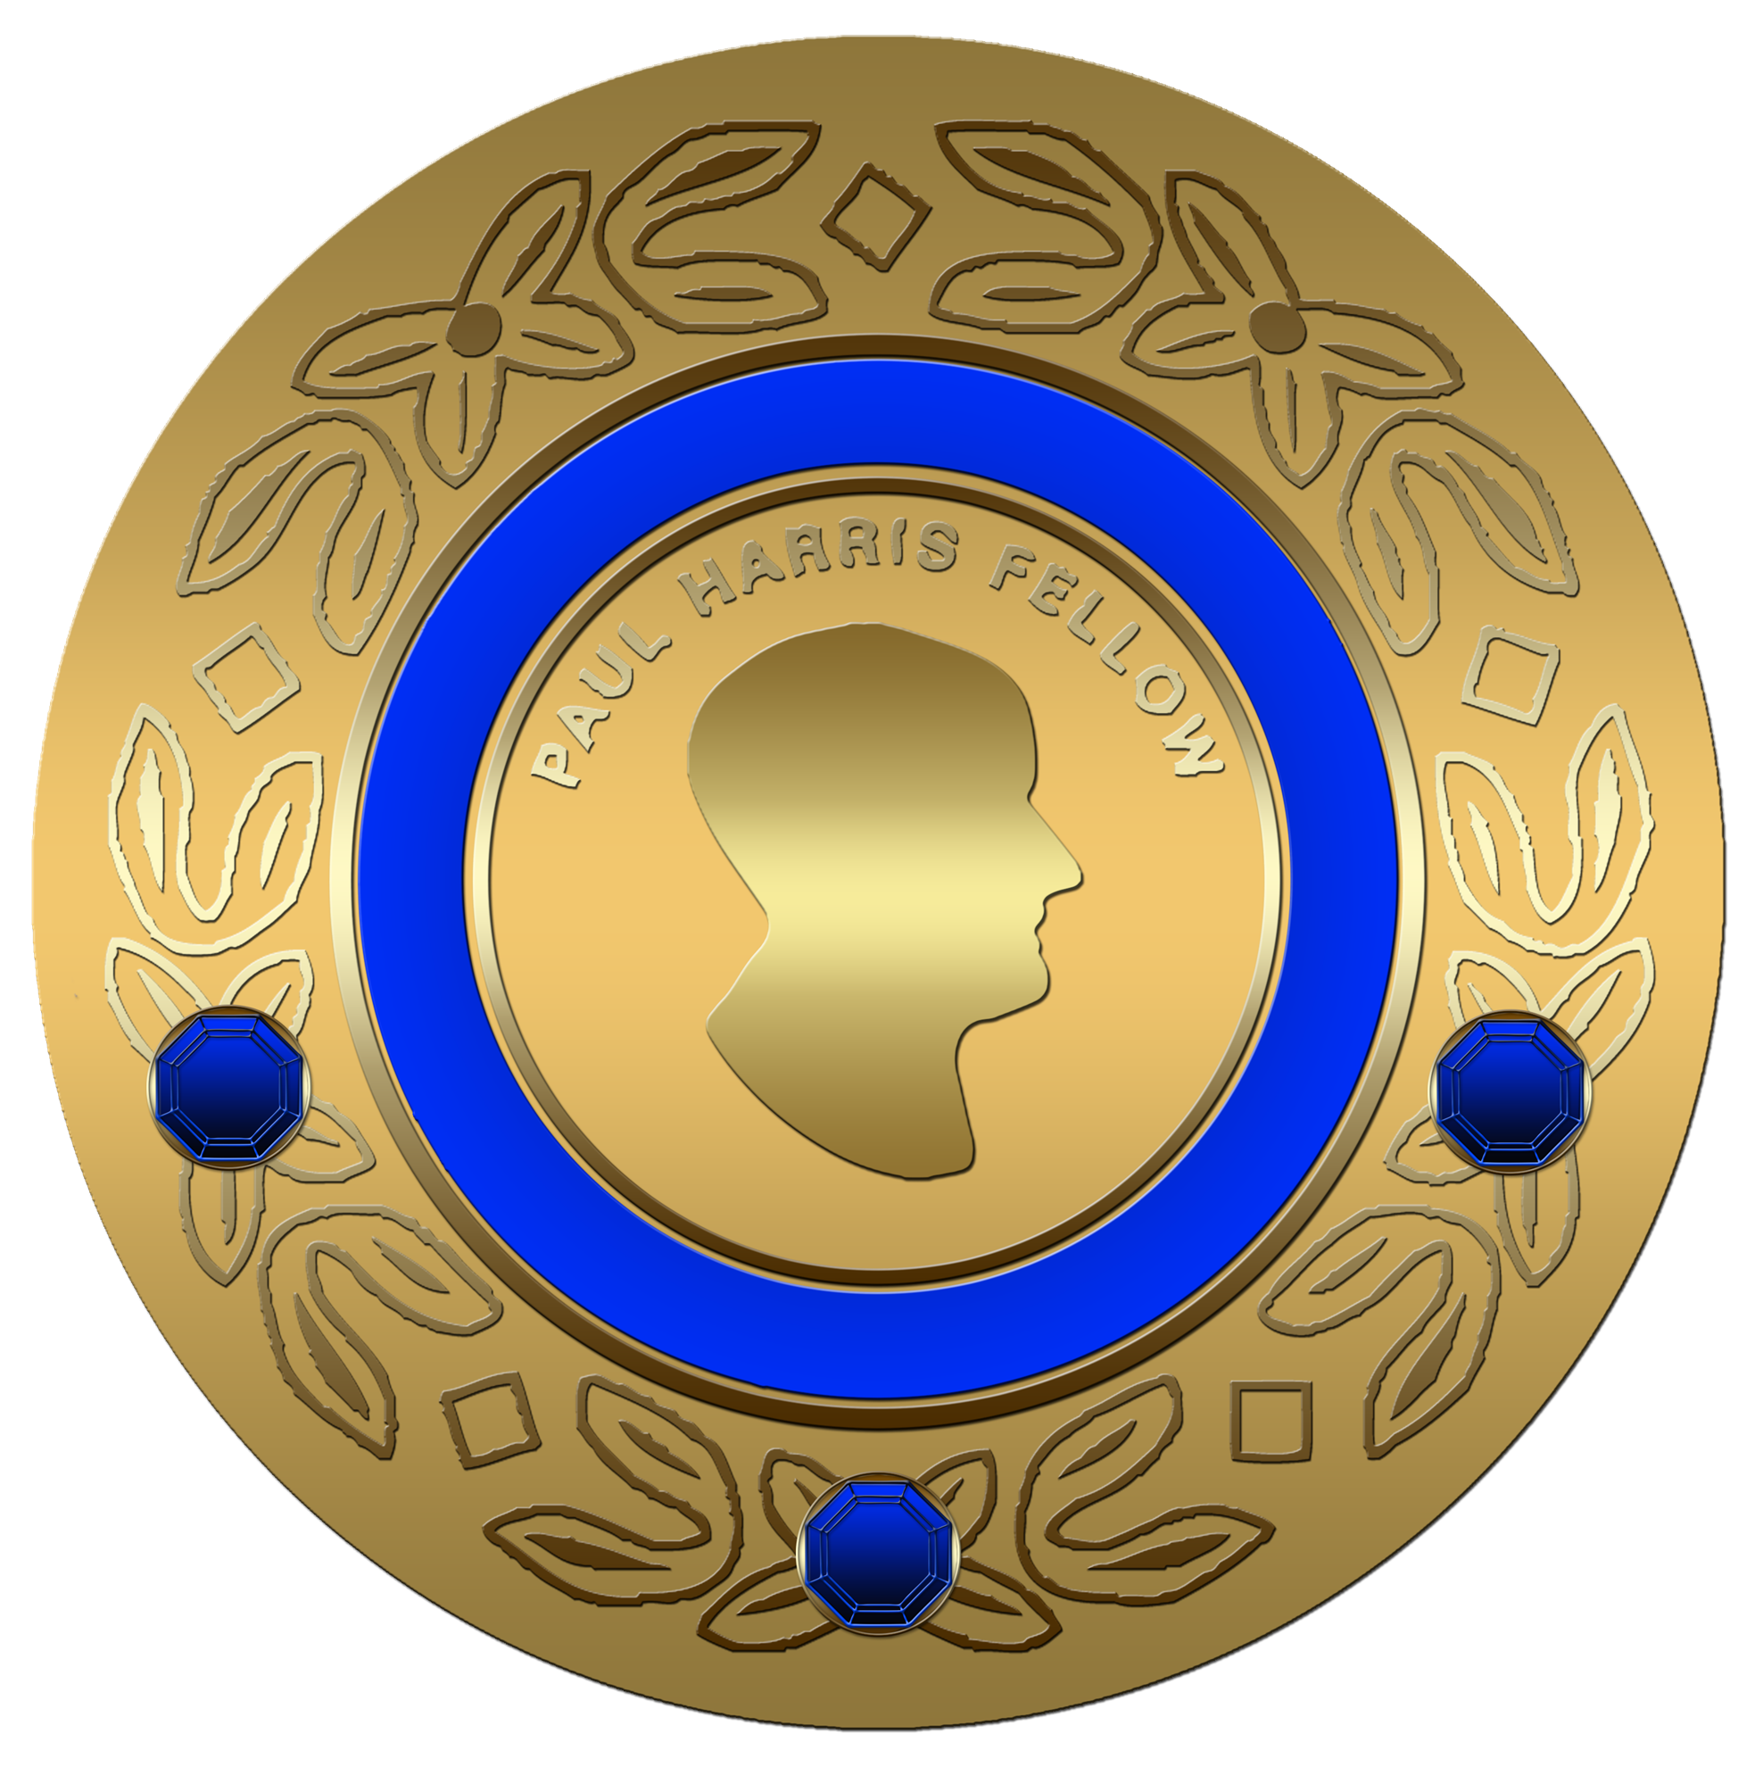
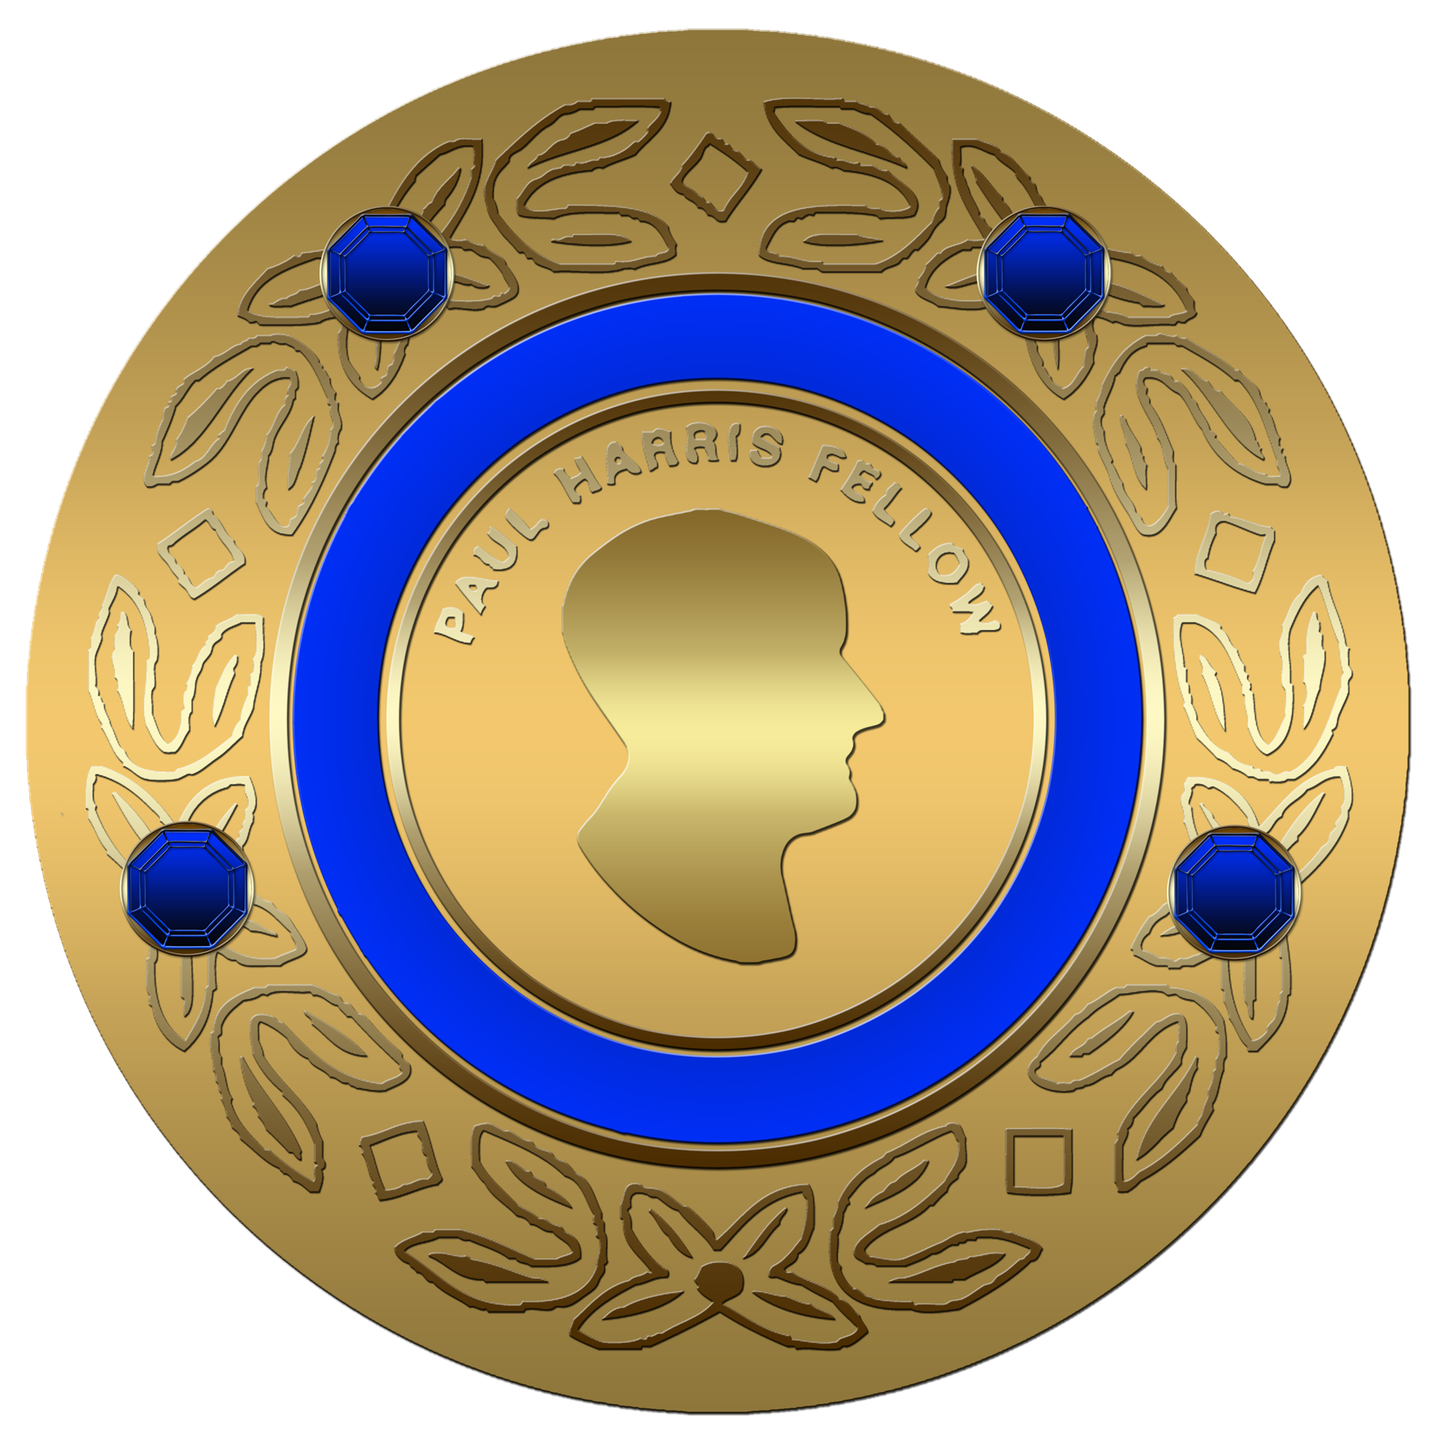
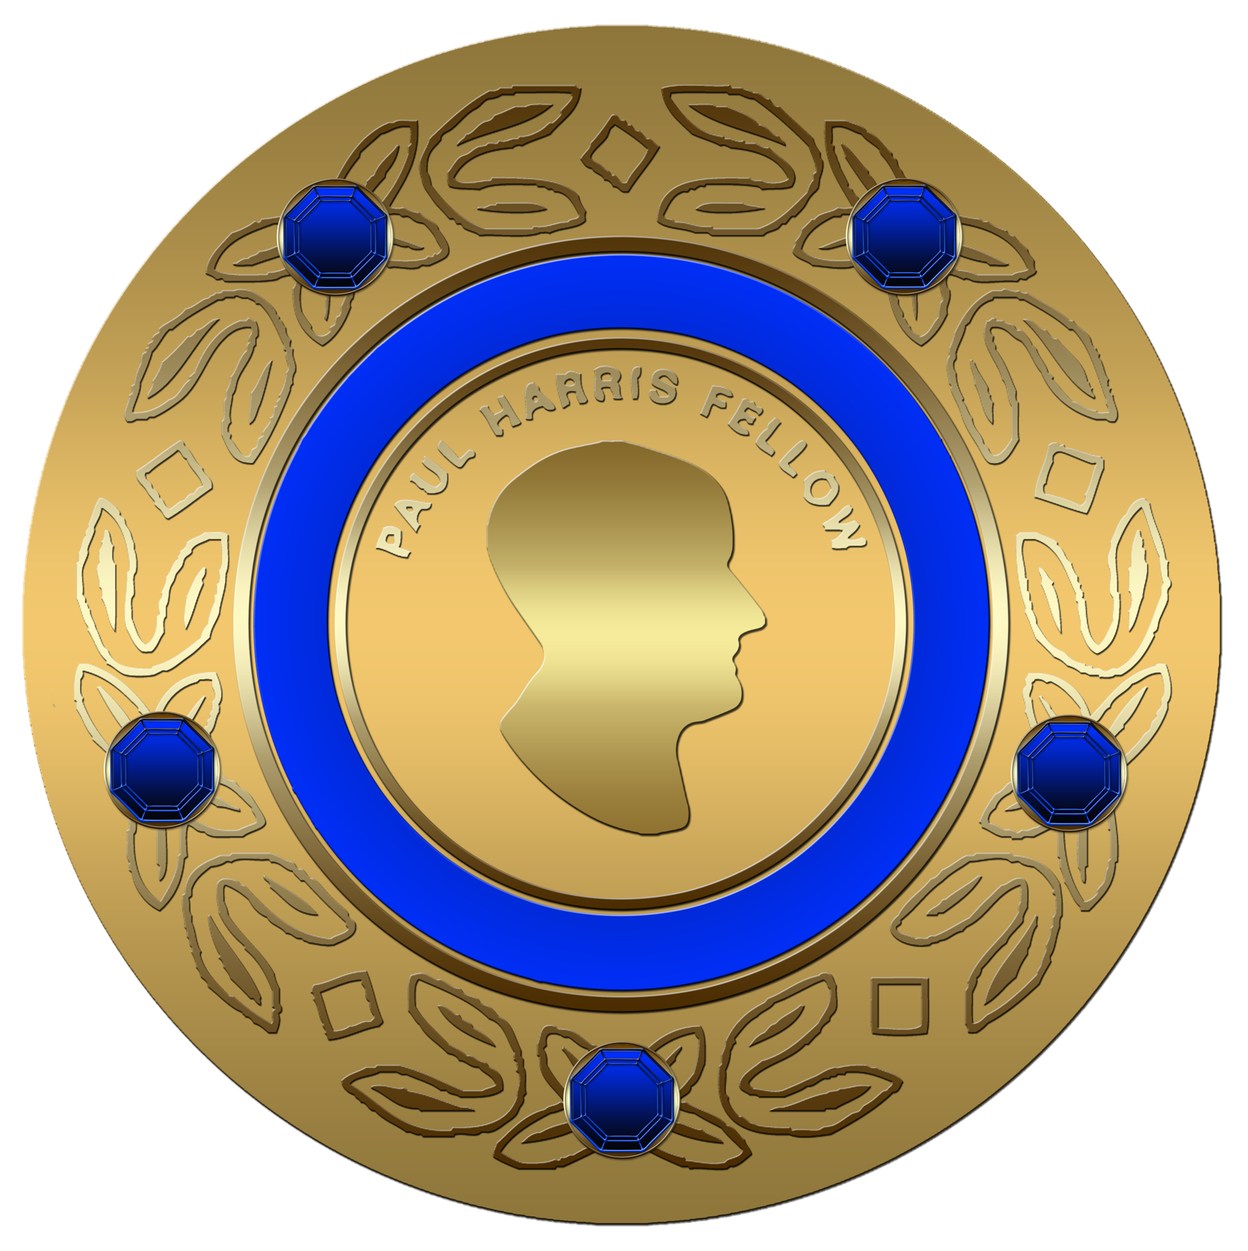
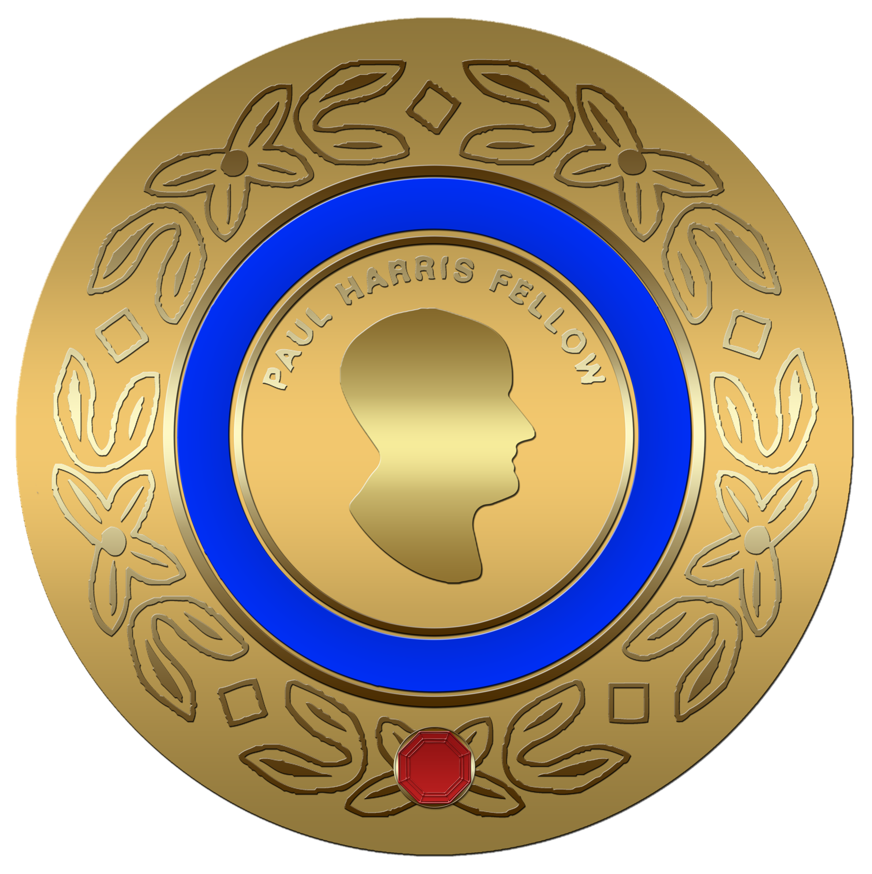
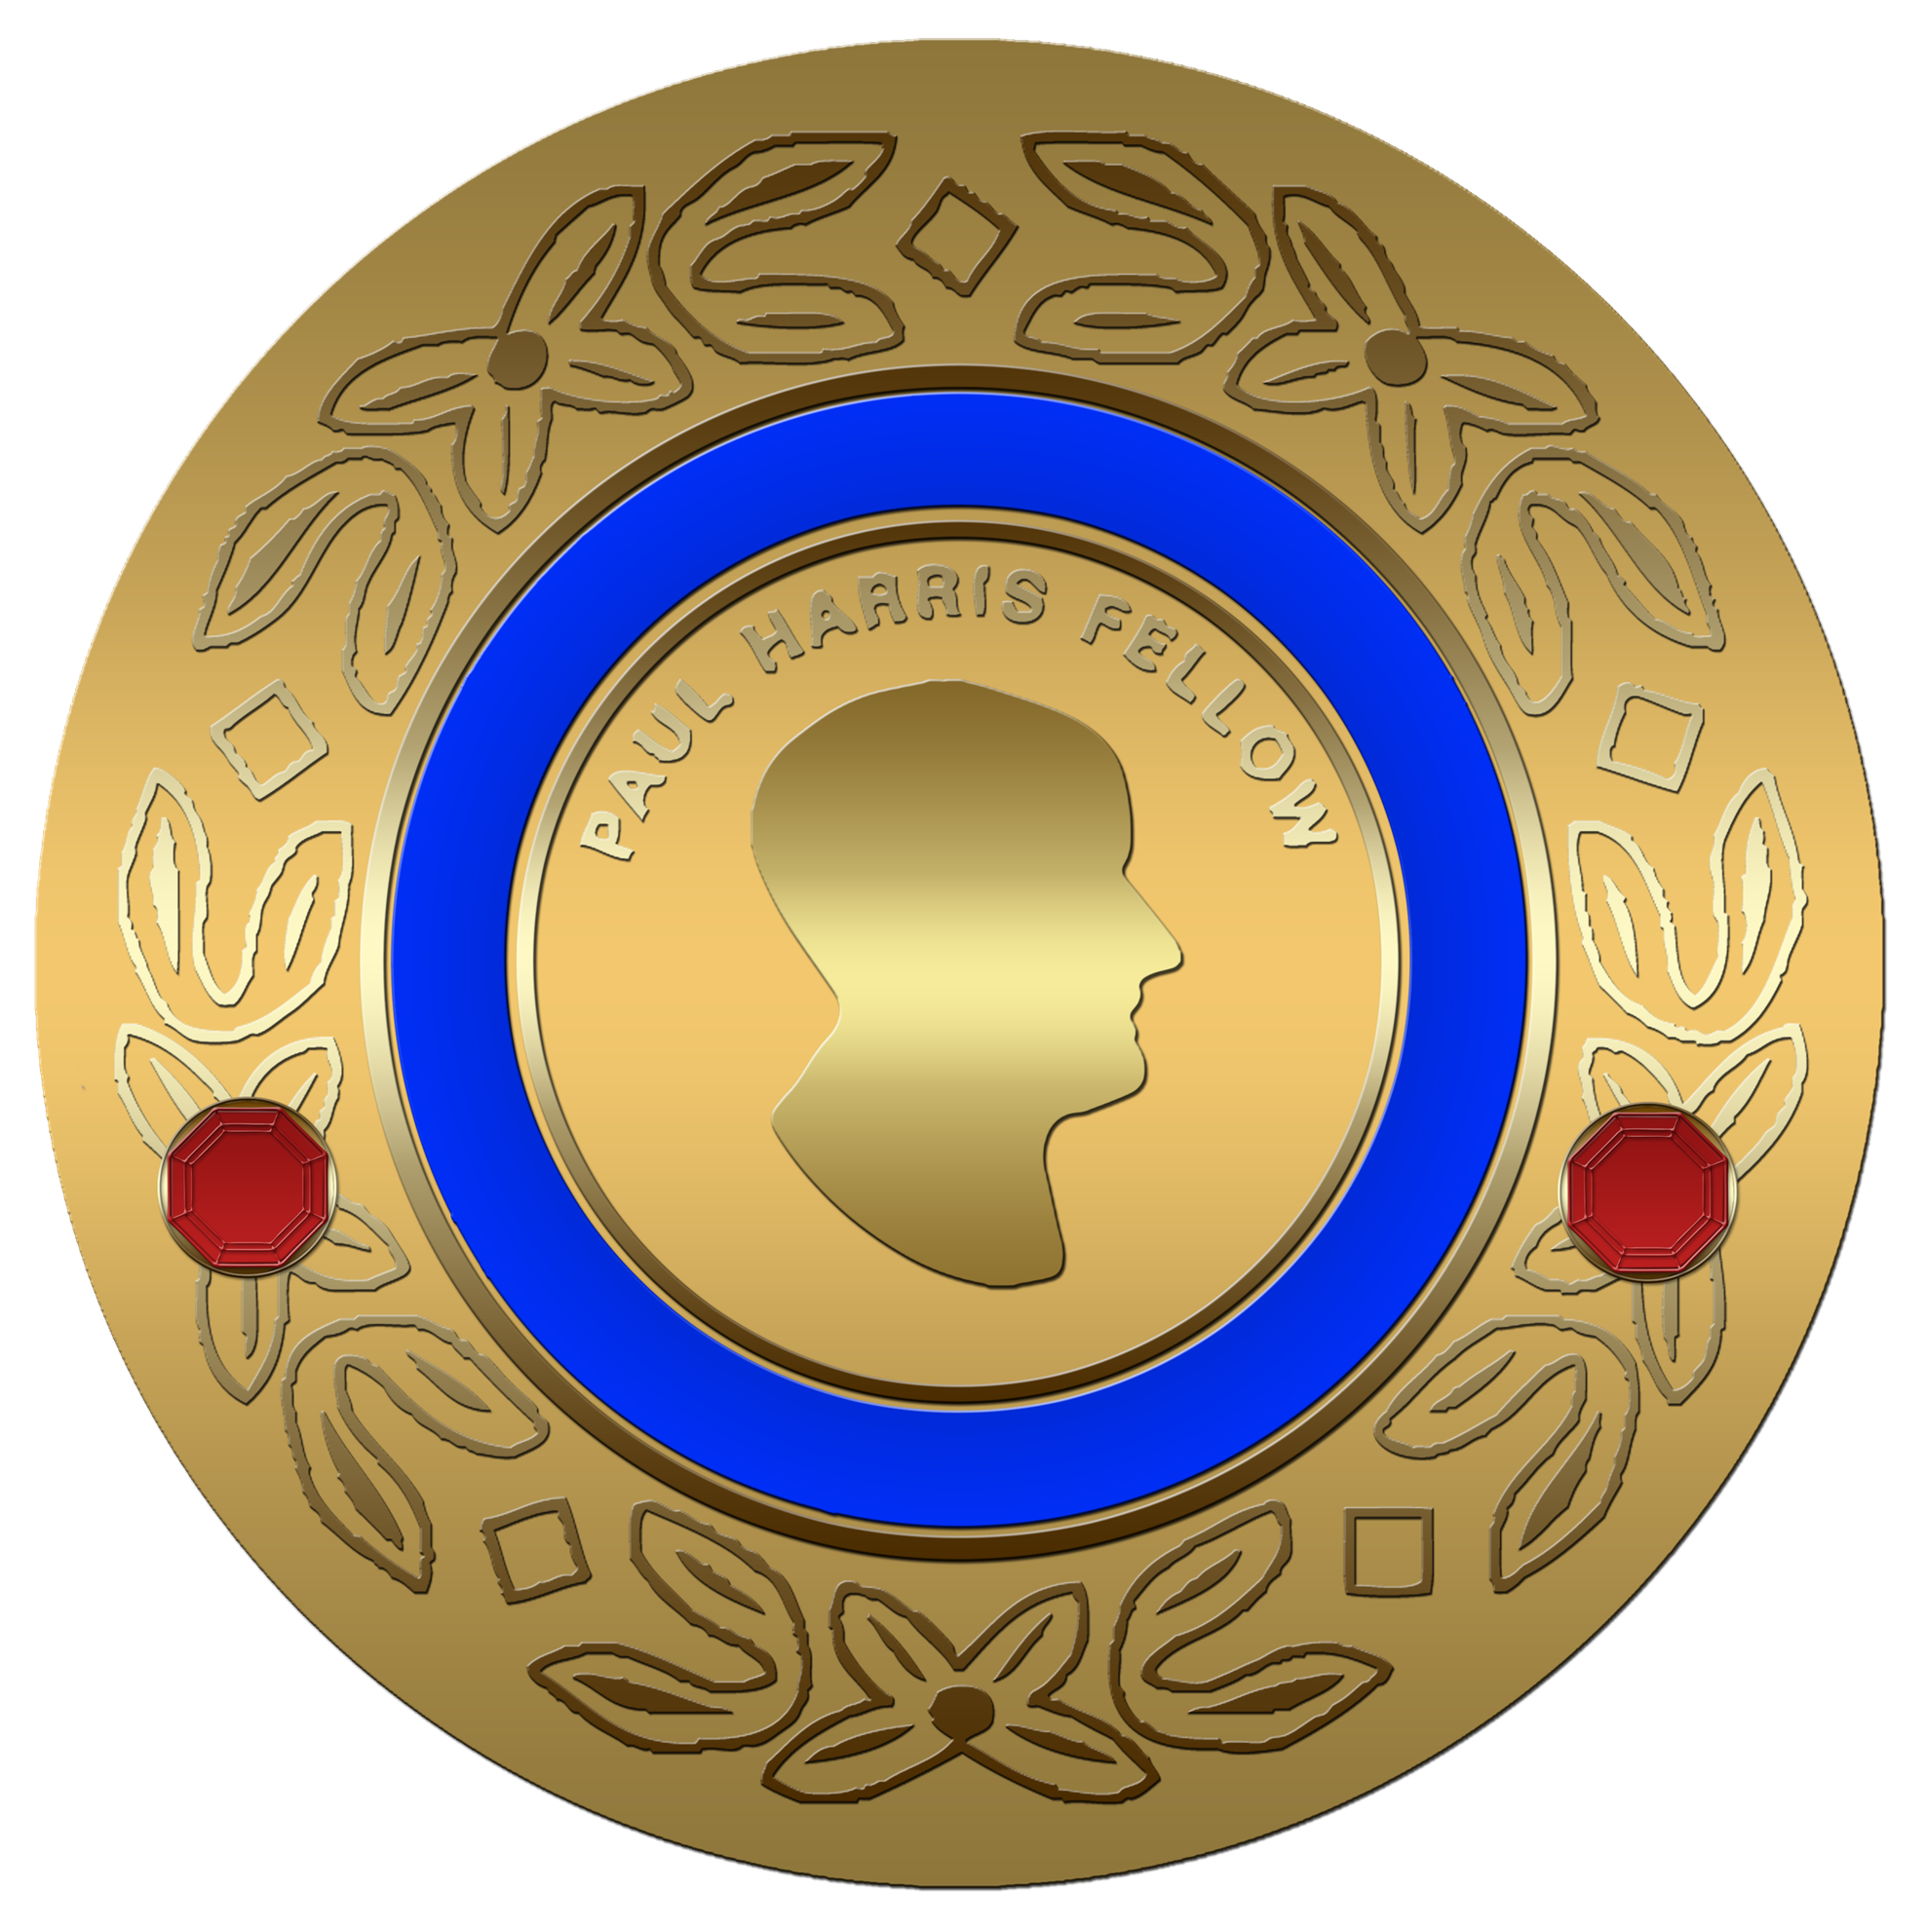
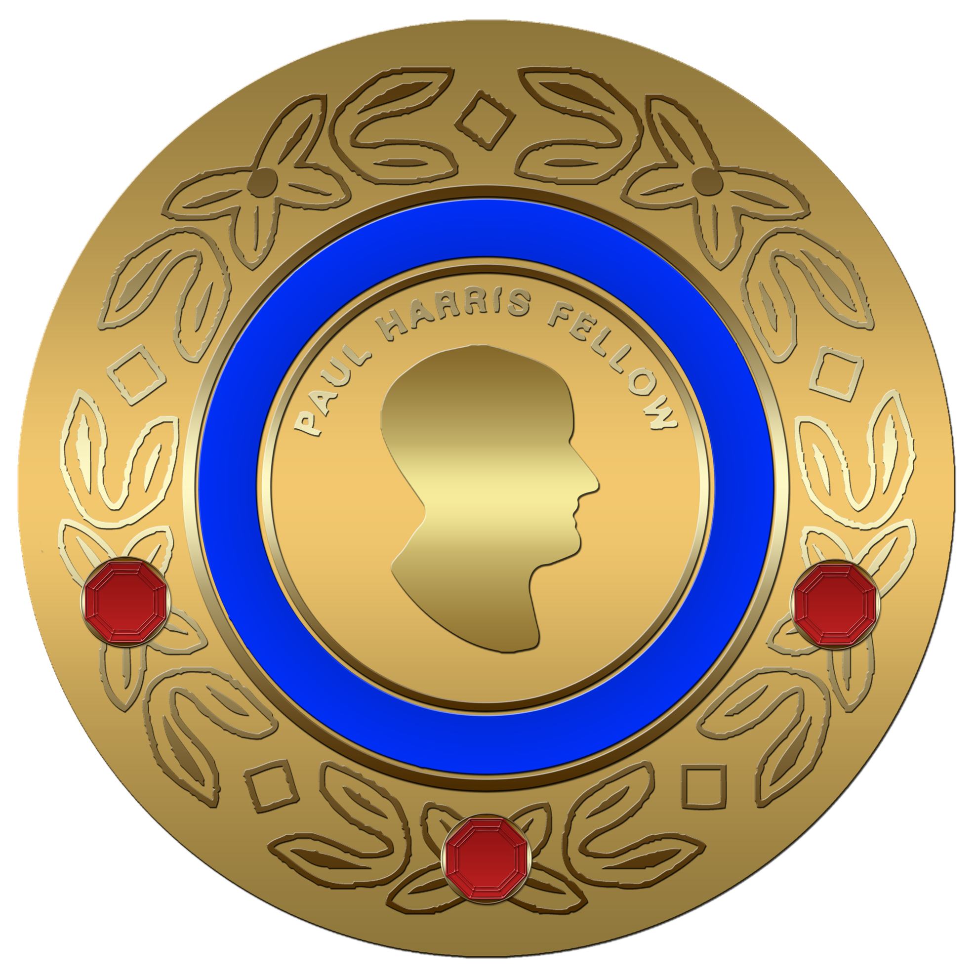
1. Paul Harris Fellowship
Notes:
Most of us are familiar with the Paul Harris fellow recognition that’s a recognition that’s provided to a donor when they give at least $1000 to The Rotary Foundation over their lifetime. Once you have achieved the Paul Harris fellow recognition you can then continue on and become a Multiple Paul Harris Fellow receiving up to eight additional Paul Harris Fellow recognitions.

Slide 15




2. Major Donor Recognition
Notes:
The Major Donor is achieved whenever a donor has given at least $10,000 cumulative to The Rotary Foundation. There are multiple levels of Major Donor recognition that span contributions from $10,000 to $249,999.

Slide 16



3. Arch Klumpf Society
Notes:
The Arch Klumph Society recognition is provided whenever a donor has given at least $250,000 to The Rotary Foundation. There are multiple levels of AKS recognition as well and they can go as high as one wants.

Slide 17
2 FUTURE Recognitions
Benefactor
Bequest Society

Slide 18


1. Benefactor

Slide 19






2. Bequest Society

Slide 20
3 “NOW” RecognitionS
EREY Rotarian ($25 per year AF)
Sustaining Member ($100 per year AF)
Paul Harris Society ($1000 per year AF)

Slide 21
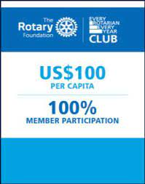


EREY & SUSTAINING CLUB BANNERS

Slide 22

The Paul Harris Society

Slide 23
Rotary Foundation Basics –
– Easy to Remember
2

Slide 24

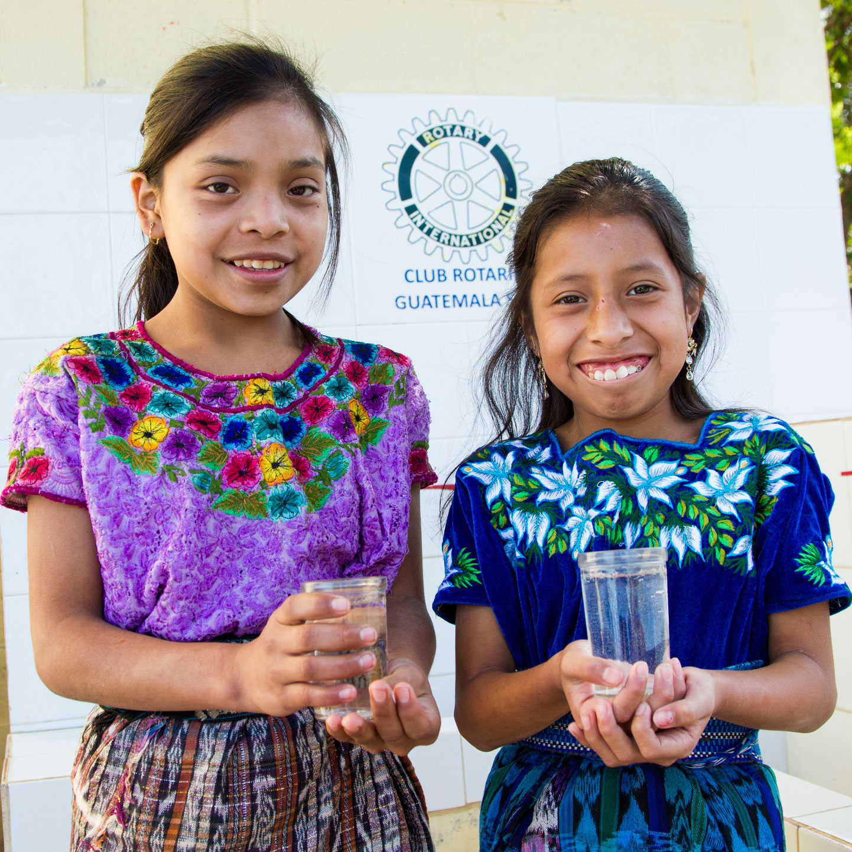
2 Ways Receive Funds
District Grants
Global Grants

Slide 25
1. District Grants
Local or international activities
Local decision making with broader guidelines
Smaller activities and projects
Include active Rotarian participation
Adhere to stewardship guidelines
Demonstrate cultural sensitivity
Align with the Foundation’s mission

Slide 26
2. Global Grants
Align with an area of focus
Respond to a community need
Include active community and Rotarian participation
Strengthen knowledge, skills, resources
Have long-term, sustainable benefits
Have measurable results
Have a budget of at least $30,000

Slide 27
Thank you!
Rotary Foundation Basics – Easy to Remember
7 3 2

Slide 28
QUESTIONS

Slide 29
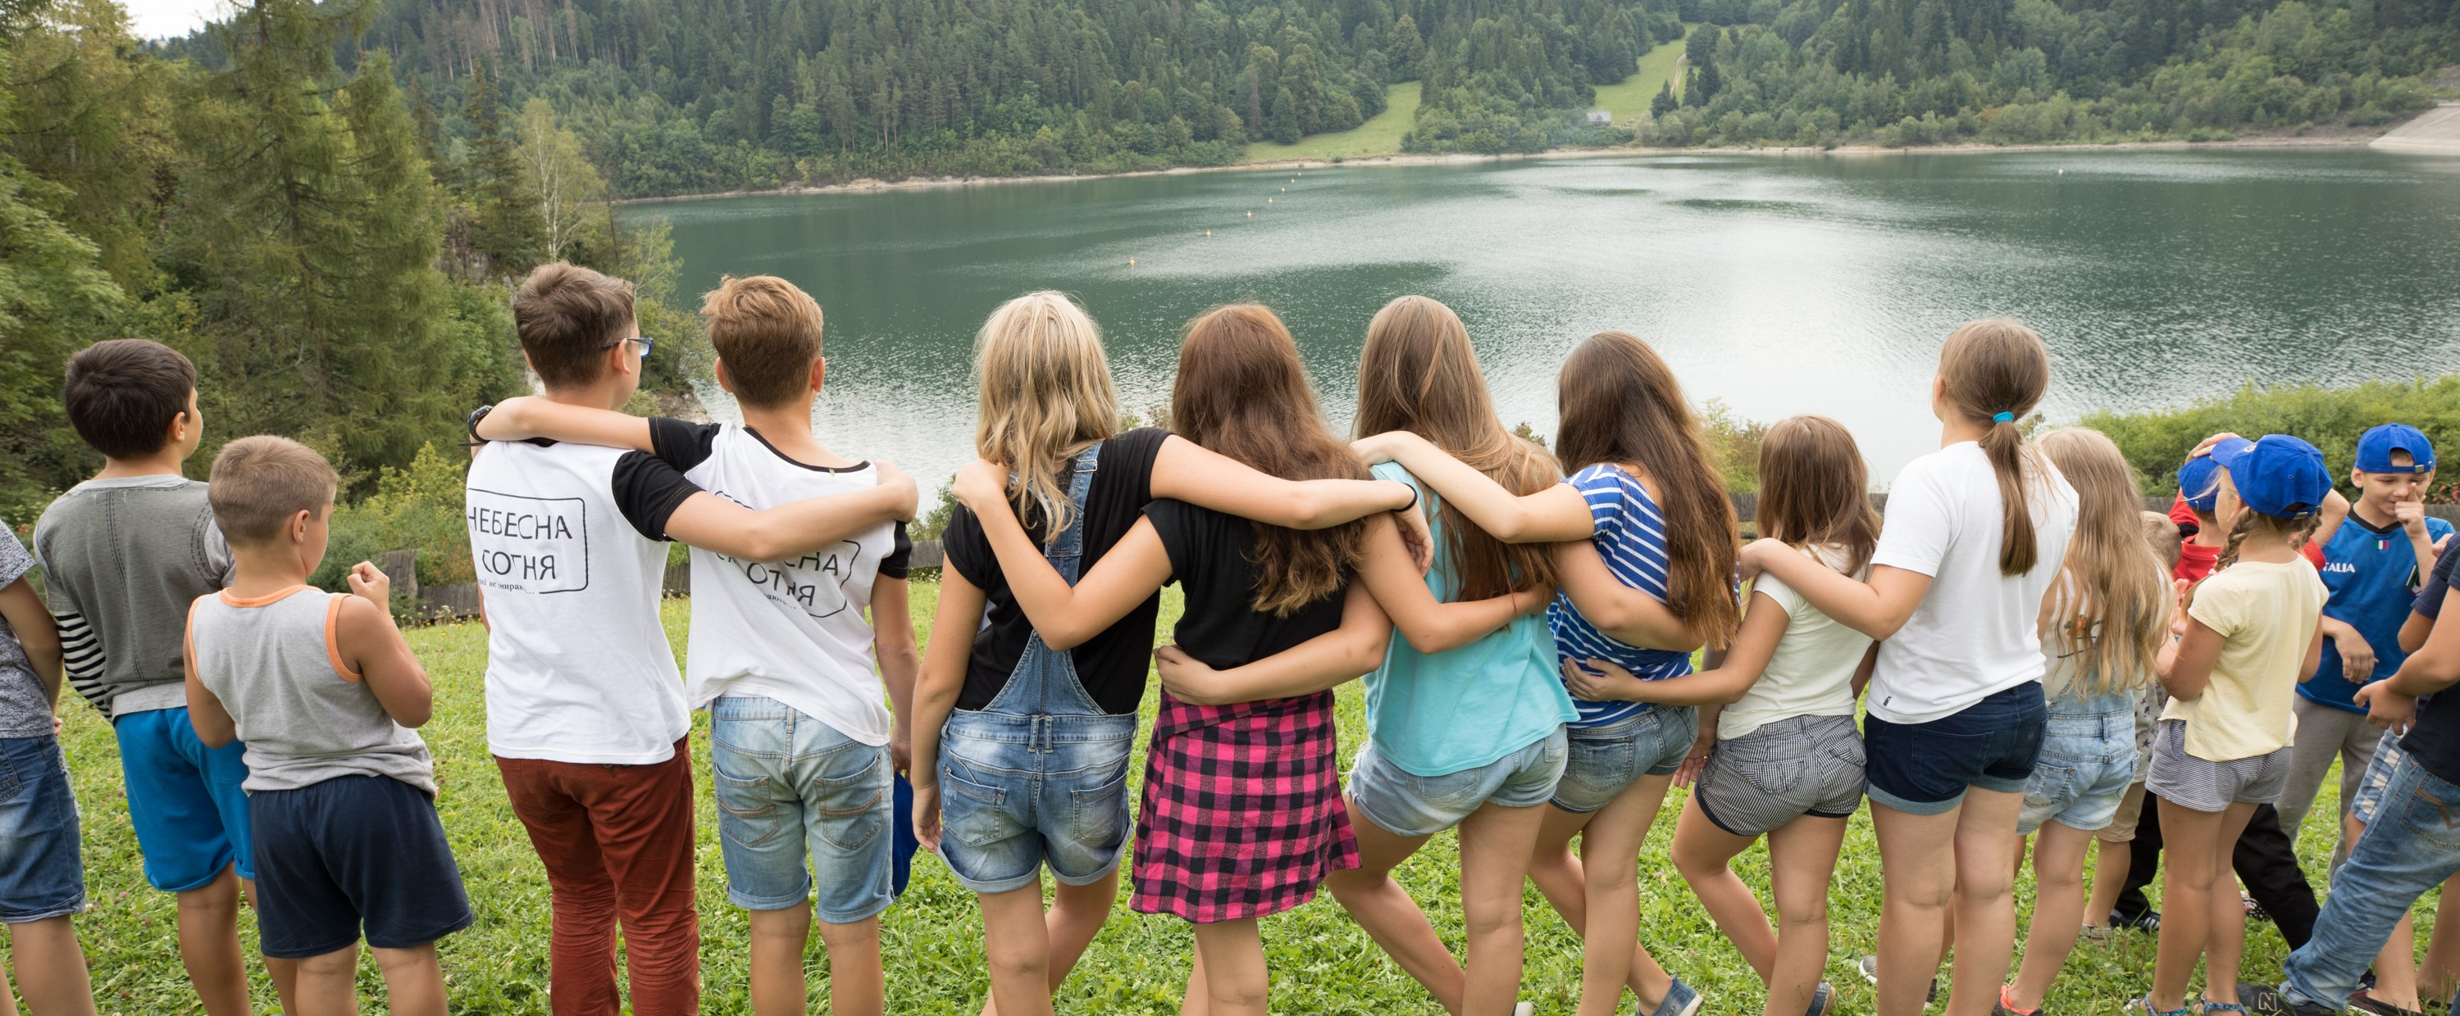
THANK YOU for doing good in the world
Notes:
[Optional, if time allows: Further personalize the presentation by recognizing the club for its accomplishments, thanking specific donors, inviting a member to share an experience working on a grant project, or talking further about a cause that particularly interests the club.]
[Recognize the club for accomplishments in giving, such as achieving the 100% EREY banner.
Thank Major Donors, Bequest Society Members, Paul Harris Society members, Rotary Direct participants, and other supporters.
Invite a member to share an experience working on a district or global grant project.
Add slides for a specific cause that interests the club or that is particularly relevant to the area.]

