Slide 1


Training
Summit
July 27th, 2019
Rotary Club Membership
Rotary
Join Leaders • Exchange Ideas • Take Action
International

Slide 2
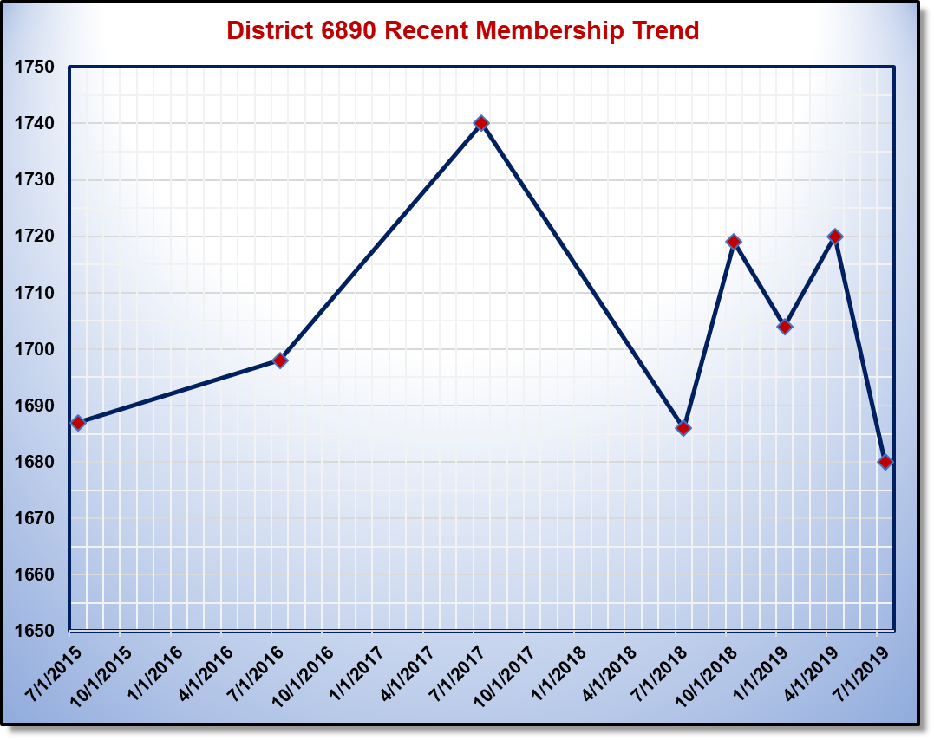
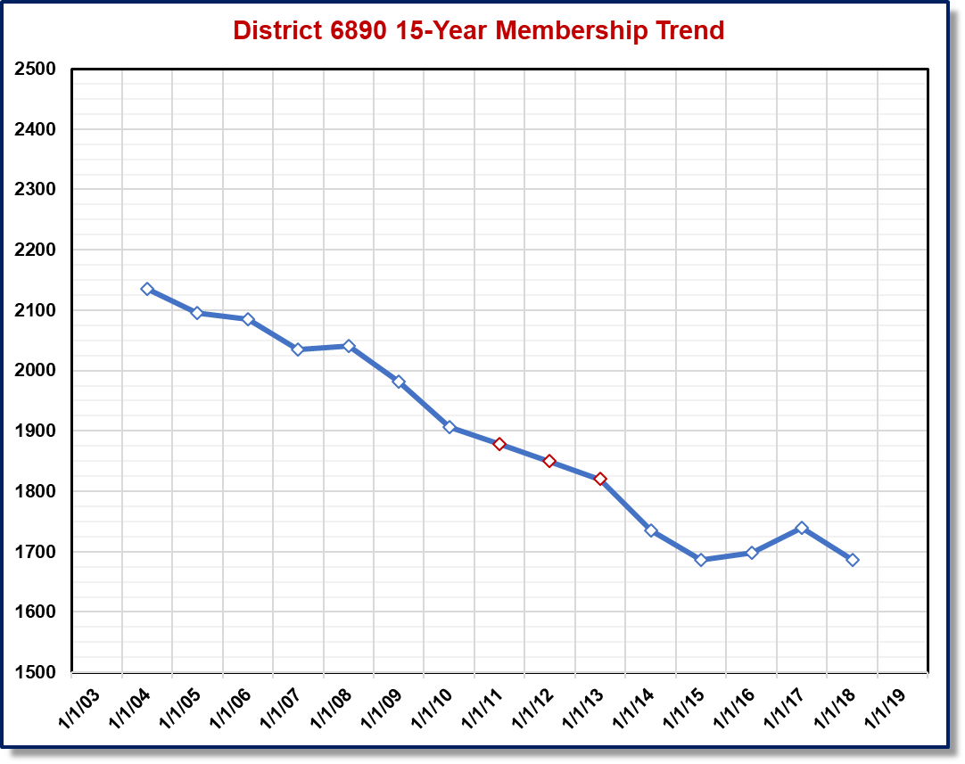
Understanding TRENDS
1,719
10/1
1,720
4/1
47 Clubs
46 Clubs
1,704
1/1
2,095
Members
38 Clubs
1,907
Members
1,686
7/1/2018
1,680
6/30/2019
1,686
Members

Slide 3
*Same Club Net Change 2018-19
* Excludes new Lakeland TigerTown RC (+30)
Rotary
Join Leaders • Exchange Ideas • Take Action
International

Slide 4
Rotary District 6890 Club Profile
38 Rotary Clubs Avg. Age = 58 (reported)
1,710 Rotarians 72% Male, 28% Female
12 Clubs with 50 or more members
• 6 with net gain for 2018-19, 4 net loss, 2 no change
13 Clubs with 25 or fewer members
• 6 with net gain for 2018-19, 5 net loss, 2 no change
13 Clubs with 26 – 49 members
• 6 with net gain for 2018-19, 5 net loss, 2 no change
Club size, alone, did not affect membership change
Rotary
Join Leaders • Exchange Ideas • Take Action
International

Slide 5

Who Do We Want in Rotary?
Standard Rotary Club Constitution – Membership
General Qualifications. This club shall be composed of adult persons who demonstrate good character, integrity, and leadership; possess good reputation within their business, profession, and/or community; and are willing to serve in their community and/or around the world.
Young professionals may not enjoy the same workplace & financial autonomy
Clubs may need to show greater flexibility in order to creative a value proposition for new Rotarians
Rotary
Join Leaders • Exchange Ideas • Take Action
International

Slide 6
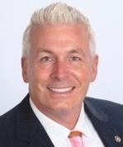
Three Key Questions
DG Kip challenges us to ask three key questions as we evaluate our clubs
1.) “Do people want to hang out with us?”
• Visitors, Guests, Community Volunteers, Youth
2.) “Do we represent the community we serve?”
• Classifications, Ethnicity, Gender, Age, Economic Status, etc.
3.) “What is the value proposition we provide to our members, prospective members, communities?
• Friendship, Networking, Leadership Opportunity, Mentoring, Meaningful Service (local and international)
Rotary
Join Leaders • Exchange Ideas • Take Action
International

Slide 7

FIRST Key Question
1.) “Do people want to hang out with us?”
• Visitors, Guests, Community Volunteers, Youth
• Are venue and meal experience appealing to most people?
• Are club members committed to make outsiders feel welcome?
• Are meeting topics (speakers) relevant, interesting, inspiring?
Your Club
Meeting
Photo Here
Rotary
Join Leaders • Exchange Ideas • Take Action
International

Slide 8
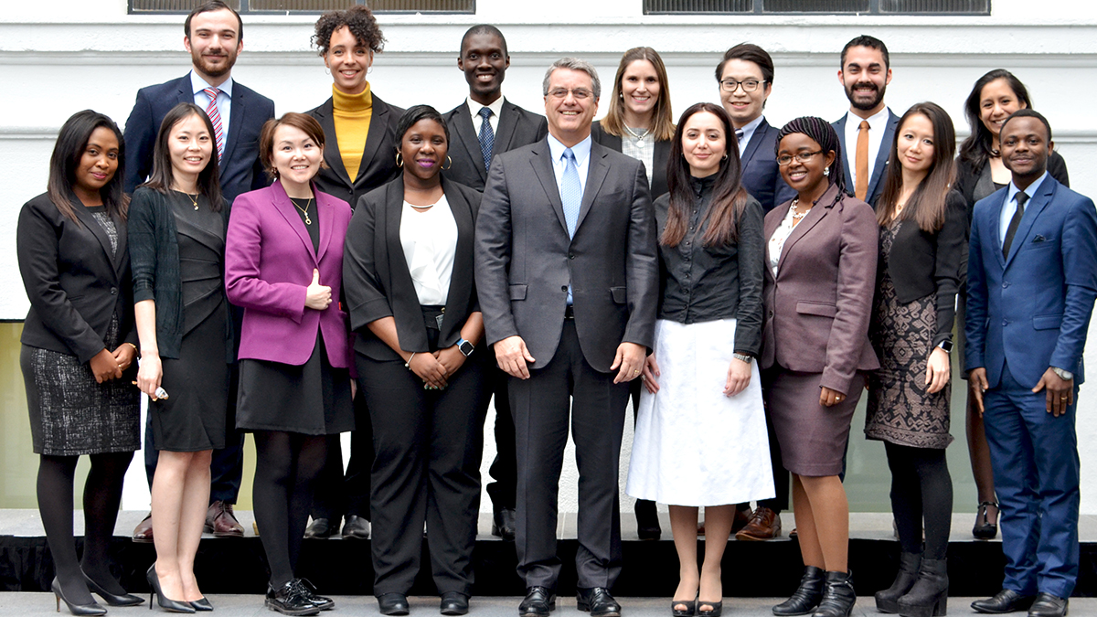
SECOND Key Question
2.) “Do we represent the community we serve?”
• Classifications, Ethnicity, Gender, Age, Economic Status, etc.
• What resources are available to determine gaps?
• What obstacles may be removed to engage more members?
• How do we connect with different individuals (or groups)?
Your Club
Meeting
Photo Here
Rotary
Join Leaders • Exchange Ideas • Take Action
International

Slide 9
2016 Changes to Constitution
Article 7 Exceptions to Provisions on Meetings and Attendance
The bylaws may include rules or requirements not in accordance with article 8, section 1; article 12; and article 15, section 4, of this constitution. Such rules or requirements shall supersede the rules or requirements of these sections of this constitution; a club, however, must meet at least twice per month.
8-1 Regular Meetings (defined meeting frequency & format)
12 Attendance (all rules regarding attendance)
15-4 Termination for non-attendance (to match Article 12 above)
Article 9 Exceptions to Provisions on Membership
The bylaws may include rules or requirements not in accordance with Article 10, sections 2 and 4 - 8 of this constitution. Such rules or requirements shall supersede the rules or requirements of these sections of this constitution.
10-2 Kinds of Membership (may modify from only Active & Honorary)
10-4 through 10-8 Satellite Club Membership, Dual Membership,
Honorary Membership, Holders of Public Office, RI Employees
Rotary
Join Leaders • Exchange Ideas • Take Action
International

Slide 10
Summary of CoL Changes
NEW: Meetings (“…must meet twice per month.”)
• Clubs may determine what constitutes a meeting
• Clubs may modify frequency, format, purpose (e.g., service project)
• Clubs may meet in person or via web or phone (or combination)
NEW: Attendance
• Clubs may amend (or eliminate) ANY attendance requirements
• Recognizes relaxed application of rules in practice for years
NEW: Membership Types
• Clubs may create new membership types for internal use
(e.g., Corporate, Associate, Family, other)
• RI still recognizes only “Active” and “Honorary”
• Caution: Consider locality and unintended consequences
Rotary
Join Leaders • Exchange Ideas • Take Action
International

Slide 11
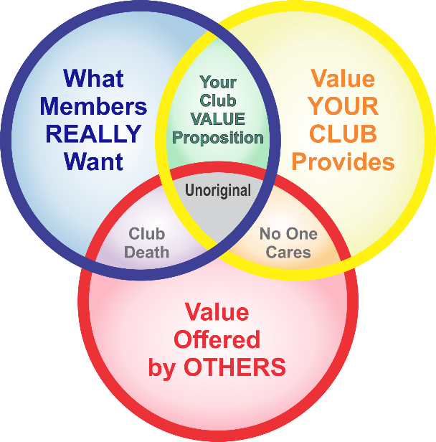
THIRD Key Question
3.) “What is the value proposition we provide to our members, prospective members, communities?
• Friendship, Networking, Leadership Opportunity, Mentoring, Meaningful Service (local and international)
• Are these or other values represented in proper balance?
• What do we ask of people in exchange for these “values?”
Your Club
Value
Proposition
Here
Rotary
Join Leaders • Exchange Ideas • Take Action
International

Slide 12
Alternative Membership Examples
(“Corporate” or “Family” Programs with “Associate” Memberships)
All cases must address: 1.) Who will be club members?
2.) Who will be registered with RI?
3.) How much will be charged in dues?

Slide 13

Alternative Membership Examples
Additional Options for “Associate” Memberships
Dual ACTIVE Membership for Rotaractors
• Associate pays enough to cover RI & District Dues
Introductory ACTIVE Membership for Young Professionals
• Associate under certain age pays enough to cover RI & District Dues
Trial (not active) Membership for New Members (define carefully)
• Associate pays nominal amount for predetermined introductory period
*** Suggest ONE set of rules / dues for Associate Memberships ***
Ultimate goal is to increase Rotarian engagement as measured in active, registered, dues-paying members (hopefully contributing to TRF as well)
Rotary
Join Leaders • Exchange Ideas • Take Action
International

Slide 14
2019-20 Challenge to Clubs
1.) Update Club and Member Data
• Birthdays in DACdb / My Rotary (over 25% of district are missing)
• Club Membership Chairs on DACdb (over 30% of clubs missing)
• Club Membership Chairs on RCC (over 30% of clubs missing)
2.) Membership Growth Goals
• Must replace anticipated losses AND increase net members
• Strategy to attract, engage, and retain target number of members
• Club Termination Profile available on Rotary.org (My Rotary)
My Rotary > Reports > Club Reports > Membership
> Club Data > Reports > Membership Termination Profile
3.) Pilot Something NEW with Membership Types
• Associate / Corporate / Friends of Rotary (for non-members)
• Determine how your club might benefit
• Coordinate with other area clubs to maximize benefits
Rotary
Join Leaders • Exchange Ideas • Take Action
International

Slide 15
Additional Resources
www.Rotary.org/MyRotary
All things Rotary (log-in required for many areas), Club Central, TRF, much more
www.Rotary6890.org/Membership
Web pages and Download Center (no log-in required)
www.DACdb.com
Database for district calendar, leadership, and member contact information
Rotary International Contact Center
Contact.Center@Rotary.org, (866) 976-8279
Rotary Leadership Institute (RLI)
Sequential discussion groups on a variety of Rotary topics
Rotary District 6890 Membership Chair
PDG Ed Odom (813) 351-9723, EdOdom01@gmail.com
Rotary
Join Leaders • Exchange Ideas • Take Action
International

