Slide 1
The Zoom will commence at 6:30PM

Slide 3
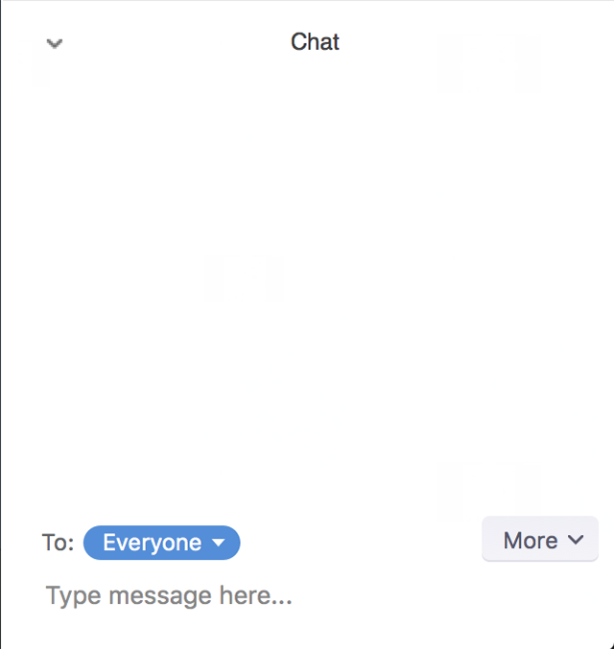
Welcome
Mute
Chat Box
To: Felix Stubbs

Slide 4
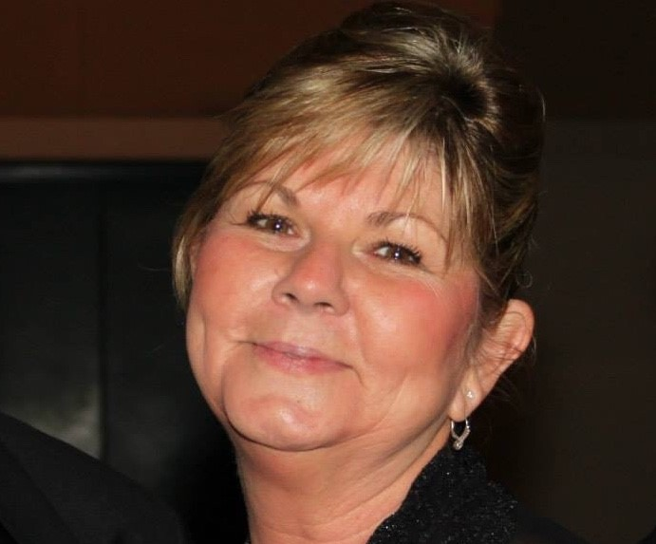
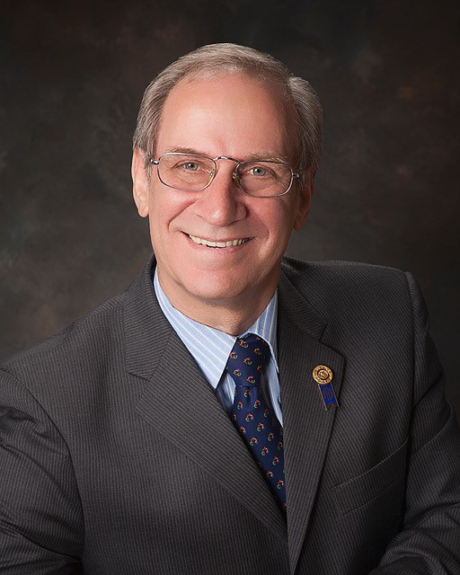
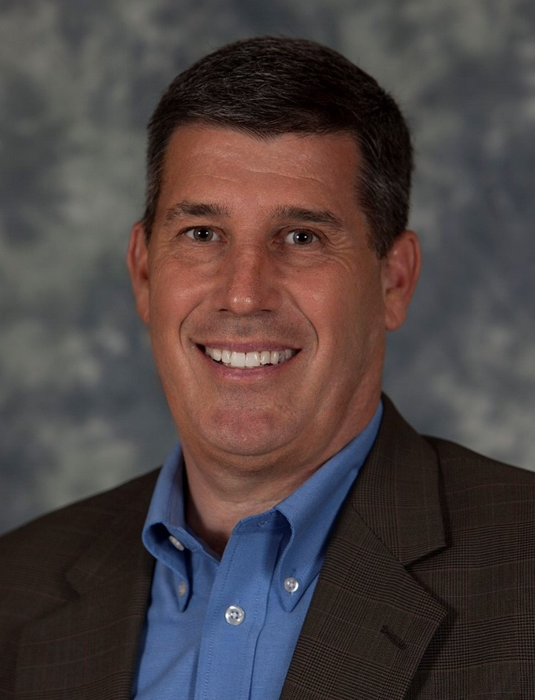
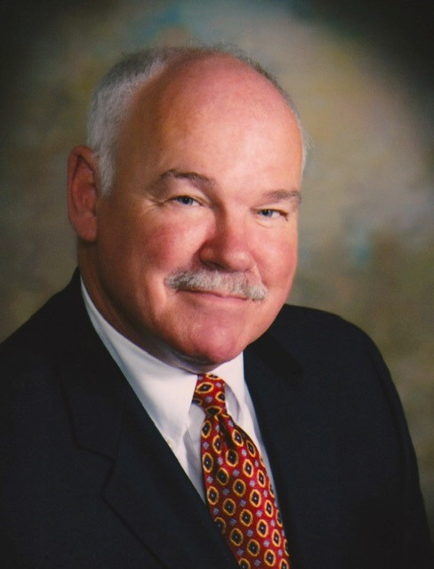
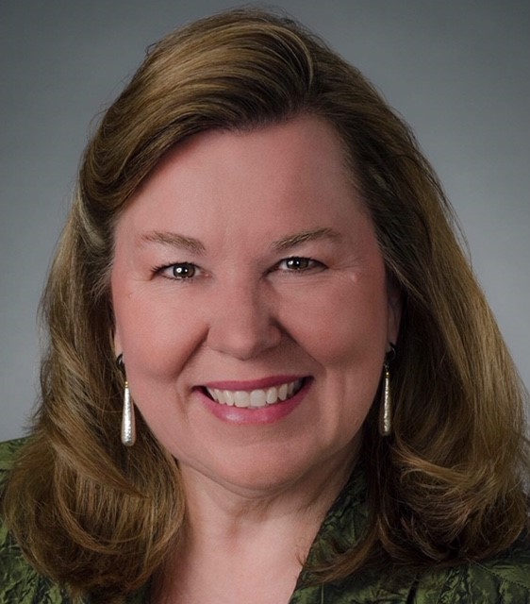
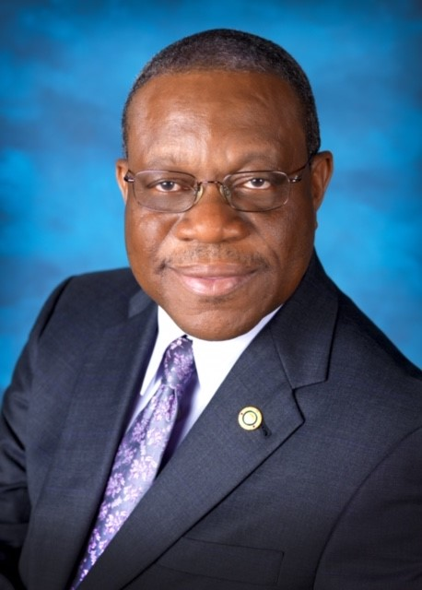
Zone 34 Coordinator Team
GeorgeRB
Cyndi
Doragh
D6960
Cynde
Covington
Felix
Stubbs
Scott
Yochum
&
Pepper
Pettit

Slide 5
Zone 34 Coordinator Team

Slide 6
Zone Coordinator Teams
District Membership Chairs

Slide 7
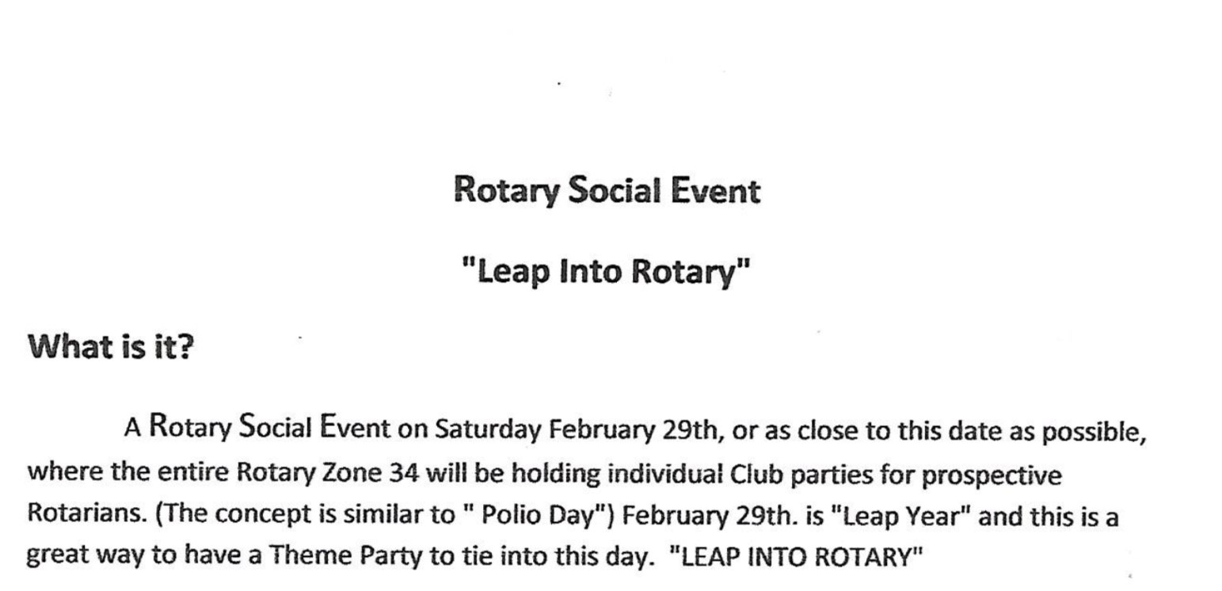

Slide 17
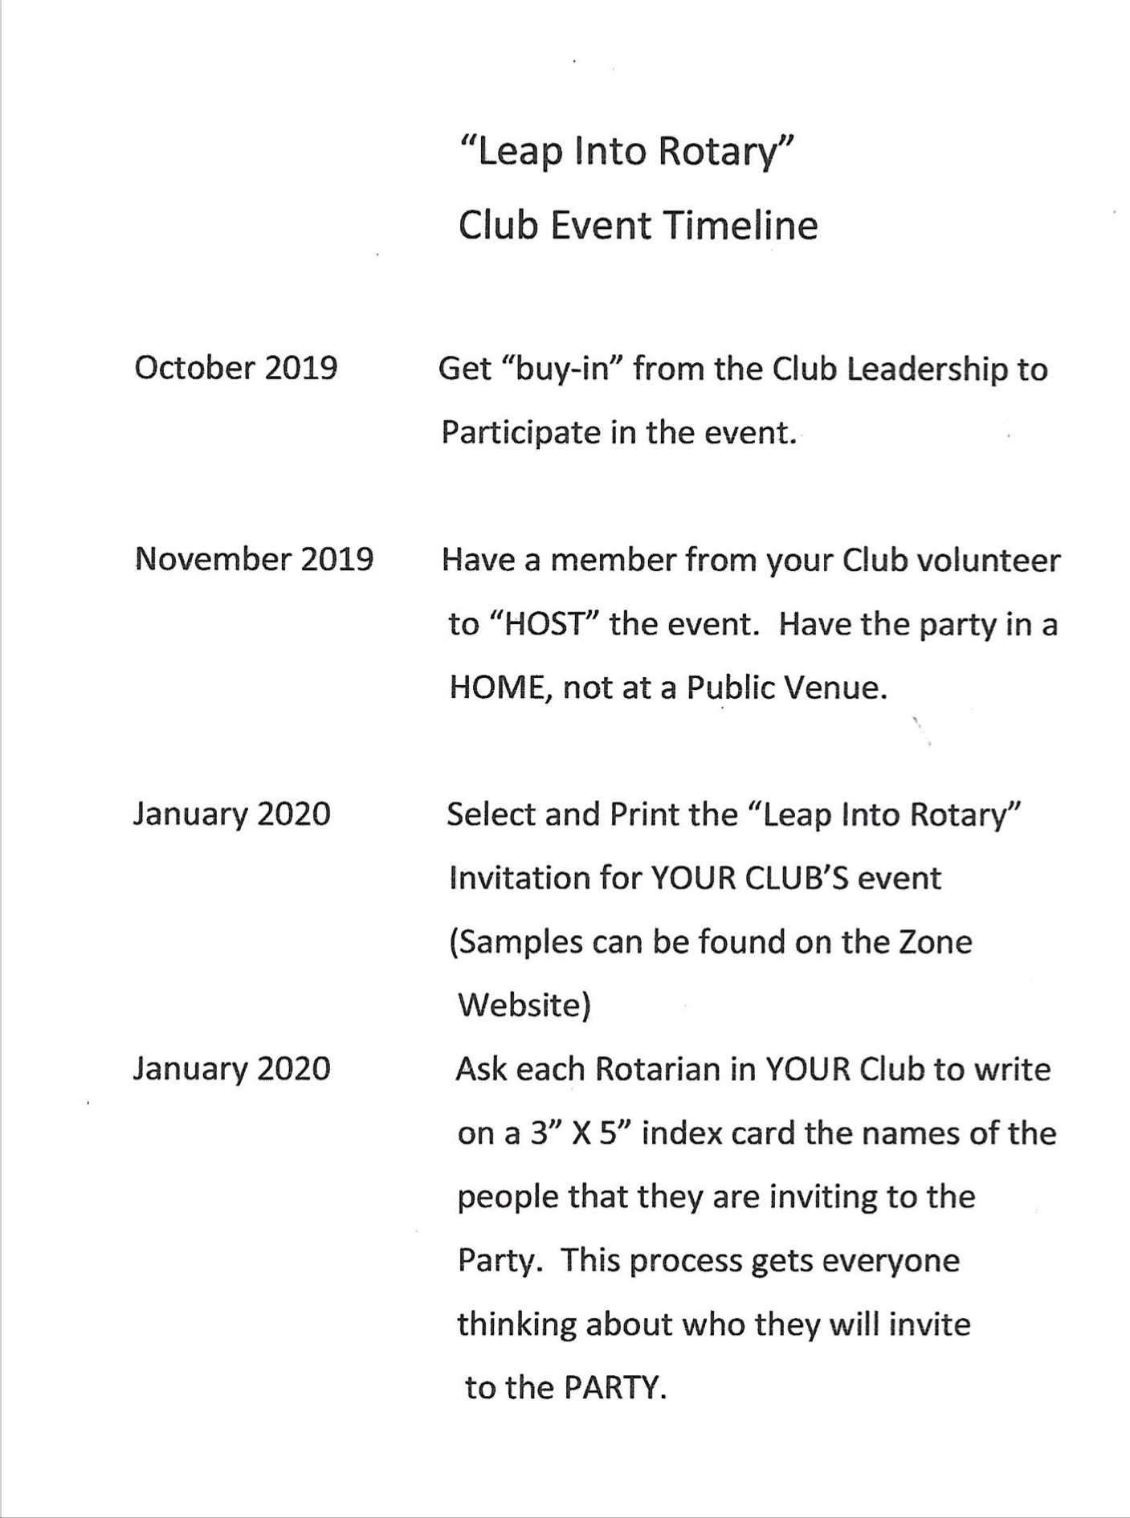
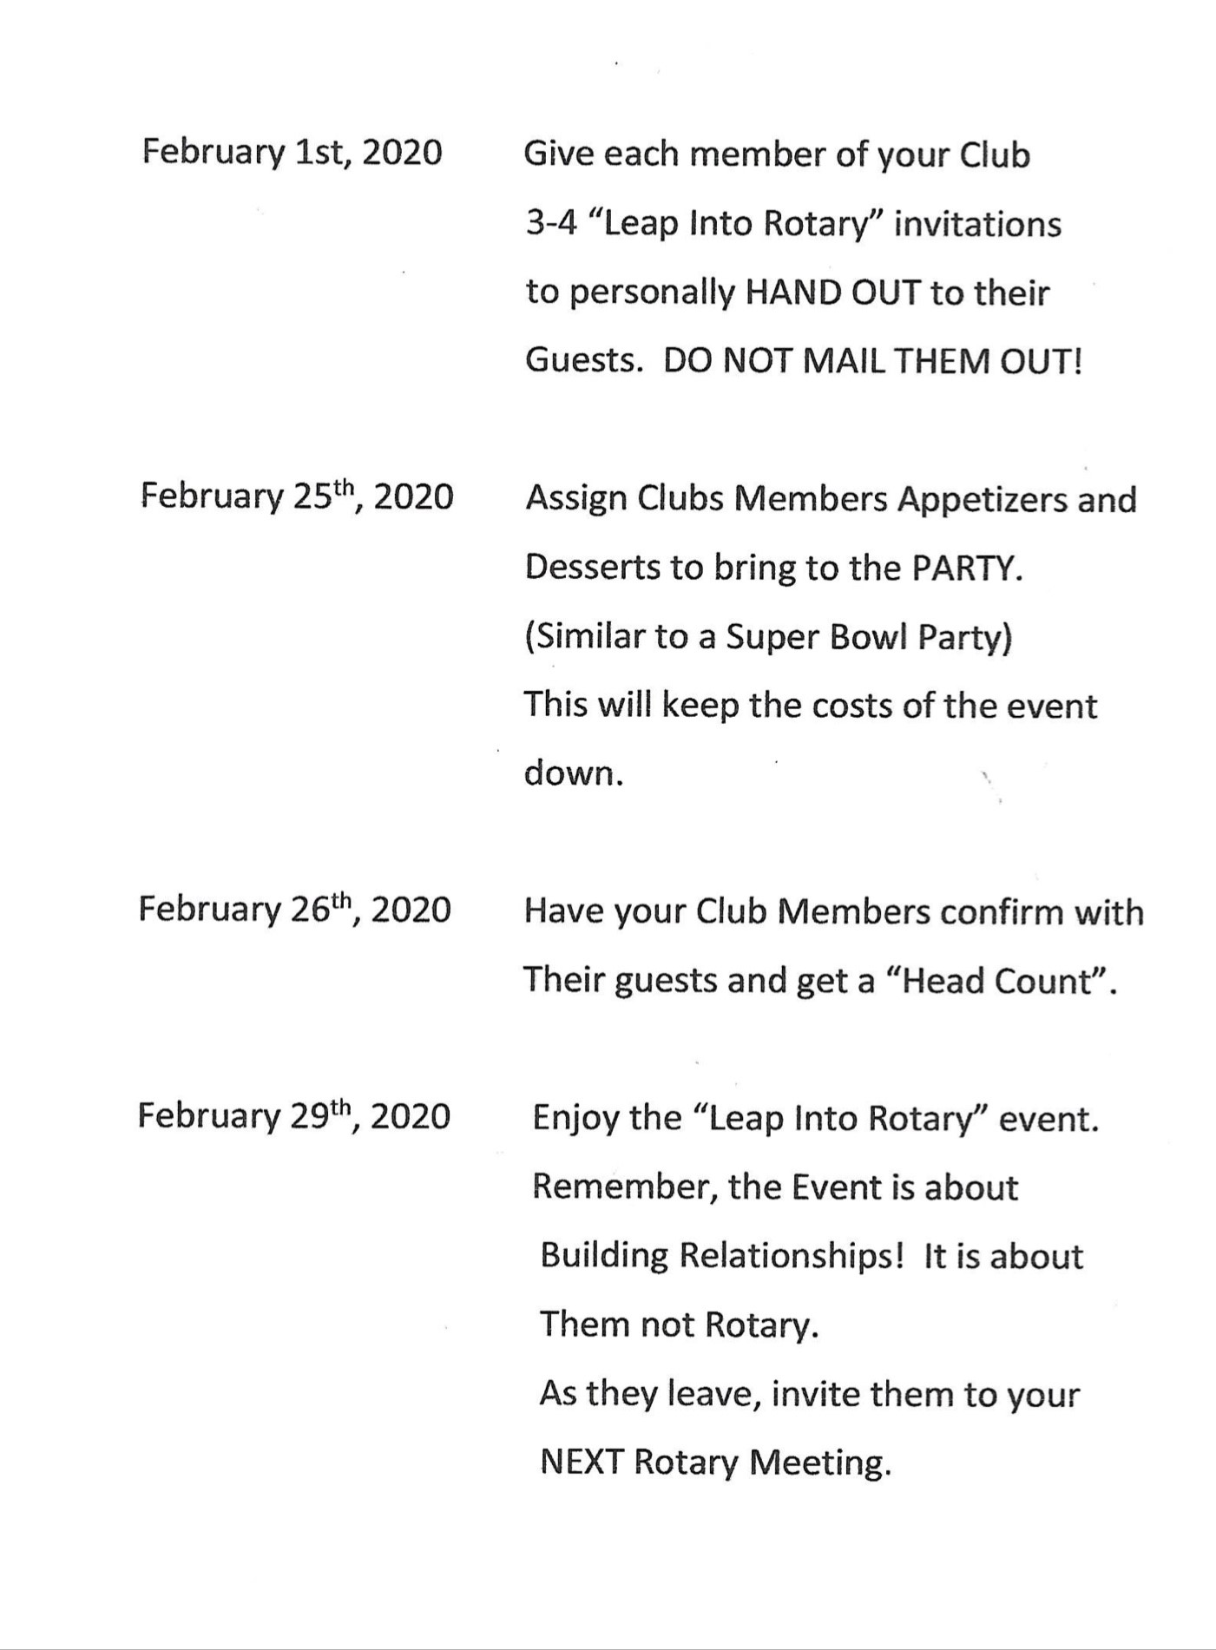
Club Event Timeline

Slide 18
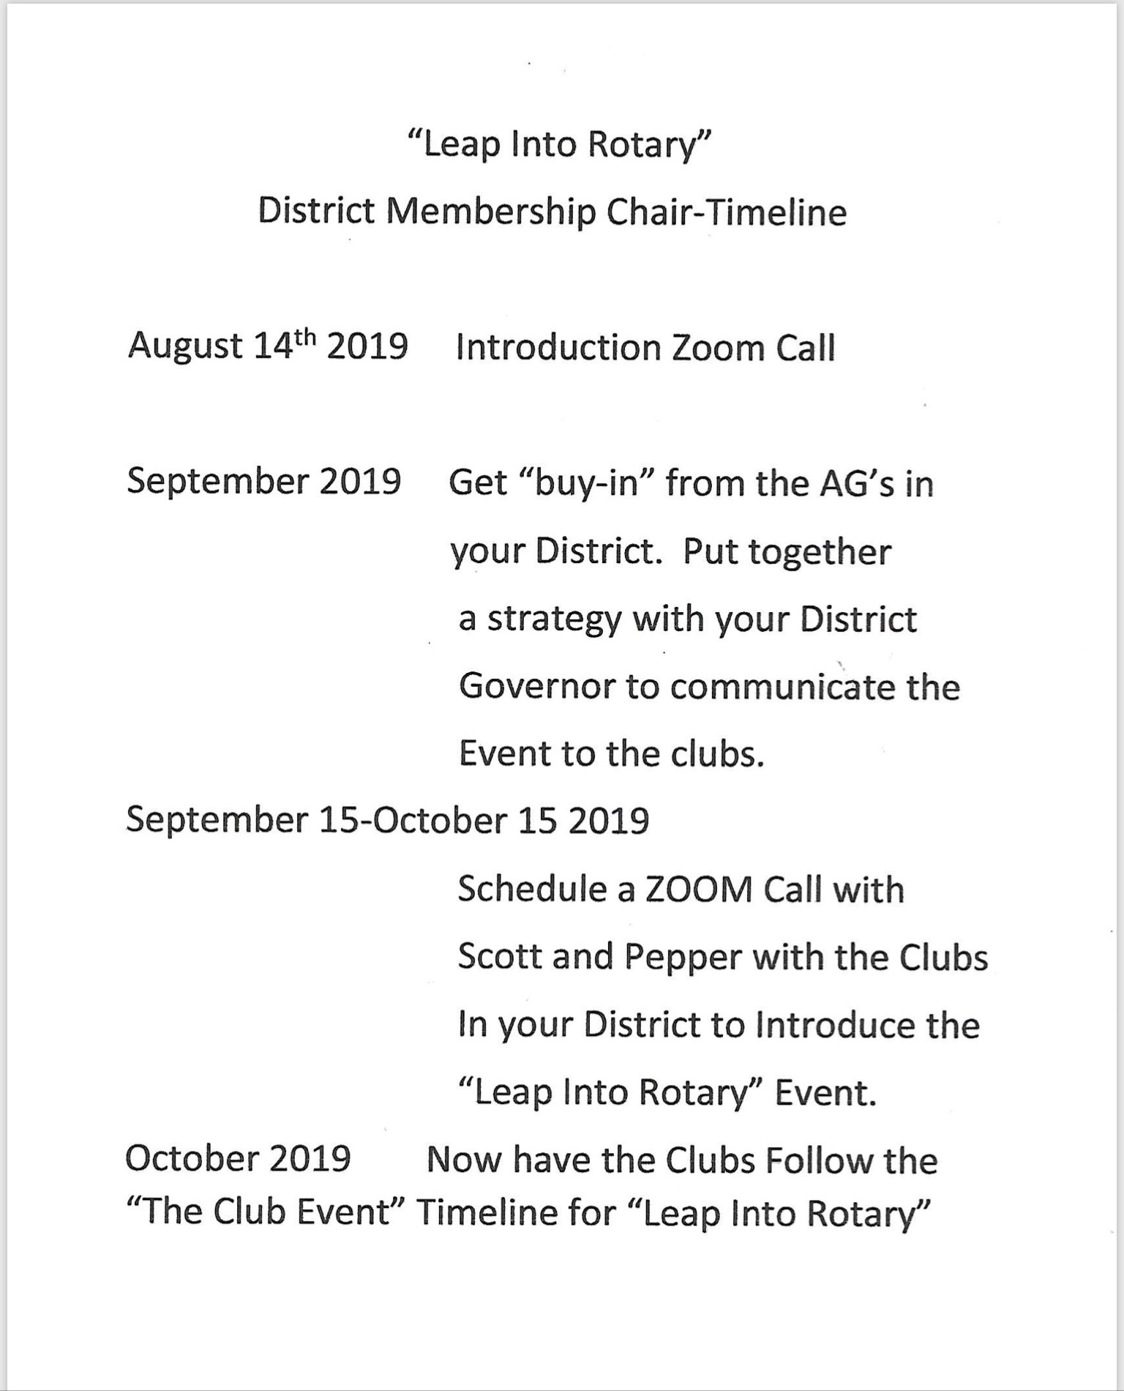
DMC Event Timeline

Slide 19
Questions and Discussion

Slide 20
We realize how busy you are, and so give you a BIG thank you!

