Slide 1
Global Grant Proposal
Project Title: DRINKING WATER A.T.M. Project FOR 7 VILLAGES IN MULSHI & MAVAL BLOCKS OF PUNE DISTRICT IN INDIA
Project by – Rotary Club of Pune Laxmi Road (D 3131)
PROPOSER AND HOST CLUB OF GLOBAL GRANT
Rotary Club of Pune Laxmi Road (RCPLR) is a super active and vibrant club in District 3131. The club is highly active in all avenues of Rotary and is one of the better performing clubs in the district having received several District Awards and RI recognitions including several Global Grants approvals. The club has consistently achieved 100% EREY Giving to The Rotary Foundation. The value of completed projects has averaged $150,000 every year. RCPLR has consistently raised the bar over the years but remain aware that a lot more can, has to be, done. A journey of this magnitude cannot be travelled without the kind and generous support from like-minded clubs and individuals motivated by the urge to serve. RCPLR will be the host club for the global grant described below.
The PILOT Project was done in 2017
Water ATM and Filtration System Provided by our Club RC Pune Laxmi Road , Dist 3131is running successfully for last 8 years from 2017 located at Kolvan village. Video of the same is attached with this email.
.

Slide 2
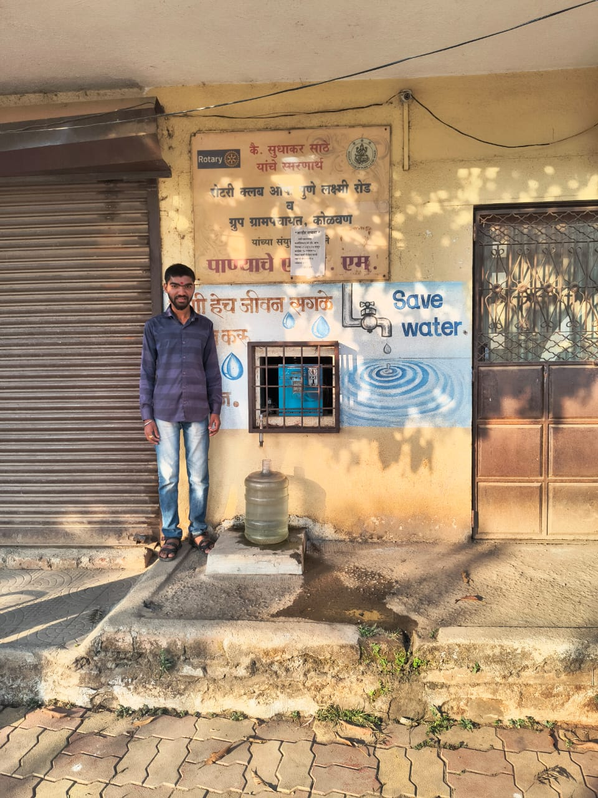
30th April 2025
GRANT PROPOSAL
DRINKING WATER A.T.M.Project
FOR 7 VILLAGES IN MULSHI & MAVAL BLOCKS OF PUNE DISTRICT IN INDIA
Water A.T.M
Need for Clean Drinking Water
Water, Sanitation, and Hygiene (WASH) related impacts on the health of rural people in India are significant. Polluted water is the main source of illnesses such as diarrhea, typhoid, cholera, hepatitis B, etc. A recent study (Goyanka, 2021) revealed that about 7% of all hospital visits in rural India were due to WASH related issues. The mean out-of-pocket expenditure for all WASH related diseases was INR 703 per out-patient and INR 9656 for patients admitted to the hospital.
Why Water A.T.M. ?
It uses ‘reverse osmosis’ & UV technology for purifying water, and dispenses a measured quantity through an automated teller machine (ATM).
This project provides clean water to rural families at an affordable price, and thus, illnesses related to polluted water can be reduced significantly. Wastage of water is also reduced when there is a ‘price’ associated with water.
Submitted by:
Rotary Club of Pune Laxmi Road
Dostrict 3131
Photo: Water ATM and Filtration System Provided by our Club RC Pune Laxmi Road , Dist 3131is running successfully for last 8 years from 2017 located at Kolvan village
. Local people can buy this water at INR 10 ($0.10) for 20 liters.

Slide 3
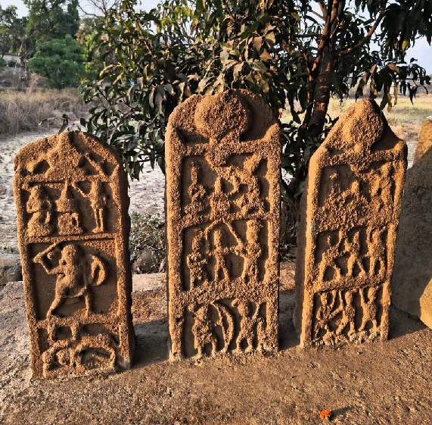
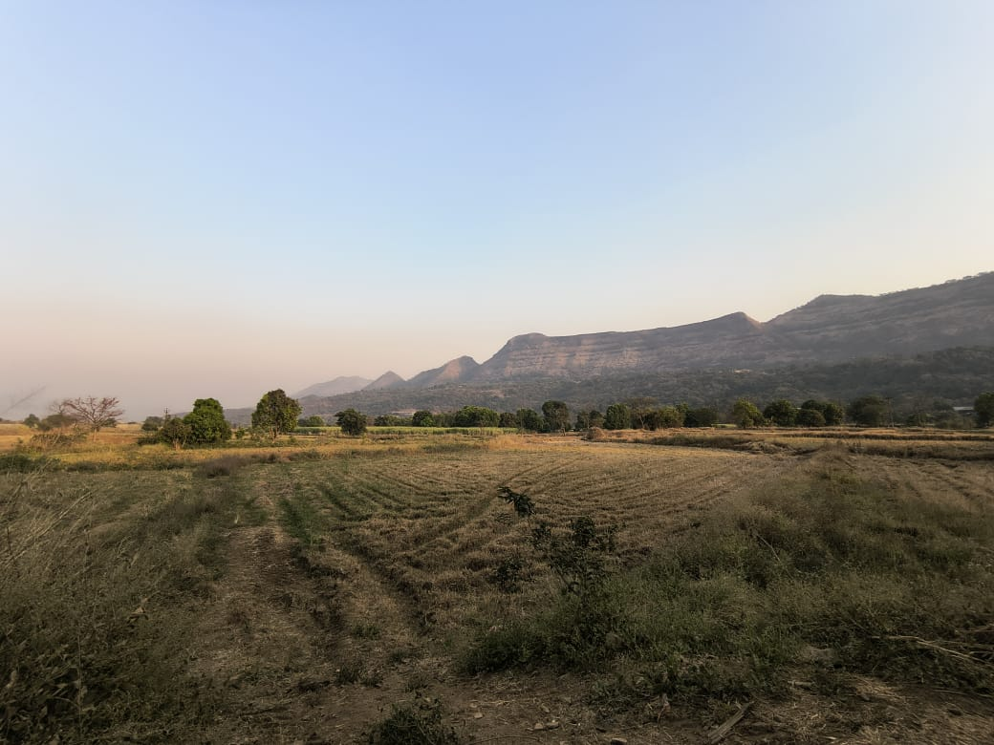
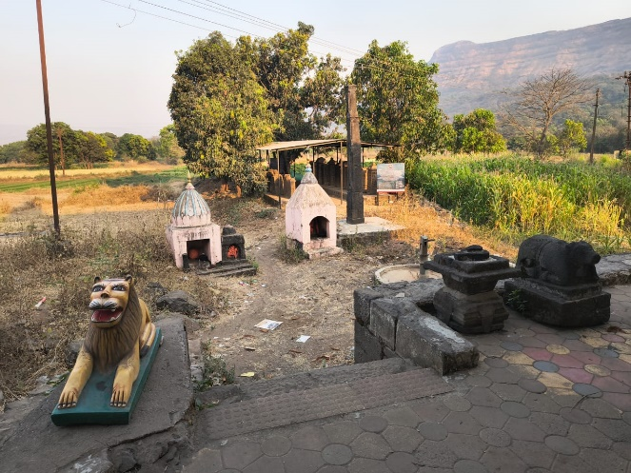
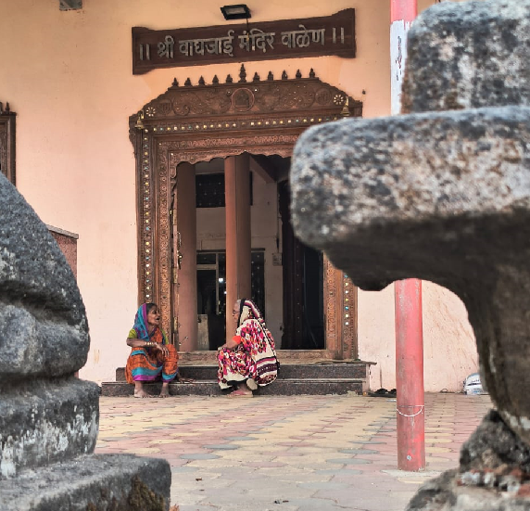
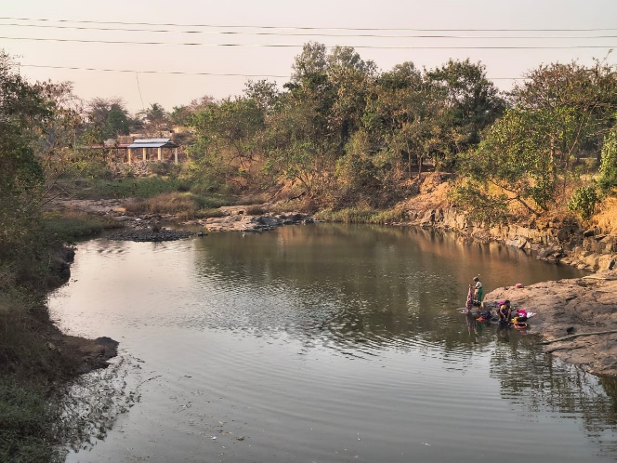
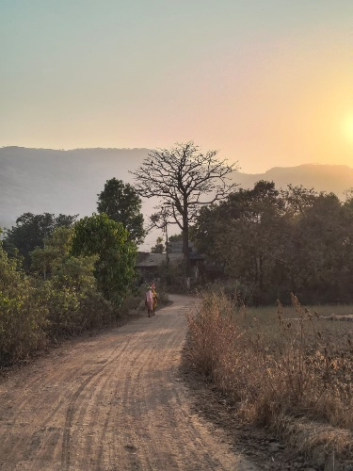
About the project area (Kolvan valley region)
The 7 villages selected for this project are located in Kolvan valley region (Mulshi & Maval blocks) of Pune district in the state of Maharashtra, India.
Project villages: 7
Elevation range: 600 – 750 meters above sea level
Annual rainfall: 90-105 inches (June – Oct)
Topography: Hilly
River: Walki
Main livelihood: Agriculture
Avg. farm size: small to medium (1 to 10 acres)
Local language: Marathi
Religions: Hindu (90%), Buddhist (8%), Muslim (2%)
Literacy: 70%

Slide 4
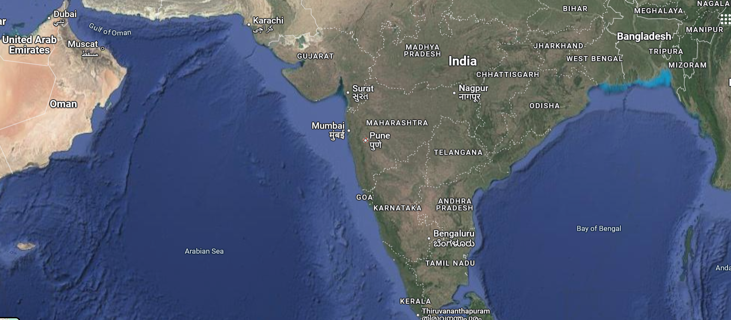

Project Location (Kolvan valley)
Project Area: Ten villages in Kolvan valley region:
Walen, (2) Nandgaon, (3) Kule, (4) Nanegaon,
(5) Bhalgudi (Ramwadi), (6) Shilimb,
(7) Paud
Blocks – Mulshi & Maval, District – Pune
State – Maharashtra, Country - India
Click to view on Google Maps

Slide 5
Details of Project Villages
Seven villages in the Kolvan valley region across Mulshi and Maval blocks have been selected for installation of Water Filtration System + Water ATM :
Sr. | Name of Village | Total Population | Number of students in the school | Room available for Project?
1. | Walen | 1260 | 55 | No; Gram panchayat will build a room for the project.
2. | Nandgaon | 1400 | 24 | Yes, near the school.
3. | Kule | 2100 | 100 | No; Gram panchayat will build a room for the project.
4. | Nanegaon | 800 | 23 | Yes, near the school.
5. | Bhalgudi (Ramwadi) | 700 | 25 | Yes, near the temple
6. | Shilimb | 1500 | 80 | Yes, near Gram panchayat
7. | Paud | 3000 | 670 | Yes, near Gram panchayat
 |  | 10760

Slide 6
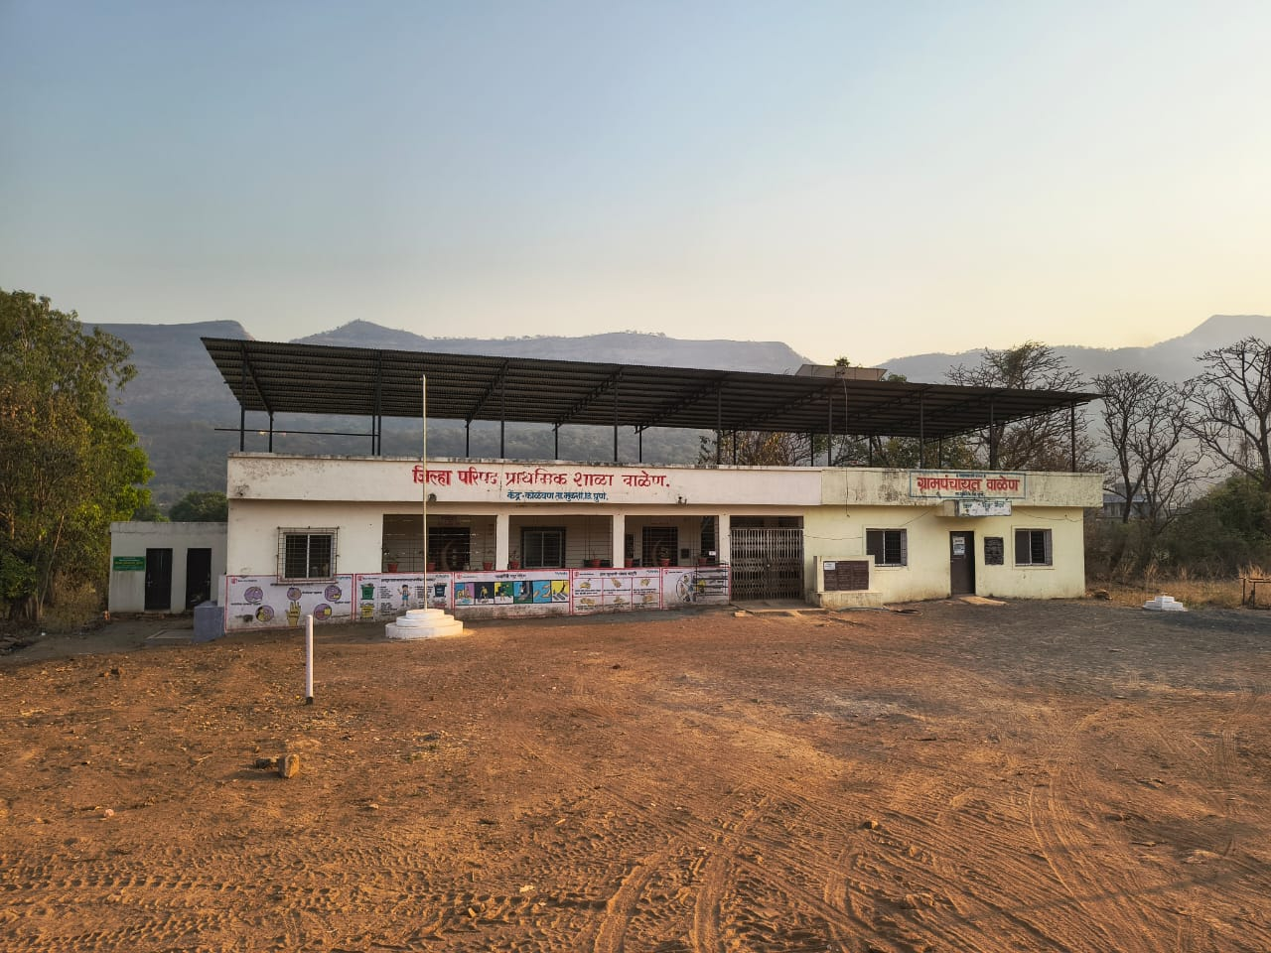
Where will the Water A.T.M. be located?
1. Walen village
The Water A.T.M. will be installed in a new room adjacent to the Grampanchayat Office (right corner).

Slide 7
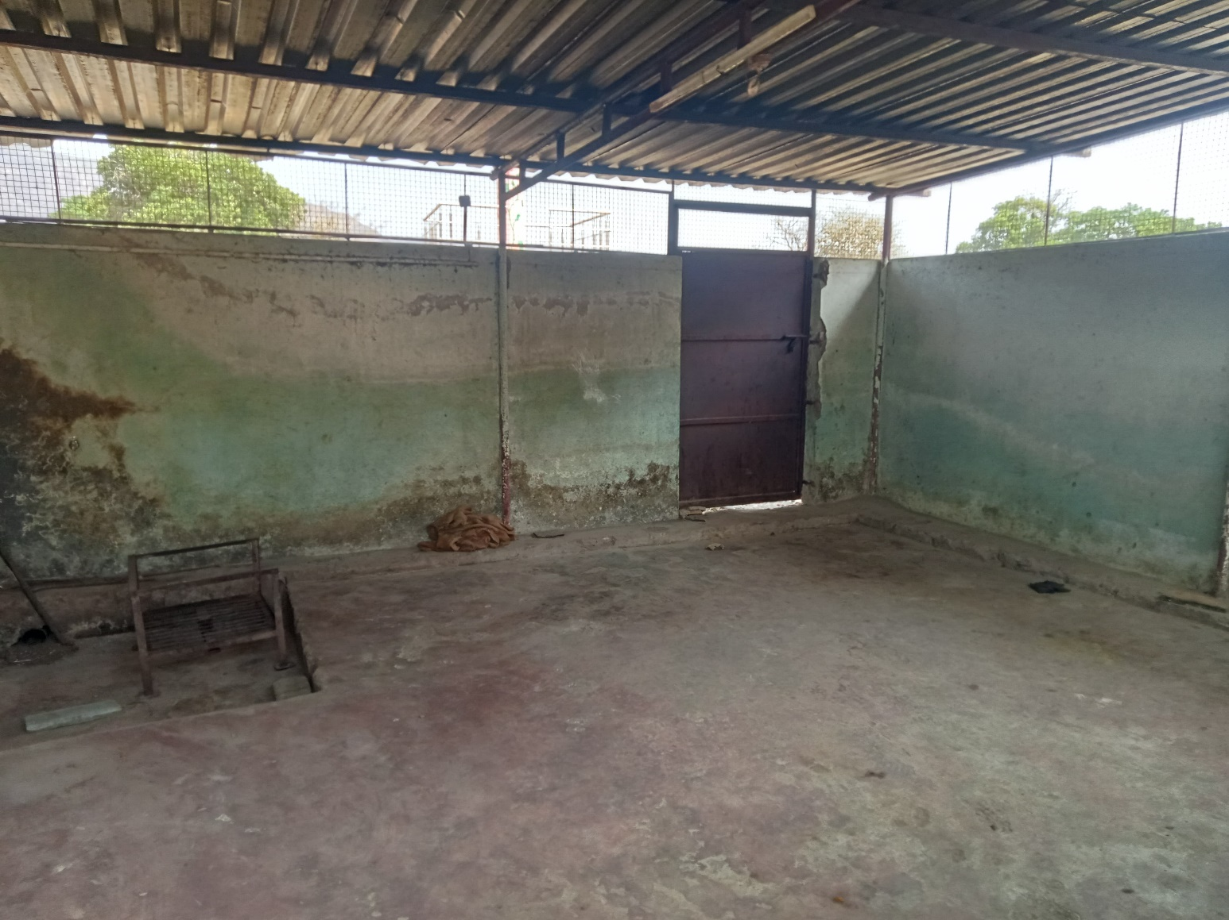
Where will the Water A.T.M. be located?
2. Nandgaon village
The Water A.T.M. will be installed in this existing room adjacent to the school building at Nandgaon village. The room will be renovated/ painted before installing the Water ATM.

Slide 8
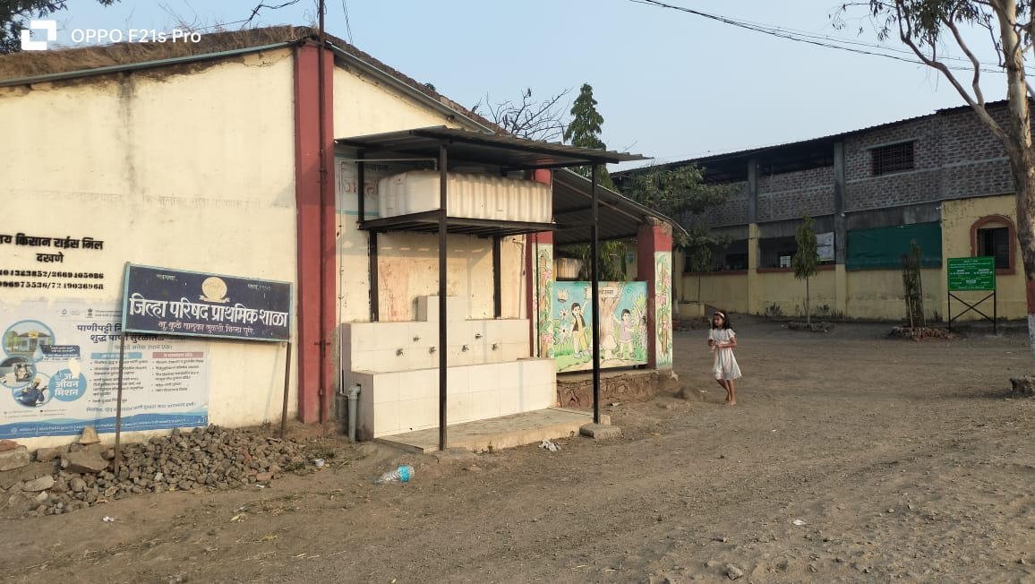
Where will the Water A.T.M. be located?
3. Kule village
The Water A.T.M. will be installed in a new room which will be built adjacent to the school building in Kule village.

Slide 9
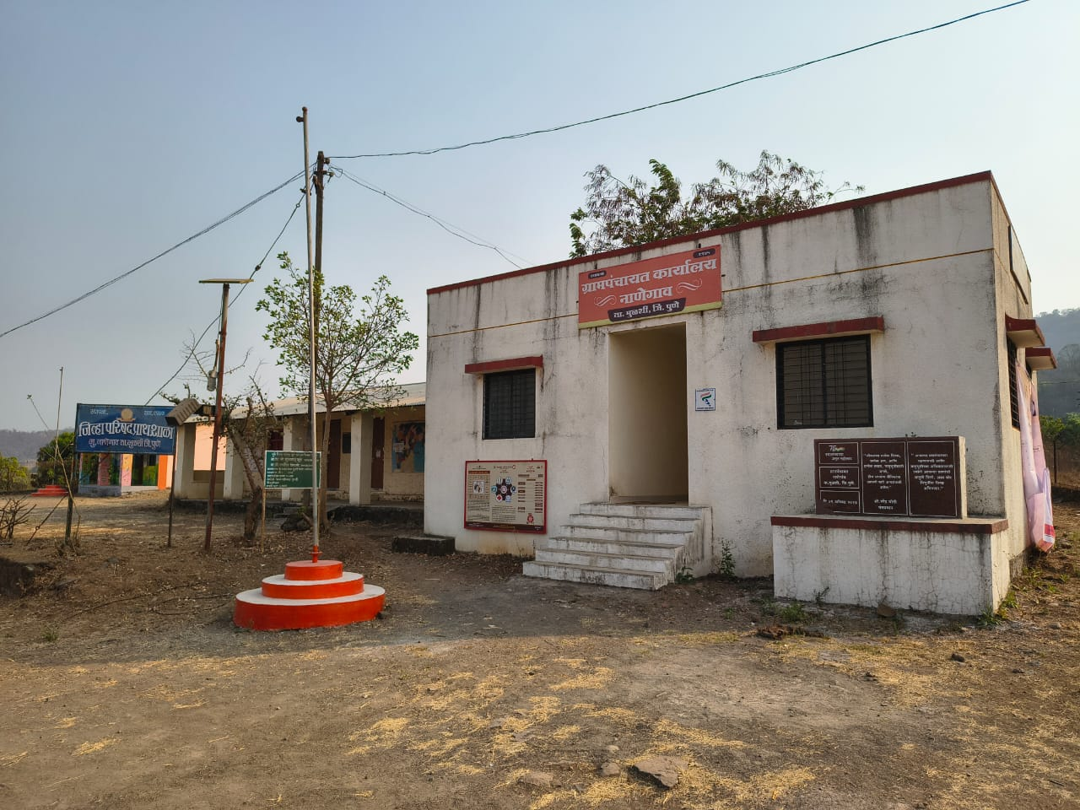
Where will the Water A.T.M. be located?
4. Nanegaon village
The Water A.T.M. will be installed in an existing room adjacent to the Gram panchayat Office, Nanegaon village.

Slide 10

Benefits of the Water A.T.M. Project
This project will provide 24x7 clean drinking water to 10760 residents of these 7 villages and travelers passing by.
Access to clean drinking water will reduce illnesses such as diarrhea, typhoid, cholera, hepatitis B, etc. that are generally caused by polluted water, thus reducing the medical expenditure of rural families and improving their health and standard of living.
Since the water from the ATM will have a price, people will use it more wisely and there is less wastage of water.
Water from the ATM will be available to anyone from the village at an affordable price regardless of their social class, caste, or religion.
Reject water from RO Filter will be re-used for irrigating trees and kitchen garden near the school/Gram panchayat.
The money collected in the ATM will be used for maintaining and servicing the filtration system regularly, and to pay the electricity bill, thus making it a self-sustaining project.

Slide 11
Project Budget for Water Filtration System and Water ATM in 7 villages
Sr. No | Item | Description | Budget in INR | Budget in USD
1 | Water ATM | Water filtration system (reverse osmosis), storage tank for purified water, pump, control panel, automatic water dispensing machine | 2370232.00 | 27244.05
2 | Pipeline & allied civil work | U-PVC pipeline, valves, civil work, project Electrical work, etc. | 140000.00 | 1609.20
3 | Room 10’x10’ | Provided by Gram panchayat | 0 | 0
4 | Monitoring & Evaluation Co-Op Agency | Facilitation agency (local NGO) | 70000.00 | 804.60
5 | Project Management |  | 28000.00 | 321.84
6 | Signages |  | 17500.00 | 201.15
7 | Contingencies |  | 71268.00 | 819.17
 | Total Project Cost for 7 villages | (Walen, Nandgaon, Kule, Nanegaon, Bhalgudi-Ramwadi, Shilimb, , Paud, | 2697000.00 | 31000.00

Slide 12
PROPOSED FUNDING (May change depending on DDF allocation by TBD , Dist in .USA
Funding Source | Contributions |  | Support Fee for Cash, 5% | World Fund Match on DDF (80%) | Total to Project
 | Type | Amount
RC Puné Laxmi Road, D 3131 | Cash | 3000 | 150** |  | 3,000
District 3131 , India | DDF | 5000 |  | 4,000 | 9,000
Club in USA ( Proposed) | Cash | 1000 | 50*** |  | 1,000
TBD, District in USA | DDF | 10000 |  | 8,000 | 18,000
TOTAL |  | $36,000 | $100** | $12,000 | $31,000
** The 5% support fee on cash donations does not go to the project. The host club will pay their share upon GG approval.

Slide 13

Submitted by:
PP Rtn Deepa Bhagwat, Primary Contact, RCP Laxmi Road, RID 3131, INDIA. Signature and Date
Director- Cervical cancer Vaccination Drive ( 2018-19& 2024-25 )District Literacy Committee Chair (2022-23) Counsellor - District Literacy Team 2022-23 , Counsellor- Human Development 2025-2026
And Primary Contact for more than 16 grants ,out of which2 grants are partnered by your district
.
Phone: +91 98220 55461, Email: deepa.a.bhagwat@gmail.com

