Slide 1
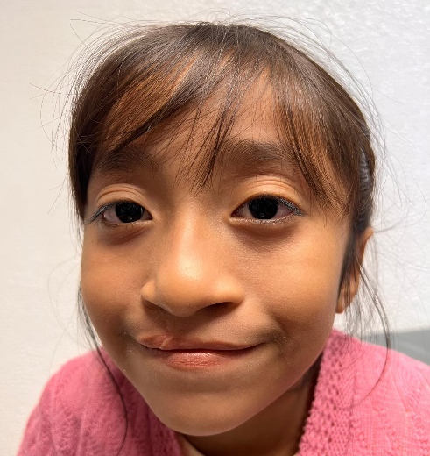
Change a Child’s Life through Sharing Smiles
GG 2580217 - 2026 Villahermosa, Mexico
Cleft Lip & Palate Vocational Training
Sponsor: Rotary Club of Venice-Nokomis Host: Real del Grijalva-Villahermosa, Mexico Location: Villahermosa, Mexico Budget: $47,2020
Team: 15 volunteers Dates: February 2026
This grant will provide children with hope and healing by developing a sustainable, fully-staffed multi-disciplinary cleft lip and palate clinic. The clinic will not only perform the initial surgery on each child, but continue follow-up care and services, which may include additional surgery, speech therapy, nutritionist, dentist, social worker, psychologist, and orthodontist specialties.
The proposed activity is to provide professional Vocational Training Teams. The teams (composed of volunteer U.S. medical personnel recruited by AdventHealth Sharing Smiles and local medical professionals) will screen patients and perform cleft lip and/or palate surgeries on up to 50 children per week, while training in-country professionals to continue treatment throughout the year.
These vocational training teams will help develop each of the disciplines that are required in a cleft lip and palate clinic. The disciplines include plastic surgery, speech therapy, orthodontics, dentofacial orthopedics, pediatric anesthesiology, pediatric recovery room nursing and operating room nursing. We will work with the local medical teams for three years.
Before
After
For more information, contact George Lewis at waterman6960@yahoo.com or Tom Fitch at 5jfitch5@yahoo.com

