Slide 1
D6890 Vibrant Club Workshop | August 24, 2024 First Presbyterian Church of Winter Haven

Slide 2
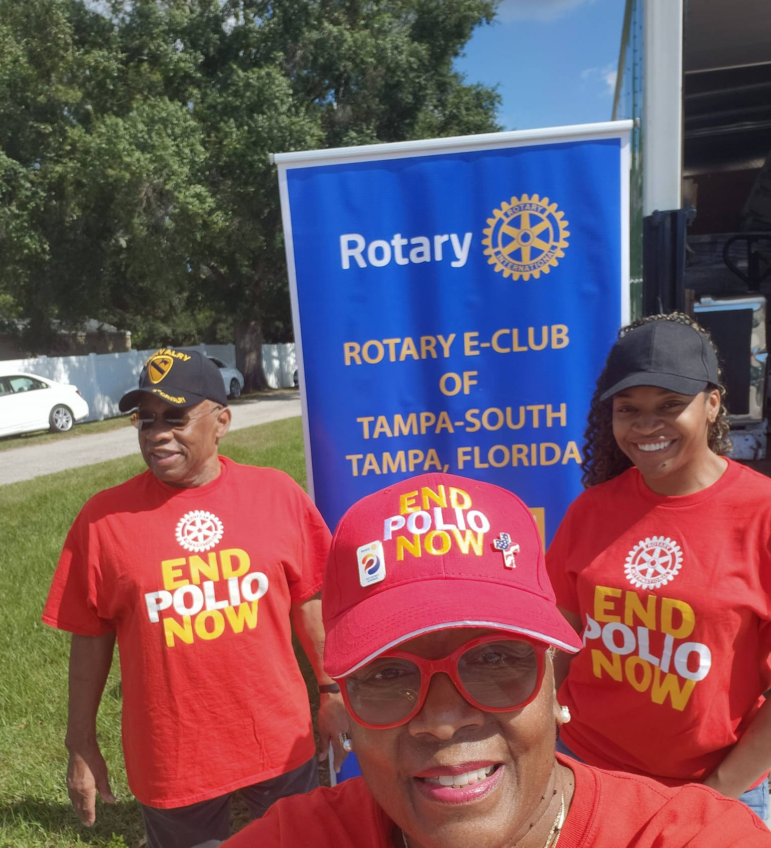
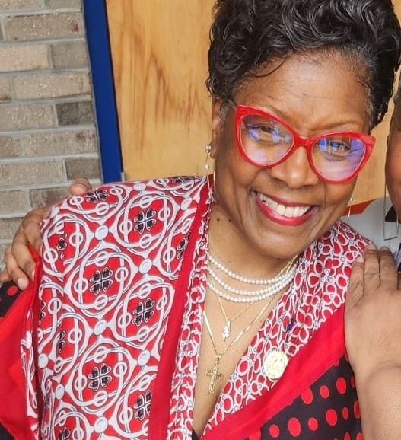
PDG Deborah Williams
District Learning Facilitator
AKA District Trainer
Rotary E-Club of Tampa South

Slide 4
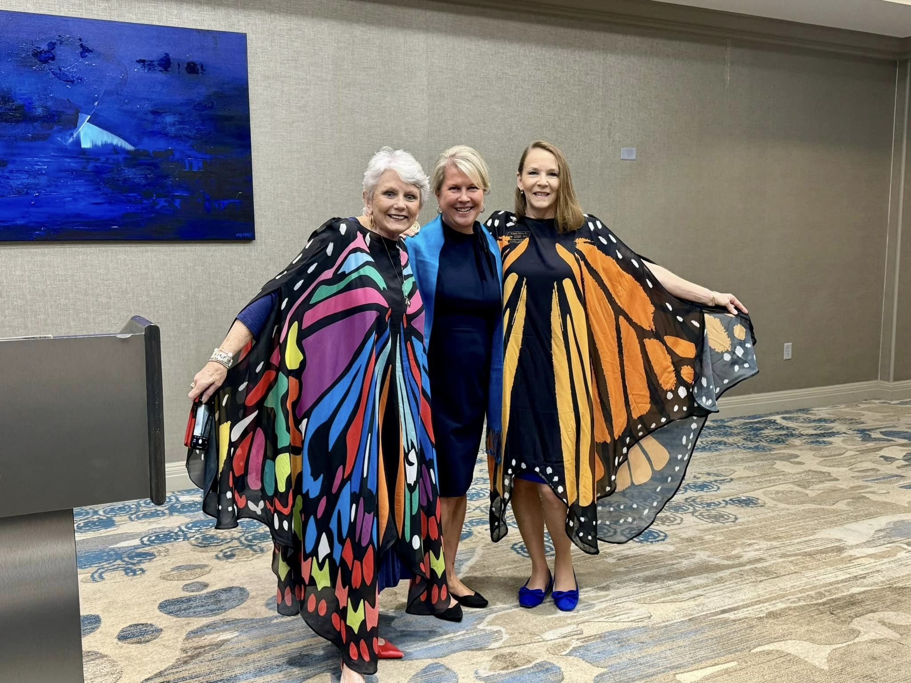
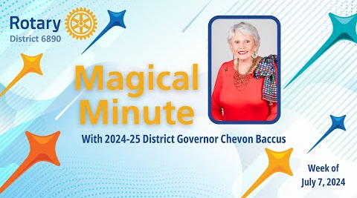
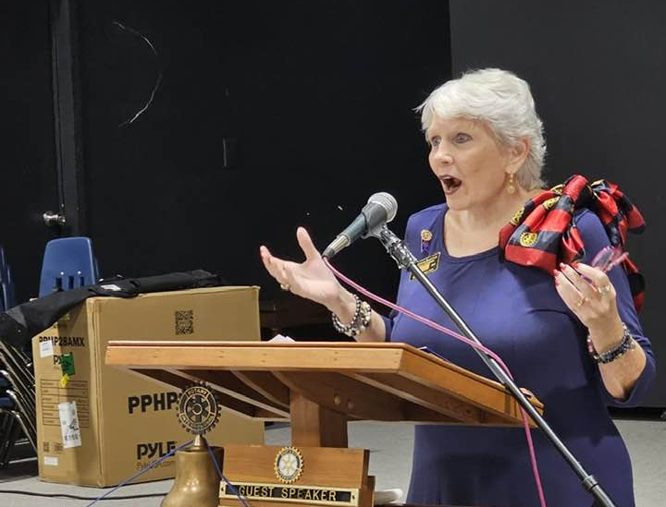

Slide 5
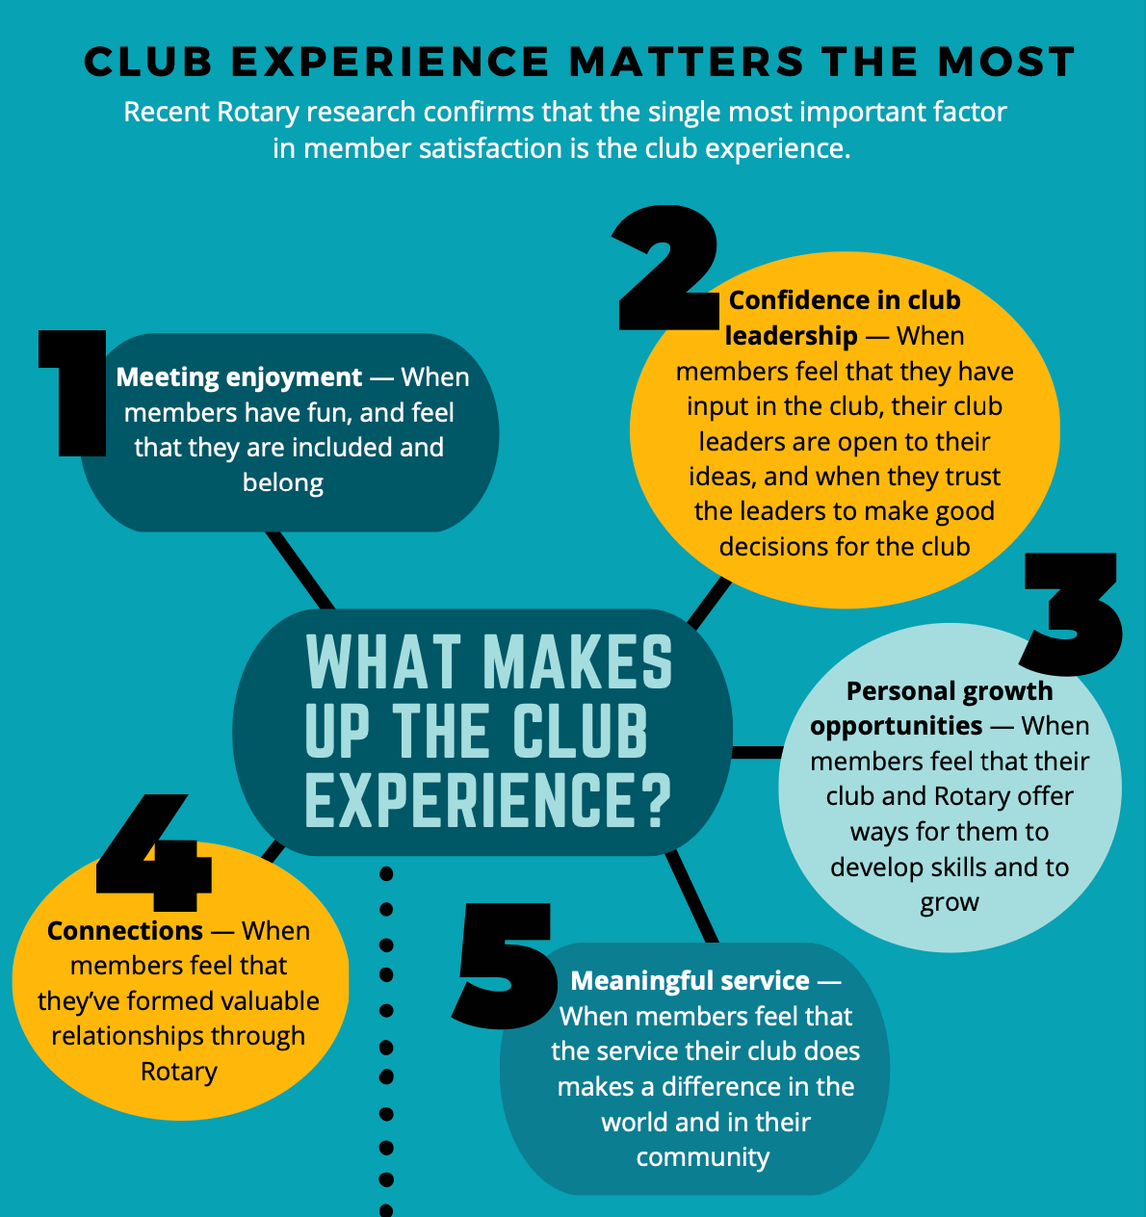
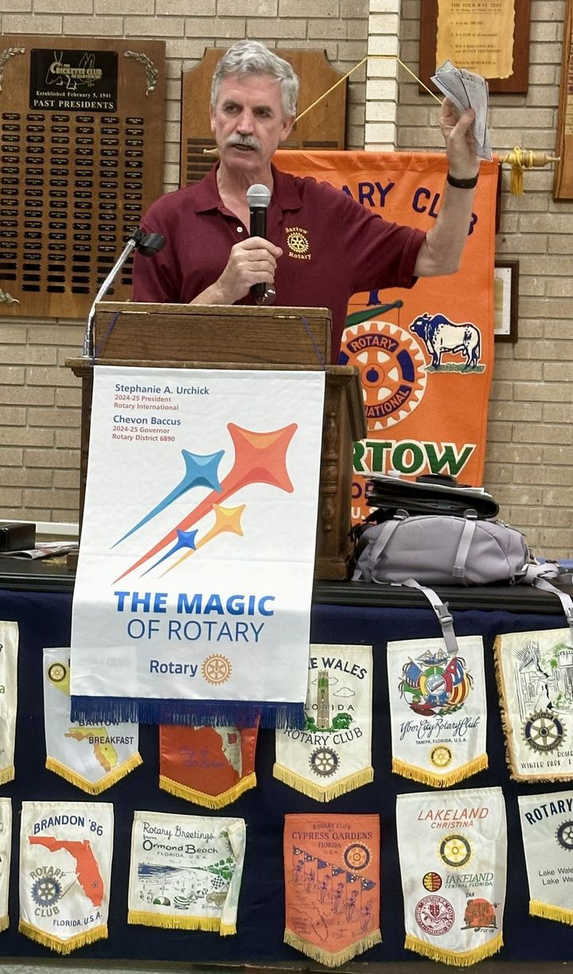
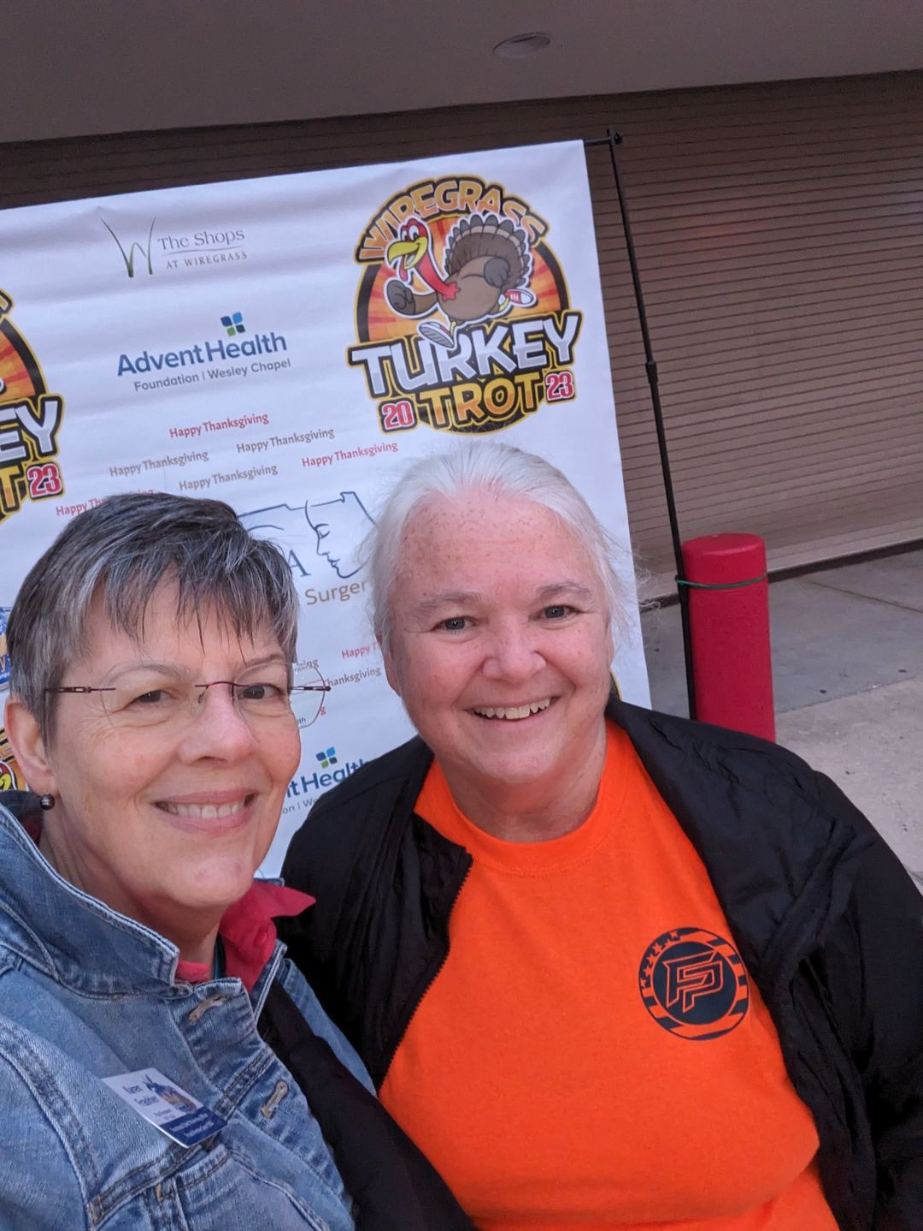
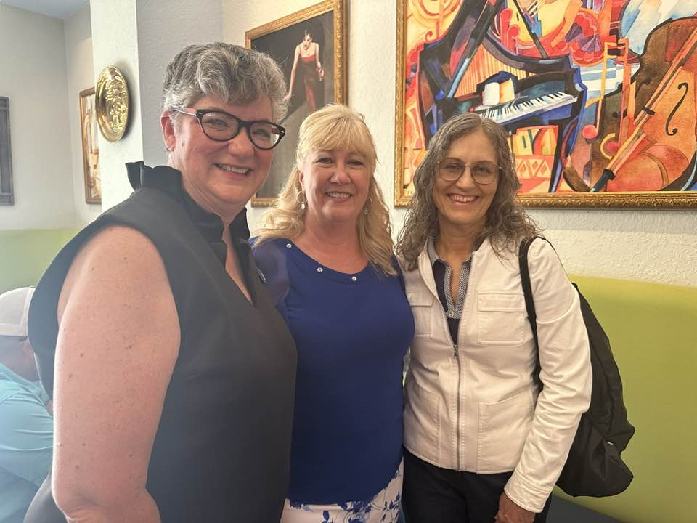
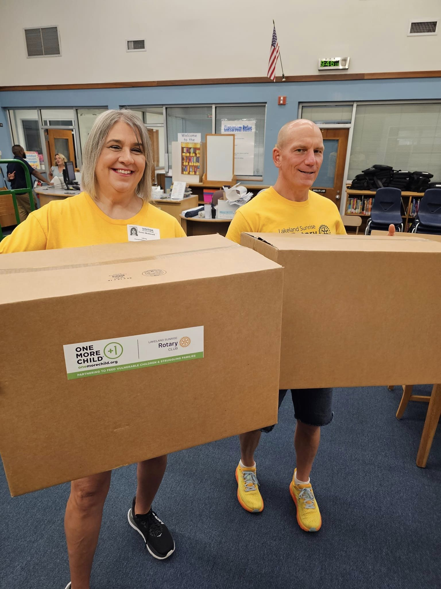
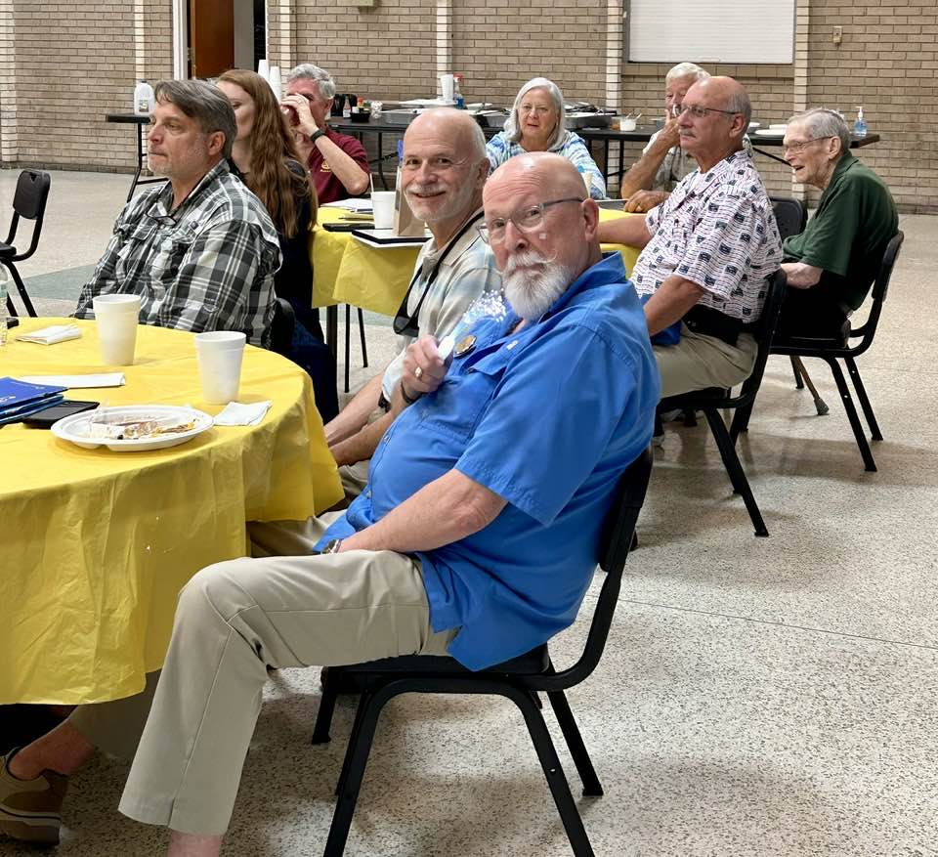
6890

Slide 6
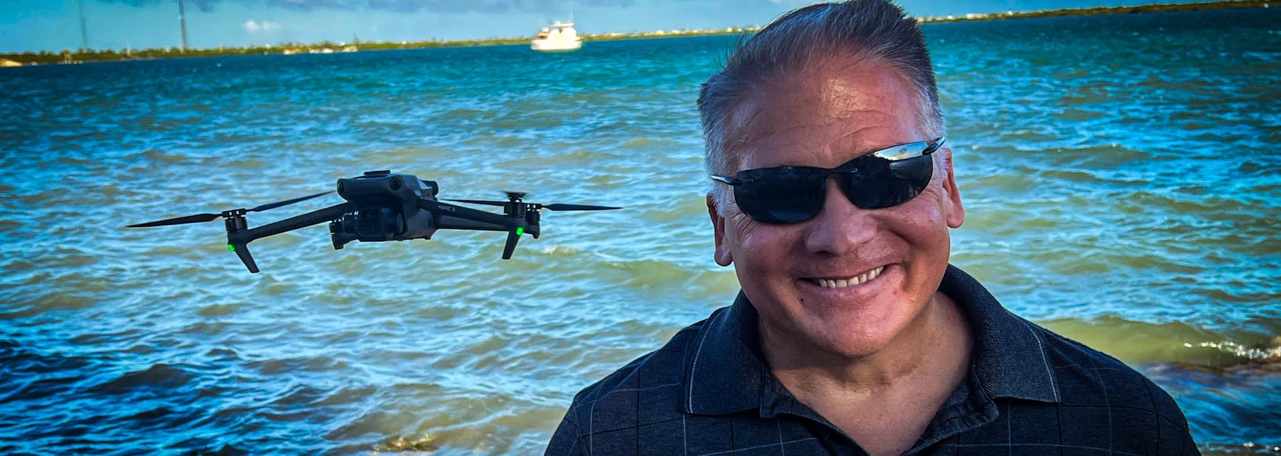
PDG
Scott Dudley
District 5050
District
Membership
Chair
Rotary Club of Winter Haven

Slide 7
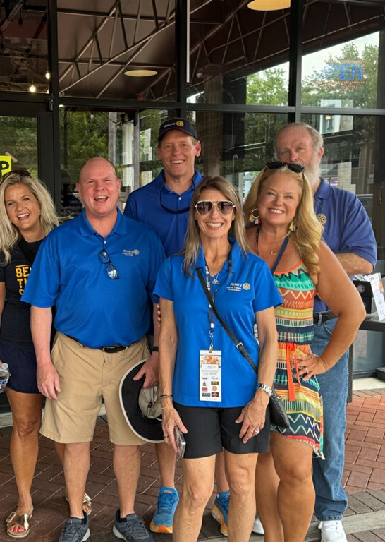
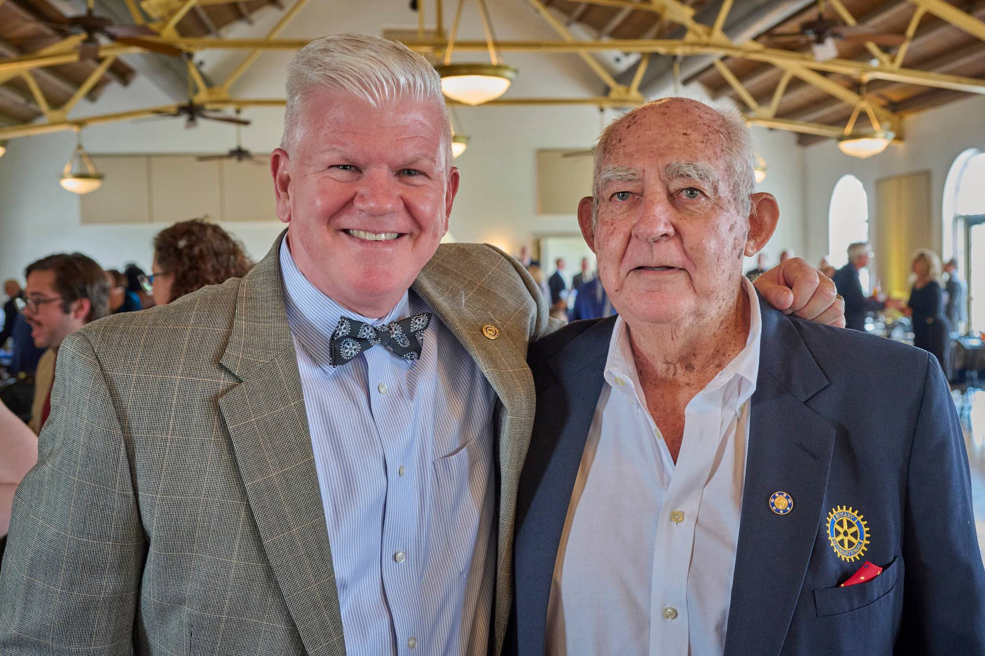
The Magical Meeting Experience
Joanna Allison
Assistant Governor Area 3
Rotary Club
of Westchase
Walter Page
Assistant Governor Area 7
Rotary Club
of Winter Haven

Slide 8
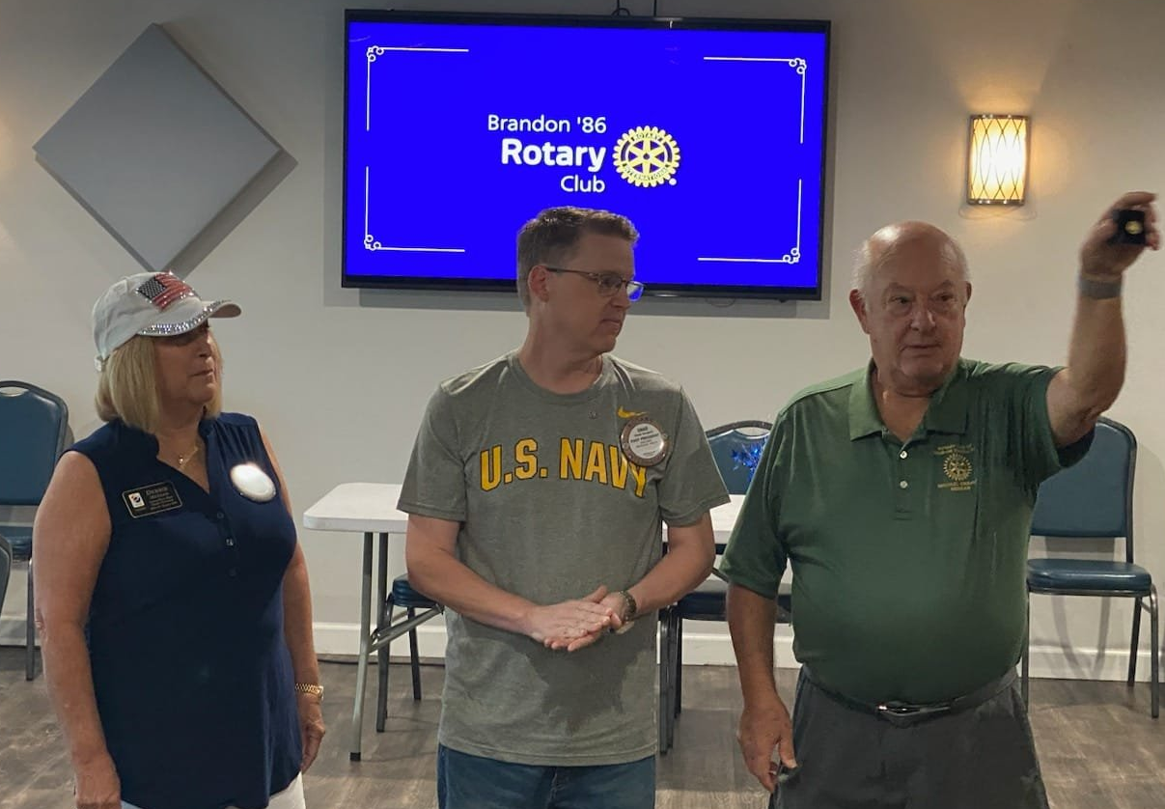
Telling the Rotary Story
Chad Norgard
District Public Image Chair
Rotary Club of Brandon ‘86

Slide 9
WHY
PI?

Slide 10
TABLE OF CONTENT
PUBLIC IMAGE PURPOSE: PROTECT THE BRAND
1
2
SHARE YOUR STORY
3
TOOLS / RESOURCES
4
ROAD AHEAD

Slide 11
WHY DO WE NEED TO PROTECT THE BRAND?
We have an internationally recognized brand that people trust.
It is part of our identity and we should take pride in our brand and our accomplishments.
Share - Connect - Collaborate

Slide 12
WHY SHARE OUR STORY?
Build trust in the community.
Increase Contribution. People may resonate with your story.
Increase Participation. People may want to help.
Get the word out and stop being the best kept secret in town. It is okay to share what your club's doing in the community!
Share - Connect - Collaborate

Slide 13
TOOLS / RESOURCES
Rotary Brand Center
Don't know where to get your Club logo? Don't have a clean logo to share anymore?
The Brand Center is your one stop shop to get it all done.
Zone PI Site: elevaterotary.org
This is your one stop shop for all Zone related PI needs from resource guides to the PI Toolkit. Everything's at your fingertips here including the Zone PI contact info.
Share - Connect - Collaborate

Slide 14
TOOLS / RESOURCES
Canva.com
We have setup a District wide Canva account that the PIC for each club can have access to. We've already uploaded all the colors and fonts, plus other templates to make content creation stress free for you!
Your Local News Outlets
What better way to get the word out about what your club is up to than to partner with a local news outlet. Ask for a monthly article slot, or maybe even see about a membership to your club for them!!
Share - Connect - Collaborate

Slide 15
THE ROAD AHEAD
Annual Club PI Audit
Monthly Zone webinars for PI
Content Creation Sessions
EPIC Citations for Clubs and Districts
Share - Connect - Collaborate

Slide 16
EPIC CITATION INFO
Month Task Start Date End Date
July Public Image Audit May 15th Oct 31st
Aug Public Image Plan May 15th Oct 31st
Sept Content Calendar May 15th Oct 31st
Oct World Polio Day Sept 15th Nov 30th
Nov Foundation Month Oct 15th Dec 31st
Share - Connect - Collaborate

Slide 17
EPIC CITATION INFO
Month Task Start Date End Date
Dec Feedback Nov 15th Jan 31st
Jan Rotary Brand & Dec 15th Feb 28th
Learning Centers
Feb Rotary Showcase Jan 15th Apr 30th
Mar People of Action Posts Jan 15th Apr 30th
April Incoming Chairs Jan 15th Apr 30th
Share - Connect - Collaborate

Slide 18
EPIC CITATION INFO
These tasks are designed to aid in organizing and facilitating the duties of the Public Image Chaire while enhancing your club’s public image.
Complete each month’s tasks to earn higher level recongnitions as follows:
Platinum: Complete 9-10 tasks
Gold: Complete 7-8 tasks
Silver: Complete 5-6 tasks
Bronze: Complete 3-4 tasks
The first 3 tasks (July, Aug, Sept) must be done to get Platinum or Gold
Share - Connect - Collaborate

Slide 19
THAT SAID....
Share - Connect - Collaborate

Slide 20
CONTACT INFO
813-454-5072
d6890pi@gmail.com
chad@norgardinsgrp.com

Slide 21
THANK YOU
We want to be a resource for your clubs, so please let us know how we can best serve you!
Share - Connect - Collaborate

Slide 22
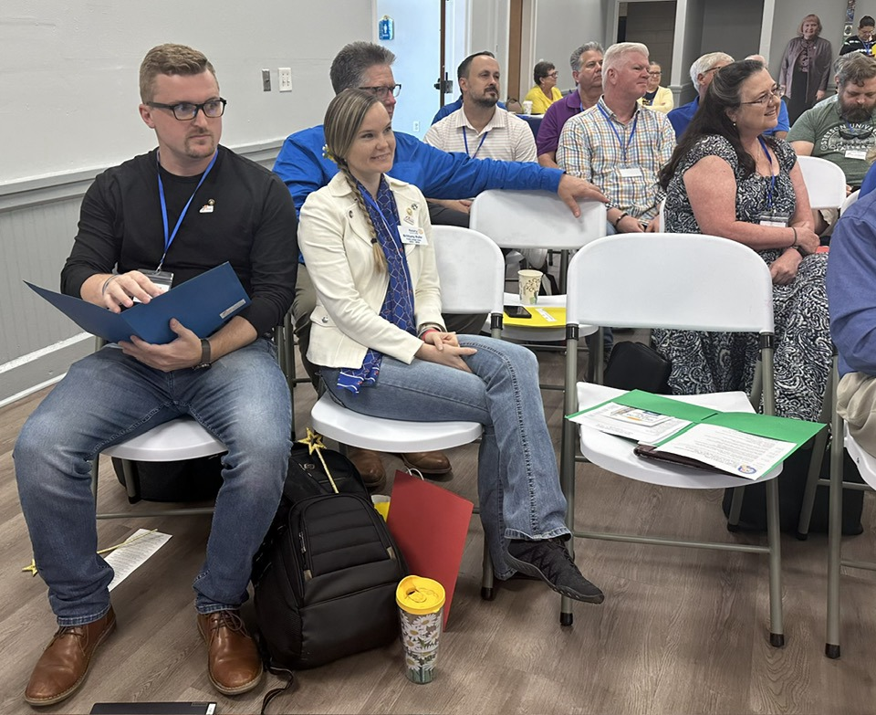
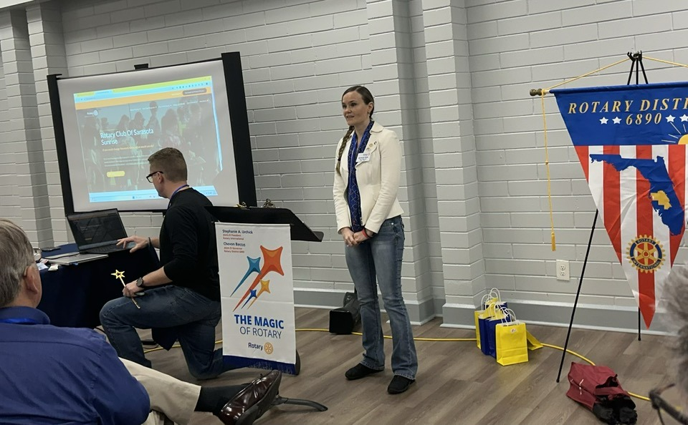
Leveling Up the Magic
Brittany Rohr
Rotary Club
of Sarasota Sunrise
Craig Wallace
Rotary
on the Ridge

Slide 23
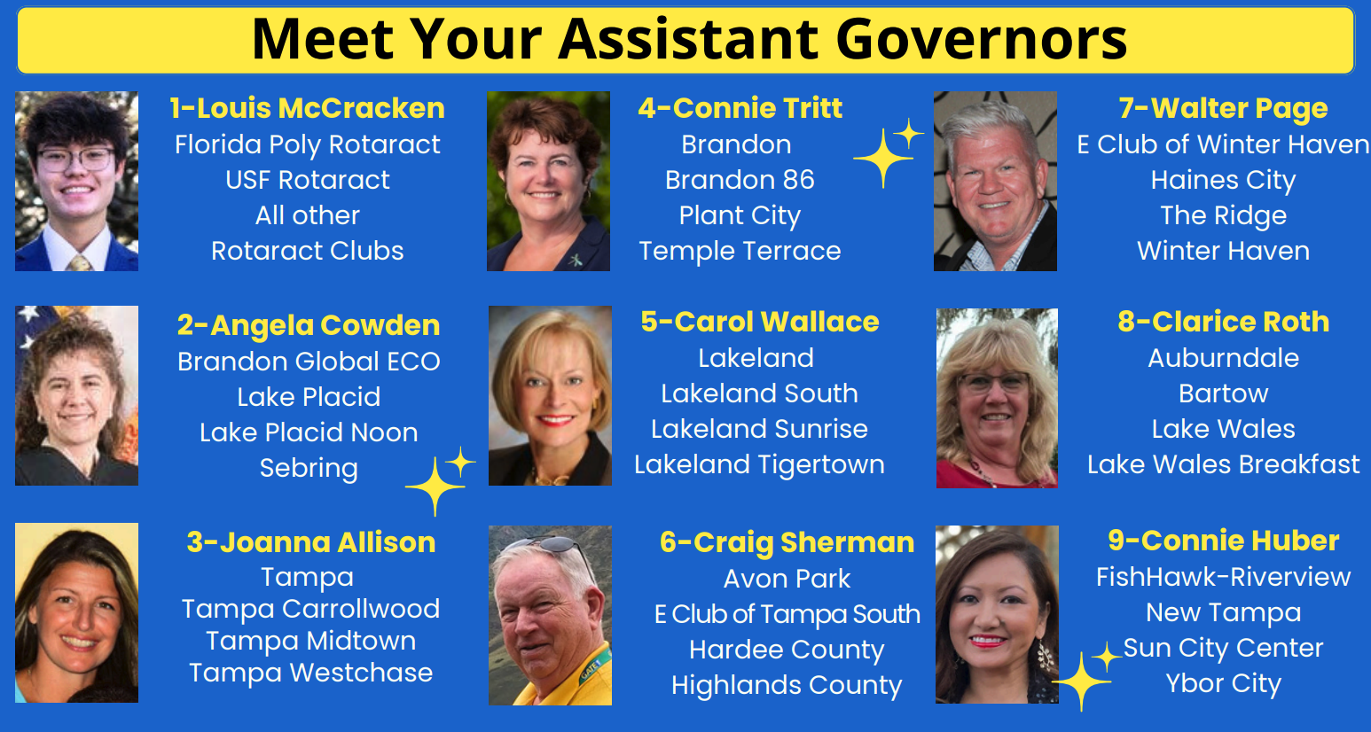
Lunch Break
Conversations
Areas 2, 3, 4, 5
Christian Education Building
Geneva Room 106
Angela & Joanna & Carol
Areas 1, 6, 7
McLeod Hall – back section
Louis & Walter
Areas 8, 9
McLeod Hall - main
Clarice & Connie

Slide 24
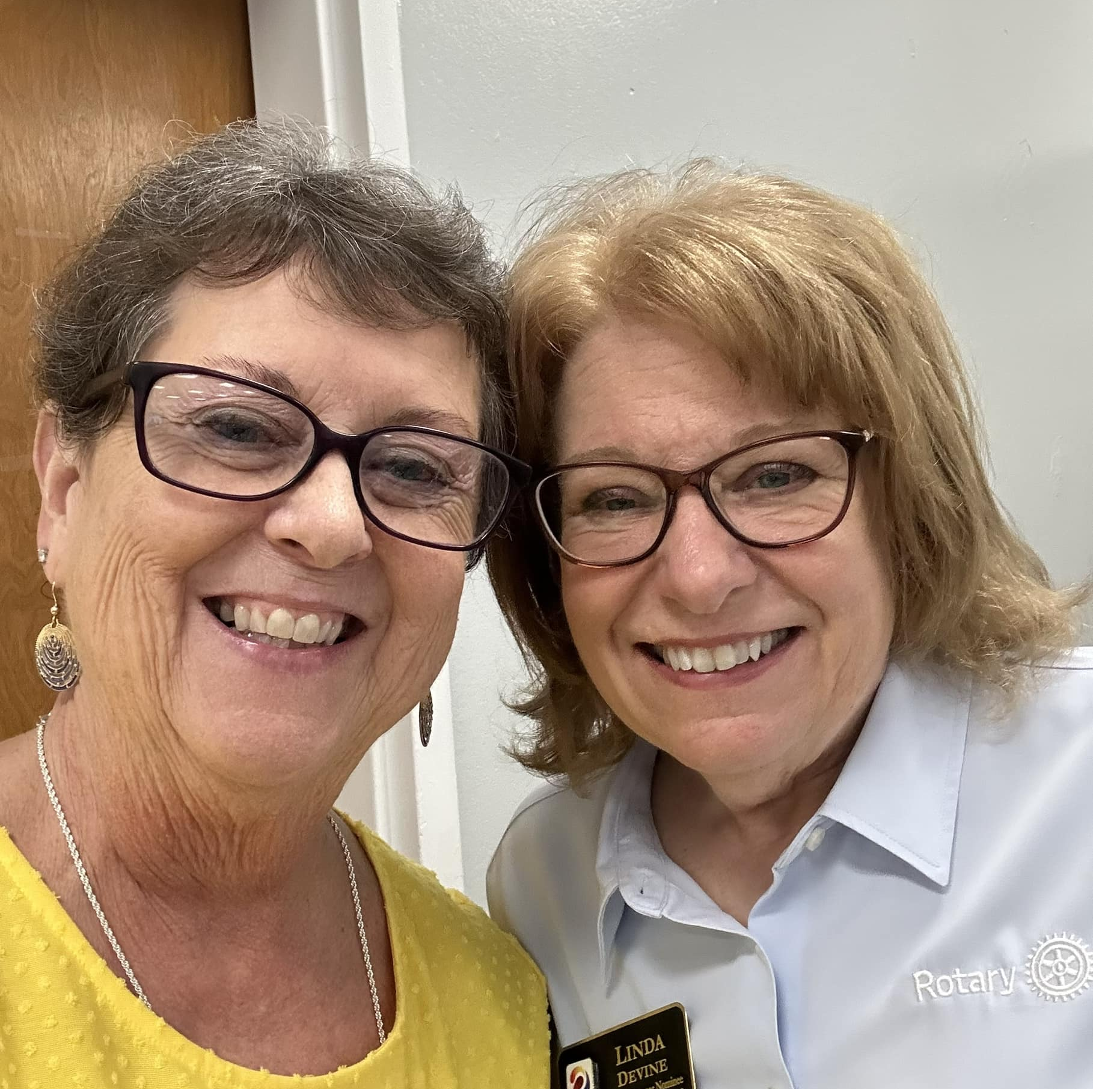
Packing Your Magic Tool Kit
“There's no such thing as too many Lindas... ☺ ”
-Linda J
April 20, 2024

Slide 25
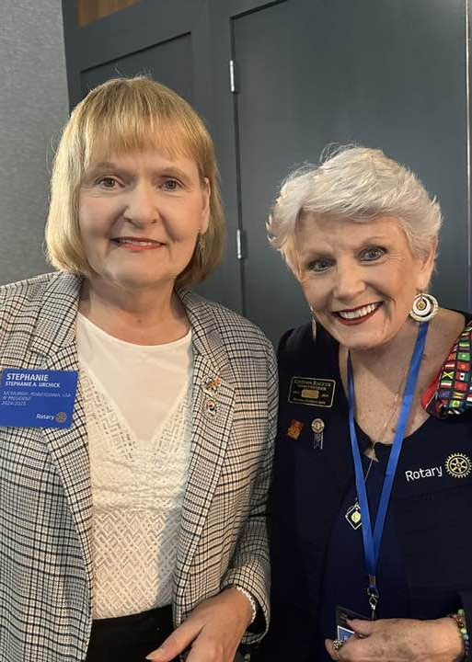
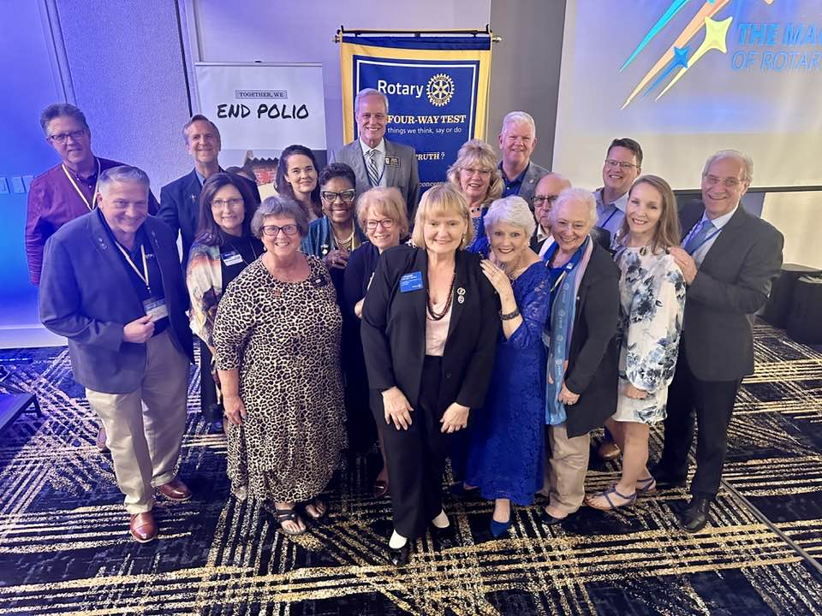
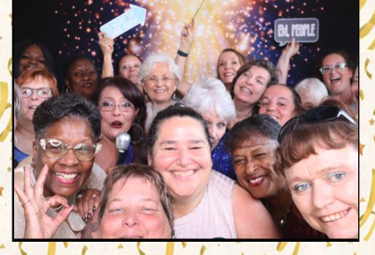
Let’s Share
the Magic
of Rotary!

