Slide 1
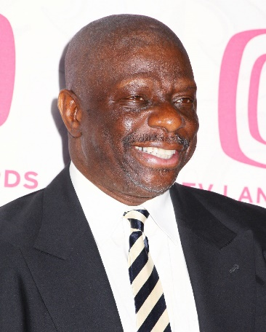
Cubans consulate in Mexico
THE LAFAYETTE ROTARY CLUB
JUNE 25, 2019
Today in
History
THIS WEEK MERILYN VINES HAS THE PROGRAM
JULY | 2 | CHRIS BUSBY
 | 9 | CHARLOTTE BLASINGAME
 | 16 | DARON BROOKS
 | 23 | JOSH YERTA
 | 30 | BUTCH BUSBY
AUG | 6 | JOHN CALDWELL
 | 13 | BRENDA & CHESTER CARTER
 | 20 | TR CLARK
 | 27 | BUSINESS MEETING
SEPT | 3 | DANTZ FRAZER
 | 10 | PHILIP GIPSON
 | 17 | TOM LEVERELL
 | 24 | SID LOCKHART
1929 US President Herbert Hoover authorizes building of Boulder Dam (Hoover Dam)
1935 Joe Louis defeats Primo Carnera at Yankee Stadium
Event of Interest
1988 Cal Ripken Jr plays in his 1,000th consecutive game
Famous Birthday: James Carter Walker Jr. is an American actor and comedian. Walker is best known for portraying James Evans Jr., the oldest son of Florida and James Evans Sr. on the CBS television series Good Times, which ran from 1974 to 1979. .

Slide 2
LAFAYETTE ROTARY CLUB
2017-2018
President…………………… | Diane Sheriff
President Elect…………….. | Dr. John Caldwell
Secretary-Treasurer……….. | Josh Yerta
Sgt At Arms………………… | Mac Tucker
Past President……………… | T.R. Clark
Directors:
Allen Tucker | Stanley Tucker
Dantz Frazer | Butch Busby
Lewis Lowe | Chris Busby
Steve Wheeler T.R. Clark
Club Bulletin………………. | Josh Yerta
Membership………………... | Charlotte Blasingame
Weekly Program………….… | Chris Busby
OVER 75 YEARS SERVICE
1937 - 2017
HE PROFITS
MOST
WHO SERVES
BEST
DIRECTORY OF ROTARY CLUBS
TIME | CLUB | PLACE
Mon. 7:00 | Lee County Sunrise | Tenda Chick Auburn
Tues. 12:00 | Alex City | Jake’s Rest
Mon. 12:00 | Montgomery | RSA Activity Center
Tues. 12:00 | Opelika | Saugahatchee Country Club
Tues. 12:00 | LaFayette | LaFayette First Baptist Church-Fellowship Hall.
Wed. 11:15 | Columbus | Conv. & Trade Center
Wed. 11:30 | LaGrange | Highland Country Club
Wed. 12:00 | Auburn | Saugahatchee Country Club
Wed. 12:30 | Tuskegee | Torch 85 Restaurant
Thurs. 11:00 | West Point | Hampton Inn&Suites
Thurs. 12:00 | Montgomery Capital | Wynlakes Golf & Country Club
Thurs. 12:00 | Roanoke | Gedney’s
Fri. 11:00 | Newnan | Newnan Country Club
OBJECT OF ROTARY
The object of Rotary is to encourage and foster the ideal of service as a
bias of worthy enterprise and, in particular, to encourage and foster:
First. The development of acquaintance as an opportunity for service;
Second. High ethical standards in business and professions; the recognition of the worthiness of all useful occupations; and the dignifying by each Rotarian of his occupation as an opportunity to serve society;
Third. The application of the ideal by service by every Rotarian to his personal, business, and community life;
Fourth. The advancement of international understanding, goodwill, and peace through a world fellowship of business and professional men and women united in the ideal of service.
ALL TIME CST
THE 4-WAY TEST
of the things we think, say, or do:
Is it the TRUTH?
Is it FAIR to all concerned?
Will it build GOODWILL and BETTER FRIENDSHIPS?
Will it be BENEFICIAL to all concerned?

