Slide 1
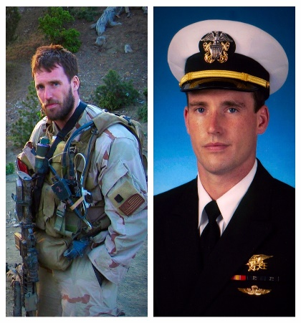
Cubans consulate in Mexico
THE LAFAYETTE ROTARY CLUB
MAY 7, 2019
Today in
History
THIS WEEK FAYE SEROYER HAS THE PROGRAM
MAY | 14 | DIANE SHERIFF
 | 21 | ALLEN TUCKER
 | 28 | BUSINESS MEETING
JUN | 4 | MAC TUCKER
 | 11 | STANLEY TUCKER
 | 18 | MERILYN VINES
 | 25 | STEVE WHEELER
JULY | 2 | JOSH YERTA
 | 9 | CHARLOTTE BLASINGAME
 | 16 | DARON BROOKS
 | 23 | CHRIS BUSBY
 | 30 | BUTCH BUSBY
1943 Dutch men 18-35 obliged to report to labor camps
1975 US President Gerald Ford declares an end to "Vietnam Era"
1984 $180m out-of-court settlement reached in Agent Orange suit
Famous Birthday: Michael Patrick "Murph" Murphy was a United States Navy SEAL officer who was awarded the U.S. military's highest decoration, the Medal of Honor, for his actions during the War in Afghanistan. He was the first member of the U.S. Navy to receive the award since the Vietnam War.
Stand-up coediana 2-

Slide 2
LAFAYETTE ROTARY CLUB
2017-2018
President…………………… | TR Clark
President Elect…………….. | Diane Sheriff
Secretary-Treasurer……….. | Josh Yerta
Sgt At Arms………………… | Mac Tucker
Past President……………… | Ken McMillan
Directors:
Allen Tucker | Stanley Tucker
Dantz Frazer | Butch Busby
Lewis Lowe | Chris Busby
T.R. Clark
Club Bulletin………………. | Josh Yerta
Membership………………... | Charlotte Blasingame
Weekly Program………….… | Chris Busby
OVER 75 YEARS SERVICE
1937 - 2017
HE PROFITS
MOST
WHO SERVES
BEST
DIRECTORY OF ROTARY CLUBS
TIME | CLUB | PLACE
Mon. 7:00 | Lee County Sunrise | Tenda Chick Auburn
Tues. 12:00 | Alex City | Jake’s Rest
Mon. 12:00 | Montgomery | RSA Activity Center
Tues. 12:00 | Opelika | Saugahatchee Country Club
Tues. 12:00 | LaFayette | LaFayette First Baptist Church-Fellowship Hall.
Wed. 11:15 | Columbus | Conv. & Trade Center
Wed. 11:30 | LaGrange | Highland Country Club
Wed. 12:00 | Auburn | Saugahatchee Country Club
Wed. 12:30 | Tuskegee | Torch 85 Restaurant
Thurs. 11:00 | West Point | Hampton Inn&Suites
Thurs. 12:00 | Montgomery Capital | Wynlakes Golf & Country Club
Thurs. 12:00 | Roanoke | Missing Link Coffee Shop
Fri. 11:00 | Newnan | Newnan Country Club
OBJECT OF ROTARY
The object of Rotary is to encourage and foster the ideal of service as a
bias of worthy enterprise and, in particular, to encourage and foster:
First. The development of acquaintance as an opportunity for service;
Second. High ethical standards in business and professions; the recognition of the worthiness of all useful occupations; and the dignifying by each Rotarian of his occupation as an opportunity to serve society;
Third. The application of the ideal by service by every Rotarian to his personal, business, and community life;
Fourth. The advancement of international understanding, goodwill, and peace through a world fellowship of business and professional men and women united in the ideal of service.
ALL TIME CST
THE 4-WAY TEST
of the things we think, say, or do:
Is it the TRUTH?
Is it FAIR to all concerned?
Will it build GOODWILL and BETTER FRIENDSHIPS?
Will it be BENEFICIAL to all concerned?

