Slide 1
5 steps to telling your People of Action story
TITLE
Chuck Barnett
Rotary Public Image Coordinator
Zone 30

Slide 2
Why do we need to tell our story?

Slide 3
Rotary People of Action
The People of Action public image campaign helps you bring the Rotary story to life by showing Rotarians as the people of action we are.
Telling our People of Action stories in a meaningful, coordinated way builds the public’s understanding of who we are and what we do. It highlights the impact we make in our communities and around the world.

Slide 4
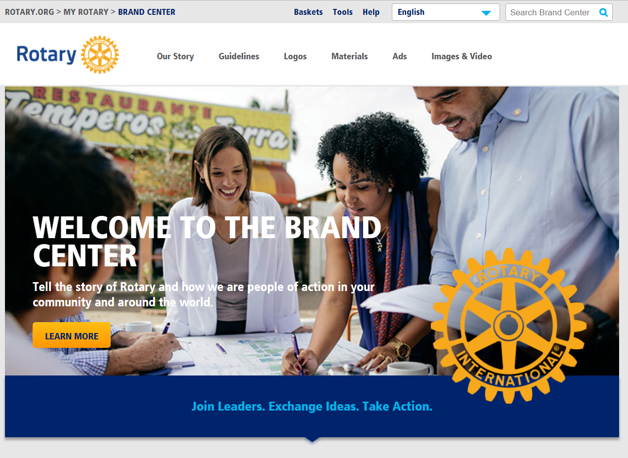
The tools – Rotary Brand Center

Slide 5
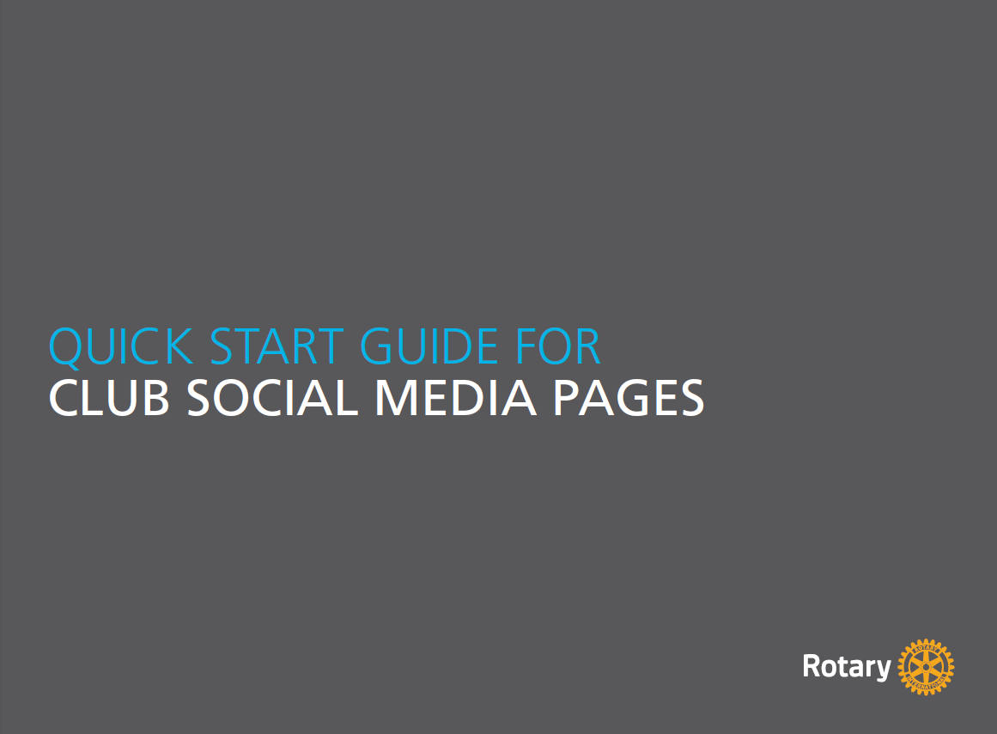
The tools – Rotary Brand Center

Slide 6
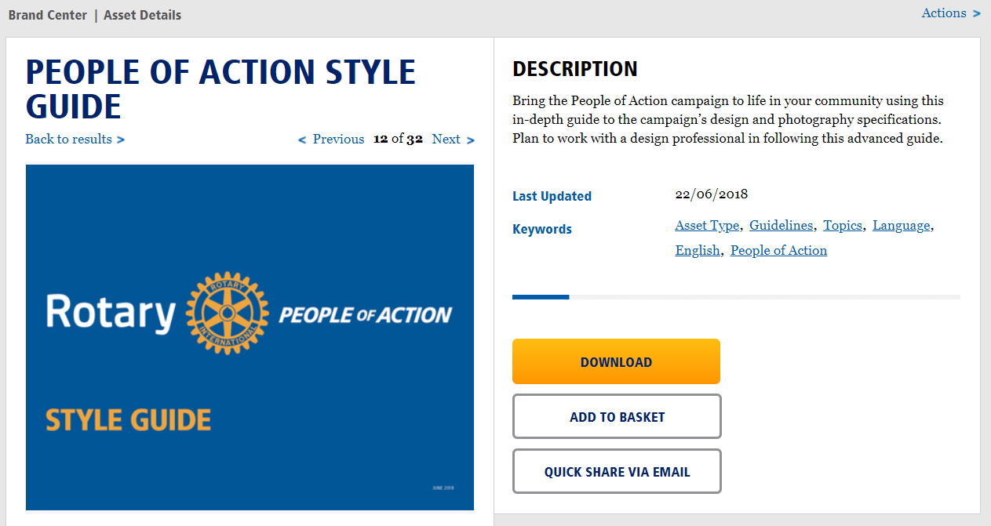
People of Action Style Guide

Slide 7
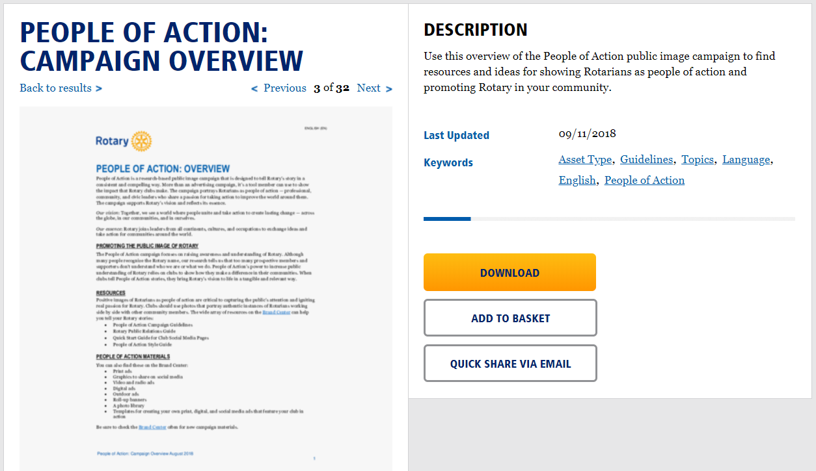
People of Action Campaign Overview

Slide 8
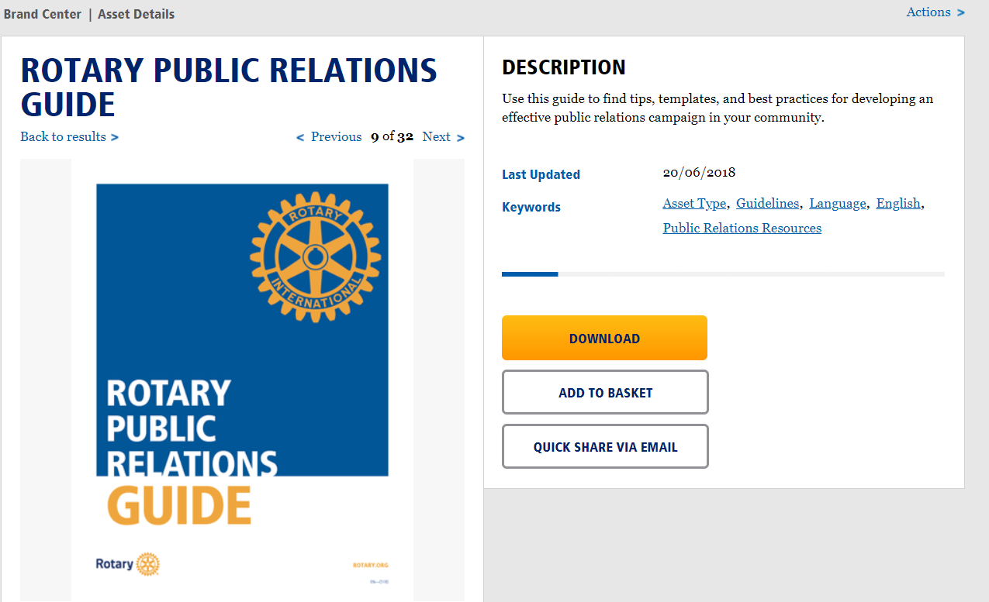
Rotary Public Relations Guide

Slide 9
Developing Your Story

Slide 10
AAAIEE

Slide 11
The First “A”

Slide 12
Accomplishment
WHAT WERE YOU OR YOUR CLUB TRYING TO ACCOMPLISH?

Slide 13
WHAT WERE YOU OR YOUR CLUB TRYING TO ACCOMPLISH?
What was the problem or challenge in your community that your club wanted to help solve?
Describe how your club members identified the problem.
Did you have national or global statistics that showed the importance of addressing this issue?

Slide 14
The Second “A”

Slide 15
Audience
WHO IS YOUR STORY’S AUDIENCE?

Slide 16
WHO IS YOUR STORY’S AUDIENCE?
Beyond Rotary members, who were you trying to reach?
What did they know about Rotary?
What did they think and feel about us?
What do we want them to think and feel?

Slide 17
The Third “A”

Slide 18
Action
HOW DID YOU OR YOUR CLUB TAKE ACTION?

Slide 19
HOW DID YOU OR YOUR CLUB TAKE ACTION?
Describe how you gathered resources and used the expertise of Rotarians or community members to tackle the challenge.
What obstacles did your club face as you worked on the project?
What action phrase best represents the action you took? (Together, We Connect? We Transform? Inspire? End Polio?)

Slide 20
New People of Action Templates

Slide 21
New People of Action Templates

Slide 22
New People of Action Templates

Slide 23
New People of Action Templates

Slide 24
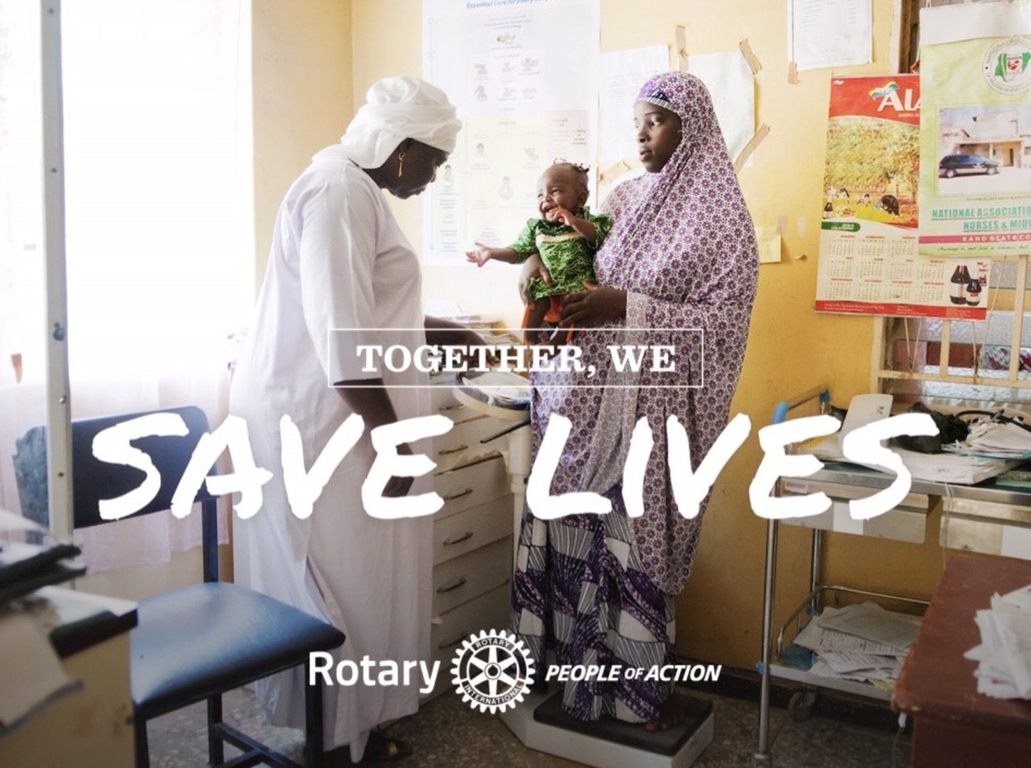
New People of Action Templates

Slide 25
New People of Action Templates

Slide 26
“I” Before The First “E”

Slide 27
Impact & Evidence
WHAT WAS YOUR IMPACT, AND WHAT EVIDENCE SUPPORTS THIS?

Slide 28
WHAT WAS YOUR IMPACT, AND WHAT EVIDENCE SUPPORTS THIS?
What were the outcomes of your project?
How many people did the project affect?
What are some relevant statistics? (Be careful not to use too many numbers.)
What changes did the project produce?
How did the project touch the lives of people in your community?

Slide 29
The Second “E”

Slide 30
Engage
HOW DO YOU WANT YOUR AUDIENCE TO ENGAGE NOW?

Slide 31
HOW DO YOU WANT YOUR AUDIENCE TO ENGAGE NOW?
The key to any good ad is your call to action.
Do you want your audience to learn more, support your cause, or perhaps join you at an event?

Slide 32
WHAT NEXT?

Slide 33
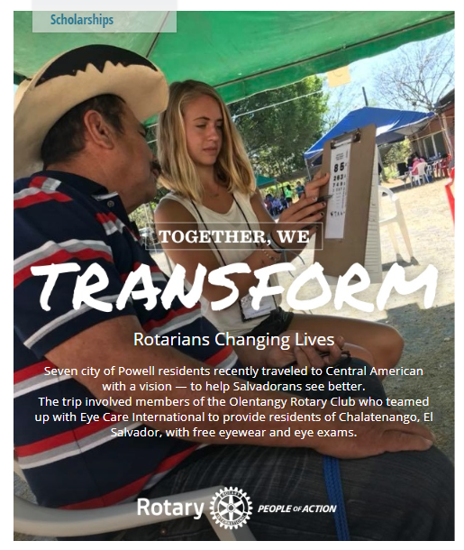
Share
Once you’ve created your People of Action story, use it to promote Rotary in your community. Share it with us, too.

Slide 34
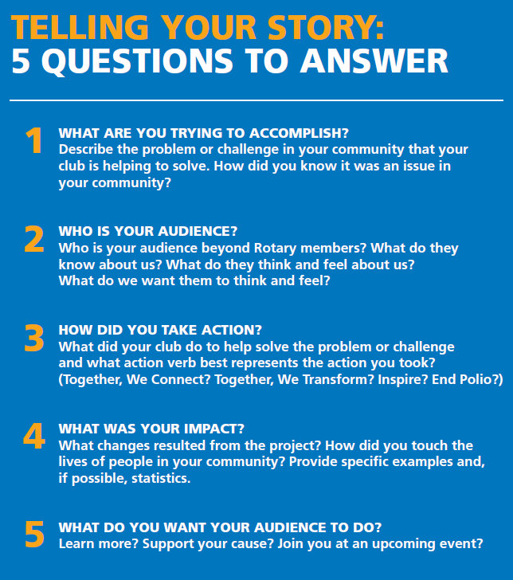
AAAIEE
Accomplishment
Audience
Action
Impact
Evidence
Engage

Slide 35
Contact Me
Chuck Barnett PDG D6760
Rotary Public Image Coordinator
Zone 30
615.708.7839
chuckbarnett@gmail.com
www.rotary.org/brandcenter

