Slide 1


MEMBERSHIP
“The POWER of Rotary lies in its Members”
PAT CROSS
ROTARY DISTRICT 6860 MID-YEAR CONFERENCE
SATURDAY, FEBRUARY 2, 2019

Slide 2
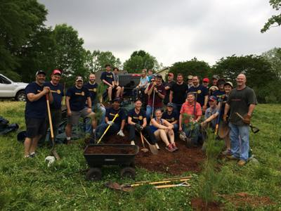
MEMBERSHIP
Rotary’s greatest asset!

Slide 3
WHO ARE ROTARY MEMBERS?
PEOPLE of all ages…young professionals, recent retirees
      INTERESTS
      PROFESSIONS
      PURPOSE SEEKERS
      VOLUNTEERS
      LEADERS
      *****WOMEN
      ETHNIC MINORITIES, UNDERREPREDSENTED GROUPS

Slide 4
Is your club diverse?
Do members mirror your community?
A diverse club is able to address broader needs in the community.

Slide 5
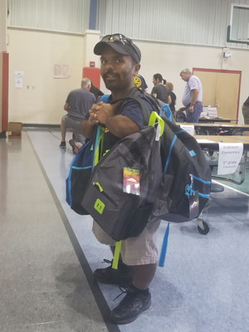
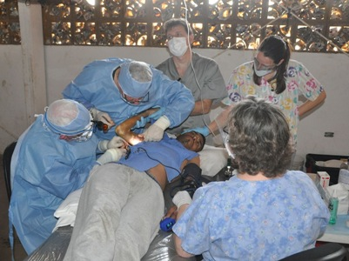
Why did you join Rotary?

Slide 6
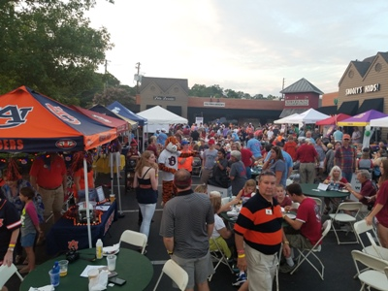
Networking
Programs
Club Projects
Friendship
Fellowship
Family of Rotary Opportunities

Slide 7
Rotary is FUN…
Club Projects are FUN.
Socials are FUN.
Service is FUN.
Meetings are FUN.

Slide 8
WHY DO MEMBERS LEAVE ROTARY?
  Lack of engagement
  Club experience not enjoyable or meaningful
  Unmet expectations
  No programs or activities of interest
  Lacking service or leadership opportunities
  Schedule conflicts
  TIME AND MONEY (provide value)

Slide 9
What is your Rotary Club’s “Impression”?
Are your club’s meetings?
  Friendly with welcoming hospitality
  Meeting room attractive, comfortable
  Meeting time compatible/flexible
  Interesting, relevant programs
  Food equals cost
  Meeting starts & ends on time
  Time for fellowship
  Are your meetings FUN?

Slide 10
Membership Happens at the Club!
Traditional/Legacy Club
Flexible Club

Slide 11
Club Flexibility…COL 2016
Vary meeting schedule…(must meet at least 2 times per month)
  Day, time or frequency
Vary meeting format
  In person or online
Relax attendance requirements
  Participate in other ways
Offer multiple membership types
  Family, Junior, Corporate, Couples
Rotaractors may join Rotary Club also
*****Flexible CHOICES all clubs can make or remain as are…Update by-laws to reflect change

Slide 12

WHAT NOW?
GROW ROTARY:
Invest in existing Clubs
Expand opportunities
Focus on ability to achieve greater impact through projects
Form new clubs/Rotaract Clubs

Slide 13
Rotary Membership 2019
Rotary District 6860 3,319
Male Members 79.08%
Female Members 19.92%
Under 40 Members 6.50%
51 Clubs
1 Satellite Club

Slide 14
ROTARY DISTRICT 6860
MEMBERSHIP HISTORY
July 1, 2014 1, 2014 3,552 Rotarians
February 1, 2019 3,319 Rotarians
Losses 233 members
                (5 Rotary years)

Slide 15
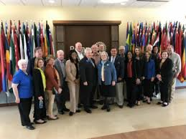
PRIP MARK MALONEY…
…”MEMBERSHIP IS ALL THAT STANDS BETWEEN A ROTARY THAT SERVES AND A ROTARY THAT DISAPPEARS…

Slide 16
How can we
Grow members in
District 6860 in 2019?
ORGANIZED APPROACH:
  Club Membership Committee
  Classification System
  Forming New Clubs and New Rotaract Clubs
MEMBERSHIP RESOURCES…

Slide 17
Consider these IDEAS!!!!
Use the “People of Action” Campaign
Develop a Membership Competition
Meals “pay as you go” or optional
Live stream on Facebook
Have one meeting a month as a social and invite friends/perspective members
Develop a Satellite Club that meets at a different time
Host an Open House
Establish a new member Mentor Program
Give the Membership Satisfaction Survey
Every member has a role
Recognize member achievements

Slide 18
MEMBERSHIP ACTION PLAN????
(What can YOU do?)
  Comments
  and
Questions?

