Slide 1
Rotary District 6860 District Grants
Submitting the
District Grant Final Report
Deadline: May 31st
(Remember…you can’t apply for a new grant until the Final Report
from your previous grant is submitted and approved.)

Slide 2
Rotary District 6860 District Grants
Frequent Final Grant Report Issues
1) Final Grant Report tab is blank – click SAVE button.
2) Current president is not one of the final report signatures.
3) Expenses Tab is missing information.
- Missing grant check/payment images – front & back
- Missing receipts/invoices images
4) Photos/proof of project are missing.
5) Files have weird names that make them unviewable.
6) Currency conversion is missing.

Slide 3
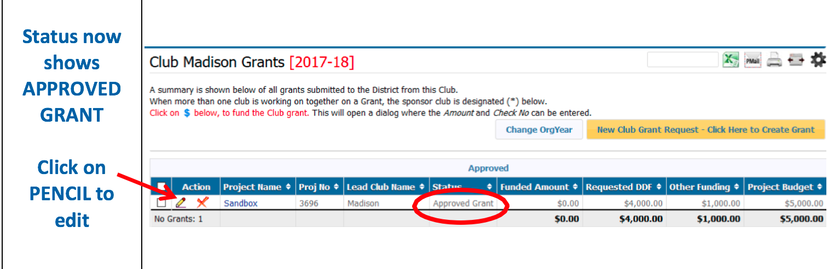
To begin the Final Grant Report process…
Return to your Club Grant in DACdb and click on the Edit pencil to the left of your grant title. Clicking on the grant name will not allow you to edit the grant.

Slide 4
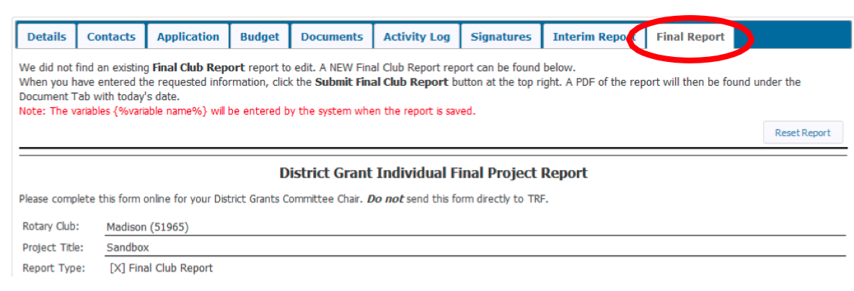
Click on the Final Report tab on the far right.
Address Sections 1 through 6.
Enter accomplishments and results of your project.
Click the SAVE Final Report button as you fill out these sections. If you don’t, everything will disappear when you click out of this tab.

Slide 5
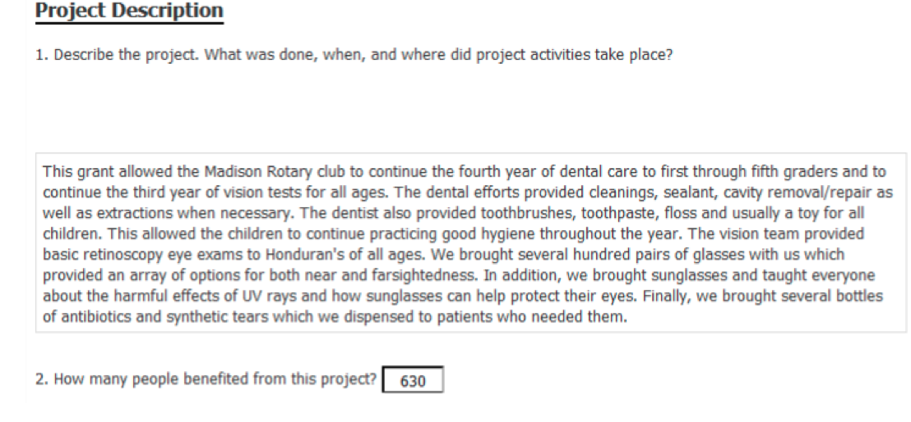
Final Report Tab
Section 1 – Describe the results of the project. (You can copy the Project Description in the DETAILS tab and edit or add results at the end.)
Section 2 – Estimate how many people benefitted from your project.
REMEMBER TO SAVE as you fill in these sections. Your info will disappear if you don’t SAVE.

Slide 6
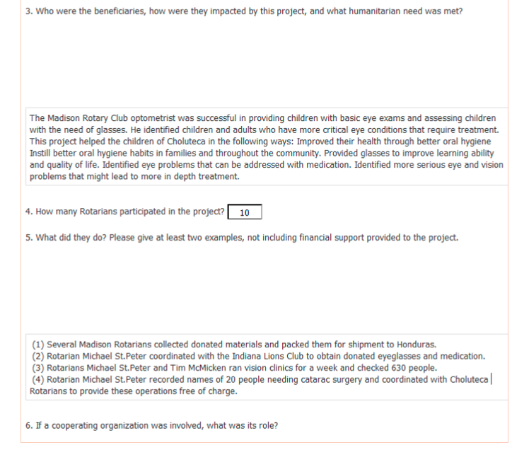
Final Report Tab
Section 3 – Describe the impact of your project.
Section 4 – Fill in how many Rotarians were involved in the project.
Section 5 – What did the Rotarians do for the project.
Section 6 – Fill in if you worked with another organization.
REMEMBER TO SAVE as you fill out these sections in case you need to leave the report. Your info will not stay in this tab if you don’t save.

Slide 7
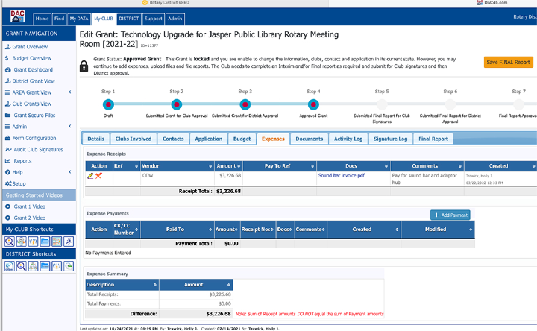
Next, go to the Expenses Tab
This is where you add your invoices, receipts & payments.
First, add the items with the + Add Expense and + Add Payment buttons. Then, use the Edit pencil to click back into the item name to UPLOAD IMAGES of invoices, receipts and cancelled checks – front & back.
Fill out the comments box for clear, more detailed information.
INVOICES/RECEIPTS GO HERE
CANCELLED CHECKS GO HERE
This total should be zero.

Slide 8
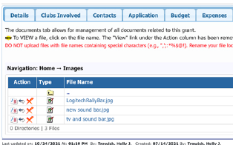
Next, click on Documents Tab
Files uploaded under the Expenses tab will automatically appear in an Expenses folder. Add final photos of project under Images folder. (Click on folder and select Upload File.) Add any other documents under Documents folder. (Click on folder and select Upload File.)
Click HOME to get back to the view with all folders.
DO NOT use odd characters in the names of your files or LOW resolution photos from your cell phone. Make sure you rename scanned images and photos so they have short names without odd characters. Use the A/B button to rename.

Slide 9
Notes on Submitted Documents
PAID invoices, receipts, CANCELLED checks, bank statements, credit card statements, photos and other supporting documents must be captured in high resolution digital form. If you can’t see it clearly, neither can the review team. If you upload a low resolution file, it becomes even smaller.
Included receipts must total up to at least your approved District Grant (DDF) amount. If not, a refund is required from your club.
A currency conversion spreadsheet is required for international projects.
NOTE: You can add documents to the Documents Tab and Expenses Tab at any time during the grant process. You don’t have to wait until you are ready to submit your Final Report.

Slide 10
Completing the Process
When you have finished all steps, click on Save FINAL Report again.
Every time the Save Final Report button is clicked, a PDF file is created and saved in the DOCUMENTS tab. This file is named “FinalReport-<encoded date_time>.pdf”
PLEASE, PLEASE, PLEASE review that pdf to make sure all information has been included and you can see and read the documents and photos you uploaded. If something is missing and we have to unlock the grant, you will have to go through the signature process again.

Slide 11
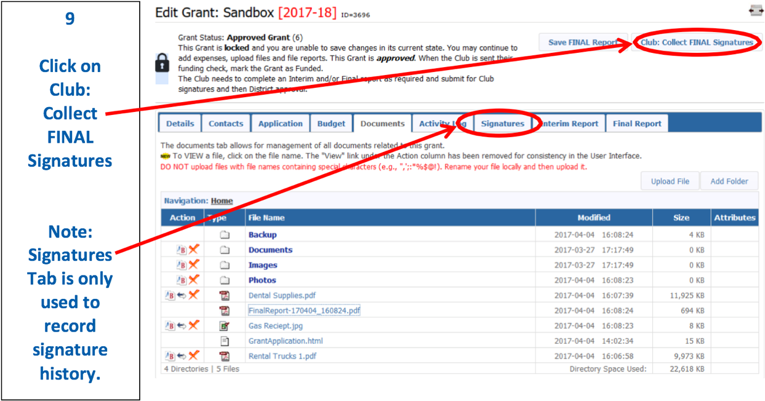
Next step: Click on Club: Collect FINAL Signatures button
An email will be sent to each person in the Club Signatures list.
Two electronic signatures are required - one must be your current Club President. The second signature might be you or someone else designated to sign the grant.
(NOTE: The SIGNATURES tab is only for review of signature history and is filled automatically.)

Slide 12
Club: Collect FINAL Signatures button
Your current Club President and someone else in the
club signatures list must log in to DACdb,
select the GRANTS tab, then Club Grants, then click on the
edit pencil to the left of your Project Name.

Slide 13
Club: Sign Final Report button
Your current Club President and a second person in the Club Signatures list must:
– Click on the Club: Sign Final Report box
– Apply electronic signature (see next slide)
(Check the Signatures tab to verify the signature was recorded.)

Slide 14
Click on SIGN GRANT button to apply your signature.

Slide 15
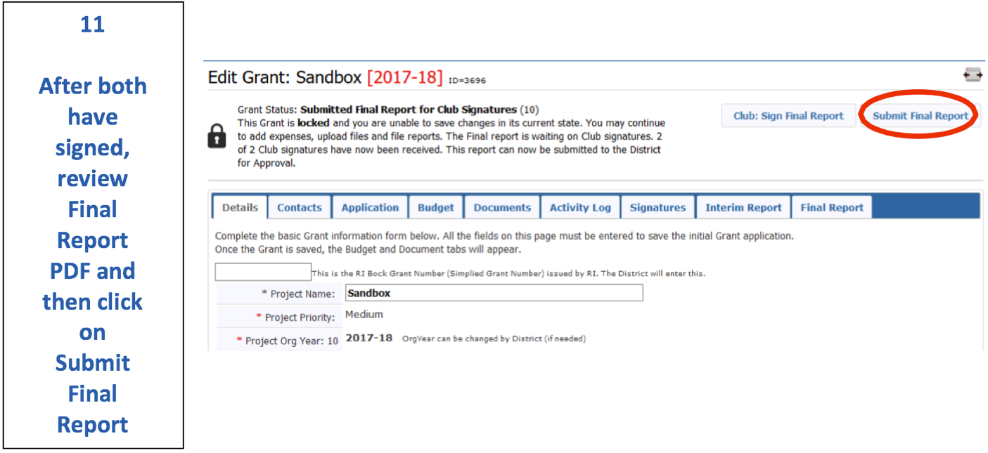
Final Report Submission
After both signatures have been recorded, click on Submit Final Report. NOTE: If you omit this step, your final report will not be submitted.

Slide 16
What Happens Next?
After the Final Report is submitted to the District, the District Grants Subcommittee Team will review the report and associated documents for any issues or concerns.
The District Grant Subcommittee Team will let your grant writer know if the report is missing any information. This review may require modifying the Final Report and/or other supporting information and resubmitting the Final Report.
If a grant has to be unlocked for modification, club signatures must be collected again in order to resubmit.
During the review process, PMails are sent to everyone listed in the CONTACTS tab. Clean up this list! Make sure all of these people want to see review messages.

Slide 17
What Happens Next?
Clubs will be notified when their Final Report is approved. You should receive an email that says your report is Approved. At some point before the new grant period begins, your grant status will be changed to Closed.
If the full amount of a club’s district grant funds were not spent on the club project, arrangements must be made to send the remaining grant funds back to District 6860 to be refunded to TRF.
Congratulations! A completed and closed District Grant is one of the qualifications for your club to apply for future grants.

Slide 18
Rotary District 6860 District Grants
Questions?
Holly Trawick
Grants Subcommittee Chair
htrawick@wcfdn.org – 205-310-3189
Ryan Stallings - DRFC
ryanstallings@alabamaone.org – 205-562-2342

