Slide 1
Rotary District 6860 District Grants
Club Qualification Training

Slide 2
District Grant Qualification Topics
General Overview
Critical Dates
Login to DACdb
Details tab
Contacts tab
Application tab
Budget tab
Documents tab
Signatures
Final Report tab

Slide 3
General Overview
DISTRICT GRANTS: (funded through District Designated Funds or DDF)
Fund small scale, short term activities.
Address needs in your communities or communities abroad.
For international projects, clubs are encouraged, but not
required, to partner with a local/host club.
Clubs have a lot of freedom to customize their service projects. There aren’t many restrictions as long as your grant supports The Rotary Foundation (TRF) and meets the terms and conditions established by TRF for the use of grant funds. It must also support and comply with the District 6860 Policies and Procedures Supplement.

Slide 4
General Overview
District Grants may be used to fund a variety of projects and activities including:
Humanitarian projects – projects in your community or outside your community including service travel and disaster recovery efforts.
Scholarships - any level, length of time, location, or area of study.
Vocational training teams - groups of professionals who travel abroad to teach local professional about a particular field.

Slide 5
General Overview
District Grant Funds CANNOT BE USED TO/FOR:
Purchase land or buildings; EXCEPT - grant funds can be used to renovate structures and build low cost housing (e.g., Habitat for Humanity).
Fundraising activities.
Unrestricted cash donations to a beneficiary or cooperating organization including a 501©(3) or a foundation.
Activities for which the expense has already occurred. We are not allowed to use grant funds to reimburse purchases.

Slide 6
General Overview
Club Qualifications:
TRF requires that clubs must be qualified to apply for grant funding. Clubs must re-qualify each year due to annual club leadership changes.
1) Club must attend a District Club Qualification Grant Training Seminar - primary audience for training is the Club President-Elect and/or any club members who will be responsible for managing the grant.
2) Club must be current on all Rotary International & District 6860 dues.
3) Clubs must be current on all grant reporting requirements.
4) Clubs should be giving to The Rotary Foundation’s (TRF) annual fund. If you are not giving to TRF, why should you receive funds from TRF?

Slide 7
General Overview
Submitting a District Grant Application:
District Grant applications may be submitted by grant qualified clubs only.
District Grant applications are submitted through the DACdb Grant module ONLY.
Project should support the mission of TRF and adhere to the terms and conditions for TRF District Grants.
New District Grant submission window is July 1 – August 1
Clubs may submit multiple grant applications. However, total District Designated Funds (DDF) for all applications must not exceed amount determined for each club.
Clubs may partner on the same project and apply each club’s maximum DDF to the project.

Slide 8
Critical Dates
New District Grant application portal is open from July 1 – August 1
No grant expenses may be incurred before TRF approves the request for funding from District 6860 and your club has received grant funds from District 6860.
Projects should be complete by May 15th
Grant Final Report is due by May 31st
NOTE: If your club has a district grant from the previous year, the final report for that grant must be submitted and approved before you can apply for a new grant.

Slide 9
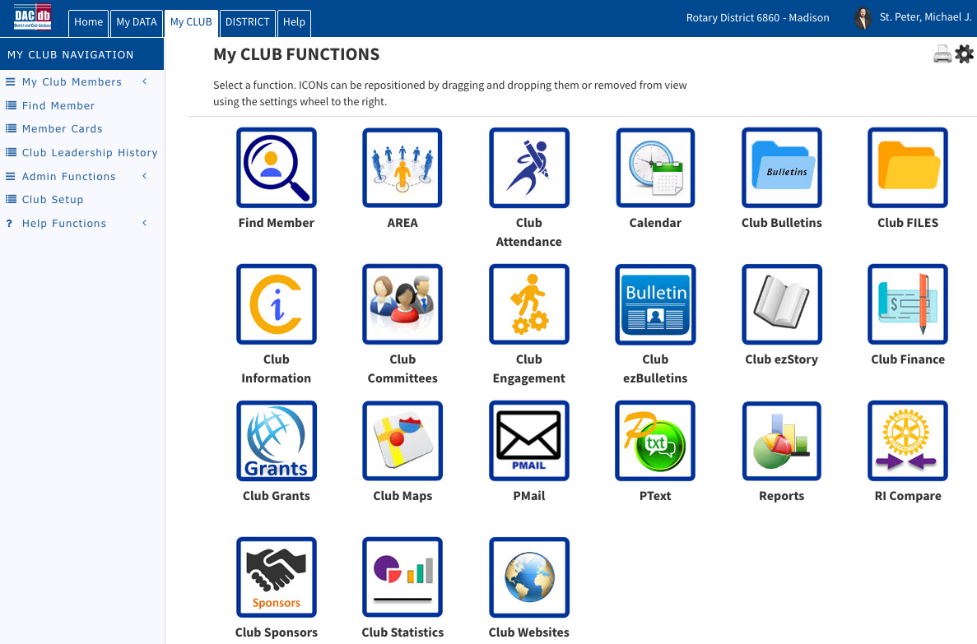
DACdb Interface Overview for District Grant Application
Login to Rotary 6860 (Rotary6860.org) and DACdb (top right).
Click on the My Club tab and select the Club Grants icon

Slide 10
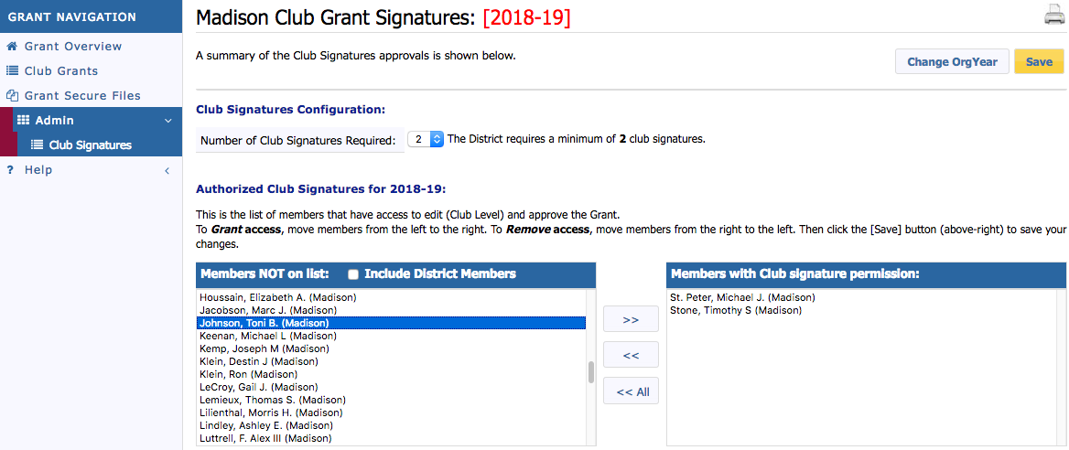
Click Change OrgYear and set the year to the new Rotary Year to identify all club members with grant signature permission for the new Rotary year. Two signatures are required. Recommended signatures include President-Elect (President during grant year), Foundation Chair, and/or anyone who will work on this grant. They will be notified whenever changes are made to the grant application.
Note this date in your grant page headings

Slide 11
Select Admin and then Club Signatures in the Grant Navigation bar.
The person working on the grant must have Level 2 access to use these features. Your club president or club secretary can make that change in DACdb.

Slide 12
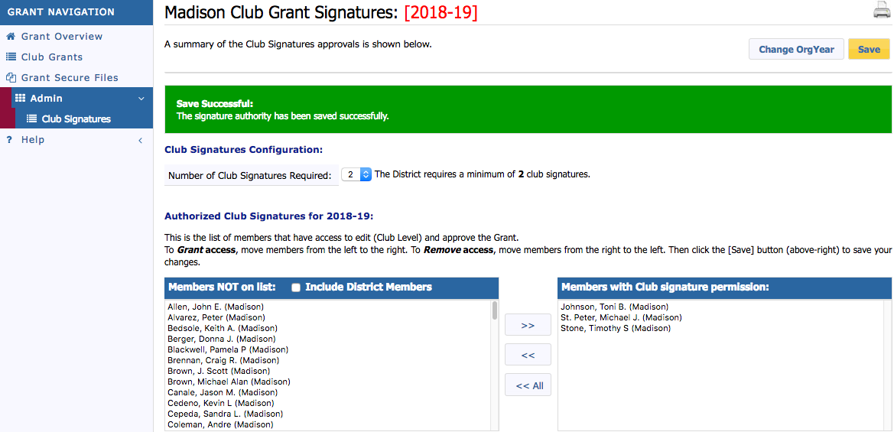
Use the right arrows ( >> ) to move names to the signature list and click SAVE . (Click SAVE after every change!)
This date should now be the new grant year

Slide 13
Select CLUB GRANTS in the Grant Navigation bar.
Double check Org Year. Click on New Club Grant Request.

Slide 14
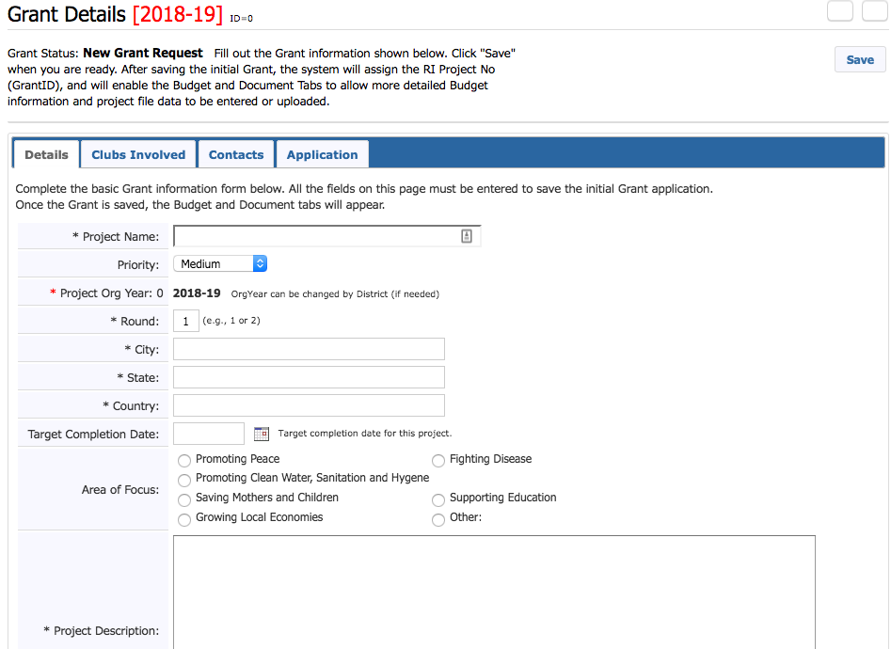
Complete tabs across the top:
Details, Clubs Involved, Contacts, and Application.
This should be ONE or TWO sentences…a quick description of your project. You can add details in the Application portion of the grant request.

Slide 15
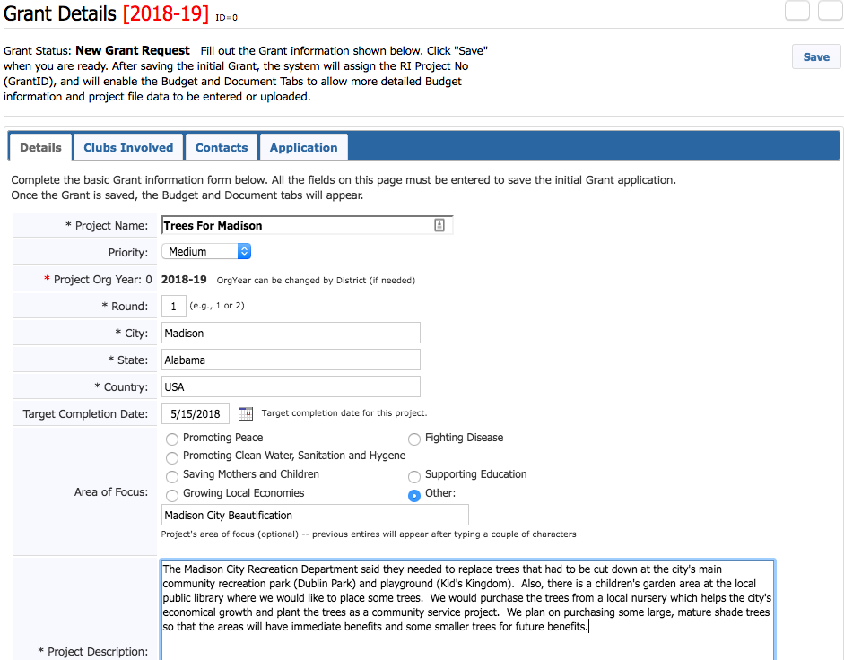
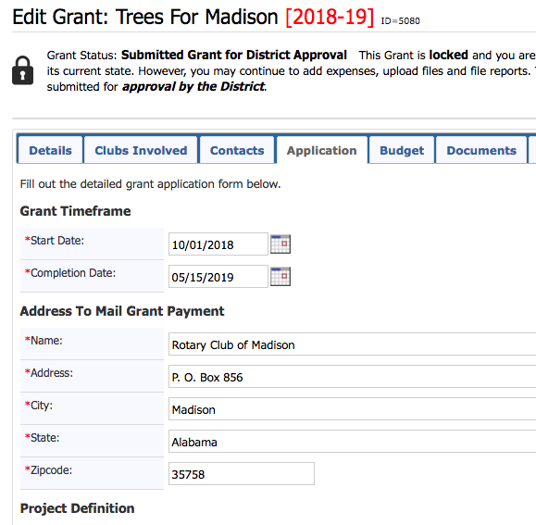
The Target Completion Date on the Details tab must match the Completion Date on the Application tab.

Slide 16
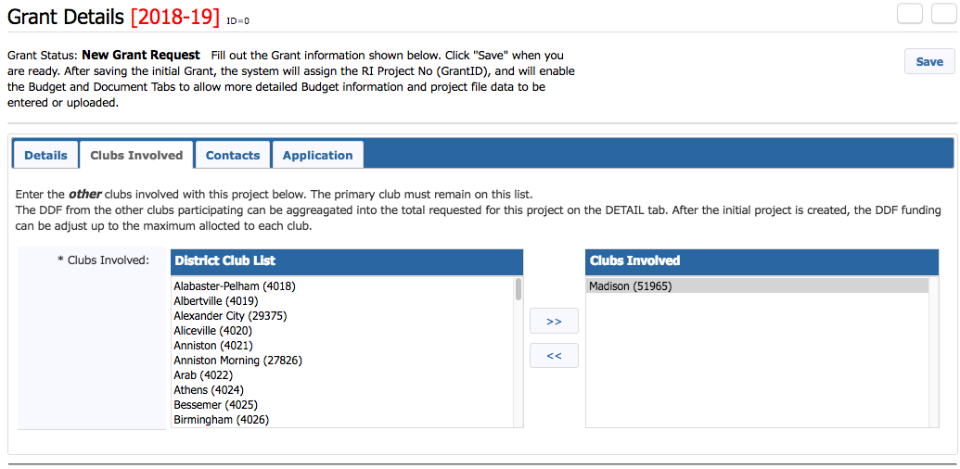
In the Clubs Involved tab identify other clubs, if any, that will partner on the project.

Slide 17
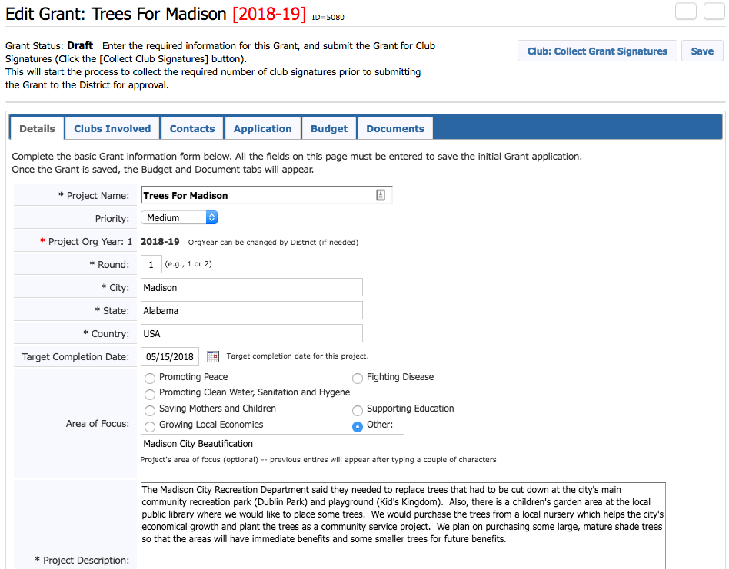
Once you click SAVE, the Budget and Documents tab appear.

Slide 18
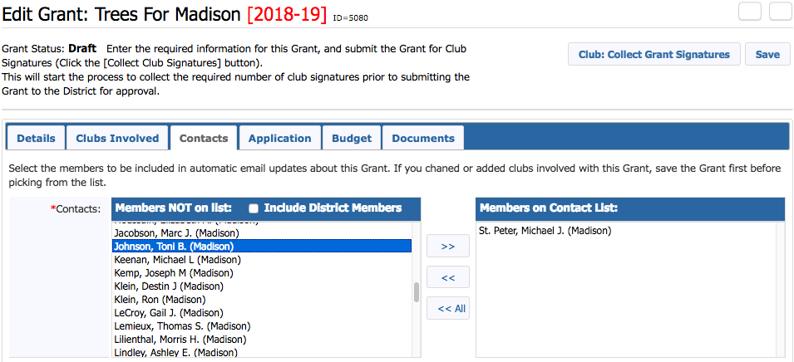
Under the Contacts tab, list only the club members involved in compiling the grant application. They will be notified automatically every time you make a change to the application. Include the individuals involved in the grant and those who will need to sign it at the end (President-Elect & 2nd signature). Click SAVE.

Slide 19
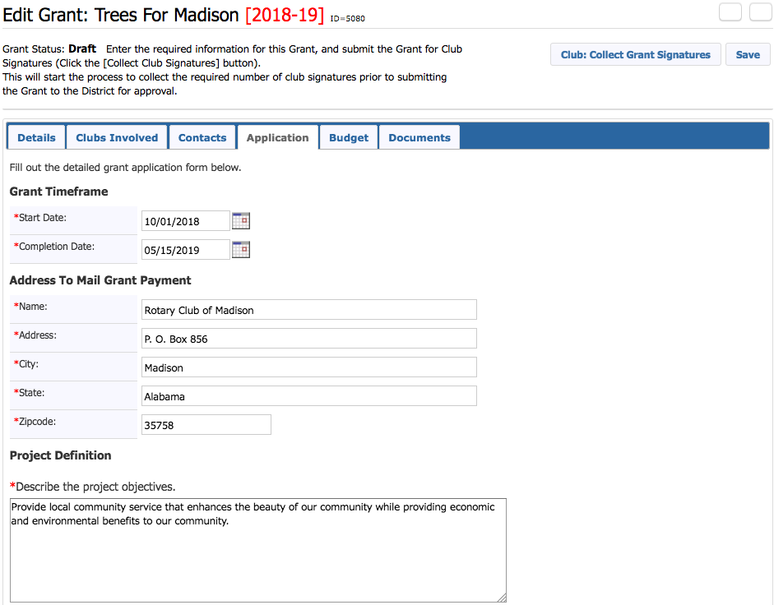
Next - Application tab. Make sure all sections with a red* are filled. Check that Completion Date matches the date under Details tab. Make sure your current club address is listed for the grant payment. Click SAVE often.
Use current Rotary Club address. Grant checks will be sent to this address
Detailed description about your grant request goes here and in the next few sections below.

Slide 20
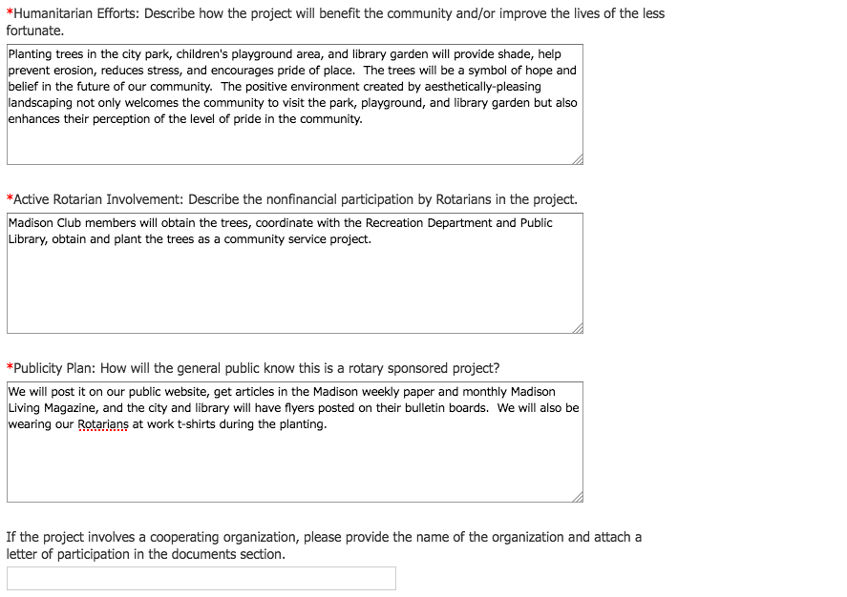
Application tab continues with these sections…
Make sure all sections with a red* are filled. Click SAVE often.
This could be a school, a non-profit, or another organization working with you.

Slide 21
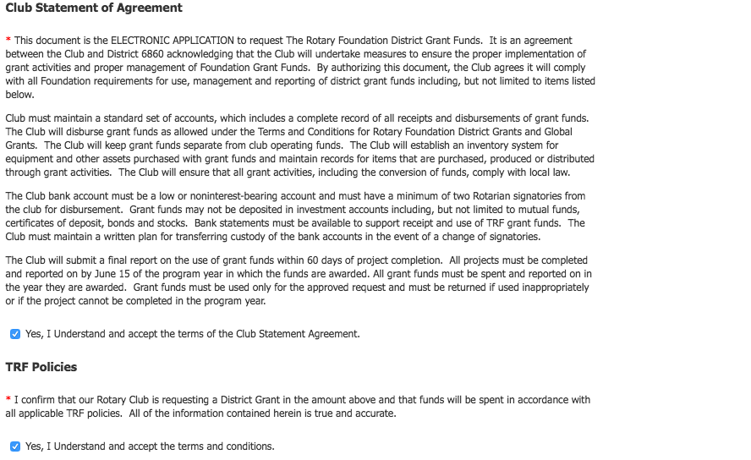
Pay attention to the Club Statement of Agreement and TRF Policies and check the boxes to affirm your understand your club’s obligations. This is your Memorandum of Understanding with Rotary that you will follow the rules regarding grant funds. Click SAVE.
This page replaces the MOU that was formerly required of clubs during grant qualification.

Slide 22
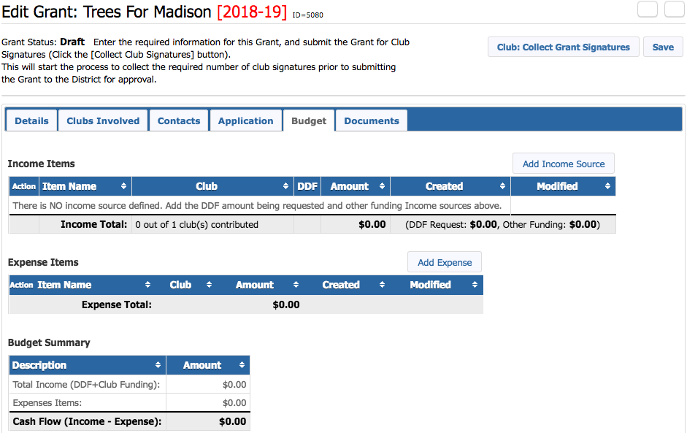
Next, complete the Budget tab. Click Add Income Source to enter income items.

Slide 23
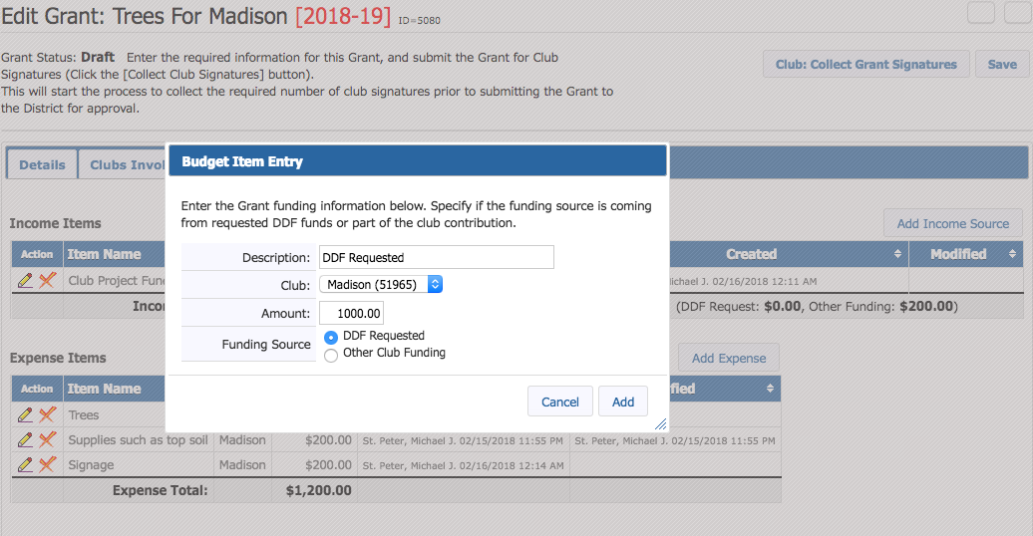
Include the club’s requested DDF on one line. Put additional funds your club may be including on a second line. Click Add for each item.

Slide 24
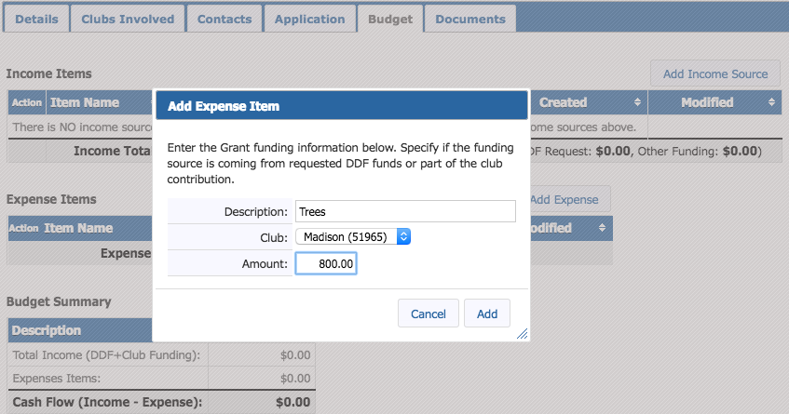
Click Add Expense to identify each estimated expense item. Click Add for each item.

Slide 25
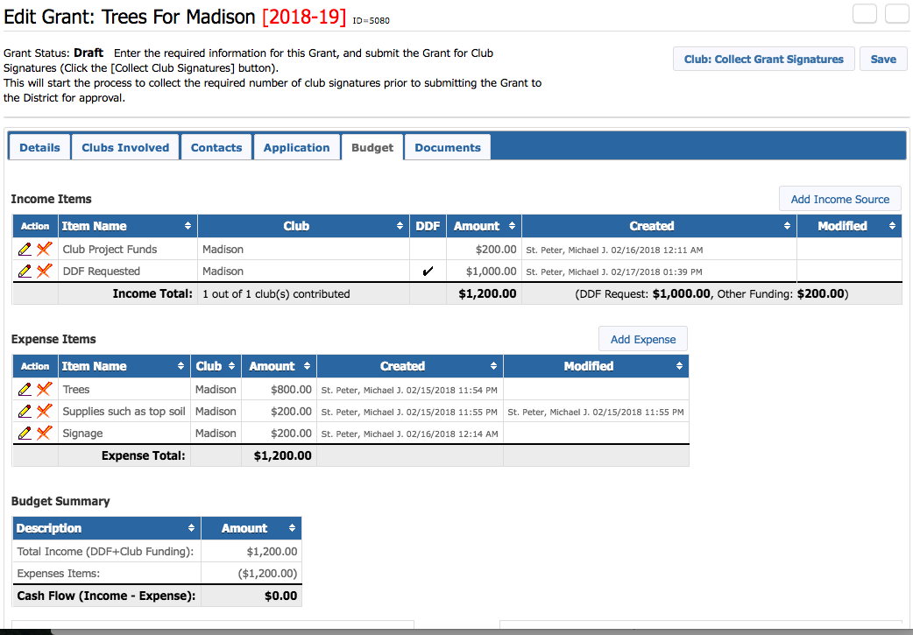
After all Income and Expenses are entered, the Budget Summary must total $0.00. Click SAVE.

Slide 26
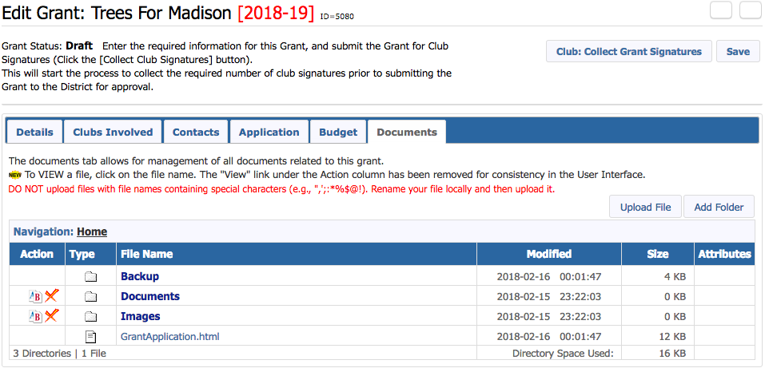
Complete the Documents tab. Upload any letters of commitment, photos of your project area, cost estimates and other relevant documents at this time.
Be careful how you name your documents. NO ODD CHARACTERS LIKE DASHES, COMMAS, ETC. Please rename your photos and scans with short names!
Files types accepted: pdf, jpeg, docx, xlsx files

Slide 27
Once all six tabs are completed and checked,
click on Club: Collect Grant Signatures to begin the signing process.
Remember…Club President for the Grant Year must be one of the two signers!

Slide 28
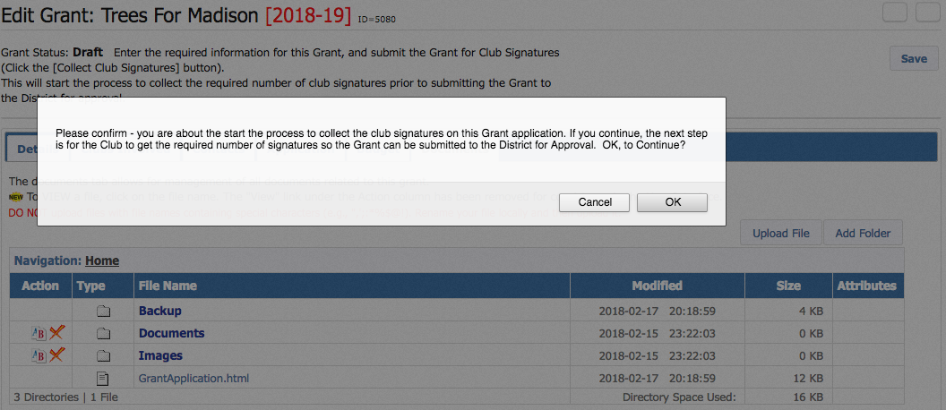
Click OK to confirm you want to start the signing process.
Note: When you click OK to confirm, the grant application will be locked. Don’t panic. If you have a problem, we can unlock the grant for you.

Slide 29
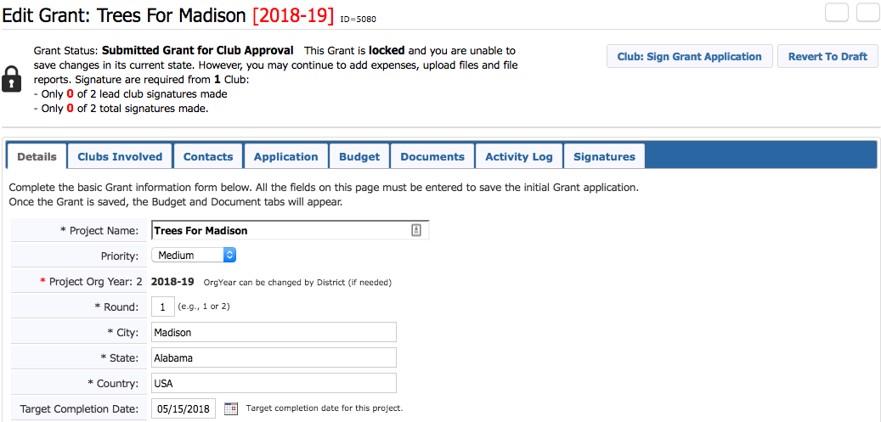
The Club: Sign Grant Application box will appear in the upper right.
Note also that the Activity Log and Signatures tabs will appear.
The Signatures TAB is to review the signature history and will show each signature entered with a date for those signatures. You do not add signatures in this area.

Slide 30
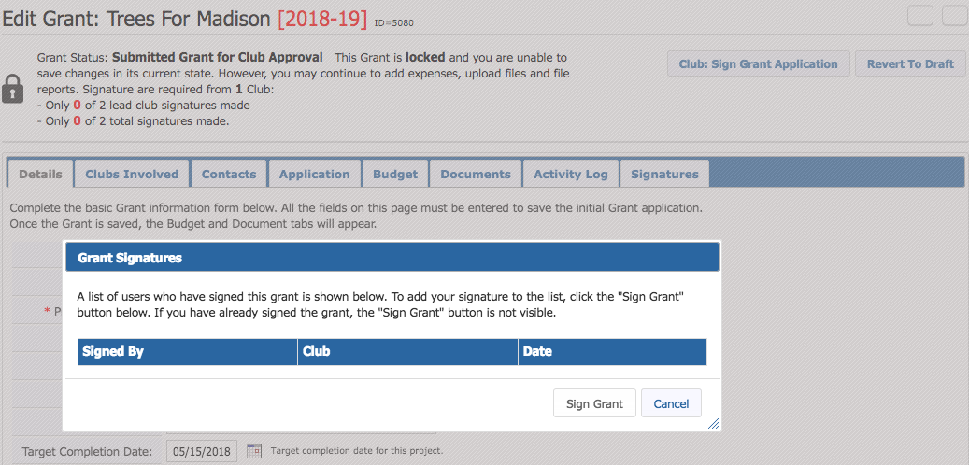
The Grant Signatures box will pop up. Click Sign Grant.
(It is likely you will be one of the required signatures for this grant and you will sign as the first of the two required signatures…shown on next slide.)

Slide 31
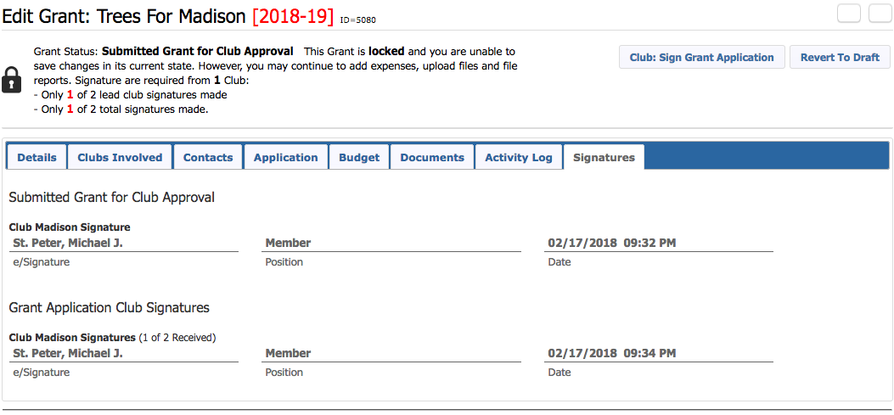
Check the Signatures tab to confirm that the first signature was actually recorded.

Slide 32
The second signer will log in to DACdb,
select the GRANTS tab and click on the EDIT pencil.

Slide 33
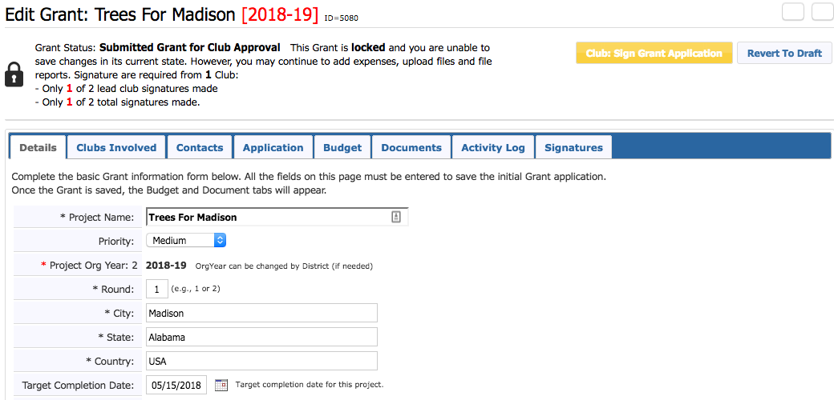
The second signer clicks on Club: Sign Grant Application.

Slide 34
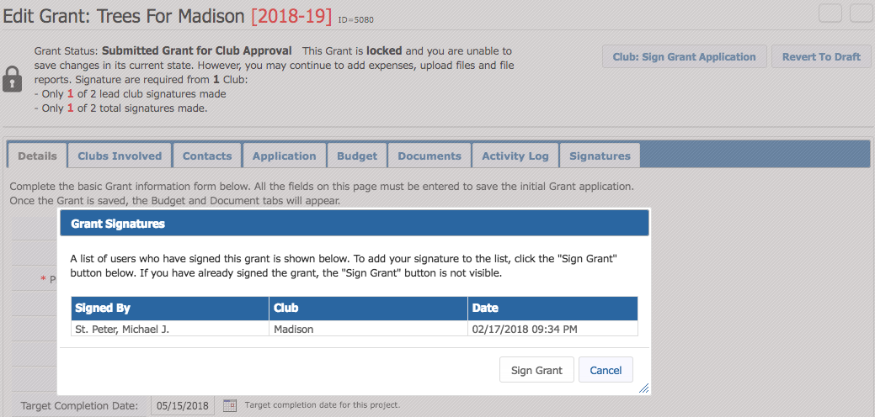
The Grant Signatures box will pop up. Click Sign Grant.

Slide 35
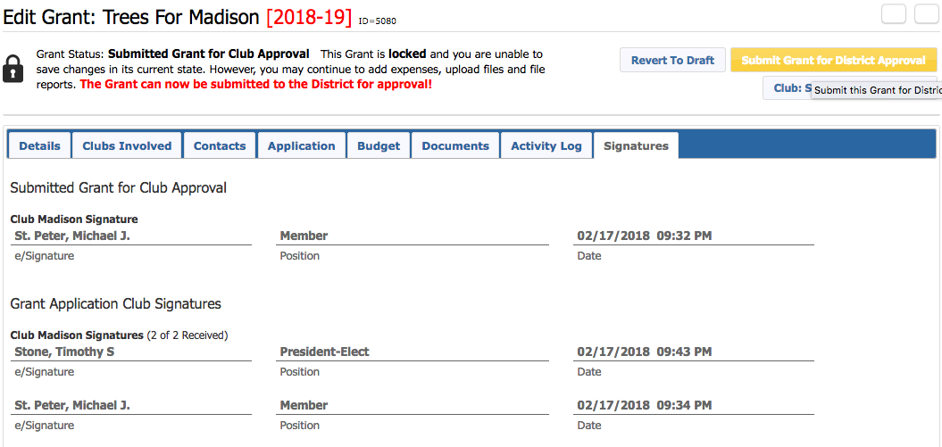
Check the Signatures tab to confirm that the second signature was recorded. At this point, the Submit Grant for District Approval box appears in gold. Click this box.
[2018-19]
07/01/2018

Slide 36
The Grant Application has been sent to the District for review.
The Grant Status should say Submitted Grant for District Approval.
(Once the application has been approved, the Status will change to Approved Grant.)

Slide 37
What Happens Next?
After the Grant Application is submitted, the District Grants Subcommittee will review the application and associated documents for any issues or concerns.
If any changes are needed, the District Grant Subcommittee will contact the signers or the project lead. Changes may require modifying the application and/or other supporting information and resubmitting the application.
If a grant has to be unlocked for modification, Club Signatures must be collected again in order to resubmit the application.
During the review process, PMails are sent to everyone listed in the CONTACTS tab. Make sure all of these people want to see every message during the review.

Slide 38
What Happens Next?
Clubs will be notified by when their application is approved. However, grant funds will not be sent to clubs until all grants are approved by TRF via the District Block Grant.
TRF approves and sends funds for the Block Grant to District 6860 and the District Treasurer will mail checks to each club.
NOTE: Clubs may not incur grant expenses dated before the TRF approval date.
Clubs execute their projects. Clubs submit Final Reports by June 15th.
Note: A currency conversion spreadsheet is required for international projects.
An Approved Final Report closes your district grant.

Slide 39
Questions?
Please ask questions as you work through this grant process. It is easier to ask lots of questions before you submit your grant than to have to unlock it at the end for additional information or changes.
Holly Trawick – Grants Committee Chair
htrawick@wcfdn.org – 205-310-3189
Ryan Stallings – District Rotary Foundation Chair
ryan.stallings@smartbank.com – 205-562-2342

