Slide 1





Ryan Stallings
DRFC 6860
Global Grants Chairman 6860 ryanstallings@alabamaone.org 205-239-9812
District 6860 Global Grants Training
TITLE
Presentation Credits: Jim Roxlo, 6780 jim@roxlo.com

Slide 2
What does it take to make
a Global Grant become reality?

Slide 3
Defining and Designing your Project

Slide 4



We often start here:
My club wants a Global Grant but we don’t know where to start!

Slide 5



Then we look at the Application!
Focus Area Sustainability Stewardship Needs assessment Partners Beneficiaries Funding
Too many tabs!
So many questions!
Too Complicated!

Slide 6
Projects to join
Join another club that is developing a Global Grant project
Find a club overseas with a project that needs an International Partner with money
Help fund Global Grants that have been developed by
others. For example: Heart 2 Heart
References: http://heart2heartprojects.org/ www.matchinggrants.org http://ideas.rotary.org/Project/Find

Slide 7
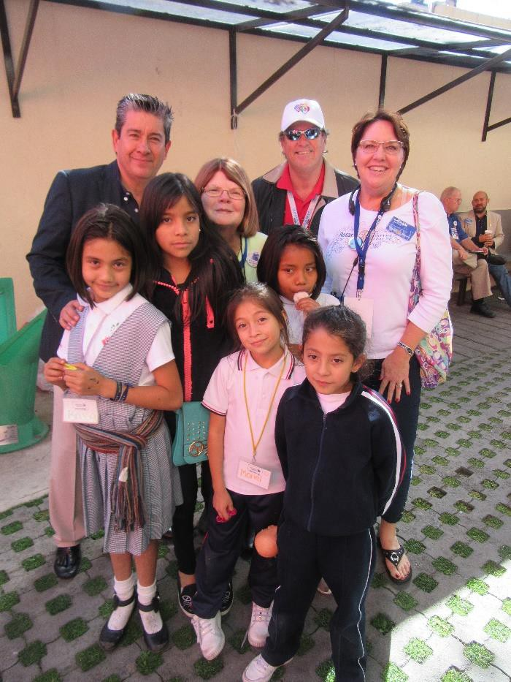
Example of a Project to join: Heart 2 Heart
D4170 (Mexico City) and Zones 30-31
14-year growing relationship
8-10 Global Grants per year
$1MM per year total project cost
Annual pilgrimage in November

Slide 8




Some of us are now here
That’s all nice but we want to have our own project!

Slide 9
Suggestions to begin the process
Principle 1: Find a team of people in your club who are passionate about doing International service.
Principle 2: Find a project that all of you can get excited about.
Principle 3: Don’t start the application until you know
what you want to do!
Principle 4: Be thinking about fundraising projects and other ways to fund the grant.

Slide 10
Team Expectations :
Be persistent
Make multiple contacts with your Host Sponsor
Find a way to do a Needs Assessment in country
Contact the RI staff member in charge of grants in that country
Spend hours writing the grant application
Be disappointed when the grant comes back to you for revision
Be diligent with respect to the grant funds
Be overwhelmed with awe when you see the results

Slide 11
Important!!
Don’t let the funding define your project
Find a good project and then get the funding
We need big projects to be successful
Bigger projects are easier to fund

Slide 12
Develop your own project
Where
Who
What
Area of Focus
Goals
Short summary

Slide 13
Where is your project?
Do you have a traveler?
  Someone who frequently visits another country
  Has time to visit potential project areas
  Can visit Rotary clubs
Can you travel with others?
  Churches
  Non-Profit organizations
  Other Rotary clubs
  Use a Group Study Exchange
  All of this travel can be paid by your District Grant

Slide 14
Find a Host Sponsor
Determine what club (the country from which you wish to complete the grant) will be best to partner with:
Active and experienced in Grants
Willing to work with your club
Accepting a balanced relationship
Are District and Club Grant qualified
Build a personal relationship from the beginning

Slide 15
Find potential project areas
Check RI for other projects in country
Ask local officials if they have a needs assessment
Do the clubs have ideas?
Is there a specific population in need?
Are there local community health committees?

Slide 16
Determine beneficiaries
Beneficiaries are people, not organizations
Can you count them?
What do they need the most?

Slide 17
Perform a Community Assessment
Work with the local club
Involve community health groups and governments
Consider both assets and needs of the community
Select a project
  Near the top of the needs list
  Time and scope of work interesting to the clubs
  Do you need special expertise?
  Relevant examples of success
  Aligned with one of the seven Areas of Focus
Community assessment can be covered by District Grant
Reference:
Needs Assessment Form

Slide 18
Areas of Focus and Goals
Areas of Focus are focused by the trustees
It’s best to have only one Area of Focus
Review Areas of Focus Policy Statements for alignment with your project
Pick specific goals that align with your project
Reference: Areas of Focus Policy Statements

Slide 19
Rotary International’s Seven Areas of Focus
Peace and conflict prevention/resolution
Disease prevention and treatment
Water and sanitation
Maternal and child health
Basic education and literacy
Economic and community development
Protecting the Environment

Slide 20
Example: Policy – Water and Sanitation
Area of Focus Statement of Purpose and Goals
TRF enables Rotarians to ensure communities’ sustainable access to water, sanitation, and
hygiene by:
Facilitating universal and equitable access to safe and affordable drinking water
Improving water quality by protecting and maintaining surface- and groundwater resources, reducing pollution and contaminants, and promoting wastewater reuse
Facilitating universal and equitable access to improved sanitation and waste
management services in order to achieve open defecation-free communities
Improving community hygiene knowledge, behaviors, and practices that help prevent the spread of disease
Strengthening the capacity of governments, institutions, and communities to develop,
finance, manage, and maintain sustainable water and sanitation services

Slide 21
Steps of the Process
You can take these steps in any order
Location
Partner
Beneficiaries and Needs
Project Selection
Area of Focus and Goals
Review these steps as you go
Review them again when you have them all in place

Slide 22
Define your Project – Example
Combine the work so far into a 2-sentence summary
Example:
“The Rotary clubs of Cleveland, TN, USA and LaPaz, Honduras will partner to provide potable water to the high school and surrounding community in Lejamani, Honduras. By providing a bore hole well, pump and water tank on the school property; plus hygiene training, they will serve about 4000 people who do not have access to potable water.”

Slide 23
Defining your Project Exercise
What’s your dream project?
Write a summary statement.
Include all 5 steps; make up the parts you don’t
know yet.

Slide 24
Completing a Global Grant Application

Slide 25


Can be Overwhelming at first
Talk to the Grants Staff member for the country of your project
Oh, no!
So much information I need to know!
References:
Grants Staff Contacts

Slide 26
Global Grant Application Template
Start with the on-line template, not the Grant Module
Editable Word document
Easy to share and collaborate
When you have good alignment with your partners and most of the fields are complete, you can transfer to the Grant Module
References:
Global Grant Application Template

Slide 27
Global Grant Application Tabs / Steps
Basic Information 7. Participants
Committee Members
Budget
Funding
Sustainability
Review and Lock
Authorizations
Project Overview
Areas of Focus
Measuring Success
Location and Dates

Slide 28
Do the easy items first
Delete fields you don’t need for a Humanitarian grant
All fields related to VTT ( in Steps 6, 7, 10)
All fields related to Scholarships (in Steps 6, 7, 10)
Fill in the fields you can do now
Most of steps 1, 3, 4, 5 and 6

Slide 29
Identify the Team Members
Step 2 Committee Members
Committee members for host club (in the country where the project will be
implemented)
Committee members for international club (in another country; only one international club allowed)
Step 7 Participants
Cooperating Organizations (usually needed for technical expertise) MOU required.
Other Partners (other Rotary groups or individuals who will work on the project, usually not needed)
Volunteer travelers (specialists, not typical Rotarians doing project oversight,
usually not needed)

Slide 30
Memorandum of Understanding
Step 7 Participants
Must have an MOU signed by the Host Sponsor, International Sponsor
and the Cooperating Organization if there is one or two.
The MOU designates the responsibilities of : The Host Sponsor
The International Sponsor The Cooperating Organization

Slide 31
Host Sponsor’s Responsibilities
Provide technical and professional services in support of the Rotary Grant
project
Provide volunteer training, mentoring, and financial review
Direct and coordinate local community education and public relations
Seek community support and resources for the project
Host visiting Rotarians who come to support or learn about the Rotary Grant project
Manage the grant funds and pay suppliers, vendors, or contractors
Prepare Rotary Grant project reports, in cooperation with the International
Sponsor
Measure and evaluate project activities

Slide 32
International Sponsor’s Responsibilities
Direct and coordinate community education and public relations
Direct and coordinate International fundraising efforts
Travel to the project location to provide technical or professional service
Maintain the master schedule of events
Contact the Host partner and (optional) cooperating organization at least monthly to discuss progress and milestones
Assist the Host Sponsor in implementing and reporting on the Rotary grant
project and ensure progress reports are timely
Issue monthly reports to leaders of both clubs and districts, plus key people in the relationship. Include a summary of contacts, milestones and accomplishments.

Slide 33
Cooperating Organization’s Responsibilities
Provide expertise, infrastructure, advocacy, training, education, or other support for the Rotary Grant project
Submit itemized expense statements and receipts to the Host Sponsor or
International Sponsor for reimbursement
Maintain sufficient records and data to complete reports to the Rotary Foundation
Report activities and results to the Host Sponsor and International Sponsor
accurately and in a timely way
Measure and evaluate project activities
Continue to support the project financially or programmatically after Rotary Grant funding ends

Slide 34
Conflict of Interest
Step 2 - See COI definition
Does your club have potential conflicts of interest?
How do you identify them?
How do you control them?
Does your partner club have potential conflicts of interest?

Slide 35
Project Plan
Develop an overall project plan with all the steps you know now. It will be used several places.
This plan is an important document. Identify all the steps you will need to make your project a success.
What elements need to be included?

Slide 36
Sustainability
Step 10 Sustainability
Start with the community assessment
Respect natural resources
Train the beneficiaries
Use local labor
Buy locally
Establish a maintenance plan
Train a monitoring group or person
Reference: Six Steps to Sustainability

Slide 37
Stewardship
Who is responsible for project funds and successful project completion?
How do you exercise responsibility?

Slide 38
Contingency Planning: Questions to ask
This is a critical part of Stewardship
What do you do if you have a financial overrun? How could it happen?
What do you do if you have reporting issues?
What do you do if you have a communication problem?

Slide 39
Monitoring, Evaluating, and Reporting
A critical part of Stewardship
How will you monitor the project?
- Observations, verbal reports, data?
How do you evaluate what you know?
Who will do the reporting? Best Practice:
Link reporting to events, not the calendar.

Slide 40
Measuring Success
Step 5 Measuring Success
Review standard measures in the Monitoring and Evaluation Plan
Supplement
Select standard measures
Consider whether you should add measures based on sustainability and contingency planning
Reference: Global Grant Monitoring and Evaluation Plan Supplement

Slide 41
Budget
Step 8 Budget
Expense Categories:
  Accommodations
  Equipment
  Monitoring and Evaluation
  Operations
  Personnel
  Project Management
Publicity
Signage
Supplies
Training
Travel
Tuition

Slide 42
Funding
Step 9 Funding
Do you have sufficient funding for the project?
Does your District have as many global grants as it wants?
Does your District have funds available for more Global Grants?
Where can you get additional funding?
Work with your District leaders to get the funding you need

Slide 43
Matching Funds

Slide 44
Funding Example from District 6860
Admin Fee | 5%
DDF Contribution | 400%
World Fund Contribution | 80%
Club Contribution | Admin Fee | DDF Contribution | World Fund DDF Match | Grant Value
$ 3,713.53 | $ 185.68 | $ 14,854.11 | $ 11,883.29 | $ 30,265.25
$ 5,000.00 | $ 250.00 | $ 20,000.00 | $ 16,000.00 | $ 40,750.00
$10,000.00 | $ 500.00 | $ 40,000.00 | $ 32,000.00 | $ 81,500.00

Slide 45
Resource: Appendix “E” – District 6860 Leadership Plan
Please see appendix “E” in the District Leadership Plan for the district’s requirements for Global Grants.
  This document outlines the procedures that District 6860 will undertake to comply with requirements specified by The Rotary Foundation in the District Memorandum of Understanding. Additionally this document outlines the steps that the clubs of district 6860 will undertake to
comply with district 6860 requirements as outlined in the Club Memorandum of Understanding (Club MOU).
Includes global grant matching funds chart
Includes instructions for requesting DDF from District 6860
  ****Prior to receiving DDF funding approval, the club must submit a formal written
request to the DRFC and the District Governor.
District Leadership Plan - Appendix "E"

Slide 46
Approval Steps
The two primary contacts (see Tab 1) review and approve and then the application is LOCKED (Tab 11)
All contributing Districts approve the DDF. (DG and DRFC in Tab 12)
The lead Districts DRFCs approve the grant for TRF compliance (Tab 12)
The application is SUBMITTED.
Partners sign to confirm acceptance of responsibility.
The application is reviewed, maybe revised, and APPROVED.
Partners set up banking instructions.
TRF transfers funds to the project bank account.
Reference:
Global Grant Lifecycle

Slide 47
Resources
Grant Center Resources

Slide 48

District 6860 Rotary Foundation Team
Ryan Stallings | DRFC Global Grants Chairman 6860 | ryan.stallings@smartbank.com
Holly Trawick | Grants Subcommittee Chair 6860 | htrawick@wcfdn.org

