Slide 1
Rotary Club of Tullahoma
Memorial Service
May 27, 2016
Reverend Don Dixon/Reverend Paul Purdue

Slide 2
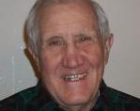
Coach Milner Carden
Passed Dec. 10, 2015 from health complications due to multiple myeloma
Middle Tennessee State University graduate
U. S. Navy Veteran
Coached in the Tullahoma School System
Paul Harris Fellow
Wife-Martha

Slide 3
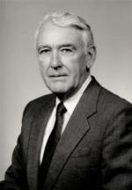
Lt. Col. John Stubbs USAF (Ret.)
Passed November 17, 2015 at Harton
Air Force Institute of Technology graduate
U. S. Air Force Veteran-760 Combat Flying Hours
Supported AEDC
Past President-Sunrise Rotary
Paul Harris Fellow
Wife Betty also passed soon after her husband’s passing

Slide 4
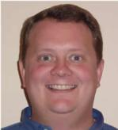
Michael TeVrucht
Passed August 7, 2015 from pancreatic cancer
Middle Tennessee State University graduate
Senior Vice President and Chief Credit Officer American City Bank
Farmer
Paul Harris Fellow
Wife-Brooke

