Slide 1

POSITIVE PEACE
AND ROTARY
Fairfield Glade
Rotary Club
November 24, 2020
Jim Roxlo
Positive Peace Activator
Notes:
Partnership.

Slide 2

What is Peace?
Notes:
Insert Poll#1: Do you understand Positive Peace? Single Choice – a) I forgot anything I ever knew about it. b) I know enough to be dangerous.

Slide 3


“Imagine all the people living life in peace. You may say that I'm a dreamer, but I'm not the only one. I hope someday you'll join us and the world will be as one.” —John Lennon
“Peace is not merely the absence of visible conflict. Only a just peace based on the inherent rights and dignity of every individual can truly be lasting.” - Barack Obama
“But while we all pray for peace, we do not always, as free citizens, support the policies that make for peace or reject those which do not. We want our own kind of peace, brought about in our own way.” - Lester B. Pearson
“It isn’t enough to talk about peace. One must believe in it. And it isn’t enough to believe in it. One must work at it.” —Eleanor Roosevelt

Slide 4

Rotary’s history of peace building
1921
Rotary convention Edinburgh – 4th Object of Rotary “Peace & World Understanding”
1949
45 Rotarians at UN Charter in San Francisco + Rotary one of 42 observer organizations
1999
Rotary Peace Centers and Peace Fellows
1942
2017
2020
UNESCO conference organized in London by Rotary Clubs of 21 countries.
Partnership – Institute for Economics & Peace
Positive Peace Activators

Slide 5
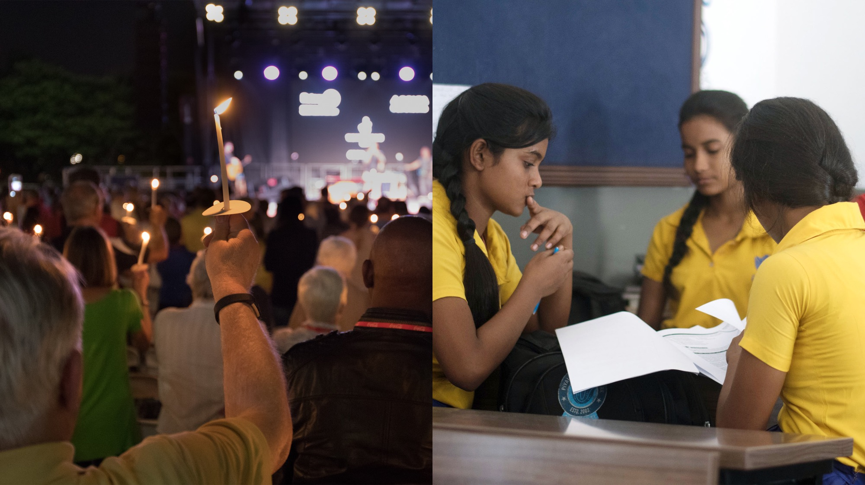
NEGATIVE PEACE
Absence of direct violence. Absence of fear of violence.
POSITIVE PEACE
Attitudes, institutions, and structures that sustain peace.
GLOBAL PEACE INDEX
POSITIVE PEACE INDEX
Notes:
Talk about negative peace Example: South Sudan peace agreement
Talk about positive peace Example: education, job opportunities for all.

Slide 6
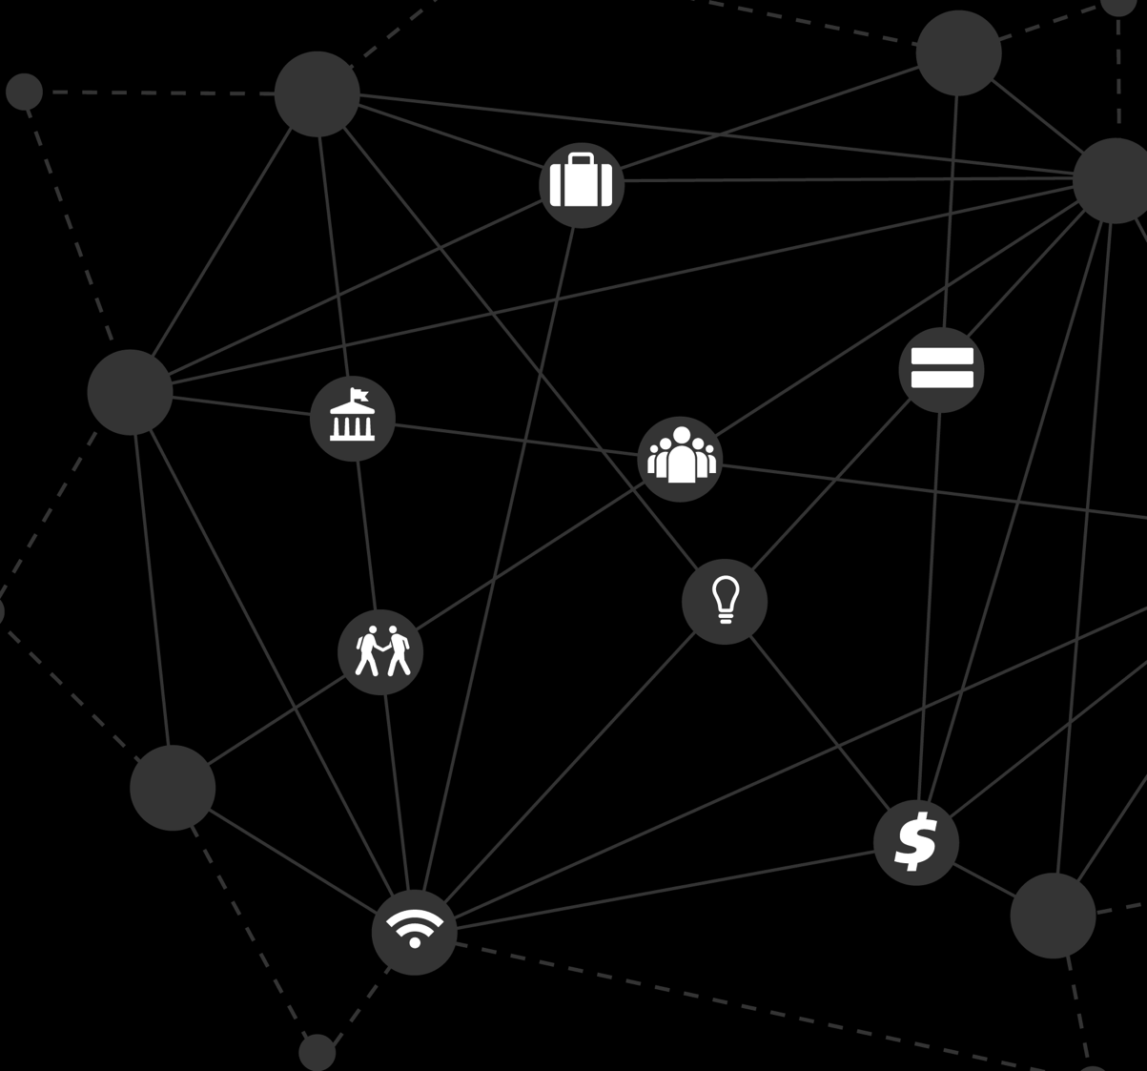
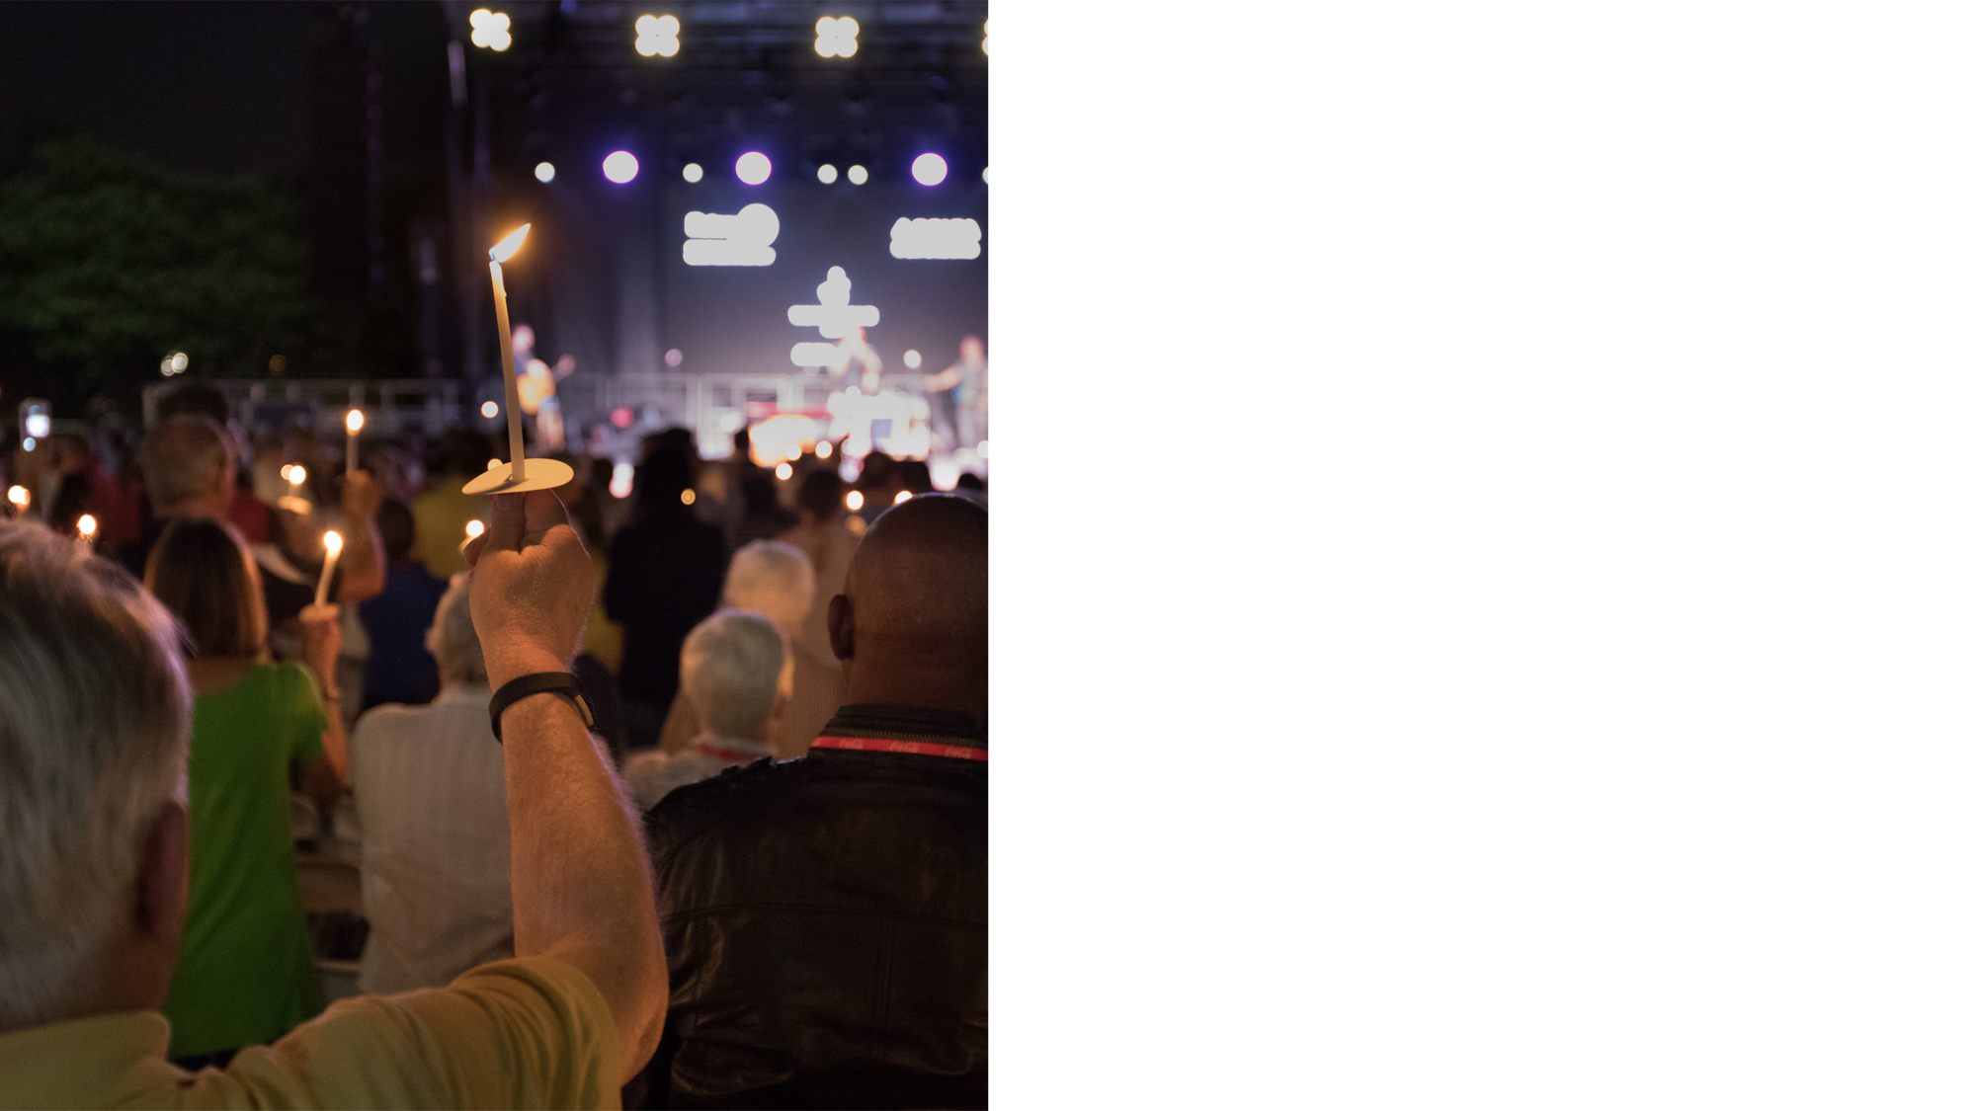
NEGATIVE PEACE
The absence of violence, or fear of violence. It is used as the definition of peace to create the Global Peace Index —the world’s leading measure of national peacefulness.

Slide 7
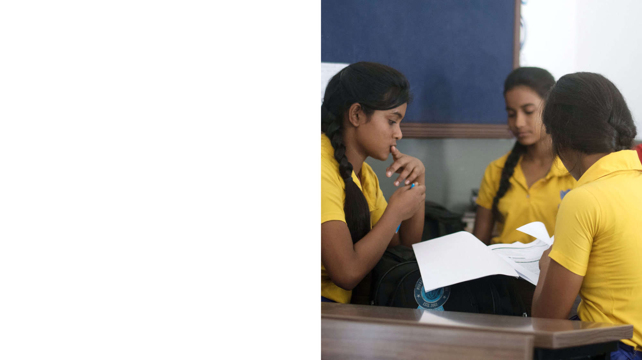

POSITIVE PEACE
The attitudes, institutions, & structures that, when strengthened, lead to a more peaceful society. These are used to develop the Positive Peace Index.
Notes:
It is not only associated with higher levels of peace, it is also associated with stronger macroeconomic performance, as the factors that sustain highly peaceful societies also provide a framework for robust economic development.

Slide 8

What the Research Tells Us
Positive Peace creates the optimal environment for human potential to flourish.
High Positive Peace systems are more likely to maintain stability and recover from shocks.
High Positive Peace is statistically linked to better environmental and economic outcomes.
The most peaceful systems perform strongly on all eight Pillars of Positive Peace.

Slide 9
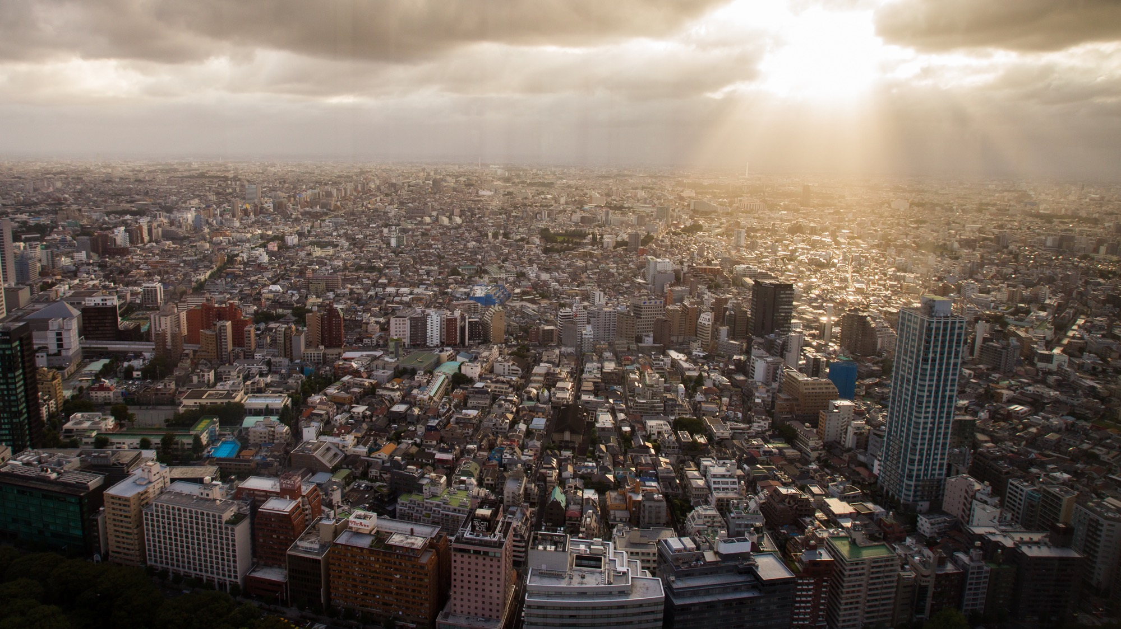
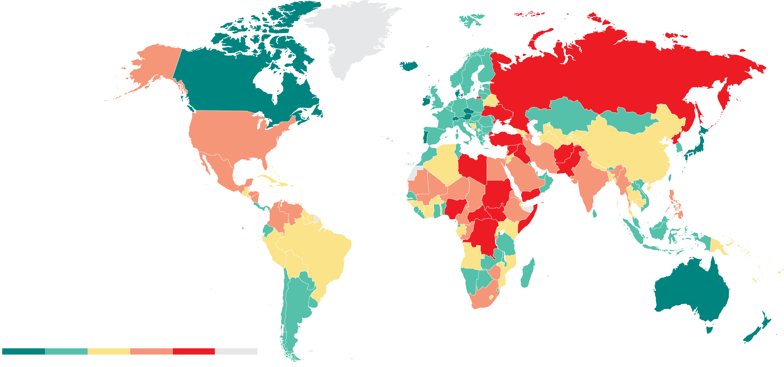
Notes:
The twelfth edition of the GPI finds that overall global levels of peace continue to deteriorate while the gap between the most and least peaceful countries continues to widen.

Slide 10
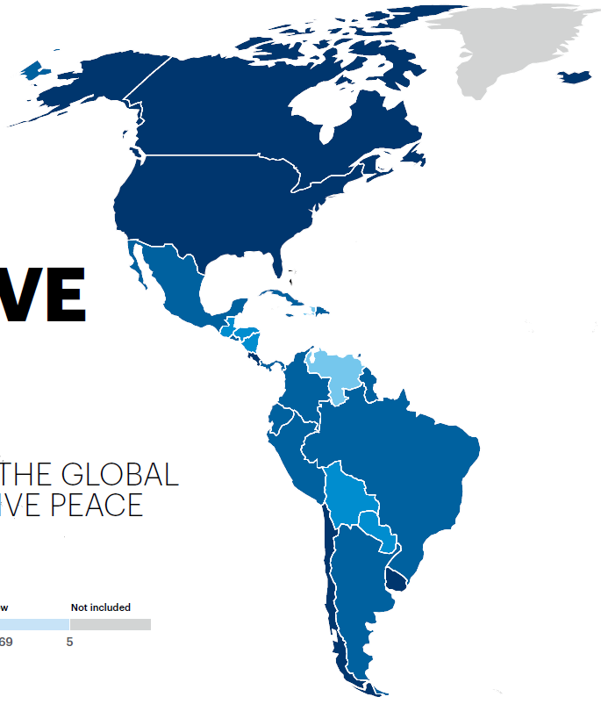
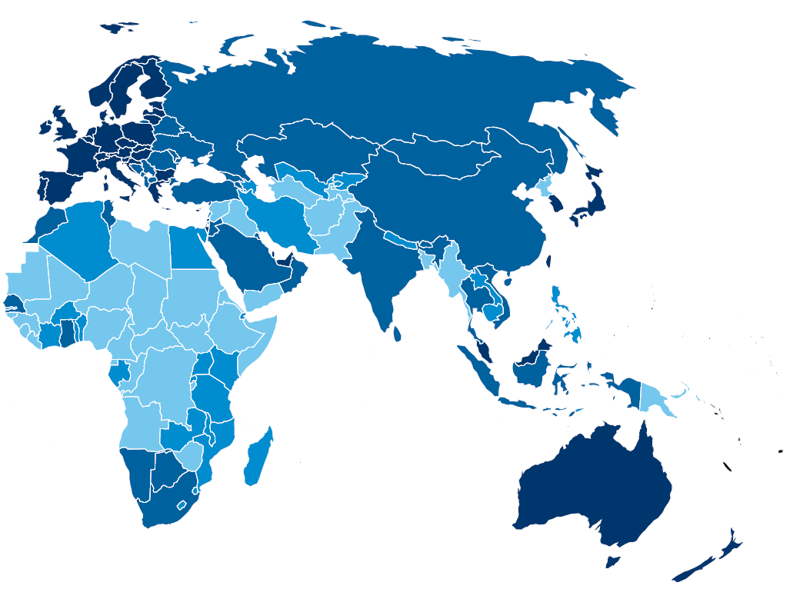
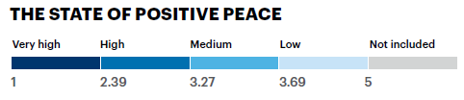
2019 Positive Peace Index

Slide 11
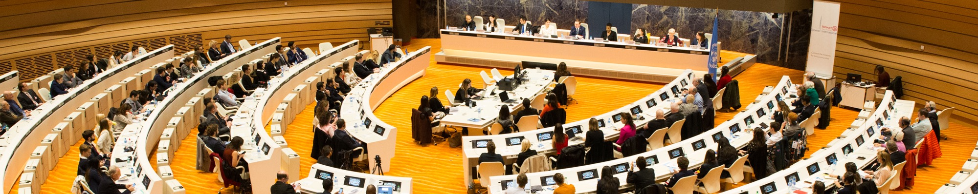


ROTARY AREAS OF FOCUS
PILLARS OF POSITIVE PEACE
Providing clean water, sanitation, and hygiene
Well-functioning
government
Sound business
environment
Equitable
distribution
of resources
Acceptance of the
rights of others
Promoting peace
Fighting disease
Saving mothers & children
Supporting education
Growing local economies
Good relations
with neighbors
Free flow of
information
High levels of
human capital
Low levels
of corruption
Notes:
Rotary areas of focus:
Peace and conflict prevention/resolution (dove)
Disease prevention and treatment (stethoscope)
Water and sanitation (water)
Maternal and child health (mother/baby)
Basic education and literacy (book)
Economic and community development (coins)
Positive Peace Pillars:
Well functioning government (institution)
Sound business environment (briefcase)
Equitable distribution of resources (equals sign)
Acceptance of the rights of others (people)
Good relations with neighbors (chat cloud)
Free flow of information (wifi symbol)
High levels of human capital (lightbulb)
Low levels of corruption (money sign)

Slide 12


Where are you now?
Is this a lot of work?
Where do we start?
Notes:
Insert poll #2: Which of these Rotarians is like you? A) This is interesting but sounds like work. B) This sounds interesting. What can we do with it?

Slide 13
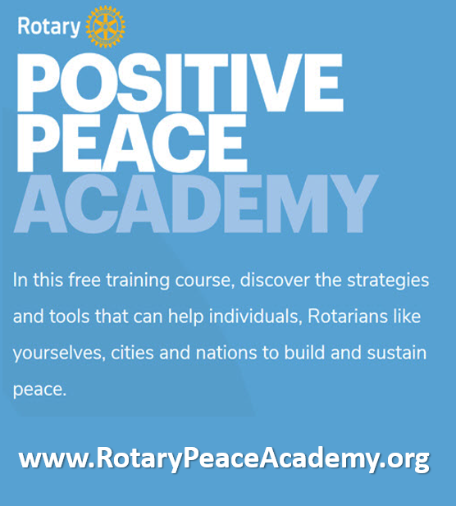
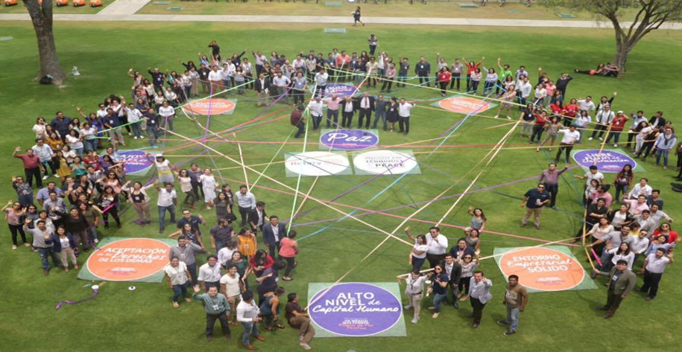
Step One to Work for Peace
Provide Training
  Train yourselves at The Rotary Peace Academy
  Support training for others

Slide 14
Step Two to Work for Peace
Maintain Dialogue
  Form a Peace Committee
    Recognize peace leadership in the community
    Look for opportunities to encourage
  Become a Peace Club
    Study positive peace together
    Engage your speakers in the discussion

Slide 15
Step Three to Work for Peace
Apply Knowledge
  Analyze a group you know
    A part of your community?
    An ethnic minority?
  Analyze a program or project you have
    Is it building peace?
    Could it build more with a few tweaks?
  Start a new peace project

Slide 16
Three Ways to Work for Peace
Provide Training
  Train yourselves at The Rotary Peace Academy
  Support training for others
Maintain Dialogue
  Form a Peace Committee
  Become a Peace Club
Apply Knowledge
  Analyze a group you know
  Analyze a program or project you have
  Start a peace project

Slide 17
