Slide 1
The Rotary Club of Louisville Suburban
Wednesday Meeting
February 6, 2019
11:30 – 1:00 pm
http://lousuburbanrotary.org
www.facebook.com/The Rotary Club of Louisville Suburban

Slide 2
The Rotary Club of Louisville Suburban
Sandra Lovell, President
Glenn R. Gilbert, Director & Past President
Allan D. Morgan, Vice President & President Elect
Neil Watkins, Treasurer
Don Gosser, Secretary
Skip F. Thorpe, Sergeant-at-Arms
Robert E. Herzfeld, Director & Chair of Compliance
Michael Parker, Director & Chair of Rotary Foundation
Mark Wilson, Director & Chair of Member Fellowship
Greg Scheller, Director & Chair of Louisville Suburban Rotary Charitable Foundation, Inc.

Slide 3
Welcome to Rotary
Opening of Weekly Meeting
Welcome and Greetings
Greetings to Members and Guests
Opening Prayer
Special Concerns and Intentions
Pledge of Allegiance

Slide 4
Welcome to Rotary
Rotary Four Way Test – Sandra Lovell
Is it the truth?
Is it fair to all concerned?
Will it build goodwill and better friendships?
Will it be beneficial to all concerned?
God Bless America
Introductions

Slide 5
Announcements
Speaker this Week:
Filson Historical Society, Heather Potter.
Follow-up: MLK Day / Lt. Gov. Hampton
Speech Contest Support
Thunder Over Louisville Raffle Tickets
Fundraising Ideas Needed

Slide 6
Announcements
Member Announcements and Good News
Social Events For Spring:
Horse Farms
Old Friends Equine
Locust Grove
Filson Historical Society
Kentucky Derby Festival Activities
DACdb Handout

Slide 7
Scheduled Speakers
Scheduled Speakers List:
As shown on DACdb.
Need to send requests and details to Sandy.
Four presenters ready for open dates, so if you have a presenter please see Sandy asap.
Open dates are shown at end of list.
February 6 - The Filson Historical Society
February 13 - City of Louisville Planning & Design
February 20 - Kentucky Colonels Organization

Slide 8
Scheduled Speakers
February 27- Thunder Over Louisville
March 6 - 2019 Rotary Speech Contest
March 13 - Louisville Suburban Planning
March 20 - Author of Rebecca Boone's Story
March 27- 2019 Kentucky Derby Festival Updates
April 3 - Larry Muennich...intro Mark Wilson
April 10 - Steve and Yvette
April 17- Kentucky Derby Time - Horses
April 24 - Honor Flight on May 28, 2019

Slide 9
Scheduled Speakers
May 1 - 2019 Kentucky Derby Party
May 8 -
May 15 -
May 22 - Memorial Day Celebration
May 29 -
June 5 -
June 12 -
June 19 -
June 26 -

Slide 10
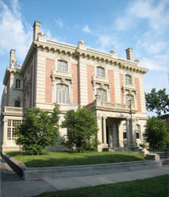
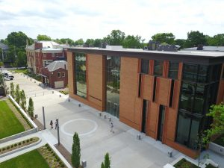
Speaker - Heather Potter Filson Historical Society
1310 S 3rd St.
Louisville, Kentucky 40208

